Slide 1
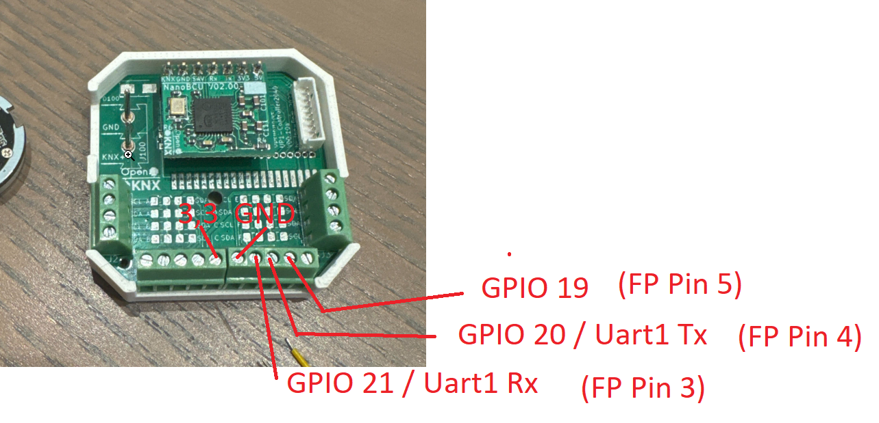
Binary 3
Binary 4
Touch left
Touch right
LED Red
LED Green
Binary 1
Binary 2

