Slide 1
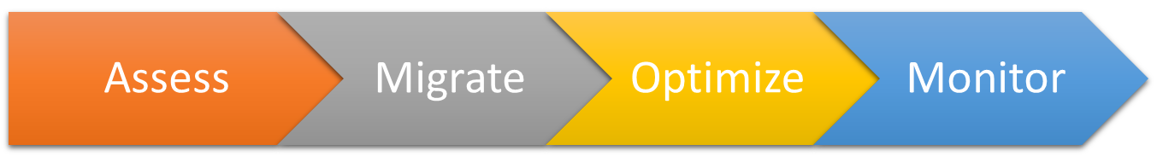



Assess
Optimize
Monitor
Migrate
Assess

Slide 2
schema
On-premises
databases
data

Slide 3



Target
Source
Recovery Services vault
vCenter
RDP
RDP
RDP
Mobility
RDP
Mobility
RDP
RDP
RPO
RPO
RDP
Mobility
RDP
Mobility
Azure Site
Recovery
Config (OVA)
Azure
VMWare on-premises

