Slide 1
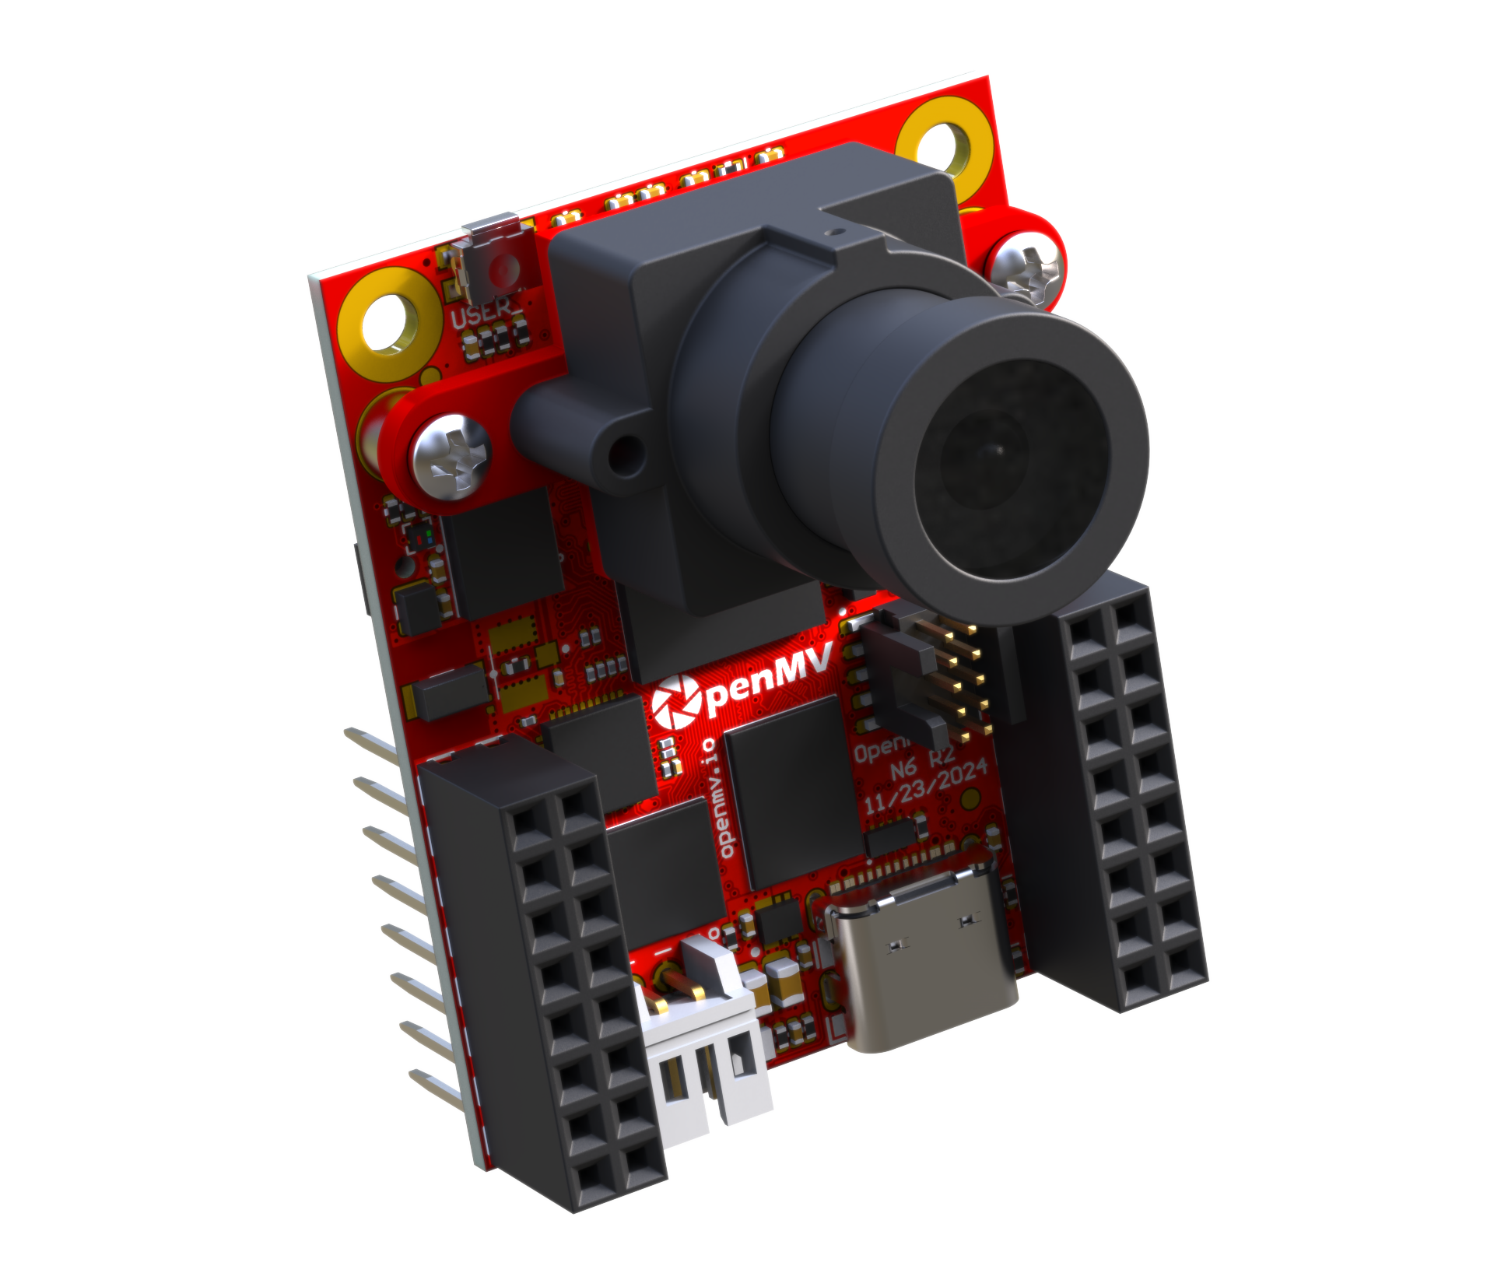




Say Hello to the
OpenMV-N6 Launching in 2025
Signup for More Info
MicroPython Powered Programmable Camera
☑ 800 MHz Cortex-M55 CPU (with ARM Helium Accelerated CV Library)
☑ 600 Gigaops NPU
☑ Runs YOLO at 30+ FPS
☑ 64MB of RAM @ 800MB/s with 32 MB of Flash @ 400 MB/s
☑ Onboard GPU with H.264/JPEG Video Recording
☑ 5MP 30 FPS HDR Camera
☑ or 1MP 120/240/480 FPS Color Global Shutter Camera
☑ or FLIR® Boson®/Lepton® Thermal Camera
☑ or Prophesee GENX320 Event Camera
☑ Gigabit Ethernet, 2.4 GHz WiFi, BLE v5.2, USB-HS
☑ Onboard Mic, IMU, and UHS-I uSD Card Slot
☑ 18 GPIOs with PWM, UART, I2C, I3C, SPI, CAN
☑ Hacking friendly exposed SWD/JTAG
☑ 3.7V Lipo Battery Charger
☑ <50uA Deepsleep Power Draw
☑ E.g. >4 Year Application Battery Life

