Slide 1

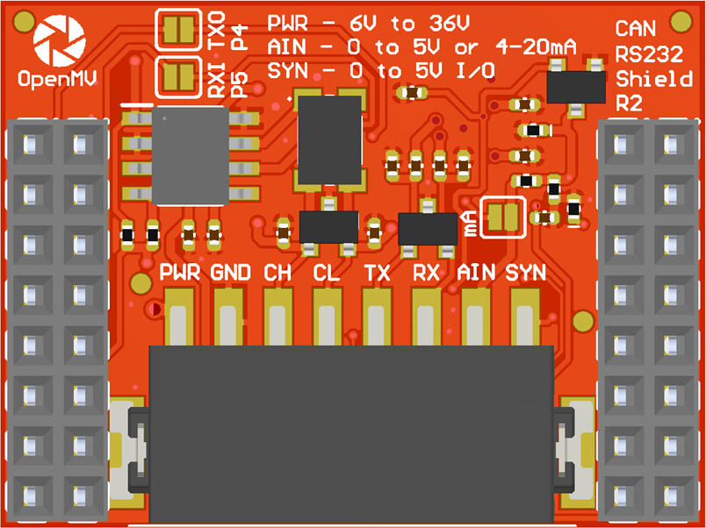
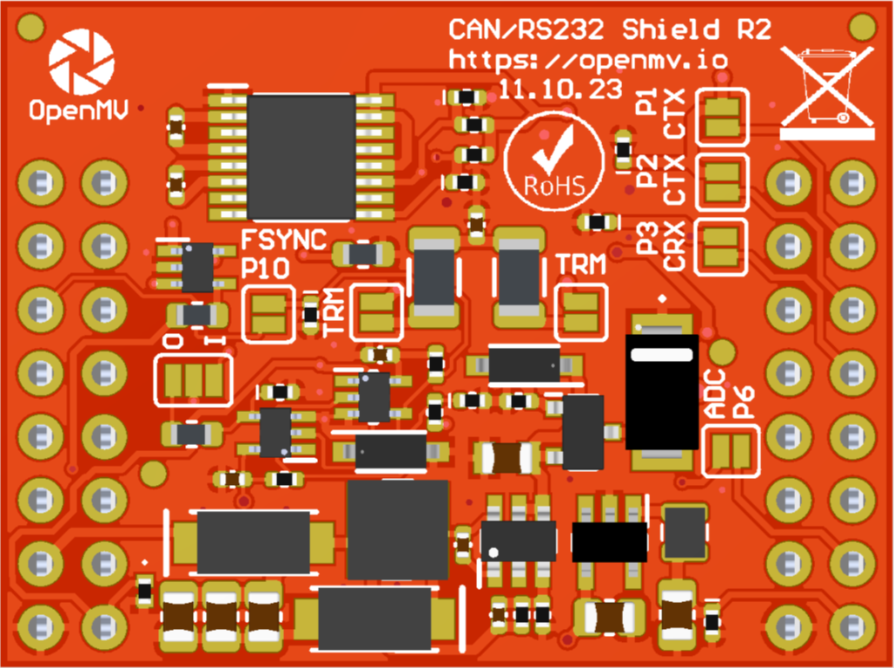
P4 & P5 Jumper
ADC 4-20 mA Mode Jumper
A gray box over a solder jumper is the default setting from the factory
CAN/RS232
Shield Pinout
Not Connected
Not Connected
P1 CAN TX (default)
Not Connected
P2 CAN TX (alternative)
P10 Input (default) or Output
P3 CAN RX
Not Connected
P4 TX -> RS232 TX Out
Not Connected
RS232 RX In -> P5 RX
Not Connected
AIN 0-5V -> P6 0-3.3V
VIN Out (5.4V @ 600mA)
3.3V Rail
GND Rail
3.3V Rail
GND Rail
P1 Jumper
CAN Termination Resistor
P2 Jumper
P3 Jumper
P10 Jumper
CAN Termination Resistor
P6 Jumper
P10 I/O Jumper

