Slide 1

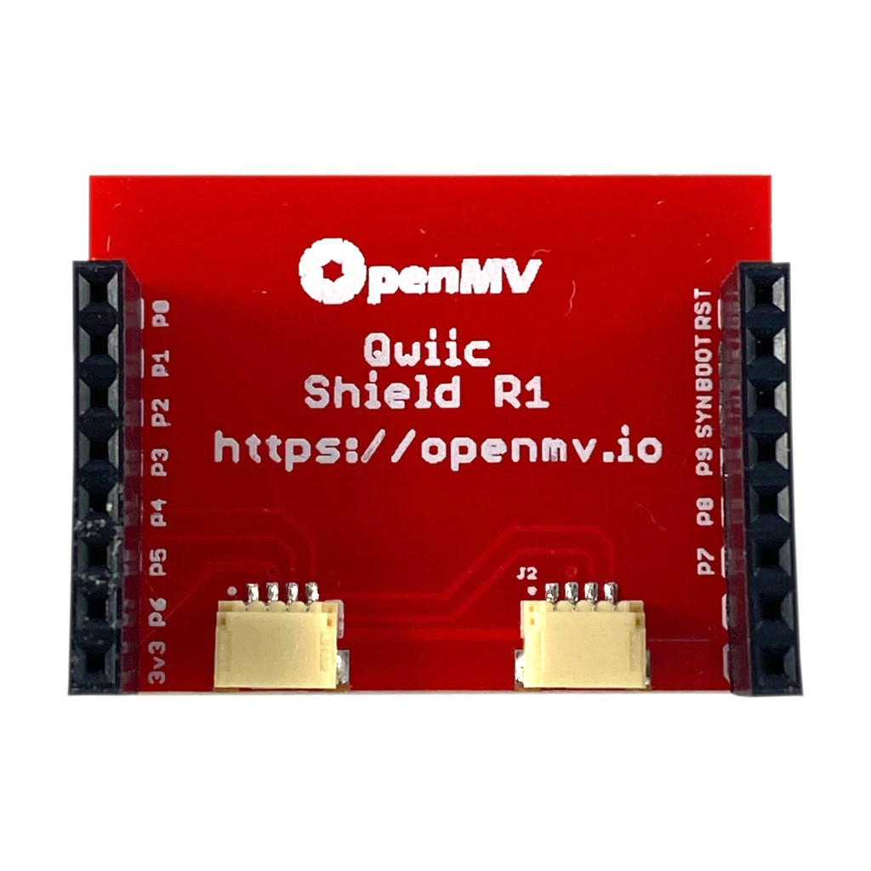
QWIIC Shield
Pinout
Not Connected
Not Connected
Not Connected
Not Connected
Not Connected
Not Connected
Not Connected
Not Connected
QWIIC SCL
Not Connected
QWIIC SDA
Not Connected
Not Connected
Not Connected
3.3V Rail
GND Rail

