Slide 1

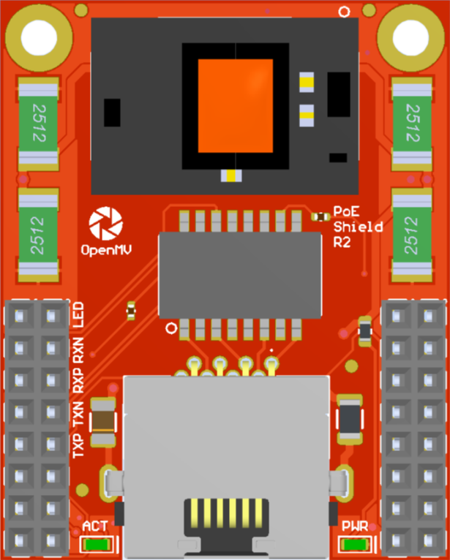
PoE Shield
Pinout
Not Connected
MDI LED
Not Connected
Not Connected
MDI RX N
Not Connected
Not Connected
MDI RX P
Not Connected
Not Connected
MDI TX N
Not Connected
Not Connected
MDI TX P
Not Connected
Not Connected
Not Connected
Not Connected
VIN Out (5.4V @ 1.2A)
3.3V Rail
GND Rail
3.3V Rail
GND Rail

