Slide 1
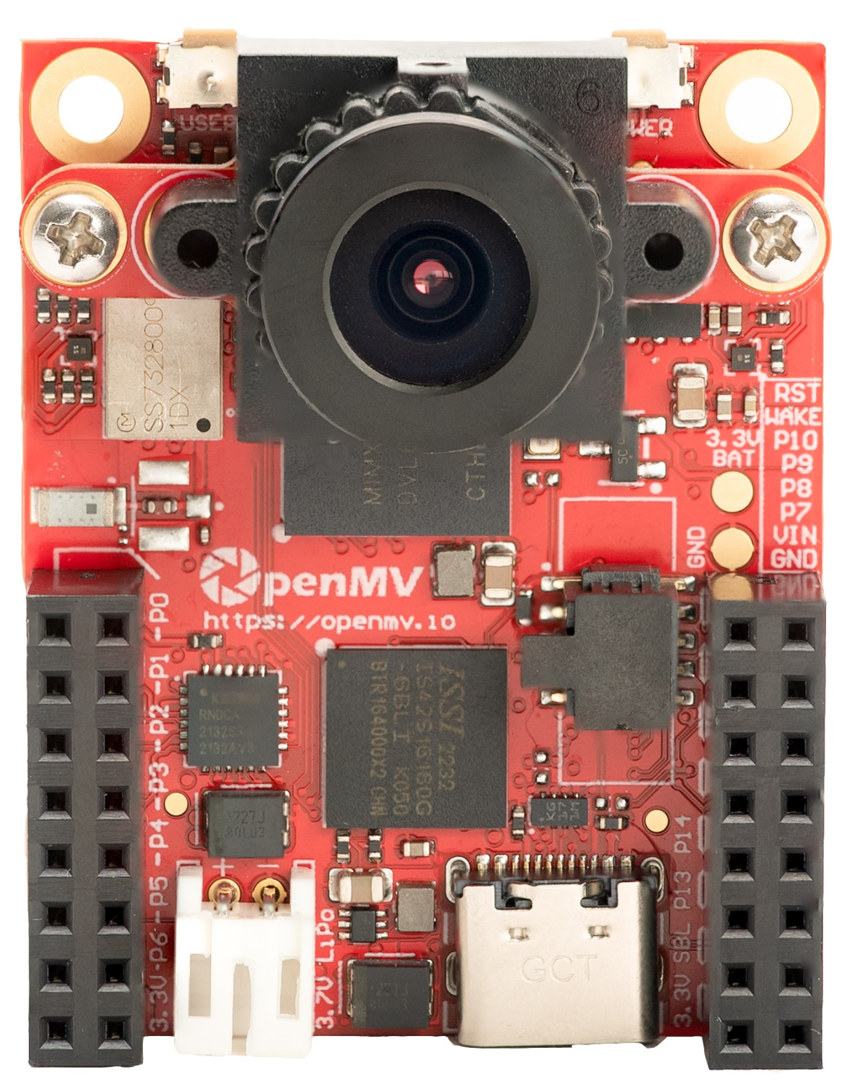

SW
All pins are 3.3V tolerant with a 3.3V output
All pins can sink or source up to 4 mA
OpenMV Cam RT1062
On/Off (or Power Button):
* Pull low for 5 seconds to turn off when on
* Pull low for 1 second to turn on when off
Wake:
* Pull low to wakeup in deepsleep (not off).
By: Ibrahim Abdelkader & Kwabena W. Agyeman
https://openmv.io
RAW provides always-on unregulated (3.6V-5V) power in on/off or deepsleep modes.
Micro SD Slot
SD < 2GB Max
SDHC < 32GB Max
SDXC < 2TB Max
Connect SBL to 3.3V to put the board into recovery mode to reflash the bootloader.
Machine Module Peripherals / Timers
Pin
Name
Pin
Name
Machine Module Peripherals / Timers
PWM2 B3
SPI 1
MOSI
P0
ETH LED
Reserved
Reset (Connect to GND to reset)
CAN 0 TX
SPI 1
MISO
P1
ETH RXN
Reserved
P11
Wakeup (Connect to ground to wakeup)
PWM2 B3
SPI 1
SCLK
P2
ETH RXP
Reserved
P10
Frame Sync Input/Output
PWM1 B3
CAN 0 RX
SPI 1
SS
P3
ETH TXN
Reserved
P9
PWM1 A3
PWM1 X2
I2C 1
SCL
UART 1
TX
P4
ETH TXP
P14
P8
PWM2 B0
PWM1 X3
I2C 1
SDA
UART 1
RX
P5
ON/OFF
P13
P7
PWM2 A0
ADC
P6
RAW
SBL
VIN (3.6V - 5V)
3.3V Rail (1A supply Max)
GND Rail
3.3V Rail
GND Rail

