Slide 1

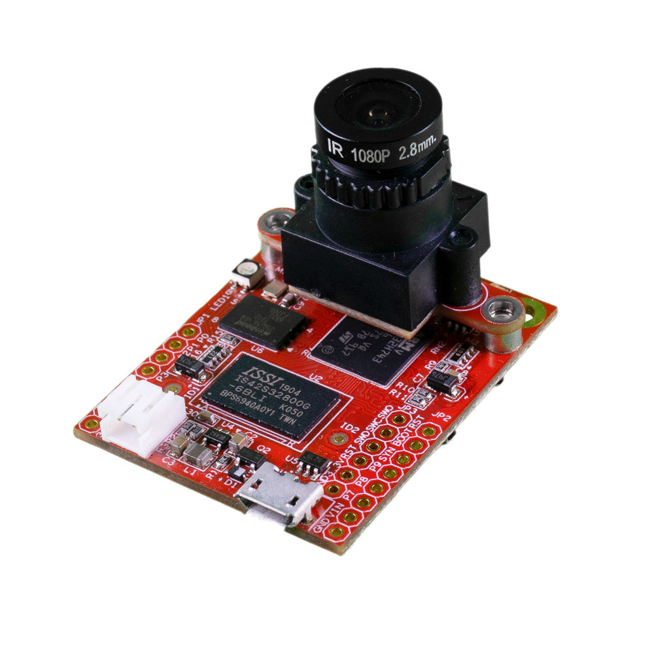
All on a microcontroller
MicroPython Powered AI Camera
FOMO CNN Face Detection
Haar Cascade Face Detection
AprilTag Tracking
QR Code Decoding
Motion Detection
And more!

