Slide 1

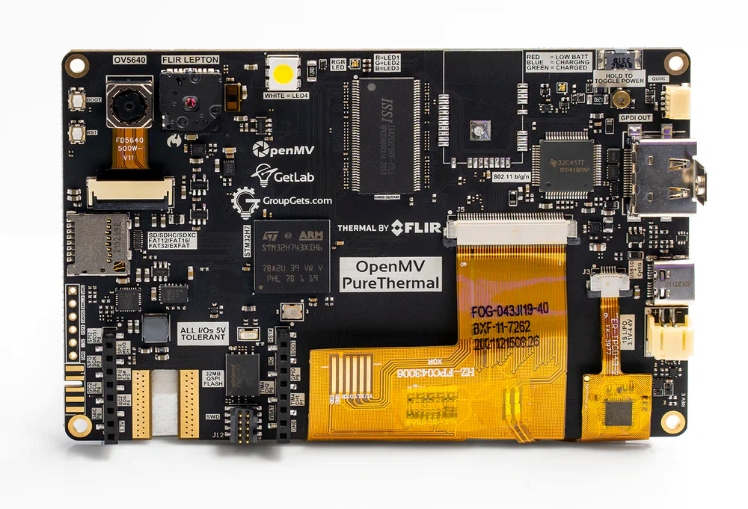
All on a microcontroller
MicroPython Powered Thermal Camera
Color Image & Thermal Image Capture
Bicubic Thermal Image Scaling
w/ Color Table Lookup
Alpha Blending onto Color Image
Hot Spot Blob Tracking
HDMI Display Output

