Slide 1

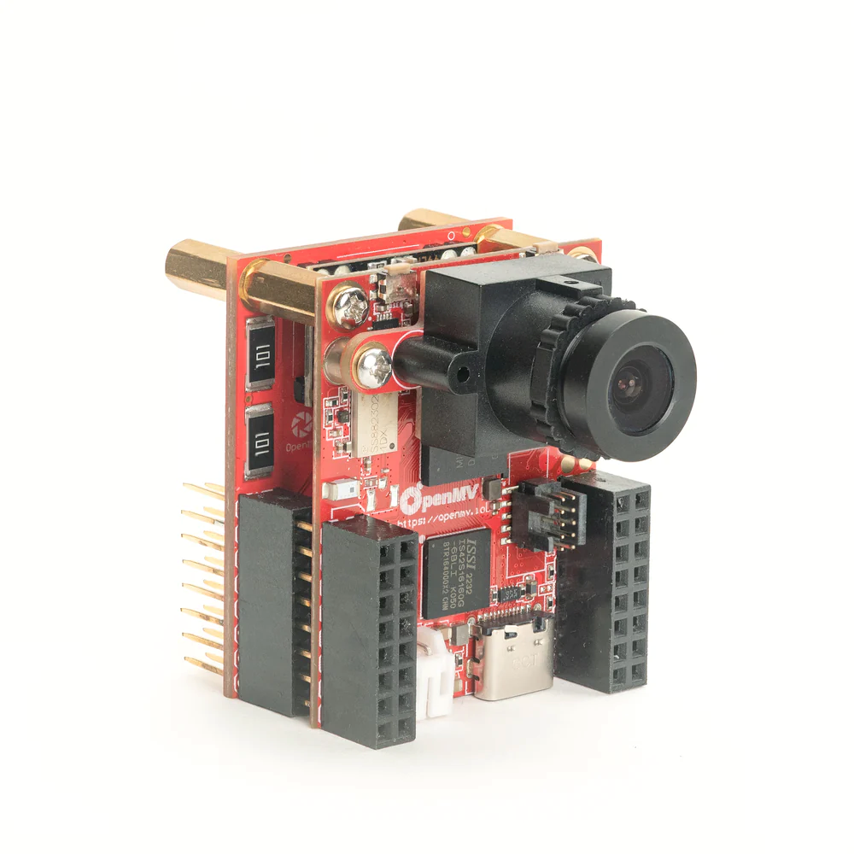
All on a microcontroller
MicroPython Powered IP Camera
Full HD 1920x1080 JPEG Image Capture
JPEG RTSP Streaming @ 1080p
via 10/100 Mb/s Ethernet
using DHCP or a Static IP
Works with FFPMEG, VLC, OpenCV, etc.

