Slide 1

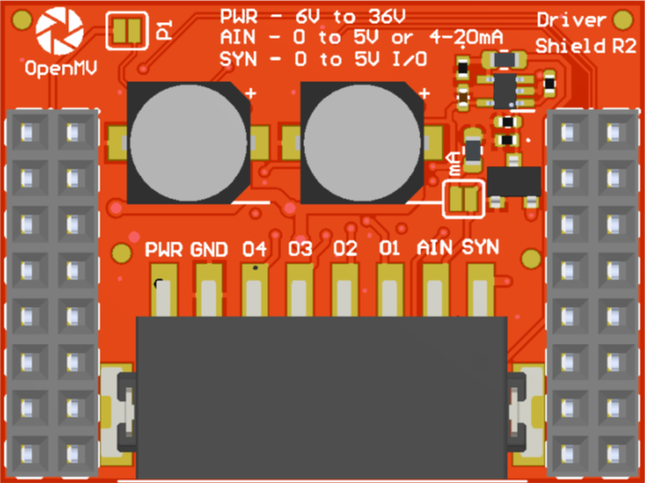
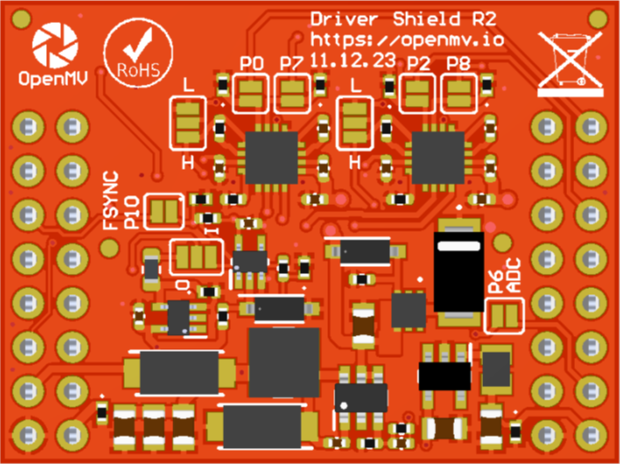
P1 Jumper
ADC 4-20 mA Mode Jumper
A gray box over a solder jumper is the default setting from the factory
CAN/RS232
Shield Pinout
P0 DIR (O1/O2) (default)
Not Connected
P1 DIR (O1/O2) (alternative)
Not Connected
Not Connected
P10 Input (default) or Output
P2 DIR (O3/O4)
Not Connected
Not Connected
P8 – PWM (O3/O4)
Not Connected
P7 – PWM (01/O2)
AIN 0-5V -> P6 0-3.3V
VIN Out (5.4V @ 600mA)
3.3V Rail
GND Rail
3.3V Rail
GND Rail
P0/P7 Jumper
P2/P8 Jumper
O1/O2 Mode Jumper
O1/O2 Mode Jumper
P10 Jumper
P10 I/O Jumper
Mode Jumpers:
Low – DIR/PWM Mode (default) High – H-Bridge Mode
Float (no connect) - Independent Mode
(e.g. P7->O1, P0->O2, P8->O3, P1/P2->O3)
P6 Jumper

