Slide 1

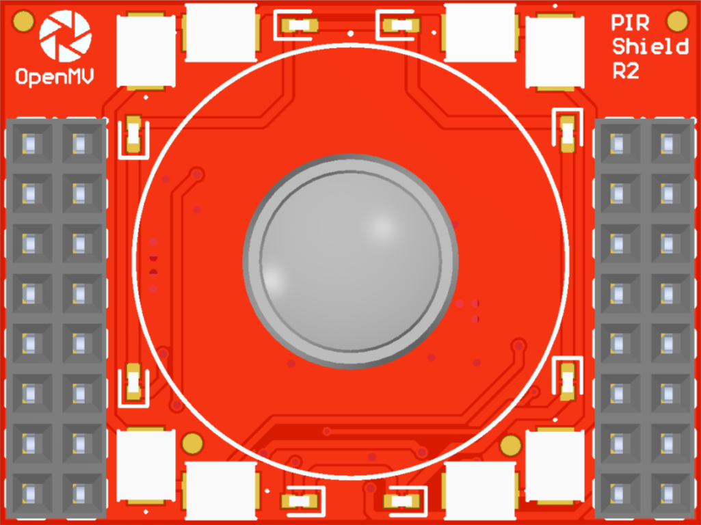
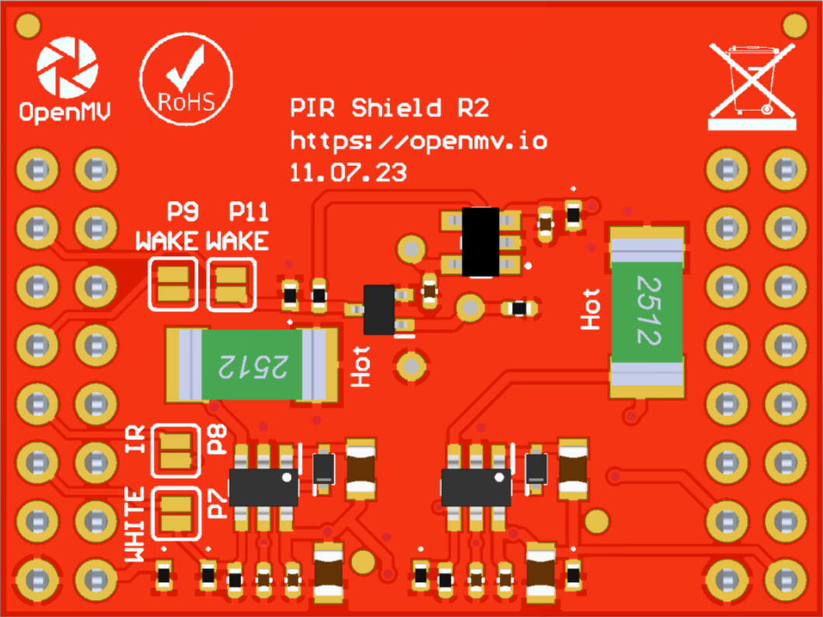
A gray box over a solder jumper is the default setting from the factory
CAN/RS232
Shield Pinout
Not Connected
Not Connected
Not Connected
P11 – Wakeup (default)
Not Connected
Not Connected
Not Connected
P9 – Wakeup (alternative)
Not Connected
P8 – PWM (IR LEDs)
Not Connected
P7 – PWM (White LEDs)
Not Connected
RAW Rail
Not Connected
3.3V Rail
GND Rail
3.3V Rail
GND Rail
P9 & P11 Jumper
P7 & P8 Jumper

