Slide 1

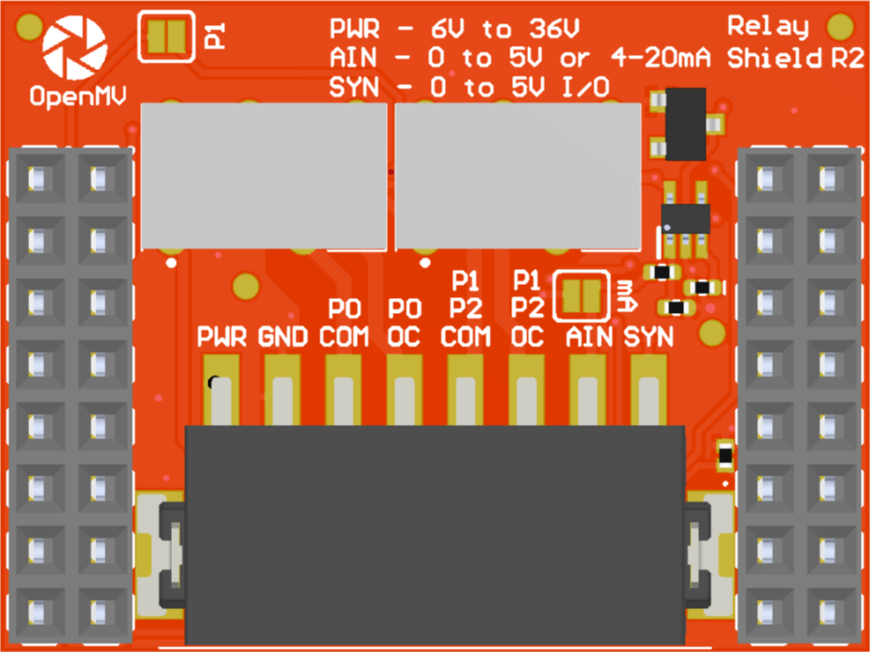
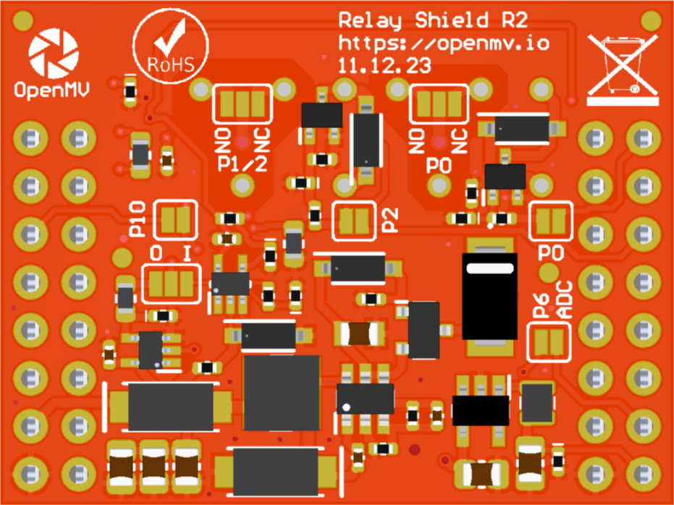
P1 Jumper
ADC 4-20 mA Mode Jumper
A gray box over a solder jumper is the default setting from the factory
Relay Shield
Pinout
P0 Relay
Not Connected
P1/P2 Relay (alternative)
Not Connected
P1/P2 Relay (default)
P10 Input (default) or Output
Not Connected
Not Connected
Not Connected
Not Connected
Not Connected
Not Connected
AIN 0-5V -> P6 0-3.3V
VIN Out (5.4V @ 600mA)
3.3V Rail
GND Rail
3.3V Rail
GND Rail
P1/P2 Relay NC/NO Jumper
P0 Relay NC/NO Jumper
P2 Jumper
P0 Jumper
P10 Jumper
P10 I/O Jumper
P6 Jumper

