Slide 1

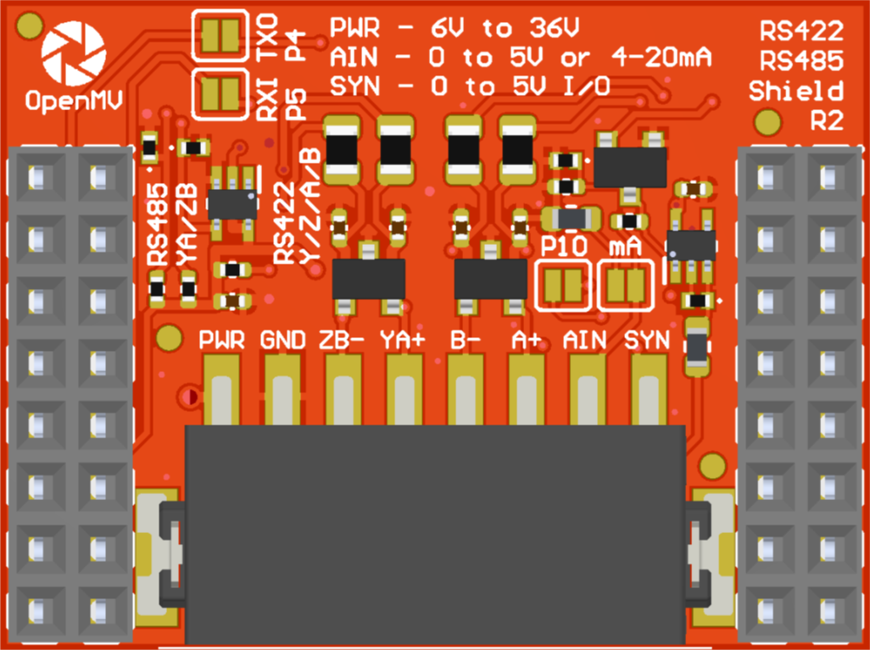
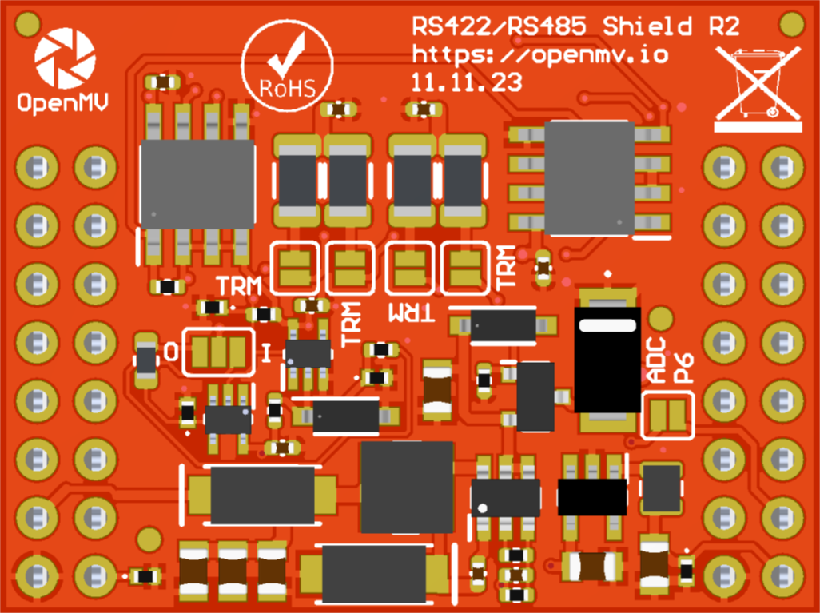
P4 & P5 Jumpers
ADC 4-20 mA Mode Jumper
A gray box over a solder jumper is the default setting from the factory
RS422/RS485
Shield Pinout
Not Connected
Not Connected
Not Connected
Not Connected
Not Connected
P10 Jumper
P10 Input (default) or Output
Not Connected
Not Connected
P4 TX -> RS422/RS485 TX Out
Not Connected
RS422/RS485 RX In -> P5 PX
Not Connected
AIN 0-5V -> P6 0-3.3V
VIN Out (5.4V @ 600mA)
3.3V Rail
GND Rail
3.3V Rail
GND Rail
RS422 A/B Terminators
RS422 Y/Z Terminators
or RS485 A/B Terminators
P10 I/O Jumper
P6 Jumper

