Slide 1

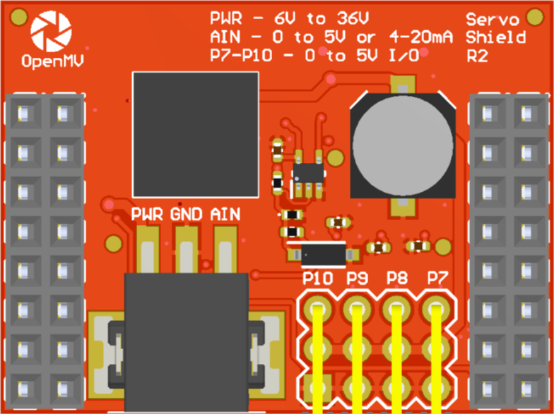
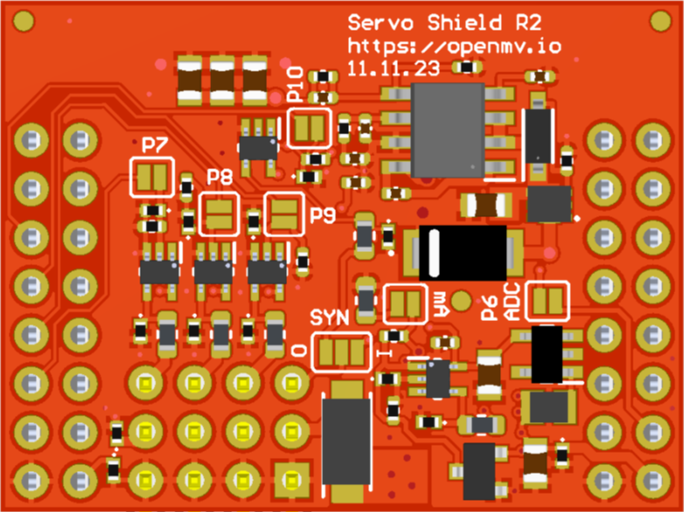
A gray box over a solder jumper is the default setting from the factory
Servo Shield
Pinout
Not Connected
Not Connected
Not Connected
Not Connected
Not Connected
P10 Input (default) or Output
Not Connected
P9 – Servo PWM
Not Connected
P8 – Servo PWM
Not Connected
P7 – Servo PWM
AIN 0-5V -> P6 0-3.3V
VIN Out (5.4V @ 5A)
3.3V Rail
GND Rail
3.3V Rail
GND Rail
P10 Jumper
P7/P8/P9 Jumpers
ADC 4-20 mA Mode Jumper
P6 Jumper
P10 I/O Jumper

