Slide 1




COCO-DR: Combating Distribution Shifts in Zero-Shot Dense Retrieval with Contrastive and Distributionally Robust Learning
Yue Yu¹, Chenyan Xiong², Si Sun³, Chao Zhang¹, Arnold Overwijk²
¹Georgia Institute of Technology ²Microsoft Research & AI
³Tsinghua University
Contact: yueyu@gatech.edu
Notes:
Hello everyone, this is Yue Yu from Georgia Tech. Today I am going to present our work “COCO-DR: Combating Distribution Shifts in Zero-Shot Dense Retrieval with Contrastive and Distributionally Robust Learning”. This work is collaborated between Georgia Tech, Microsoft Research and Tsinghua University.

Slide 2
Dense Retrieval
Definition: Performing Retrieval by first encoding query and documents in a dense continuous embedding space and then conducting relevant match by nearest neighbor search
In contrast to classic retrieval which acts in the sparse representation space (e.g., bag-of-words)
Dense Representations
Nearest Neighbor Search
Vector Match
Encoder
Encoder
Query
Document
Notes:
First, let me give a brief introduction of Dense Retrieval. Different than sparse retrieval method such as Bm25 that represents query and documents in high dimensional, sparse vectors, dense retrieval learn dense representations for both queries and documents. After that, approximate nearest neighbor search is applied in the embedding space for retrieval.

Slide 3
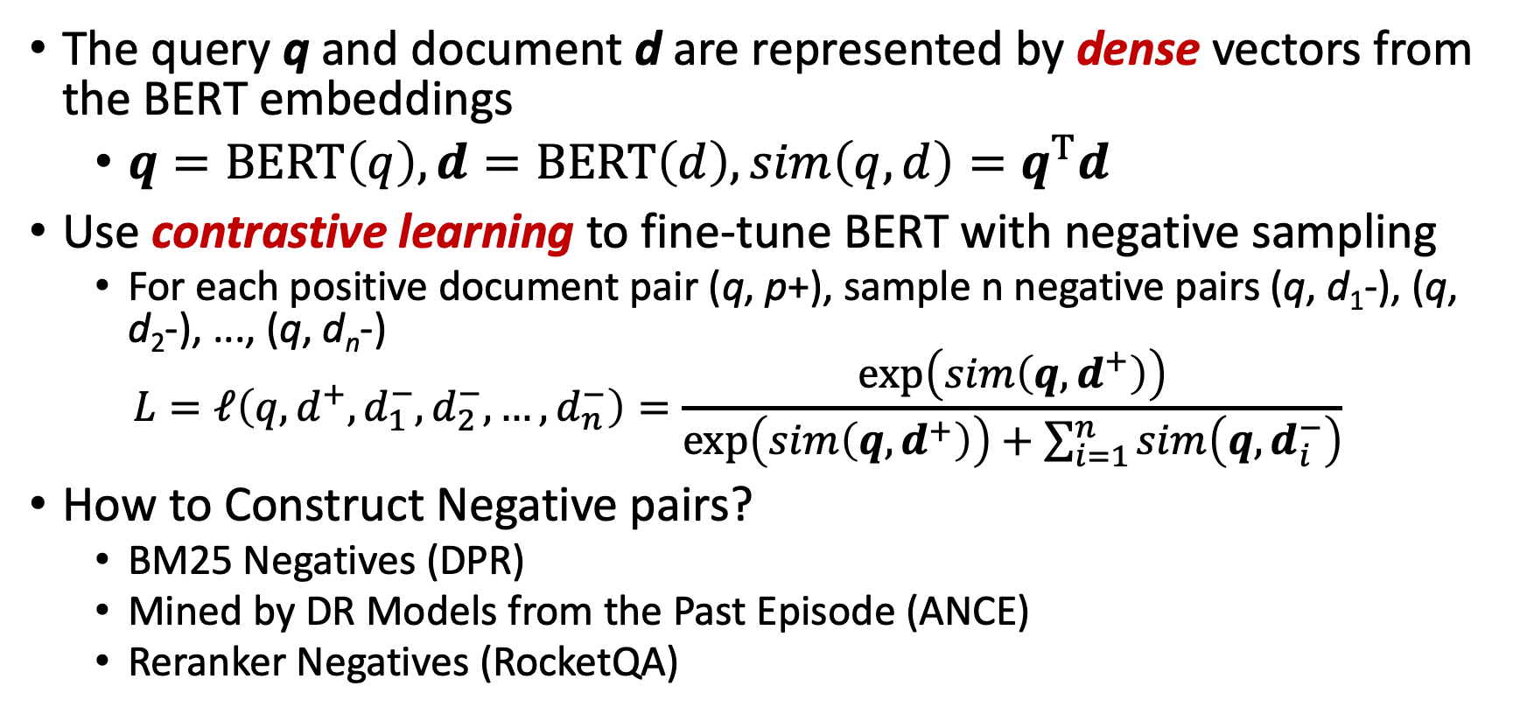
Dense Retrieval Training
The query q and document d are represented by dense vectors from the BERT embeddings
$q=BERT\left(q\right), d=BERT\left(d\right),sim\left(q,d\right)=q^{T}d$
Use contrastive learning to fine-tune BERT with negative sampling
For each positive document pair (q, p+), sample n negative pairs (q, d₁-), (q, d₂-), ..., (q, d_{n}-)
$$L=ℓ\left(q,d^{+},d_{1}^{−},d_{2}^{−},…,d_{n}^{−}\right)=\frac{\exp\left(sim\left(q,d^{+}\right)\right)}{\exp\left(sim\left(q,d^{+}\right)\right)+\sum_{i=1}^{n}{sim\left(q, d_{i}^{−}\right)}}$$
How to Construct Negative pairs?
BM25 Negatives (DPR)
Mined by DR Models from the Past Episode (ANCE)
Reranker Negatives (RocketQA)
Notes:
Specifically, we train the DR model with contrastive learning in order to maximize the similarity over given query-document pairs and minimize the similarity between the query and negative docuemnts.
The negatives documents are constructed either using sparse retrieval or using the hard negative mined from model checkpoint of past episode

Slide 4
Dense Retrieval v.s. Sparse Retrieval
DR Models outperforms Sparse Models on in-domain tasks (MS Marco, TREC DL)
DR Models still underperforms Sparse Models for out-of-domain (OOD) tasks (Train on MS Marco, Evaluated on BioASQ, SCIDOCS)
Left: In-domain Evaluation
Right: Out-of-domain Evaluation
Notes:
Although Dense Retrieval models achieve significant performance gains when compared with sparse retrieval models on in-domain modeling tasks (as shown in the left two barplots), the zero-shot generalization ability of such models are still not satisfactory.
Here we show the zero-shot performance of DR model on two datasets in the right two barplot, where the model is first Train on MS Marco, the directly Evaluated on them.
From the result, we find that there still exist non-negligible gap between DR model and sparse models.

Slide 5
What Causes the Performance Degradation?
Distribution Shifts Matters
DR Models trained from the source domain (e.g. MS Marco) cannot generalize to target domains (e.g. BioMedical) well
How to measure distribution shifts?
Query Side (Intent Shift): Similarity of topic distributions. Split the queries into different topics (9 types)
Document Side (Lexical Shift): Similarity of unigram word distributions
Notes:
From the experiments, we find that when the source domain and target domain are different, the performance of DR models will drop rapidly.
To further quantify the correlation between the distribution shift and performance degradation, we use the intent and lexical shift for queries and documents respectively, and measure the similarity between the source domain and target domains on BEIR tasks.

Slide 6
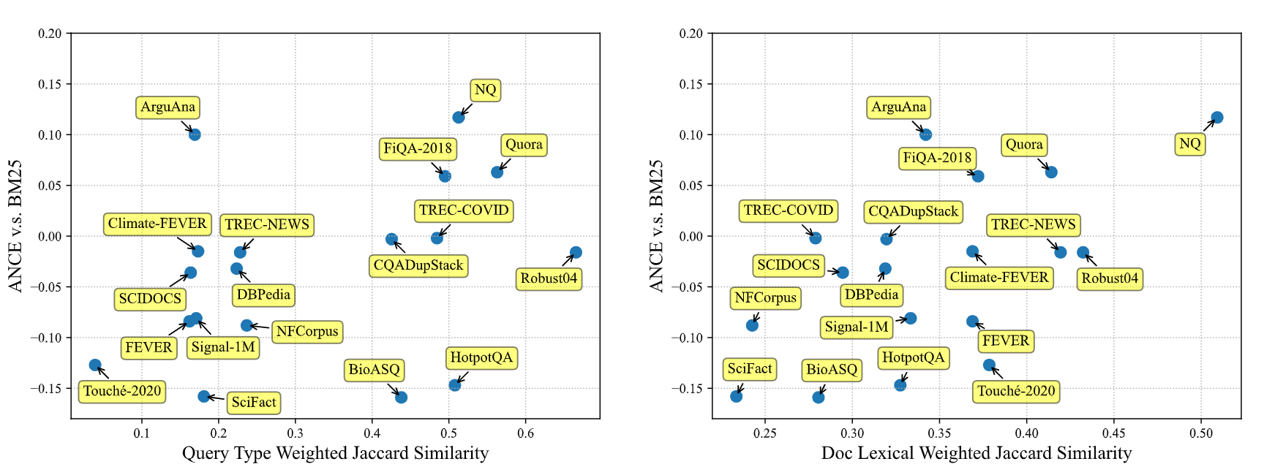
Distribution Shifts for Queries & Documents
The distribution shifts exist for both queries and documents.
Such distribution shifts are correlated to the performance drop of DR models (0.33 for Query, 0.59 for Document in terms of Pearson Corr.)
Notes:
Here, X-axis is the similarity, and y-axis is the performance gap between ANCE (one representative DR model) and BM25.
From the results, we have the following findings:
First, we observe that the distribution shifts exist for both query and document, as more than half of the datasets in BEIR are dissimilar with the source domain (MSMARCO) with similarity less than 0.4.
Second, the distribution shifts are aligned with the performance degradation, as there exists a positive correlation between the distribution shifts and the performance degradation.

Slide 7
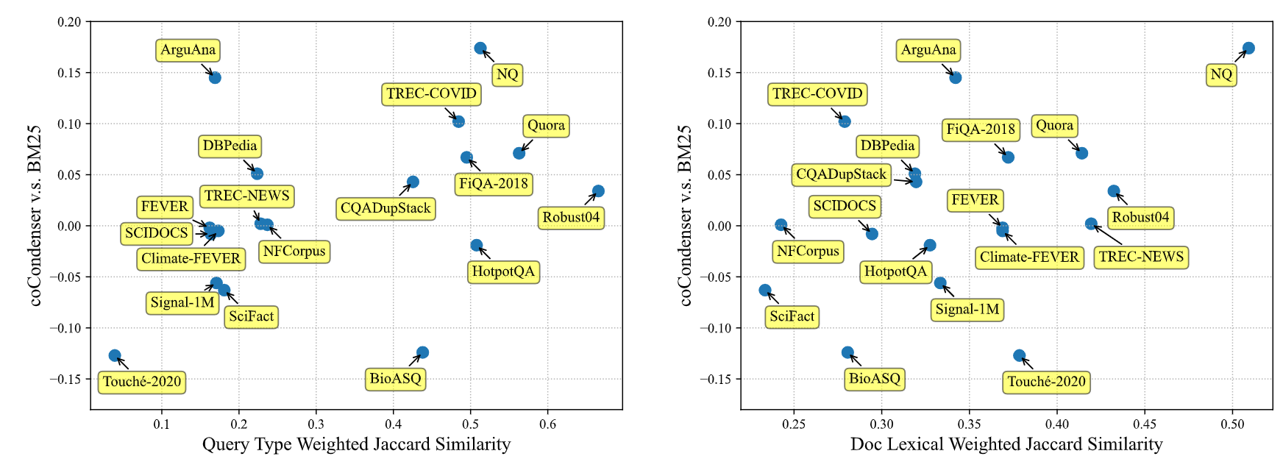
Does Retrieval-Oriented Pretraining Helps?
Test the performance on coCondenser, a DR model pretrained on MS MARCO with superior in-domain performance.
The performance degradation still exists when distribution shifts are severe.
Notes:
One may ask whether more advanced DR models will be helpful to eliminate such an issue. Here we plot the performance of coCondenser, an improved DR model with retrieval-oriented pretraining on MS MARCO tasks.
From the figure, we observe that coCOndenser still cannot outperform BM25 when the distrbutions shifts are severe (e.g. on SciFact and BioASQ)

Slide 8
Model Design Overview
Setting
MS MARCO as the source and BEIR tasks as the target
BEIR corpora available at training time
Tackle the distribution shifts problem from both query and document sides
For documents: Continuous Contrastive pretraining (COCO) on target corpus to adapt the model to target domains
For queries: No available queries available. Use implicitly distributionally robust optimization (iDRO) to improve model performance on rare queries.
Notes:
Based on the previous observations, we aim to tackle the distribution shifts issue from both query and document sides.
Specifically, for documents, we aim to leverage the BEIR corpora and design continuous contrastive pretraining to adapt the DR model to the target domains
for queries, since no queries from the target domains are available. We Use implicitly distributionally robust optimization to improve model robustness over rare queries.
We will introduce these two methods in detail in the following slides

Slide 9
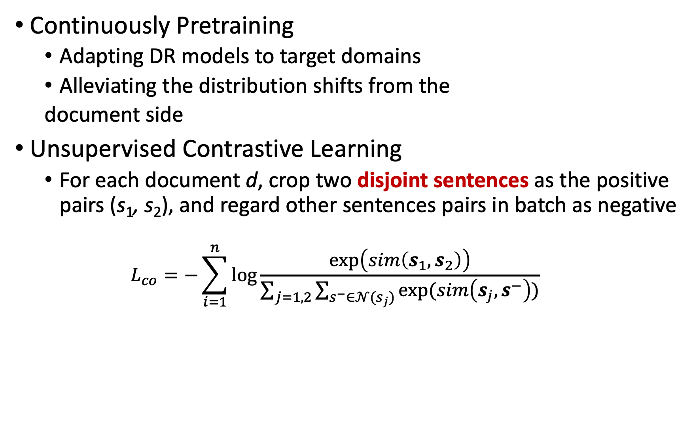
Continuous Contrastive Pretraining (COCO)
Continuously Pretraining
Adapting DR models to target domains
Alleviating the distribution shifts from the
document side
Unsupervised Contrastive Learning
For each document d, crop two disjoint sentences as the positive pairs (s₁, s₂), and regard other sentences pairs in batch as negative
$$L_{co}=−\sum_{i=1}^{n}{\log{\frac{\exp\left(sim\left(s_{1},s_{2}\right)\right)}{\sum_{j=1,2}{\sum_{s^{−}∈𝒩(s_{j})}{exp⁡(sim\left(s_{j},s^{−}\right))}}}}}$$
Source
Domain
Target
Domain
Notes:
To adapt the pretrained model to the target domain to handle document distribution shifts, we continuously pretrain the language model on the BEIR corpora, using the contrastive learning objective.
Specifically, for each document d in target corpora, we randomly extract two disjoint sequences s1 and s2 from d to form the positive pairs, and regard other in-batch sequence pairs as negative.
This simple design enables us to capture the information from the target task, and reduce the impact of document distribution shifts.
,

Slide 10
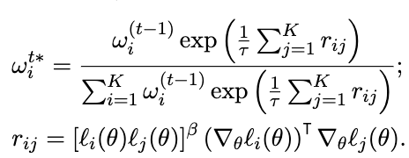

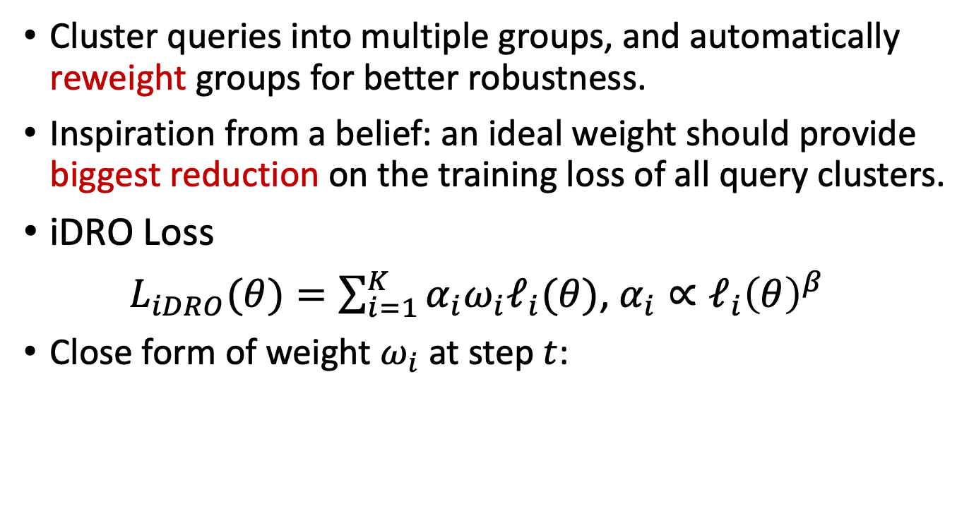





Implicit Distributionally Robust Optimization (iDRO)
Cluster queries into multiple groups, and automatically reweight groups for better robustness.
Inspiration from a belief: an ideal weight should provide biggest reduction on the training loss of all query clusters.
iDRO Loss
$L_{iDRO}(θ)=\sum_{i=1}^{K}{α_{i}ω_{i}ℓ_{i}(θ)}$, $α_{i}∝ℓ_{i}{\left(θ\right)}^{β}$
Close form of weight $ω_{i}$ at step $t$:
$$θ$$
$$g_{1}$$
$$g_{4}$$
$$g_{2}$$
$$g_{3}$$
Notes:
When it comes to the query, we face a taller challenge as we need to improve model generalization ability over unseen target queries solely using training signals from the source.
To tackle this, we bring in a key assumption, that a model trained to be more robust on the source domain is likely to generalize to target domains.
TO this end, as explicit target domain/group information is unavailable, We first adopt K-Means on query Embeddings to cluster training data into different groups.
Then, we perform implicit DRO (iDRO) to improve models’robustness over source query clusters.
The overall loss can be written as the weighted sum of different group’s loss, where alpha is designed to assign higher weight to groups with higher loss. To calculate the optimal weight omega, an ideal choice of omega would provide biggest reduction on the training loss of all query clusters.
Based on this belief, we approximate the loss reduction using first order Taylor expansion to obtain the closed form solution of omega shown in the slides. Intuitively, the optimal solution considers the gradient and loss similarity between different groups, to improve the model robustness across all clusters.

Slide 11
Experiments
Evaluate on BEIR benchmark
18 tasks from multiple domains: biomedical, news, question answering, etc.
Training Procedure
Multi-stage Training: first pretrain on BEIR+MS MARCO corpora, then finetune on MS MARCO labeled data.
Consider both BERT-base and BERT-large as the backbone
Baselines
Standard Baselines: BM25, DPR (EMNLP’20), ANCE (ICLR’21), Contriever (TMLR’22), GTR (EMNLP’22, concurrent), CPT-text (arXiv’22, concurrent)
Domain-adaptive DR baselines: GenQ (EACL’21), MoDIR (ACL Findings’22), GPL (NAACL’22), etc.
Notes:
We evaluate our model on BEIR, the standard zero-shot retrieval benchmark with 18 tasks from multiple domains.
In the training step, we employ a multi-stage process, where we first pretrain on BEIR+MS MARCO corpora, then finetune on MS MARCO labeled pairs. We consider both BERT-base and BERT-large as the backbone, and the corresponding model is named as COCO-DR base and COCO-DR large.
For the baselines, we consider various approaches including both sparse retrieval (BM25) and dense retrieval methods. Note that many baselines are published very recently, and we believe the seletcted baselines are comprehensive enough.

Slide 12
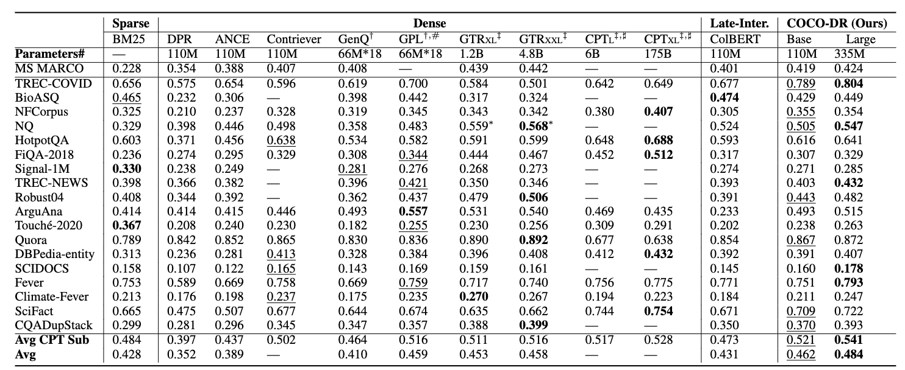
Main Results
COCO-DR Base outperforms DR models (GTR-XXL) which has 50x parameters
COCO-DR Large outperforms all the baselines including GPT-3 embedding model
Notes:
This table shows the result of COCO-DR compared with those strong baselines.
When we look at the COCO-DR base, we find that it outperform other DR models with much more parameters (e.g. GTR-XXL which use T5-XXL as the backbone with 50x more parameters)
For COCO-DR Large, at bert-large scale, it even outperforms GPT-3 embedding model which has 500x more parameters

Slide 13
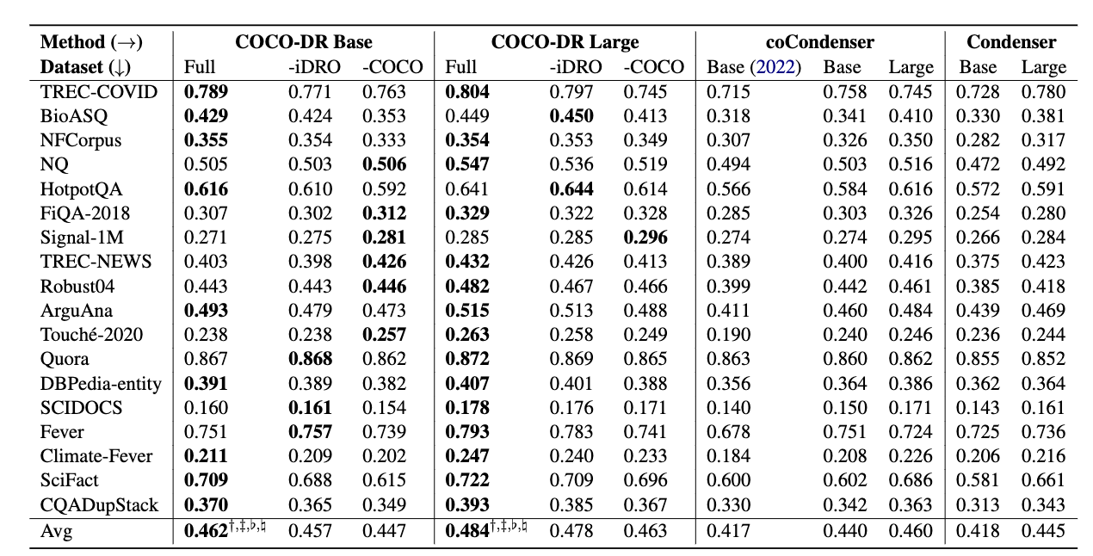
Ablation Studies on COCO-DR
Ablation studies for both COCO-DR base and Large
COCO and iDRO lead to 3.8% and 1.2% of the performance gain
Notes:
We further conduct ablation studies to show the effect of two components, namely COCO and iDRO.
Both two components are useful, as they improve on the majority of datasets for both backbones.
On average, these two components leads to 3.8% and 1.2% % of the performance gain

Slide 14
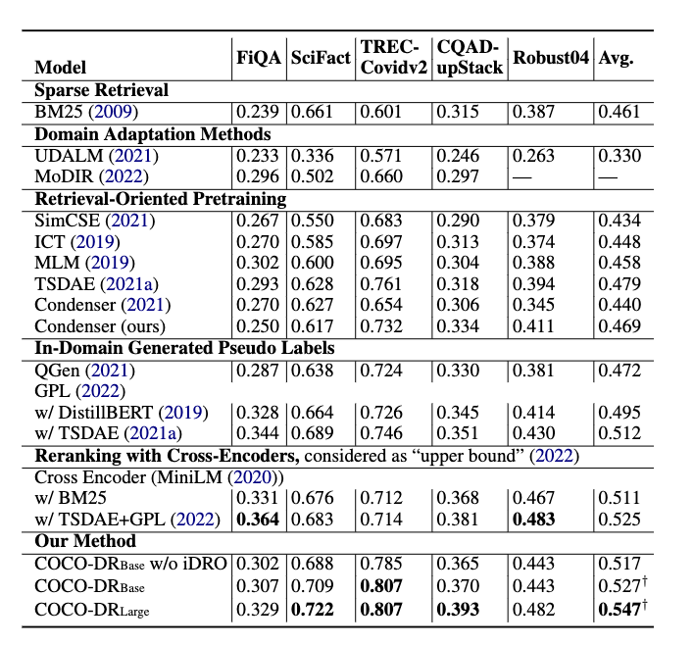
Ablation Studies on COCO
Comparison with other domain adaptation methods
GPL uses seq2seq model for query generation, reranking model for filtering and train one model per task
COCO-DR only use simple contrastive pretraining without any other external tools
However, COCO-DR achieves 2.9% gain over GPL, and even outperform GPL stacked with reranking models
Notes:
Now we take a closer look at these two key designs.
First we aim to justify the effectiveness of COCO by comparing it with the previous domain adaptation approaches. The previous SOTA method, GPL, rely on several components including seq2seq model for query generation, reranking model for filtering and it trains one model per task, making it less efficient.
Instead, coco-dr only use contrastive pretraining without any other external tools, and use one unified embedding model for all tasks. Despite its simple design, COCO-DR achieves 2.9% gain over GPL,and even outperform GPL stacked with reranking models.
Besides, previous contrastive learning methods such as SimCSE cannot outperform BM25. We remark that these methods developed for sentence similarity benchmarks do not perform well on DR as the two tasks are quite different, both in formats (query-document versus sentence pairs) and matching signals (relevance versus other language properties).

Slide 15
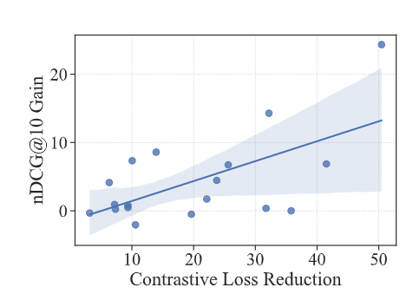
Ablation Studies on COCO
The connection between contrastive pretraining and fine-tuning loss
Plot the relation among the reduction of contrastive loss and the gain on 18 BEIR tasks
Clear positive correlations --- contrastive pretraining provides attributable gain on final zero-shot performance
On BioASQ dataset, COCO reduces 50% of the contrastive loss, and lead to 22% of the gain in nDCG@10
Notes:
We further plot the reduction of the contrastive learning loss after using COCO pretraining, as well as the corresponding zero-shot improvements for each BEIR task. There is a notable correlation between them. On BioASQ, COCO reduces contrastive loss by 50% which yields 22% gains in zero-shot peformamnce.

Slide 16
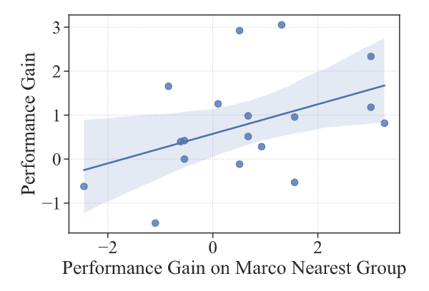
Ablation Studies on iDRO
The connection between iDRO finetuning on MS MARCO and the gain on BEIR
Plot the gain of iDRO for each BEIR task and the gain on its closest queries on MS MARCO
iDRO improves the training loss on most of the clusters close to BEIR
The gain on MS MARCO groups can propagate to BEIR
Notes:
Recall that the assumption of iDRO is that it can improve the model robustness on rare query clusters in source, which helps generalize to unseen target.
To verify this assumption, we find MARCO query clusters closest to queries in each BEIR task. Then we plot the improvements of iDRO as well as the reduction of training loss on their closest source clusters for each beir task in the right figure.
From this figure, we observe that iDRO improved the training loss on the majority (12 out of 18) of source query clusters closest to BEIR.
Moreover, such improvements can be successfully propagated to the BEIR tasks, as there exists a clear positive correlations among the performance gain on the source nearest groups and the corresponding target tasks.

Slide 17
Conclusion
We propose COCO-DR to combat the distribution shifts for Zero-shot dense retrieval with two training strategies
Continuous contrastive pretraining (COCO) to help language models capture the sequence representations of target corpora in pretraining
Implicit distributionally robust learning (iDRO) improves model robustness over rare query clusters in fine-tuning
COCO-DR achieves strong performance in BEIR benchmark with a one light-weighted, unified model
Future works
Design better pretraining objective other than COCO
Integrate COCO-DR with other language models as backbone

Slide 18
Reproducibility
Code: https://github.com/OpenMatch/COCO-DR
Model Checkpoints on HuggingFace:
Some additional checkpoints are also available
Check the GitHub repository for details
Model Name | Link
COCO-DR Base | OpenMatch/cocodr-base
COCO-DR Base fine-tuned on MS MARCO | OpenMatch/cocodr-base-msmarco
COCO-DR Large | OpenMatch/cocodr-large
COCO-DR Large fine-tuned on MS MARCO | OpenMatch/cocodr-large-msmarco
Notes:
To ensure Reproducibility, our code and model checkpoints have been released.

