Slide 1

How to achieve user-friendly interactivity in Mathematics Exercises on the web
Giovannina Albano¹, Bernardo D’Auria^{1,2},
Aldo Pagano², Sandro Viglione²
¹DIIMA – University of Salerno
²CRMPA c/o University of Salerno
Notes:
I work for CRMPA Centre for Research in Pure and Applied Mathematics in University of Salerno
In this presentation we want to show some problems that can arise in developing Mathematics Exercises on the web and how we have tried to face them.

Slide 2
Summary
Math and E-Learning
Web Mathematic Exercise
Our experience “MoMAM@th”
Limitations
To Overcome the problems
  Our Solution
  Ideal Solution
Notes:
Math and E-Learning is a brief introduction to the rapport that exists among Mathematics and E-Learning
In the second topic I will present our idea of Web Mathematic Exercise.
Momam@th is our web application that lets the user solve on-line exercises about basic mathematics. We will see how it works and also some limitations of it.
Then we will see how to overcome the limitations. We have developed our solution using javascript and WebEq applet plug-ins, but we have also thought about which the ideal solution could be

Slide 3
Math and E-Learning
Computer Algebra System supports the didactical approach based on descriptive, intuitive and experimental aspects.
WWW and the e-learning explosion impose to transport the new contents and didactical approach on the net.
Notes:
Since the first time they have been introduced, Mathematica and all similar systems of
C.A. (Computer Algebra) ,have been useful to change both the way people looked
and thought about didactics in mathematics. Students are no longer passive watchers
of a process which used to be distant and unrelated to them.
The students are at the center of the learning process and they learn through a new didactical approach based on descriptive, intuitive and experimental aspects.
This means more and more interactive didactic content and more and more user friendly software application, so the student can focus only on the contents and not on the understanding as to how to interact with the software application.
WWW and the e-learning explosion imposes to transport the new contents and didactical approach on the net.
The step isn’t simple. To enable anyone to access the learning contents from any place, it is necessary to follow the net standards http, html xml etc. Moreover with the actual software technology it is complicated to implement interactive and user friendly web application.

Slide 4

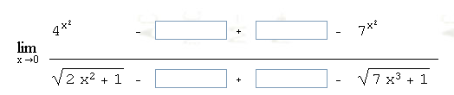
Web Mathematics Exercise
It should:
present a user friendly interface
follow the student in the learning process by being decomposed in incremental steps
allow the learner to complete the mathematic expression easily
Exercise
Step 1: Add and Subtract values to obtain the fundamental limits
Notes:
Building a web mathematic exercise that enables the previous didactic approach, does not mean to implement simple right or wrong answers, but a more complex application that follows the student in the learning process by being decomposed in incremental steps.
Our experience in e-learning application suggests that in order to produce good quality e-learning mathematics exercises it is important to provide user-friendly tools to the student. The user has to pay attention to the content rather than the way s/he has to write mathematical expressions.

Slide 5
MoMAM@th
MoMAMath is an on-line interactive software for mathematics learning.
At the moment it is in Italian and it is accessible through the following web site www.momanet.it/momamath.
Notes:
We have developed a web application, MoMAM@th, that lets the users solve on-line exercises about basic mathematics.

Slide 6
MoMAM@th
General Characteristics
Access through a common web browser
Personal accounting by login and password
User-friendly interface
Menu for the selection of the topics
Memory of the state of the exercise when the user logs out
Notes:
– Personal accounting by login and password: each user accesses a personal working space by login and password and then s/he can choose topics, type of exercise, theory and so on
– Menu for the selection of the topics: a menu is available for selecting topics and various types of exercises.
– Memory of the state of the exercise when the user logs out: when a user logs out because s/he wants to interrupt his/her exercise session, the system memorizes the state of the exercise so that, when the same user logs in again, s/he finds the exercise in the exact point in which s/he left it.

Slide 7
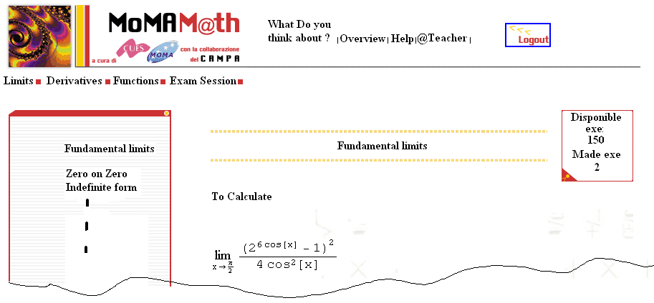
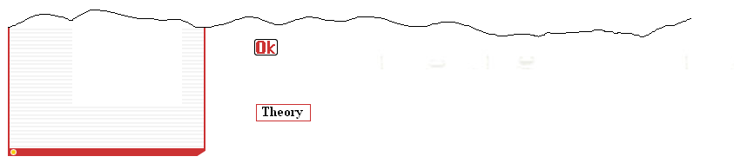
MoMAM@th
Notes:
This is the html page that the student sees after login
We can see the topics Limits…, and The Exam Session that we will see better in the next slides
For each topic there are some types of exercises
When the learner selects a type of exercise a new exercise is randomly generated.
Momam@th does not have a database containing exercises and solutions,
but they are randomly generated on the fly by the software any time that
a student requires one.
At the top of the interface there are four links.
The first one allows the learner to send an e-mail with her/his comments about Momam@th
The second one is a link to a Momamath overview document
Help opens the help on-line.
The teacher link allows the learner-teacher asynchronous interaction
By the theory button students have the possibility to consult theory pages related to the current exercise step.

Slide 8
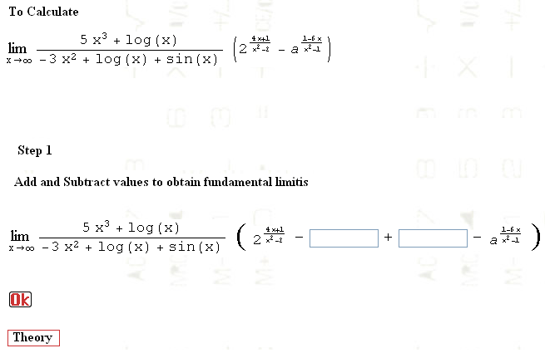
MoMAM@th
Didactic Strategy
Notes:
We have chosen the divide and conquer strategy, splitting each exercise into
one or more elementary steps; in other words the student is guided to the solution facing
easier sub-problems. At each step the students have to give an answer to the current sub-problem.

Slide 9
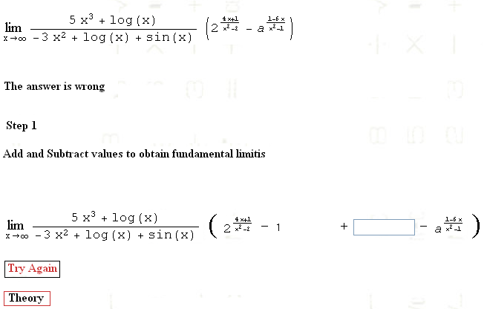
MoMAM@th
Didactic Strategy
Notes:
If the student’s answer is wrong the first time, the system,
imposes to re-insert the answer in order to stimulate the students
to try again.

Slide 10
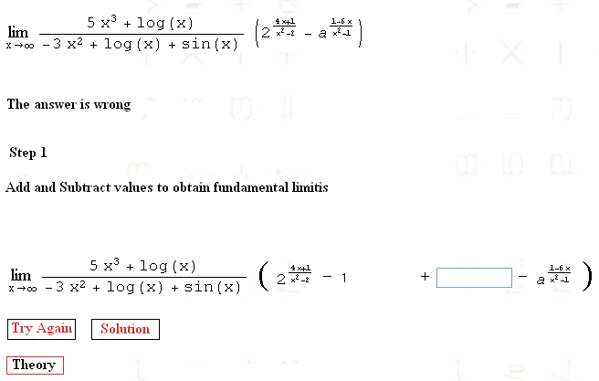
MoMAM@th
Didactic Strategy
Notes:
then if the students make a mistake again, the system gives the chance of viewing the correct result if the students want.

Slide 11
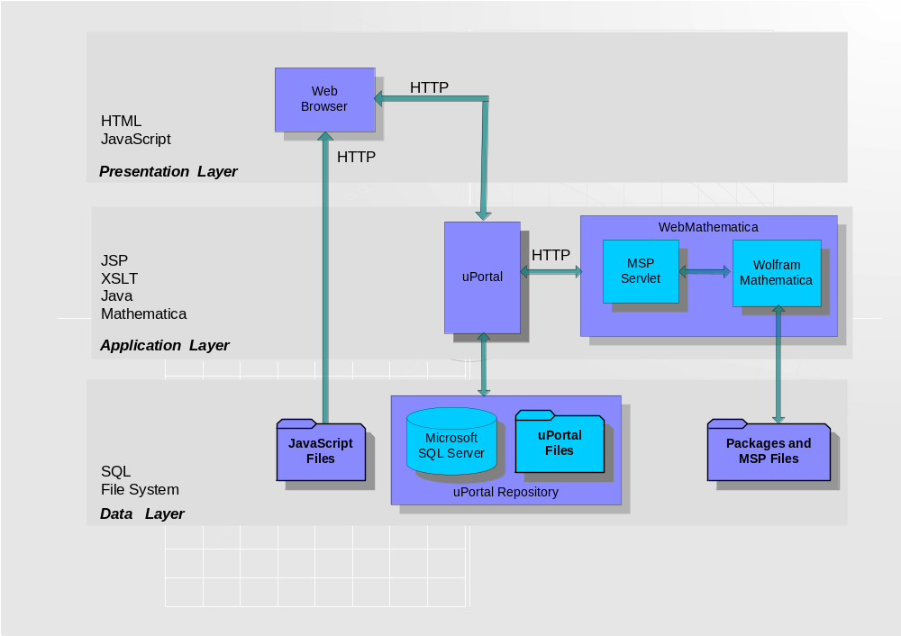
MoMAM@th
Application Layers
Notes:
The logical architecture of MoMAM@th is distributed on three layers: the data access layer contains the database and the file system that store all system data; the application layer where the information are elaborated according to the user’s inputs; the presentation layer that is responsible of the delivery.
MoMAM@th is mainly based on two applications, uPortal and WebMathematica©. uPortal is a free and open source application, developed in java by the JA-SIG group, and it is used to create web portals, that is. to organize the presentation of resources on the web. uPortal lets to organize the web-page in sub-areas, called “channels”, managed independently by software.
In MoMAM@th we used the channels to collect exercises all belonging to a particular mathematical subject (such as Limits, Derivatives, etc.). Moreover these topics additionally are grouped in different sessions relative to particular branch of mathematics (e.g. Functional Analysis, Linear Algebra etc.).

Slide 12
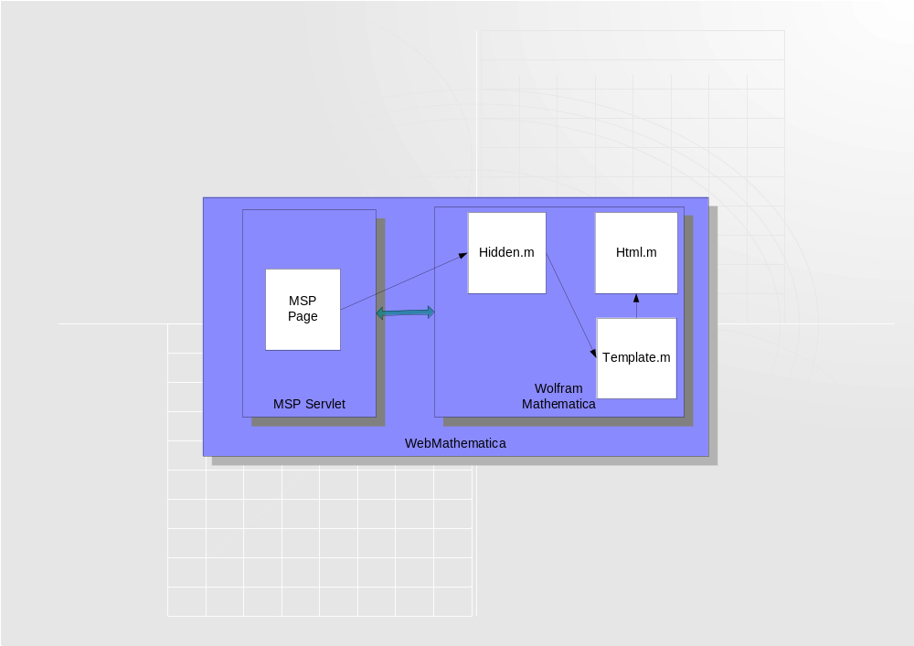
MoMAM@th
WebMathematica
Notes:
The exercises appear in the exercise area and consist of a sequence of pages generated by Web-Mathematica, containing text, graphs, formulas and tools necessary to solve the specific problem. As the following figure shows, one exercise is made by a set of files.
Some of them, the MSP page and some Mathematica Packages, are fixed, identical for all the exercises. The only file different for each exercise is the "Template.m" that contains the logic for the specific exercise. This choice was adopted in order to make easier the task of the content development.

Slide 13
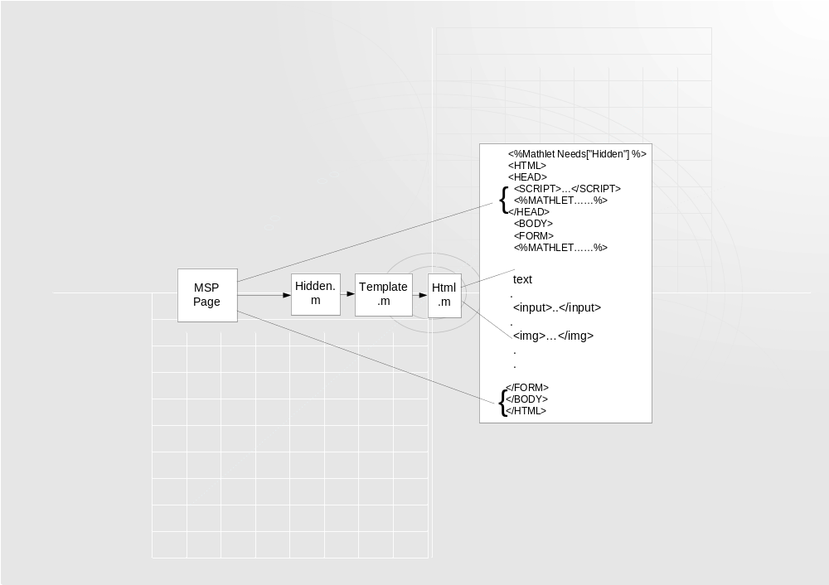
MoMAM@th
MSP Page
Notes:
In the figure it is roughly shown the structure of a MSP page. It is mainly an HTML page, but for the mathlet script that make calls to the Hidden.m functions. In the figure, at the beginning of the page, it is also shown the mathlet instruction that is needed to load the package Hidden.m. (i.e. the tag <% Mathlet Needs ["Hidden"]%>).
The resulting HTML page, representing one step of some exercise, will contain text and formulas, the latter generated as images in the classic mathematical formalism, produced automatically by WebMathematica.

Slide 14
MoMAM@th
Formula Structure
gif image
gif image
text box
Notes:
The exercise in MoMAM@th tries to help the user face the question and simplify her/his way to answer. As it’s visible in the figure the answer is given by filling some text boxes that are part of the formula. Hence the formula is made by fixed parts, visible as gif images (that are also used to draw square roots and fraction lines) and by editing parts that at the moment are simply text boxes.
This implies that the fixed parts are shown by using symbolic formalism but the user has to answer the question filling the text boxes by using textual expressions.
Sometimes, as we have seen in the previous slides, we have also used other html tools like buttons and combo boxes to simplify the user input.

Slide 15
Limitations
Our Considerations
It needs a lot of work, at level of “Template.m” package, to create a formula
The formula can be too long
Many times the format of the answer is not easy to respect (for example {{1,2,3},{5,6,4},{2,3,4}} )
Notes:
Our solution seems far from being the best one. AT the moment in order to create a formula in the way described before we need to do a lot of work at the level of “Template.m” package. This means that who creates the exercise has to also take into account how to generate the structure that the user will use to provide the answer, and often the result is not very appealing from an aesthetic point of view. In the browser if the formula is too long and overcomes the maximum horizontal window size, it doesn’t distribute on more lines but causes the horizontal scrolling of the browser window. In this way the learner cannot see the formula fully but he will have to use the horizontal scroll bar to see all the mathematic expression.
Moreover, many times the format of the answer is not easy to respect; for example, if the exercise needs to receive the base of a vector space for the answer, the user should give in input something similar to {{1,2,3},{5,6,4},{2,3,4}}, which is not very intuitive.

Slide 16
Limitations
Student Feedback
It isn’t possible to write a formula in mathematical symbolic notation
It is not allowed to copy and paste between graphical and textual parts of the formula
Notes:
MoMAM@th has been experimented at the Faculty of Engineering of the University of Salerno. It has been used as a complementary tool for the first year mathematics students. The students attending traditional lectures have used the software for their own extra exercise sessions.
Some students have sent e-mails to teachers asking for help on how to write textually mathematic expressions with Mathematica syntax, and other students have sent comments about the fact that in MoMAM@th it’s not possible to copy and paste the graphical part of the formula.
Hence student feedback has underlined two more important limits that the MoMAM@th exercises have: they don't allow the learner to write the formulas in symbolic notation and obviously it is not allowed to copy and paste among graphical and textual parts of a formula.

Slide 17
To Overcome the problems
To enable the learner to write the formula by mathematical symbolic notation
More complex definition formula:
  It could contain an inner structure template with some fixed parts (read only parts) and some editable.
  Editable parts should be described by an operator with some properties
Notes:
To overcome the previous limitations the ideal solution would be to let the user be able to directly edit formulas in the browser using the symbolic mathematics notation. Moreover as shown before, the formulas of the exercise aren’t a simple series of mathematical symbols.
They could contain an inner structure that we will call template, with some fixed parts (read only parts) and some editable. The last should be described by an operator with some properties.

Slide 18
To Overcome the problems
Editable part
Simple operator: Mathematica placeholder
More complex operator: control the data inserted by the learner by letting or avoiding her/him to put some type of mathematical symbols or operators
Notes:
The editable part should be described by some operators, one example, the simplest, could be the placeholder (equivalent to the Mathematica placeholder) that let’s the user put in every type of mathematical expression.
More complex operators could control the data inserted by the learner letting or avoiding her/him to put some type of mathematical symbols or operators.

Slide 19
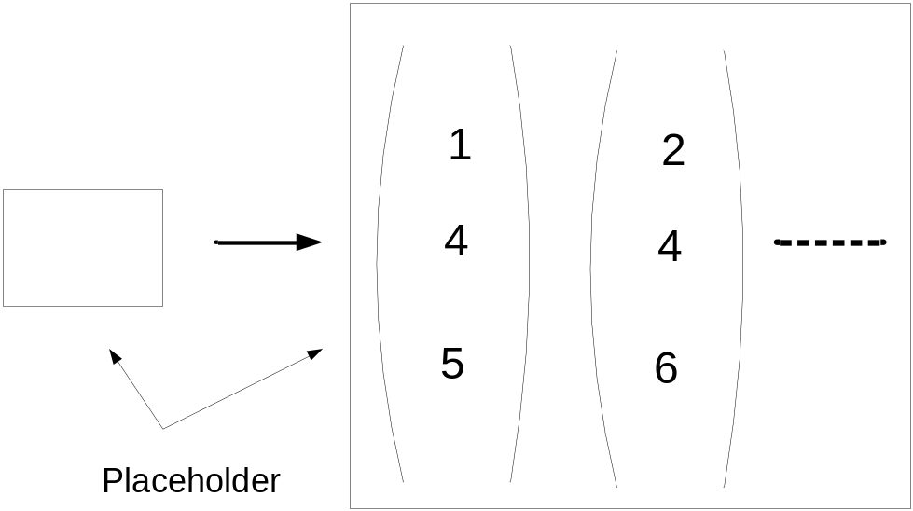
To Overcome the problems
Complex operator example
Considering the previous example about the base of a vector space the user could:
1. insert the complete list of vectors
Notes:
No control is made on input formula, the student can write anything in the box

Slide 20
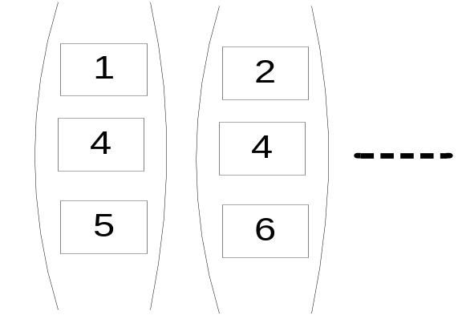
To Overcome the problems
Complex operator example
Considering the previous example about the base of a vector space the user could:
2.fill the components of a varying number of vectors, defining also their dimension
Notes:
The learner can insert varying number vectors defining also their dimension but the dimension has to be the same for all vectors.
Moreover the vector components have to be numbers.
In this case the user can insert only vectors together with their components, deciding also the dimensions of the vectors is unique for all of them. The system controls which objects the learner can use and their properties directly client-side.

Slide 21
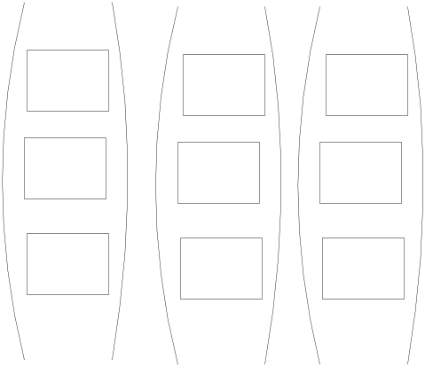
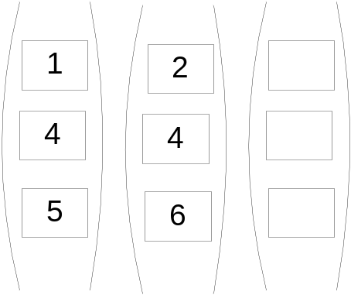
To Overcome the problems
Complex operator example
Considering the previous example about the base of a vector space the user could:
3. fill the components of a fixed number of vectors (whose dimension is right), leaving some vectors empty
System
Learner answer
Notes:
The system proposes a formula with the fixed number vectors (whose dimension is right).
The user can fill the vector components leaving some vectors empty.
The system shows the user a given set of empty vectors whose dimensions are fixed, the user can only fill the components. In this case the system maintains full control of the user but limits the possible answers, it cannot verify if the user has understood the dimension of the vector space.

Slide 22
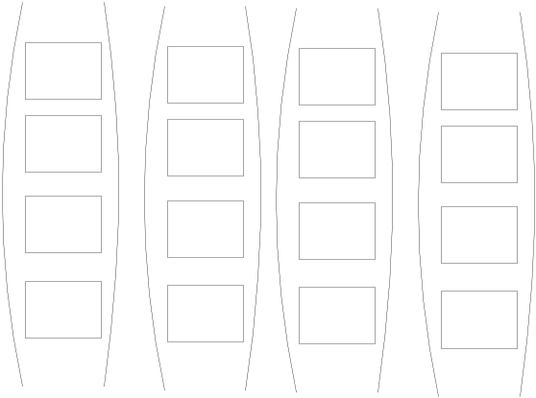
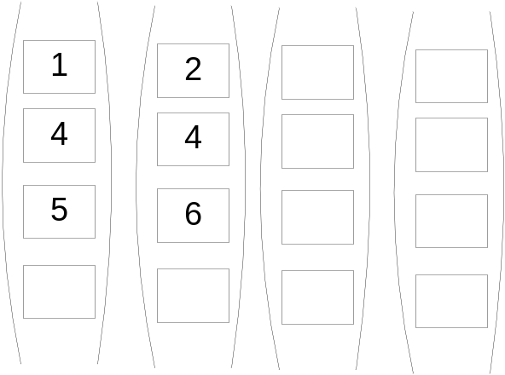
To Overcome the problems
Complex operator example
Considering the previous example about the base of a vector space the user could:
4. fill some components of a fixed number of vectors, leaving some vectors and some components of the vectors empty
System
Learner answer
Notes:
The system shows, as in the previous case, empty vectors. However in this case their dimensions are more than the right one. Hence the user answer results to be complete even if to give it (i.e. to leave empty some components in the vectors) is less intuitive.

Slide 23
To Overcome the problems
Complex operator example
The best way is surely the second one
2.fill the components of a varying number of vectors, defining also their dimension
Notes:
The best way surely is the second one. This one, however, imply that the user could insert only vectors, all with the same but not fixed dimension, and whose components can be only numbers. Hence, in this case, the input formula should know its structure by using special operators that know what the user has to insert. These operators are able to do syntactic verifications of the input directly client side and while the user write the answer.

Slide 24
To Overcome the problems
Current Technologies
They are too complicated and ad hoc
MathML and plug-ins do not support template and placeholder as described by us
Notes:
The problem with the current technologies for putting mathematics on the web is that they are too complicated and ad hoc. It often takes expert knowledge and programming skill to get different math software packages to work together, but no single approach provides a complete answer. The remedy is obviously standard. MathML support is already widespread and it plays a pivotal role for dynamic math in Web pages. MathML equations can be manipulated using JavaScript, Applets and plug-ins can send MathML-encoded equations to server-side software such as computer algebra systems or scientific visualization software. However both MathML and plug-ins do not support template and placeholder as described by us. MathML deals only with complete formulas and not with formulas that may contain parts to fill, and more precisely parts that need to be filled in a specific way.

Slide 25
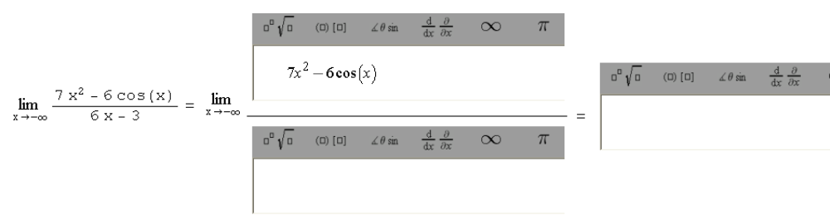
To Overcome the problems
First solution
Substitute each potential placeholder inside a formula with a plug-in to write by symbolic notation
Notes:
To obviate to this lack, a first solution could be to substitute each potential placeholder inside a formula with a plug-in to write by symbolic notation (the natural extension of our current use of text boxes). Such solution, however, results to be unacceptable from an aesthetic point of view because of the interface of available plug-ins that is huge thanks to the existence of a palette for the mathematical symbols. The presence of more then one plug-in inside a formula has resulted in a html page that overcomes the maximum horizontal window size, so the learner cannot fully see all the formula.

Slide 26
To Overcome the problems
Our solution
We use a single plug-in to write and one or more plug-ins to visualize the written formulas, in symbolic notation.
Notes:
Another and better solution is to use a single plug-in to write and one or more plug-ins to visualize the written formulas, in symbolic notation. This has the advantage that the visualizing plug-ins occupy just the space required to show their mathematical contents. They naturally need to communicate with the writing plug-in to get the data to show. This is our solution

Slide 27
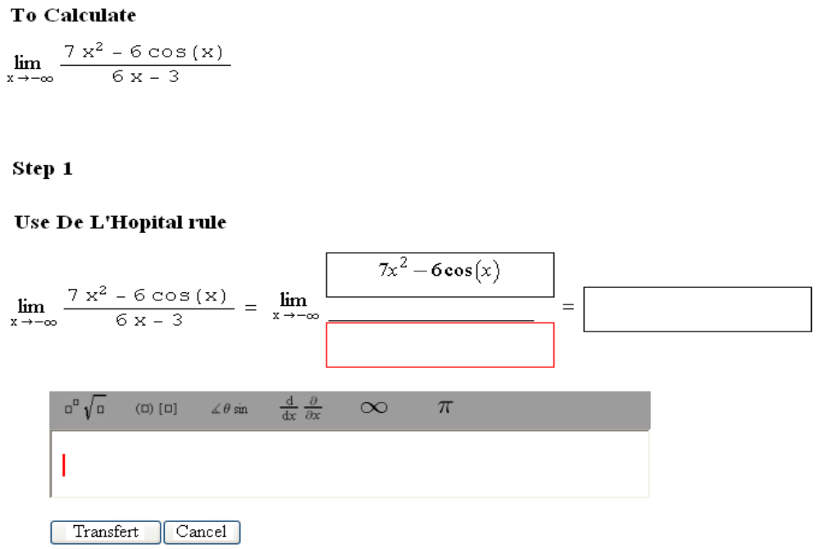
To Overcome the problems
Our solution
OutputControl
MathPlayer
ActiveOutputControl
InputControl
Notes:
In this slide we show which will be our next improvement of MoMAM@th that will lead to the complete editing of formulas in symbolic notation.
To reach our aim we have used two WebEquation applets and the MathPlayer Plug-in of the Design Science.
The InputControl is used to modify the editable parts of a formula and let the learner write text and mathematic symbols choosing them by a graphic palette.
The OutputControl is used to visualize them in the formula and the MathPlayer plug-in is used to display the fixed parts of the formula.
In this way all the formulas are transferred by using MathML so using textual information reduces also the time needed to download the pages.
The three OutputControl represents what we defined as placeholders. To complete a part of the formula, the learner selects one placeholder and writes the mathematic expression in the InputControl. The active OutputControl is evidenced by a red border, so the learner can understand which part s/he is editing. When s/he ends digitizing the formula, pushing the ‘Transfer’ button, transfers the content of the InputControl to the active OutputControl. If the user selects an OutputControl that is non-empty, its data is transferred in the InputControl giving her/him the possibility to modify them. Using the InputControl, the learner has also the possibility to do operations like copy and paste.
WebEquations applets furnish a series of API to access the formulas that is represented through a MathML tree. We used Java Script to call the API functions in order to manipulate and move the expression in the InputControl and OutputControl.
Our solution still has some problems: we use many applets, their fixed server-side dimensions cannot be modified by the client-side by the usual browser commands. Moreover it is necessary to write a lot of Java Script code to manage the applet communications. Indeed one limitation of WebEquation controls is that they can be controlled by JavaScript code but they are not able to issue events. This obliged us, for example, to capture the focus of the OutputControl by means of adding objects, because the applet does not manage the event onmouseclick.

Slide 28
To Overcome the problems
Ideal Solution
The ideal solution would be that standard MathML is directly able to deal with formulas containing a template described by special operators
The possibility to use a standard will assure the development of exercises for the web that are independent from client plug-ins and CASs.
Notes:
With the plug-ins technology we have obtained a good solution on how to put mathematic exercises on the web, but it is the custom solution.
However, the ideal solution would be that standard MathML is directly able to deal with formulas containing a template described by special operators. In the last years the didactic contents used for the e-learning have become more and more interactive and more widely used. In the case of the mathematics, MoMAM@th application constitutes a valid example of such interactive contents.
The standard MathML, that surely will be used in e-learning applications about scientific domains, will have to be suitable to support the kind of interactivity and structures described before. The possibility to use a standard will assure the development of exercises for the web that are independent from client plug-ins and CASs.

