Slide 1
In Search of the Semantic Spider
Stephen Buswell, Stilo Technology Ltd
Relationships between OpenMath and the Semantic Web
OM-TN-2000-28719 OpenMath Workshop, Linz, Sep 2001

Slide 2
Overview
What is the Semantic Web ?
What is OpenMath ?
Relationships
What Next ?

Slide 3
Semantic Web Issues - Overview
Collection of Ideas and Technologies:
Metadata and Ontologies
Web Services and Components
Two-way transactions
User Profiles and Intelligent Agents

Slide 4
What is OpenMath ?
2 ½ XML Languages
  Content Dictionary Schema
  OpenMath Object Schema
  OMDoc, MathBook, … (namespaces for additional constructs)
Mathematical Resource
  CD library
  Phrasebooks and Implementations
  OM aware applications
  OM aware stylesheets (MathML etc …)

Slide 5
Metadata – Background
Genealogy, Real Estate, Pornography
Librarians
Screen Scraping
Search Engines
  Yahoo (human, top-down, subject-based)
  Google (automatic, bottom-up, text-based)

Slide 6
Metadata needed - A Fruitful Illustration
Headline : “Apple Sacks Fuller”
“Today, Austrian fruit farmers announced a record harvest ….”
“Today, Wendall J. Fuller, CEO of Apple Corp. was replaced by …”

Slide 7
Metadata – First Steps
PICS (Platform for Internet Content Selection)
  Grading by 3rd party, proprietary tag values
<html><meta name=“author” value = “buswell”>
RDF (Resource Description Framework)
Dublin Core
  Author etc
RSS (RDF Site Summary)
  Headlines, syndication (o’reilly meerkat)

Slide 8
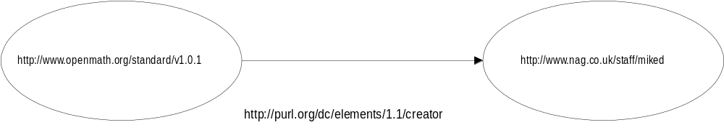
Metadata in RDF (1)
Labelled Directed Graph
Triple (Property, Resource, Value)

Slide 9
Metadata in RDF (2)
<?xml version = “1.0” ?>
<rdf:RDF xmlns:rdf = “http:// www.w3.org/1999/02/22-rdf-syntax-ns#”
xmlns:dc = “http://purl.org/dc/elements”>
<rdf:Description about = “http://www.openmath.org/standard/v1.0.1” />
<dc:creator rdf:resource = “http://nag.co.uk/staff/miked “ >
</rdf:Description>
</rdf:RDF>
<rdf:Description about = “http://www.openmath.org/standard/v1.0.1” dc:creator = “http://nag.co.uk/staff/miked “ />

Slide 10
rdf:about
RDF has Classes, subclasses, transitive relations … (see example)
Vocublaries constrained by RDFS (restricts values available for terms) … Value-set for terms ~~ data dictionary, term inter-relationship ~~ ontology
<rdf:Description about = “http://www.openmath.org/standard/v1.0.1” dc:creator = “http://nag.co.uk/staff/miked “ />
Idea is that RDF processor can step over non-rdf namespace elements, RDF-level interpretation is still correct
RDF is ontology-neutral format – requires another language to provide domain-specific terms
Interchangeable classes & properties
Structure of RDF is not the structure of the information described

Slide 11
Ontologies – Next Steps
OIL (Ontology Inference Layer/Language)
DAML (DARPA Agent Markup Language)
Frameworks for more complicated ontologies (eg. Cardinality, uniqueness statements, instances)
…domain-neutral (cfr KR languages)
…content not process (cfr KQML)
…type-checking for consistency tests
…higher ontologies for domain-specific reasoning

Slide 12
A Web Services Model
UDDI (Universal Discovery, Description and Integration)
WSDL (Web Services Description Language)
  XML Service Description Language
SOAP (Simple Object Access Protocol)
…visit UDDI.org and www.w3.org

Slide 13
User Agent Model – CC/PP
CC/PP = Composite Capabilities / Preferences Profile
  W3C working Group
Profile has Components – sets of attribute-value pairs
  Hardware
  Software – markup and scripting languages supported (eg. XHTML, WML)
  Audio/video capabilities
  Network characteristics
Provided on behalf of the user
Pre-installed or gathered at transaction time
Expressed in RDF

Slide 14
CommonKADS Transaction Model
Type Negative Low Medium High
Commitment Commitment Commitment Commitment
Task delegation Reject-td Request Require Order
Task adoption Reject-ta Propose Offer Agree
Info exchange Inform Ask Reply Report
Two way information flow
‘Negotiation’ between User(Agent) and Service based on Profile Information

Slide 15
What is OpenMath ?
2 ½ XML Languages
  Content Dictionary Schema
  OpenMath Object Schema
  OMDoc, MathBook, … (namespaces for additional constructs)
Mathematical Resource
  CD library
  Phrasebooks and Implementations
  OM aware applications
  OM aware stylesheets (MathML etc …)

Slide 16
OpenMath – Semantic Web Comparisons
CD = micro-ontology
CD group = domain-specific ontology
OpenMath.org = application – specific UDDI server

Slide 17
OpenMath – Possible Next Steps
CDs – Restructure in RDF
  Each CD / CD group ‘becomes’ an ontology ‘Language is a social contract’
  FMPs may be statements linking CDs
  Use existing vocabularies (rdfs, dublin core, …)
Use URI as unique OpenMath CD / symbolname identifier instead of CDname/Symbolname combination (ensures global uniqueness)
Build Mathematical Service Description Language over (eg.) WSDL
  Use eg. iCalendar
Develop Transaction Models for OpenMath service contract negotiation
Develop Agent Models over (eg.) CC/PP
OpenMath.org = application – specific UDDI server OpenMath resource discovery
Visualisation and Navigation

Slide 18
OpenMath – Possible Next Steps (2)
Visualisation
Navigation

