Slide 1

OpenMath, MathML in the
Math-Net Project
Winfried Neun
ZIB Berlin
OpenMath Workshop
Pisa
September 28, 2002

Slide 2
What is Math-Net?
Math-Net is the idea of a new information and
communication system in mathematics built up by a
common effort of the mathematical community.
The mathematical community (individuals, mathematical
institutions, all other institutions which provide relevant
information for mathematics) is organized in the Math-Net
Initiative.

Slide 3
Math-Net Basics (I)
6/2000 Declaration of the Math-Net Charter
http://www.math-net.org/charter
approved by the
Executive Comittee of the
International Mathematical Union
on May 16, 2000

Slide 4
Math-Net Basics (II)
Math-Net is intented to organize and enhance the free flow of information within mathematics worldwide.
The objective of Math-Net is to provide efficient access to high quality mathematical information "at the fingertips" of the user.
The use of Math-Net is free.
Math-Net aims at making information and services freely available - whenever possible.

Slide 5
Math-Net Basics (III)
Math-Net is organized under the aegis of the International
Mathematical Union (IMU).
Results of the internationalization presented at ICM 2002
Math-Net is steered by the IMU Committee on Electronic
Information and Communication (CEIC) via
  - a user-driven and not for profit activity,
  - open for all willing to provide mathematical information
  electronically.

Slide 6
Math-Net Basics (IV)
Math-Net is a global electronic information and communication system for mathematics:
structrured
distributed,
interoperable,
user-friendly,
high-quality.

Slide 7
Math-Net Basics (V)
Math-Net is based on structured mathematical information offered electronically by participating institutions,
the Math-Net Members.
Math-Net combines the available resources into services,
provided by groups of volunteers, the Math-Net Service
Providers.

Slide 8
Math-Net Charter: Organization
CEIC
TAB
Math-Net Service Providers
Math-Net Members
Information Coordinators
Math-Net Member Associations

Slide 9
Tasks
  development of user-friendly concepts and tools for
  - creating Math-Net Pages,
  - metadata for preprints and
  - professional homepages
  a broad international dissemination of the methods
  Meta Maker for Math-Net Pages, preprints and
  professional homepages
  Set up of services
  - Navigator, Sigma (Search Engine)
  - MPRESS,
  - PERSONA MATHEMATICA/World Directory of
  Mathematicians

Slide 10
Math-Net Page - Concept and Tool
the concept:
idea: A standardized portal for the core information of
Math-Net Members and the Math-Net Services
three parts
controlled vocabulary
structure
layout

Slide 11
Remarks (I)
The idea of Math-Net Pages was born in the Math-Net
project (1997-1999) in Germany
the idea was successful, because it was a simple idea with a
a great use
a tool for generating Math-Net Pages exists
nearly all mathematical institutions in Germany (70) have
a Math-Net Page (moreover some institutions in UK and
Austria, and Denmark have Math-Net Pages too)
the Math-Net Pages are accessible by the Math-Net
Navigator

Slide 12
Remarks (II)
the Math-Net Page of the first generation were essentially
html-documents (only some few metadata)
the links to the Math-Net Services were not explicit
some categories for core information of the institution were
missing
internationalization of Math-Net

Slide 13
Math-Net Page - Requirements
Requirements to the concept:
visible „labels“ of the Math-Net Page should be flexible
(typical notations for the groups and categories of the Math-Net
Page labels could differ between regions)
Math-Net Pages should be acceptable worldwide:
What do we have to invest for a multilingual extension?
tools allowing to
- generate a Math-Net Page and
- change an existing Math-Net Page
in an intuitive way

Slide 14
Math-Net Page Maker
a tool for generating and editing different modes
Math-Net Pages for Departments
Math-Net Pages for Research Institutes
Math-Net Pages with „standard labels“
Math-Net Pages with „alternative labels“
Math-Net Pages with different character sets

Slide 15
More
The Math-Net Page Maker produces a deeply structured document,
it consists of three parts:
the xhtml-part
the metadata-part
hidden fields

Slide 16
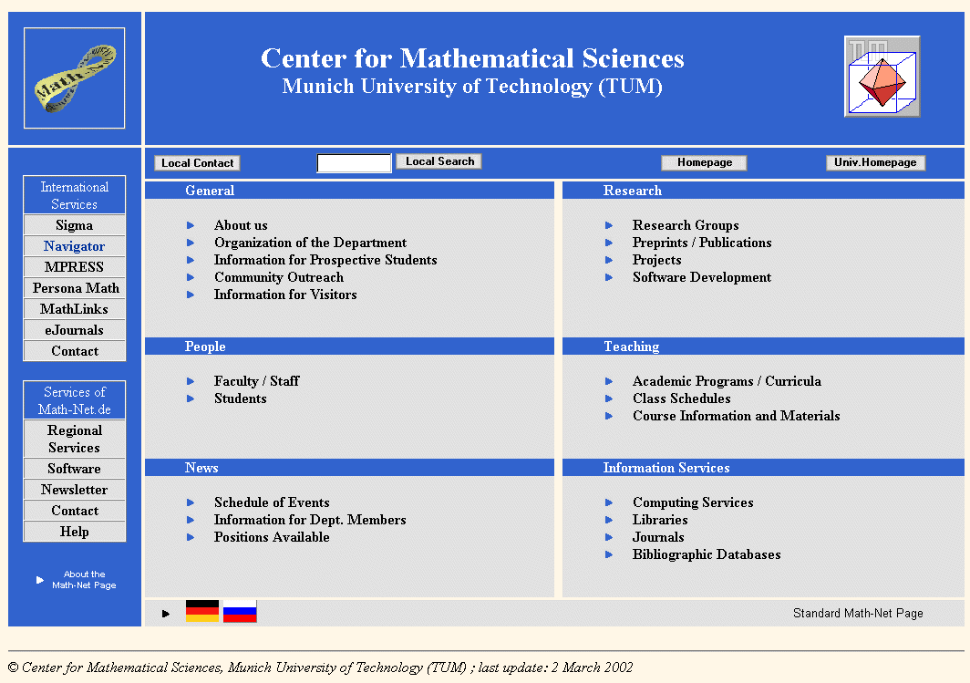
Standard Math-Net Page of TU München

Slide 17
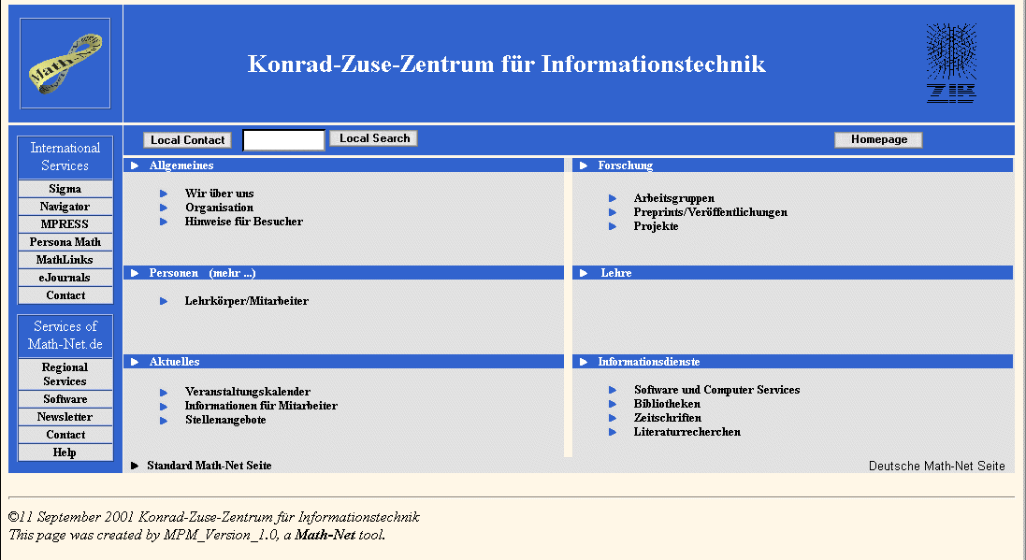

Slide 18
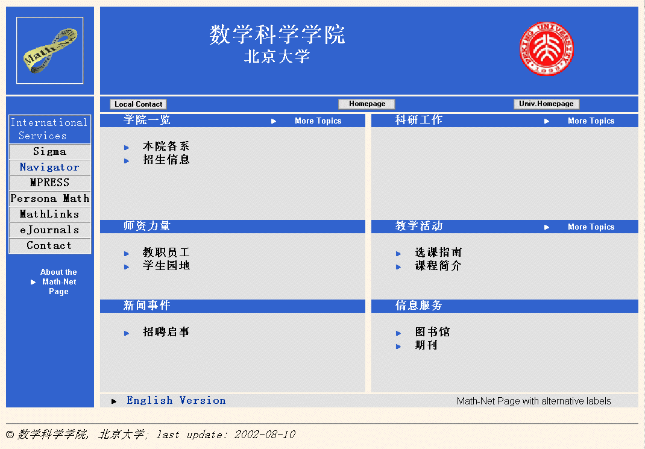
Alternative Math-Net Page of the Beijing University

Slide 19
The metadata part (IWI Os)
Which data?
data about the information coordinator (DC, vCard)
data about the institution (DC, vCard)
groups and categories of Math-Net Pages (own)
The metadata specification covering
a Math-Net namespace
definition of Resource classes (Math-Net Page, Preprints, ...
a Math-Net type and Math-Net subject scheme for the groups
and categories of the Math-Net Page)
an Application Profile for all metadata used on the Math-Net
Page

Slide 20
A piece of the code ...
...
<rdf:Description about="http://www.zib.de">
<dc:subject>
<mnst:Descriptor rdf:value="about Us" rdf:about="
http://www.iwi-iuk.org/material/RDF/1.1/descriptor/#AboutUs"/>
</dc:subject>
</rdf:Description>
<rdf:Description about="http://www.zib.de">
...

Slide 21
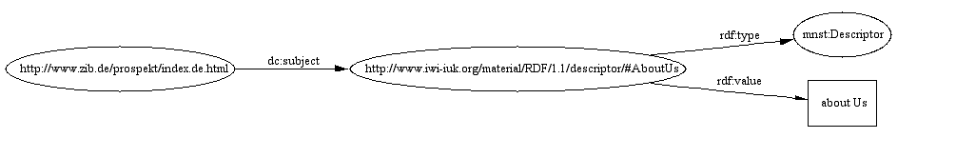
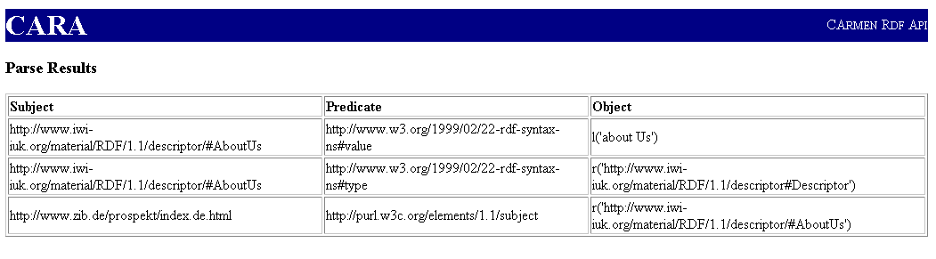
the graph representation
the triple representation

Slide 22
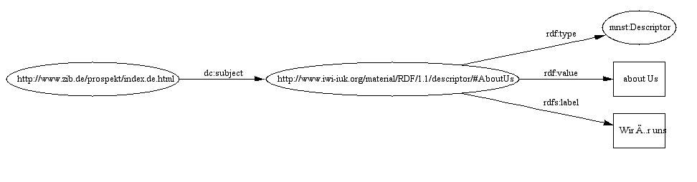
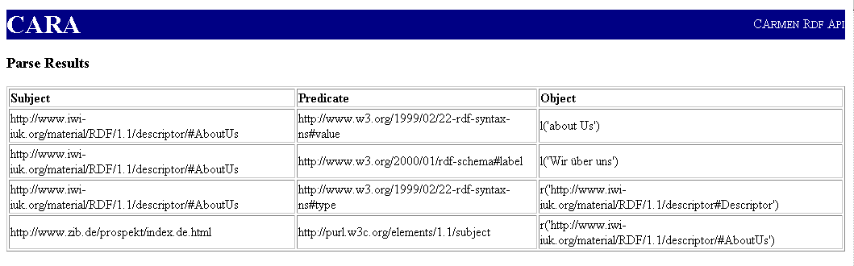
extended by the label
the triple representation

Slide 23
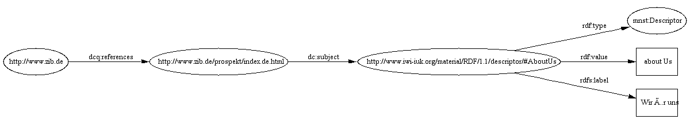
A category as part of the Math-Net Page

Slide 24
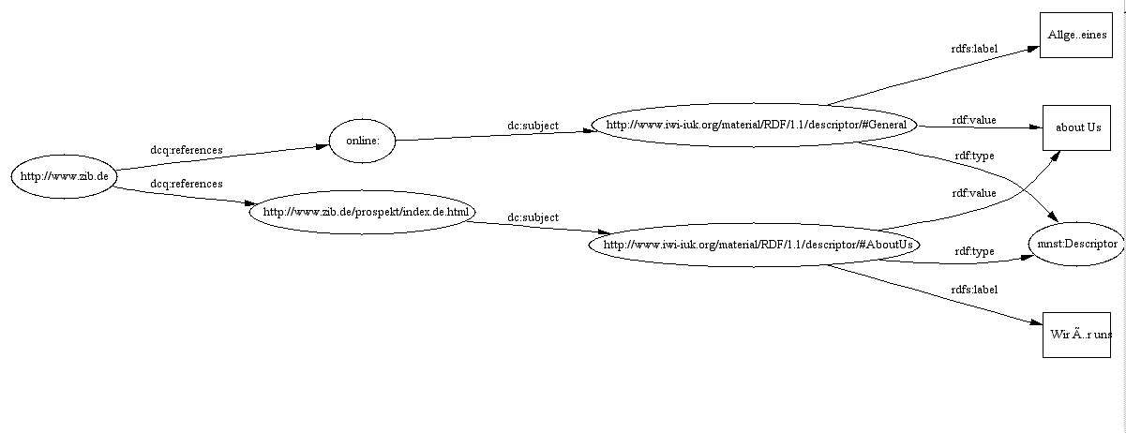
two categrories
more complexity on the next pictures:

Slide 25
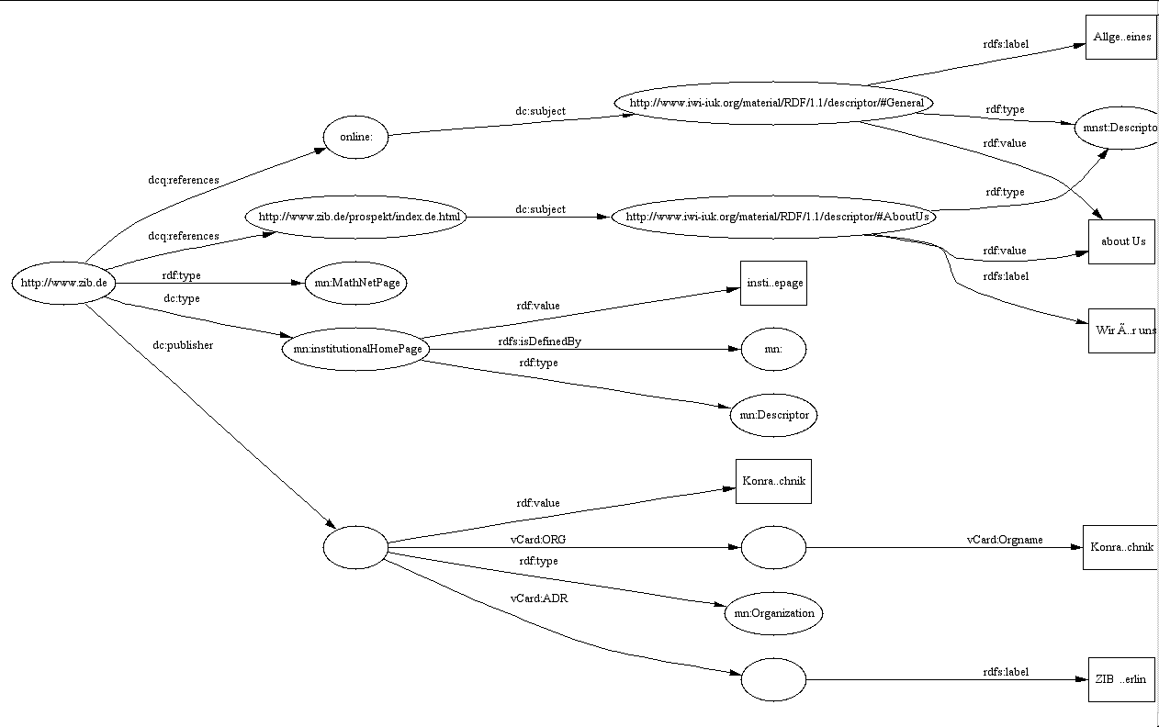

Slide 26
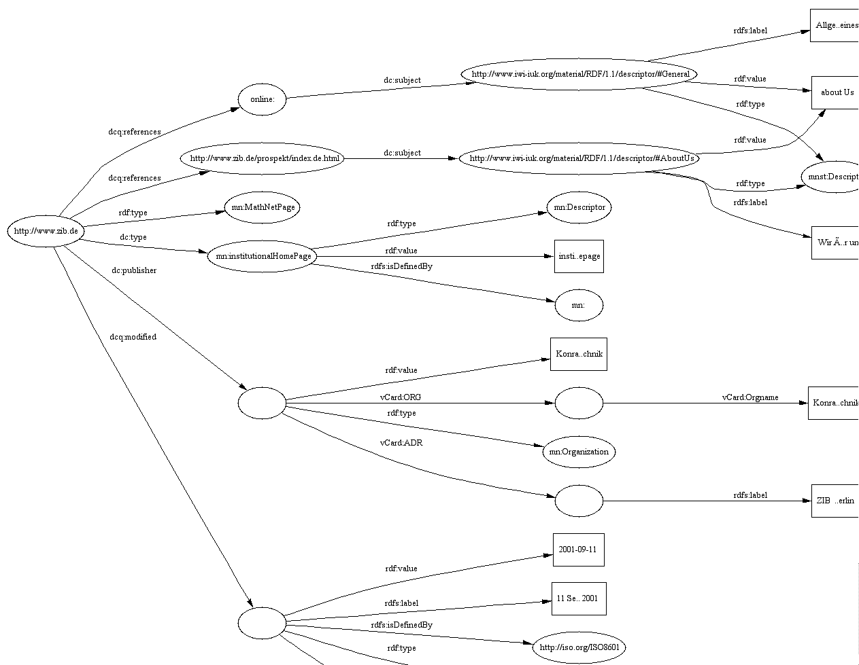

Slide 27
Test phase (I)
The test phase for the current Math-Net Page Maker was started
on 2001-03-09:
10 test installations in Germany:
- international
France
Canada
USA

Slide 28
International Deployment and Promotion of the Math-Net Page
official announcement of the Math-Net Page and the recommendation to mathematical institutions to implement Math-Net Pages by IMU, national and regional mathematical societies and other institutions of the mathematical community

Slide 29
A Math-Net Service: the Navigator
The Math-Net Navigators is the tool for navigation and search
the Math-Net Pages
in more detail:
lists of institutions (e.g. ordered by continents, countries,
regions)
lists of information coordinators
search for institutions and information coordinators
clickable maps
specials view of and search on groups and categories

Slide 30
The Σ search engine
Sigma uses the collection of Math-Net pages for harvesting mathematical information, like: persons, preprints, ...
The types of info which can be currently analysed are Tex, Pdf, Ps, html...
With OpenMath and MathML encoded math we have new important types, also courseware.

Slide 31
Harvesting Semantic Information
MathML documents (presentation markup) cannot be summarized easily
Have to analyse variants of the markup used for interpretation, e.g. annotations
Summarizing OpenMath documents should be a lot easier.

Slide 32
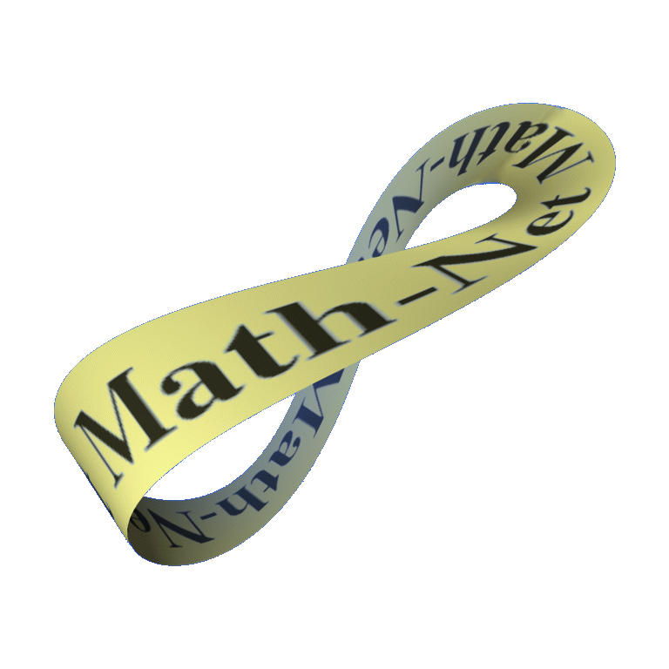
Thanks!

