Slide 1
Semantic Markup for Legacy Documents: A Case Study
Mike Dewar
NAG Ltd

Slide 2
The Problem in General
Many documents in presentation-oriented format
Want to add:
  meta-data
  specialised content markup (e.g. OpenMath/MathML)
  extra structure & indexing
In general this cannot be achieved except on a case-by-case basis, but …
… this doesn’t preclude automating the process as far as possible.

Slide 3
NAG’s Specific Problem
Extensive software documentation:
  circa 2000 individual documents
  documents potentially more than 30 years old
  hundreds of different authors
  authoring: typewriter → golfball → TSSD → LaTeX & SGML
  display: ASCII → PostScript → Dynatext → PDF
Goals:
  subset documentation easily
  display documentation on the web, in Microsoft help etc.
  automate production of document variants (e.g. Fortran and C routines)
  generate code to embed software in different environments from interface specifications

Slide 4
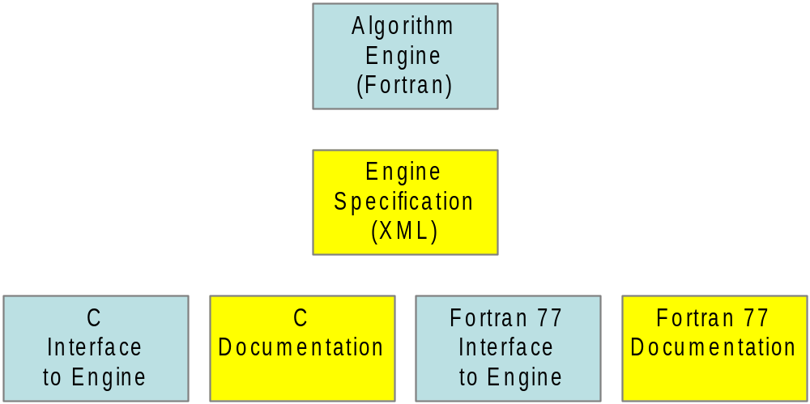
New NAG Software Architecture

Slide 5
Example: Discrete Fourier Transform
Fortran
C

Slide 6
Strategic Issues
Goal: create new C library based on Fortran code base (using in-house Fortran → C translator)
We are in a production environment
  need to fit in with product timescales
  need complete solution
Need to support authors
  software-oriented
  happy with emacs and LaTeX
Need to maintain look and feel of old documents
Need to avoid massive proof-reading activity

Slide 7
Markup for NAG documents
Main documentation tool is 3B2
  phasing in appropriate standards-based technologies (XML, XSLT, …)
A NAG document is SGML with embedded mathematics fragments in LaTeX
  … where <arg>N</arg> is <math>\frac{L}{2}</math> and …
  home-grown DTD
This is a common approach but:
  unwieldy since can’t mix SGML and LaTeX within an expression
    requires “parallel” SGML and LaTeX macros
    disconnects mathematical structure from markup structure
  doesn’t work well with generic tools
  hand-written LaTeX mathematics is very hard to process

Slide 8
General Approach
Convert SGML to XML
  better tool support
  more web-friendly
  easier to learn
Convert mathematics to suitable XML
Infer semantics based on
  notation (informal stylistic structure)
  key phrases
  external information
Add additional information as necessary
Generate documentation & software wrappers together
  proof-read representative sample of documentation
  test all software as rigorously as possible

Slide 9
Example: Fragmentation
Ideal syntax:
  <math> \arg{A} + \arg{B} > 0 </math>
but authors write:
  <arg>A</arg> <math>{}+{}</math> <arg>B</arg> <math>{} > 0</math>
and proof-readers never notice the difference …
… <math>x > 0 {\rm and} y > 0 </math> …
… <double> <arg>M</arg>(<math>*</math>) …
… where <math>n = </math> the maximum degree …

Slide 10
XML Markup
What we would like to have is
  <math>
  <mrow><arg>A</arg><mo>+</mo><arg>B</arg></mrow>
  <mo>&gt;</mo>
  <mn>0</mn>
  </math>
or even better:
  <OMOBJ><OMA>
  <OMS name=“gt” cd=“relations1”>
  <OMA>
  <OMS name=“plus” cd=“arith1”/>
  <arg>A</arg>
  <arg>B</arg>
  </OMA>
  <OMI>0</OMI>
  </OMA></OMOBJ>

Slide 11
Processing Mathematical Expressions (1)
Identify mathematical expressions by
  merging adjacent fragments
  splitting on font changes
  discarding non-mathematical cases
  ∴ reduced number of maths expressions from > 1,000,000 to 235,000
Gradually replace LaTeX by Presentation MathML
  start with problem cases like \frac
  use stylesheets to recreate original LaTeX

Slide 12
Processing Mathematical Expressions (2)
Identify areas where content markup is preferable
  examples of use of routines (users might use cut-and-paste)
  larger, complicated expressions (e.g. in description of mathematical aspects of algorithm)
  expressions where ambiguity of presentation markup causes problems
Convert to OpenMath or Content MathML using context, e.g.:
  is F(3) a function call or an array element?
  in linear algebra chapters, matrices are called A, B, … while vectors are X, Y, …

Slide 13
Testing generated software
Many NAG input parameters have constraints on their values.
The XML:
  <con><maths>
  <ar><arg>M</arg><ai>1</ai></ar> &gt; 0
  </maths></con>
Appears in Fortran documentation as:
  M(1) > 0
and C documentation as:
  m[0] > 0
and C wrapper code as:
  if ( !(m[0] > 0) ) error(…);

Slide 14
Language neutrality
Original documents describe Fortran:
  need to transform to language-neutral form
  hence need to understand semantics of certain expressions
Easy cases:
  .GE. replaced by &gt; etc.
Harder cases:
  Array references
    fixed: M(3) versus m[2]
    relative M(j) for j=1..n versus
      m[j-1] for j=1..n or m[j] for j=0..n-1
    and watch out for “m[j-1] is m_{j} for j=1..n” …
  <math>M</math> versus <math><arg>M</arg></math>

Slide 15
Parameter data and meta-data
Classification according to:
  name (generic, language specific)
  concrete type (integer, real, …)
  abstract type (structured matrix, enumeration …)
  intent (in, out, …)
  purpose (data, algorithm, workspace, dimension …)
  relationship to other parameters (leading dimension of M)
  optional or required
  constraints/recommended values
  generic documentation
  environment-specific documentation

Slide 16
Classification strategy
Look for key phrases:
  e.g. “On entry <arg>A</arg> contains … ” suggests A has intent in
  identify clusters of documents with the same style
Identify “hidden structure” in documents:
  e.g. variables used for describing constraints defined early in a document
Look for correlation between similar documents
Double check with existing software where possible
  e.g. check intents with tool – not 100% accurate

Slide 17
Checking Correctness
Run regression tests and diffs on generated software after every change
It often doesn’t help to diff documents because
  XML tools add/remove whitespace, may expand entities etc.
  diff-style tools tend to be line-based
  introducing entities and new markup changes structure substantially
Validate against extremely strict DTDs where possible
  offer authors a more relaxed DTD
Use human proof-readers for representative sample of documents, iterate proof cycle intelligently

Slide 18
Summary
Produced our C Library on time, well-received by customers
As well as software benefits, improved documentation:
  identified many errors and omissions
  more stylised ⇒ easier for non-English speakers
  more flexible delivery (PDF, XHTML+MathML, LaTeX)
  more functionality (hyper-linking, better indexing and searching etc.)
  facilitates bespoke documentation for software partners etc.
In our case, adding semantic markup was possible but
  long process and very context-sensitive
    subject area
    structure of documents
    idiosyncrasies of authors
  need appropriate checking and validation mechanisms
Document management has become an ongoing activity.

