Slide 1
Mathematics On The Semantic Web:
MONET Session
The MONET Project
  Mike Dewar
Putting Bernina On The Web
  Yannis Chicha & Marc Gaetano
The Mathematical Service Description Language
  Olga Caprotti
OWL: An Ontology Language for the Semantic Web
  Ian Horrocks

Slide 2
The MONET Project
Mike Dewar
NAG Ltd

Slide 3
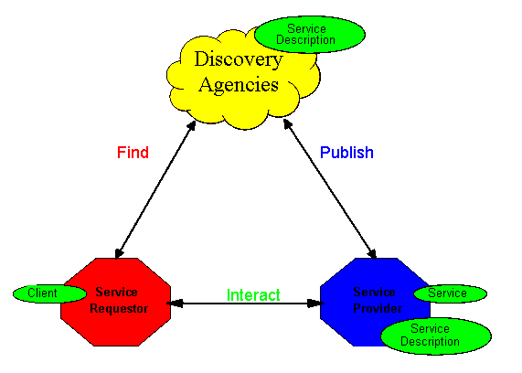
Web Services
Source: http://www.w3.org/TR/2002/WD-ws-arch-20021114/

Slide 4
Web Services Overview
Web Service technologies allow:
  Integration of computational components
  Distribution of components (useful for pervasive computing / collaborative working / sharing hardware …)
  Service providers / IP stakeholders to control exactly what they expose to clients
Key Technologies (WorldWide Web Consortium, …):
  SOAP (XML-messaging)
  WSDL (Low-level interface description)
  Choreography languages (BPEL4WS, WSCI, …)
Implementations:
  IBM Websphere, Microsoft .NET, BEA WebLogic, Sun JWSDP, TheMindElectric Glue, …

Slide 5
How will web services be deployed?
As resources within physical organisations
  behind a firewall ⇒ security/authentication less of an issue
… within virtual organisations
  authentication an issue
  partners trust services to behave as advertised
  partners have control of availability of services
As public service available to anybody
  free/pay-per-use/subscription …
  issues of trust
  need framework for contracts, payments, dispute resolution …

Slide 6
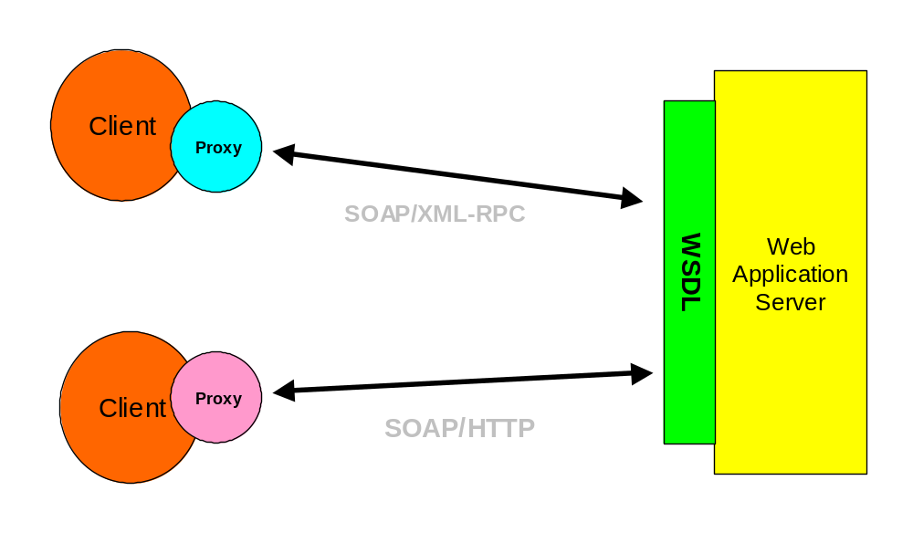
Web Services Today

Slide 7
Web Service Description Language (WSDL)
XML application for describing how to bind to a service
A WSDL document defines:
  Messages (i.e. data objects)
  Operations (i.e. methods)
  Ports (i.e. classes)
Complex data types described via XML Schema
WSDL document usually generated automatically
Client can generate proxy template from WSDL document

Slide 8
Web Service Discovery: Existing Technologies
Universal Description Discovery and Integration (UDDI)
  Taxonomy-based
  Original version not very nimble or dynamic
  Evolving towards more flexibility
Web Service Inspection Language (WSIL)
  Format for collecting links to service descriptions
  e.g. pointer to entry in UDDI registry

Slide 9
Service Discovery: The Semantic Web
"The Semantic Web is an extension of the current web in which information is given well-defined meaning, better enabling computers and people to work in cooperation."
  Tim Berners-Lee et al, Scientific American May 2001
Generic ontology languages:
  Resource Description Framework Schema (RDF/S)
  Web Ontology Language (OWL)
Specific Mathematics Languages:
  MathML (Content)
  OpenMath
  OMDoc
  …

Slide 10
Mathematics On the NET
MONET Project: 2 Year EU-funded RTD activity
Principal goals:
  Design an architecture for brokering mathematical web services
  Develop the necessary mechanisms for describing services, problems and queries
  Build prototype brokers and services based on generic technologies
Partners:
  NAG Ltd, Stilo Technology Ltd, Universities of Bath, Eindhoven, Manchester and Western Ontario, I3S Nice

Slide 11
Why Mathematical Web Services?
Mathematics underpins a large proportion of scientific and commercial activities
  NAG software used in Engineering, Manufacturing, Finance, Utility Provision, Astrophysics, Education, …
Software increasingly complex and specialised
  different languages for application and algorithm
  application developers lack mathematical knowledge to identify most appropriate technologies
Mathematics is relatively well-defined so automating service discovery and choreography should be feasible

Slide 12
Simplified MONET Architecture
Service
Service
Service
Manager
Planning
Manager
Client
Manager
BROKER
Client

Slide 13
Service Registration
Service
Service
Service
Manager
Planning
Manager
Client
Manager
BROKER
Client

Slide 14
Client Submits Query
Service
Service
Service
Manager
Planning
Manager
Client
Manager
BROKER
Client

Slide 15
Execution Plan Created
Service
Service
Service
Manager
Planning
Manager
Client
Manager
BROKER
Client

Slide 16
Plan Returned To Client
Service
Service
Service
Manager
Planning
Manager
Client
Manager
BROKER
Client

Slide 17
Client Approves Plan, Requests Resources
Service
Service
Service
Manager
Planning
Manager
Client
Manager
BROKER
Client

Slide 18
Client Gains Access to Resources
Service
Service
Service
Manager
Planning
Manager
Client
Manager
BROKER
Client

Slide 19
Client Interacts With Service
Service
Service
Service
Manager
Planning
Manager
Client
Manager
BROKER
Client

Slide 20
Role of the Broker
Client Manager:
  API for client
Service Manager:
  Maintain service registry
  Negotiate service access
  Perform various housekeeping duties
Planning Manager:
  Extract discrimination criteria from queries
  Match to features of registered services
  Construct one or more execution plans with indicators of adherence to client’s specification

Slide 21
Other MONET Components
Planning Services
  Invoked by broker
  Create execution plans
  Domain- and possibly service-specific (e.g. NAG ODE planner)
Execution Services
  Implement choreography languages
Mathematical Object Manager
  Registry for mathematical objects
  Can refer to an object by URI
Explanation service
  Provide a human client with explanation of solution process
Commercial Infrastructure
  Banks, resource usage services, service certification agencies, …

Slide 22
Conclusions
The web service architecture could underpin software integration and distribution in the future
  widespread support in the IT industry
  cross-platform, open standards
Semantic web is an attractive vision
  not yet any accepted standards
  little tool support
Mathematical service infrastructure feasible, but must
  be layered on top of commodity technologies (SOAP, WSDL, …)
  accommodate different kinds of mathematical service
  co-exist with other mechanisms (OGSA, GESA, …)
  not make service deployment disproportionately expensive

