Slide 1
Advanced Learning Technologies
Proposal to the 6th FWP of the EU
Mika Seppälä and Jouko Väänänen
University of Helsinki

Slide 2
OpenMath, MathML, XML
Right balance between ease-of-use and versatility
Technology for developing powerful educational applications
Allows one to create adaptive multilingual systems

Slide 3
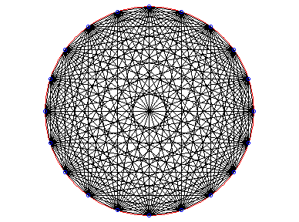
20 instructors developing and sharing educational materials

Slide 4
20 instructors developing and sharing educational materials
A pre-calculus course at a large university may have 20 instructors
Each instructor develops on-line materials
Sharing does not happen
Individual efforts have no permanent value

Slide 5
A common standard for educational materials via Course Content Dictionaries (CCD)
Easiest to do in mathematics
Advanced table of contents
XML namespace

Slide 6
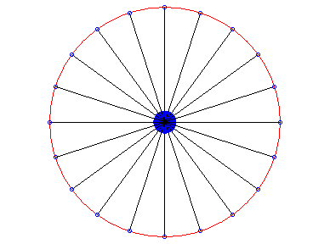
CCD makes sharing of materials possible

Slide 7
Outline of the proposal
Core group: companies producing on-line materials, group of professors writing CCD’s, project management team
Content generation and wireless on-line testing tools: (Open) Universities, large companies (NOKIA, Siemens, telephone companies)
Dissemination and user support: support centers in as many EU countries as possible

Slide 8
Advanced Learning Technologies
Aim: to use current tools to
Develop good sample content using the MathML/OpenMath, enable sharing
Educate colleagues – dissemination
User support
Horizontal vs. vertical development.
Total budget: 10 M€

Slide 9
Participants
Core Group: Helsinki, Eindhoven, INRIA, SKOL, …
Content generation: Helsinki UT, UNED (Madrid), …
User support: CSC (Helsinki), INRIA, …
NOKIA, Siemens, Telecoms, …

Slide 10
Participants
If you want to be a partner in this proposal:
Send a short description of what you propose
to do to to Jouko.Vaananen@Helsinki.Fi with
a cc to Mika.Seppala@Helsinki.Fi.
Deadline: October 17, 2002

