Slide 1
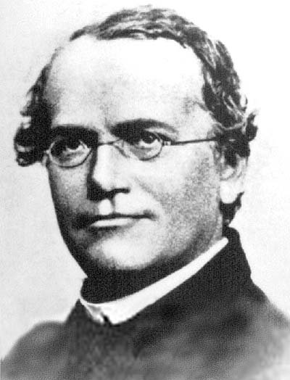
SnpArrays.jl, VCFTools.jl, and ADMIXTURE.jl
OpenMendel Workshop
ASHG Annual Meeting 2020
Hua Zhou (huazhou@ucla.edu)

Slide 2
Motivation
SnpArrays.jl and VCFTools.jl are two gateway packages that
Translate (potentially big) genotype data files to vectors/matrices for statistical analysis
Perform common manipulations such as subsetting, summary statistics, filtering, quality control, GRM calculation, PCA calculation, and so on in a high-level language environment
I’ll demonstrate functionalities of SnpArrays.jl here. Those for VCFTools.jl are similar.

Slide 3
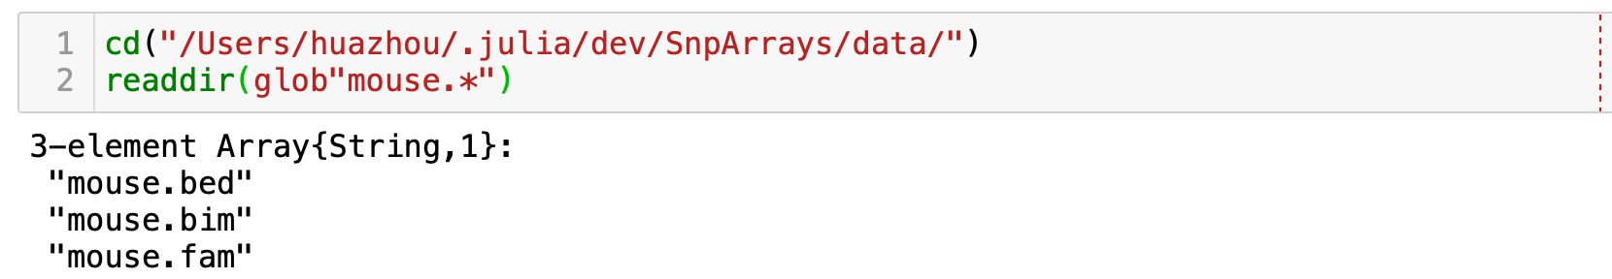
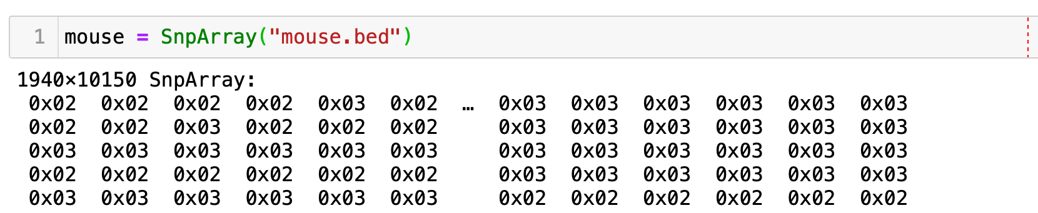
Read in Plink binary format
Given a set of Plink files
we initialize a SnpArray
Notes:
Reduce words

Slide 4
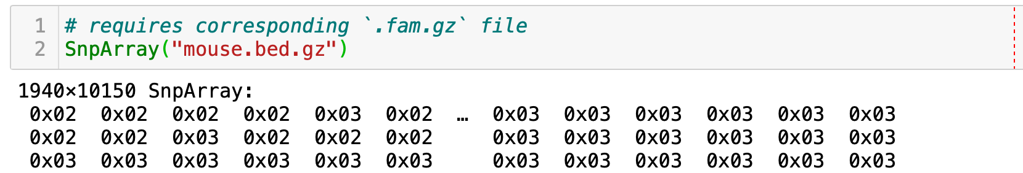
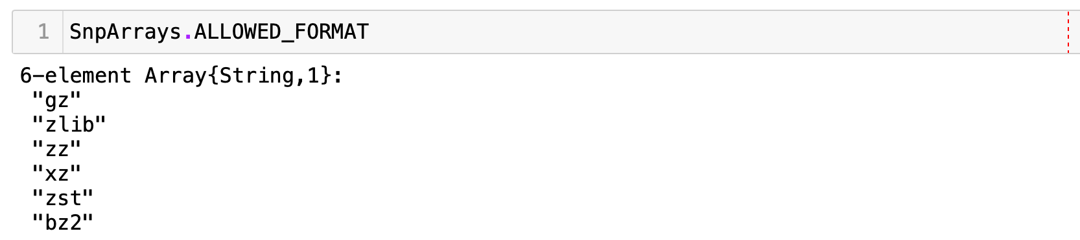
Gzipped Plink files?
No problem. Use the same command
Other supported compressed formats are
Notes:
Reduce words

Slide 5
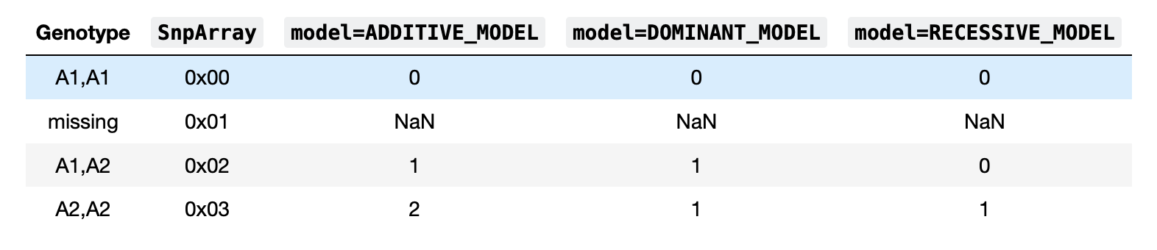
Translate genotypes to numbers
Codebook:

Slide 6
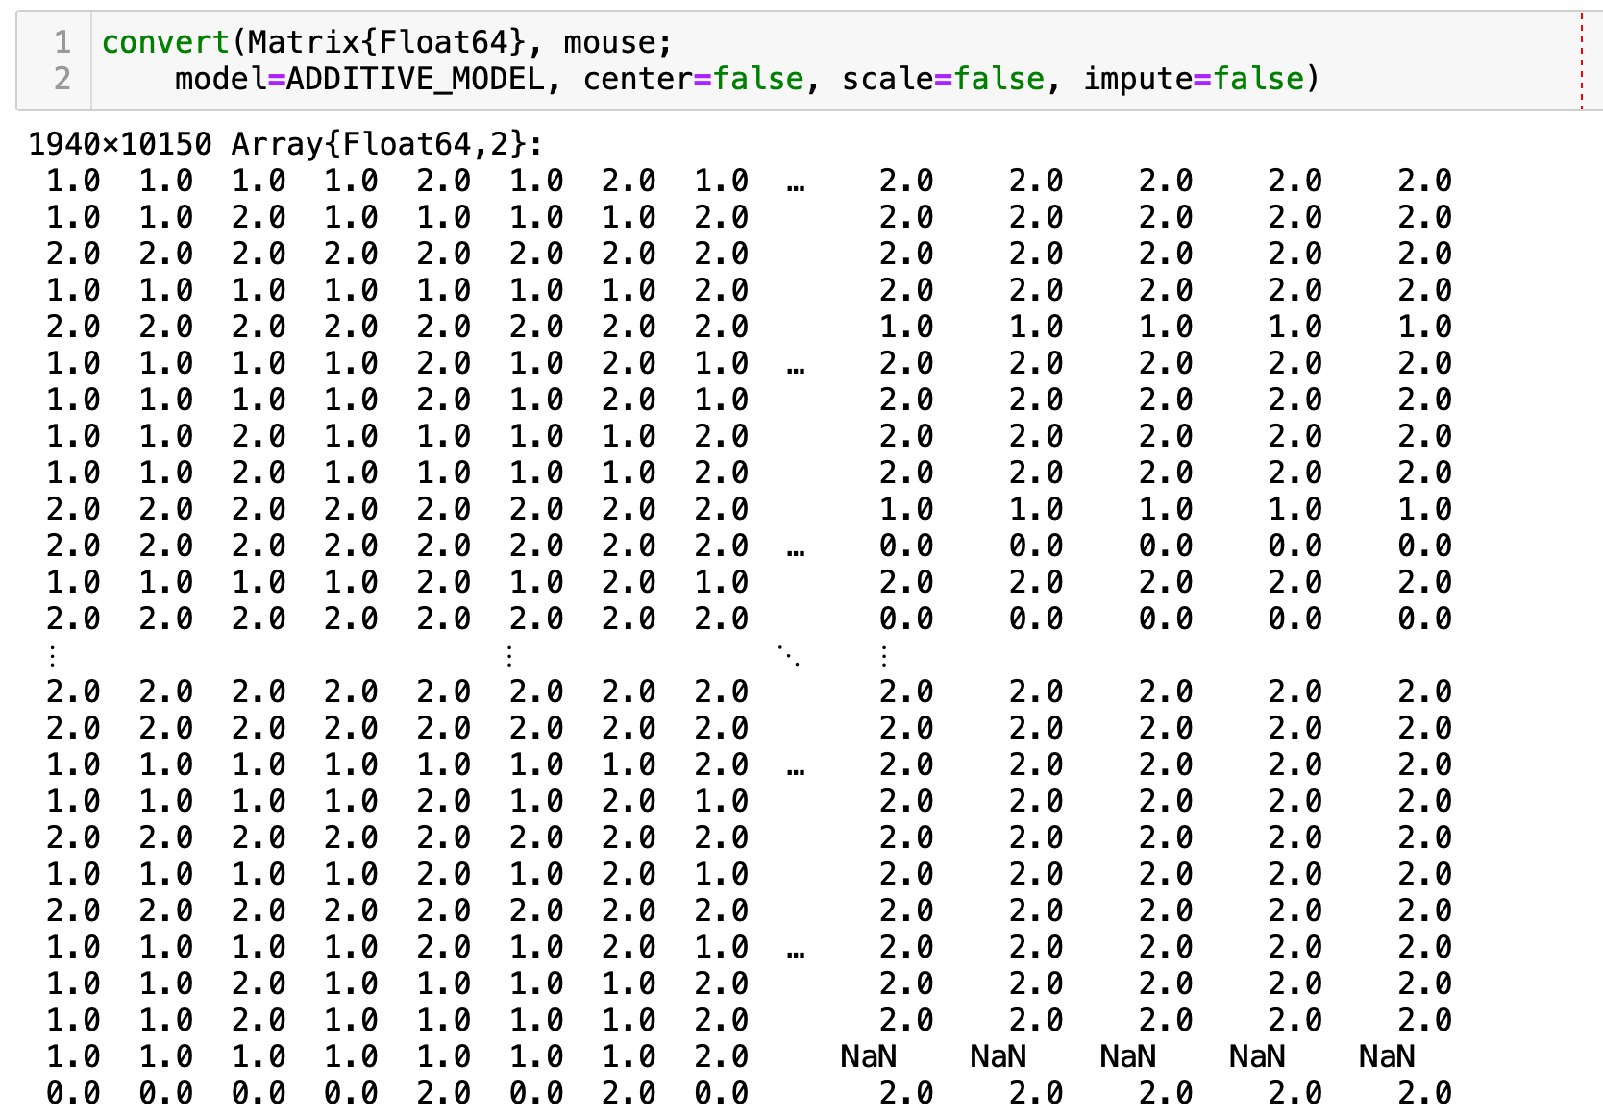
Convert SnpArray to a numeric matrix
Notes:
Reduce words

Slide 7
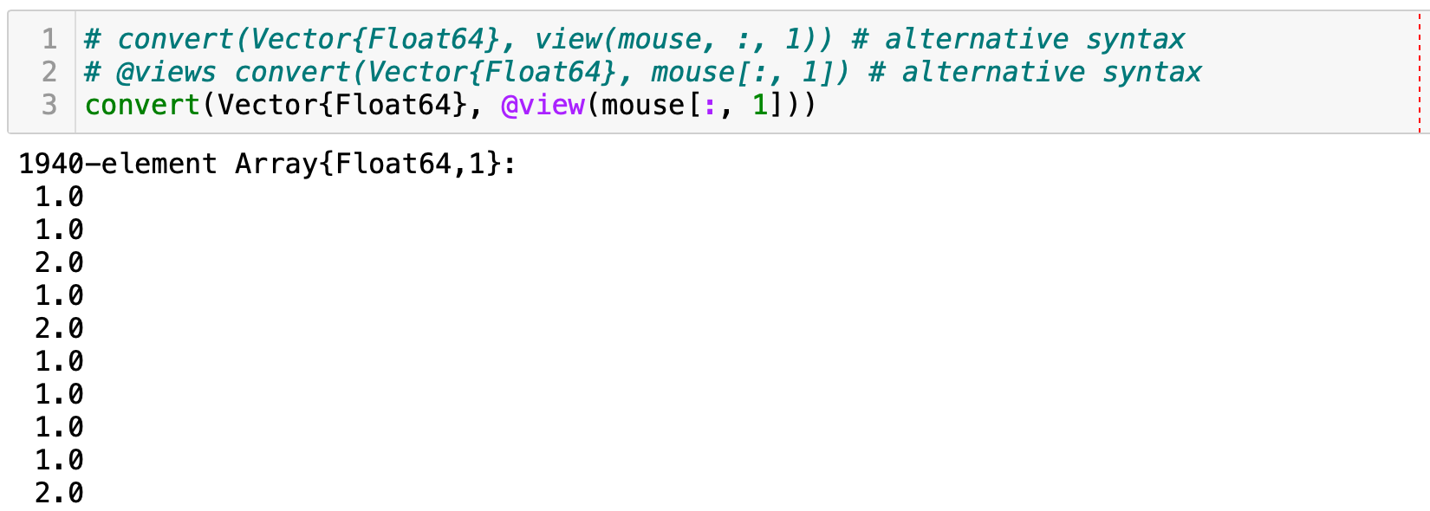
Convert a column of genotypes

Slide 8
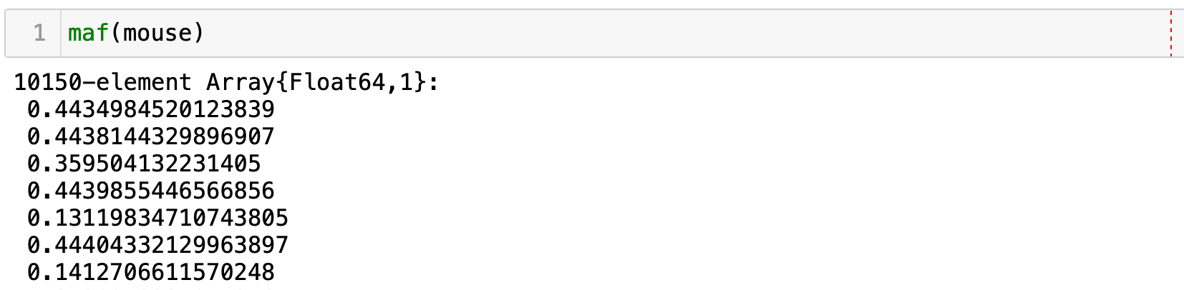
Summary statistics
Minor allele frequencies (MAF)

Slide 9
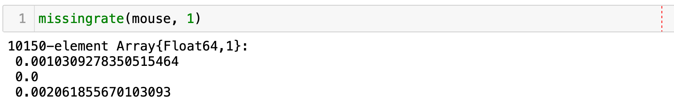
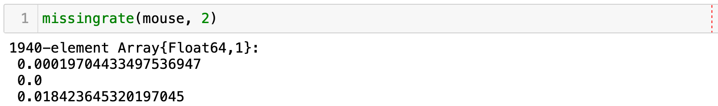
Summary statistics
Missing rate by SNP
Missing rate by individual

Slide 10
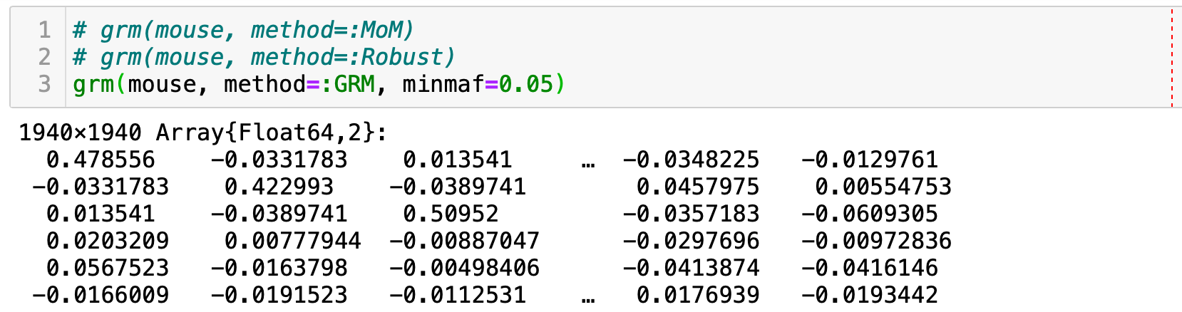
Empirical kinship matrix
SnpArrays.jl implements commonly used methods for calculating empirical kinship matrix.

Slide 11
Not covered here
Filtering
Linear algebra on SnpArray directly without converting to numerical matrix
Linear algebra on SnpArray directly on GPU
Split, concatenate, merge, and reordering of Plink files
VCF to Plink
Learn from
Package documentation: https://openmendel.github.io/SnpArrays.jl/latest/
Workshop tutorial (Binder link): https://mybinder.org/v2/gh/OpenMendel/ASHG-OpenMendelWorkshop-2020-Oct/master?filepath=04-SnpArrays-HZhou%2FSnpArraysTutorial.ipynb

Slide 12
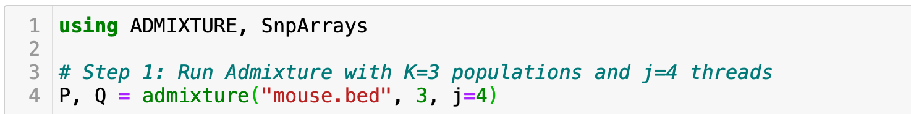
Demo: empirical kinship from admixed samples
Step 1: Run Admixture program (available on Mac and Linux) to calculate ancestry fractions (per sample) and population specific allele frequencies (per SNP)

Slide 13
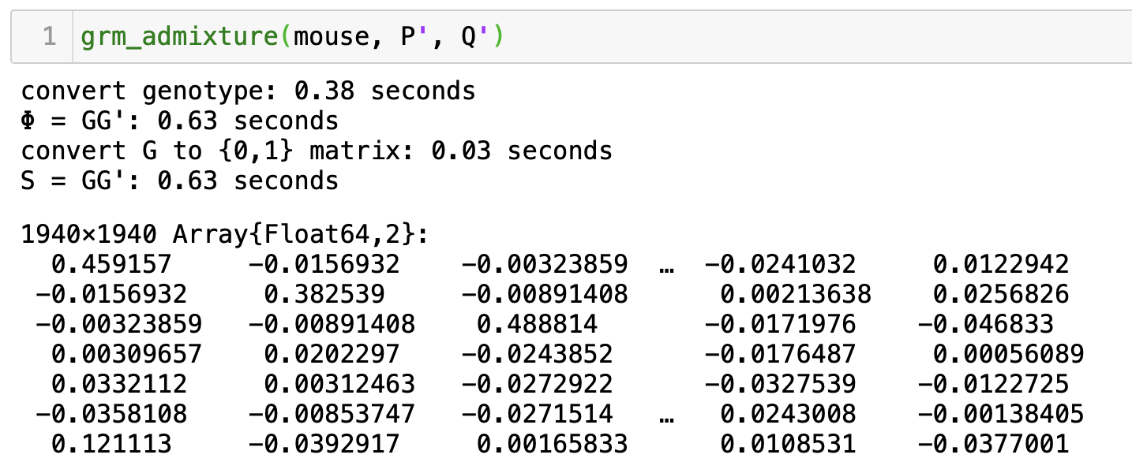
Demo: empirical kinship from admixed samples
Step 2: Use the P (allele frequencies) and Q (ancestry fractions) matrix from Admixture to compute the kinship coefficients

Slide 14
Demo: calculate empirical kinship from admixed samples
Timing results on the ACCORD data with ~6,000 individuals from 4 populations, each with ~800,000 SNPs
SnpArrays.jl takes about 6 minutes
REAP (C Program) takes about 10 hours

Slide 15
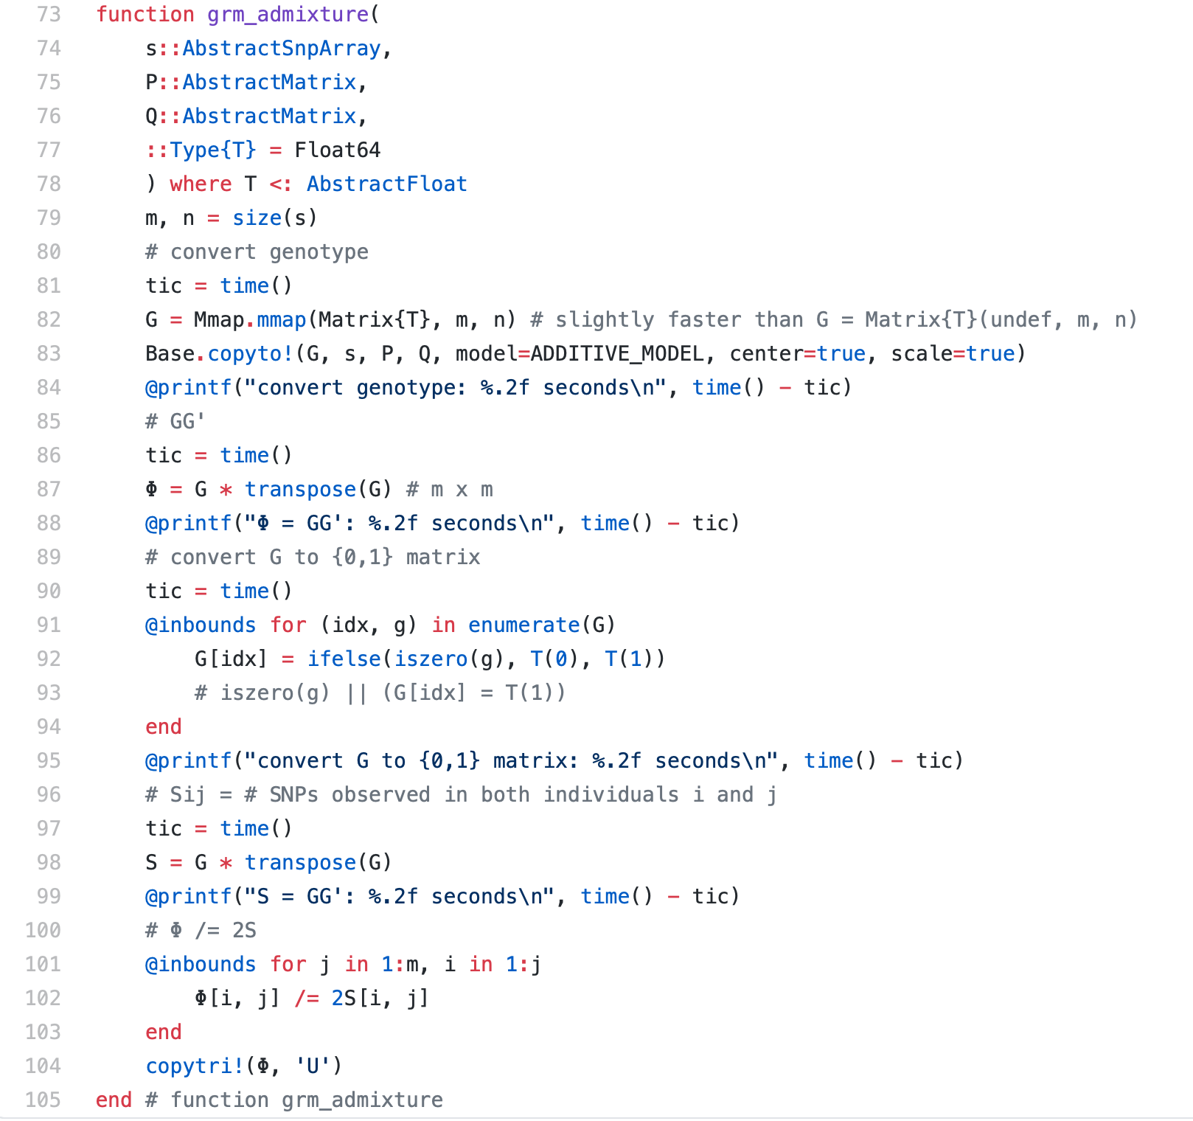
Is that easy to write Julia code?

