Slide 1

Cardiovascular Disease
AISC-1006 Steps Presentation
Group - C

Slide 2
INDEX
RECAP
TIMELINE (GANTT CHART)
DATA CORRELATION
HEATMAP
NEW DERIVED FEATURES
SCALLING
MULTICOLINEARITY
UNIVARIATE & BIVARIATE
VISUALIZATION

Slide 3
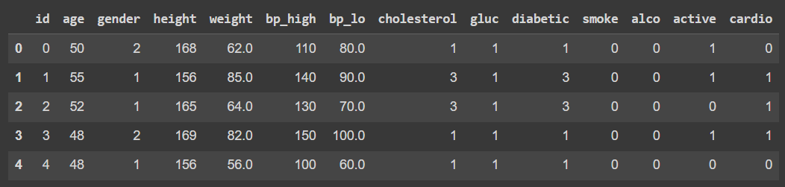
RECAP OF WORK TILL WEEK 4
DATA DESCRIPTION
DEFINED THE SCOPE OF PROJECT
DATA CLEANING
DATA EXPLORATION USING EXCEL

Slide 4

DATA CLEANING
Transformed age data from days to years.
Remove negative and out of range values from bp_high and bp_low column.
Removed improper data from height and weight column.
Found the count of categories in the gender, physical_activity, smoke.

Slide 5
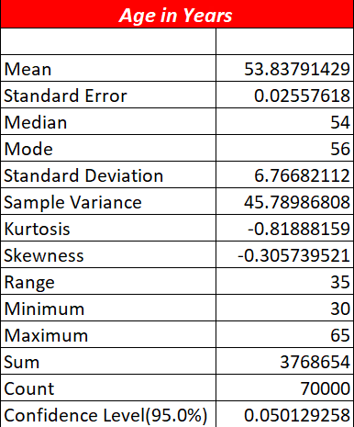
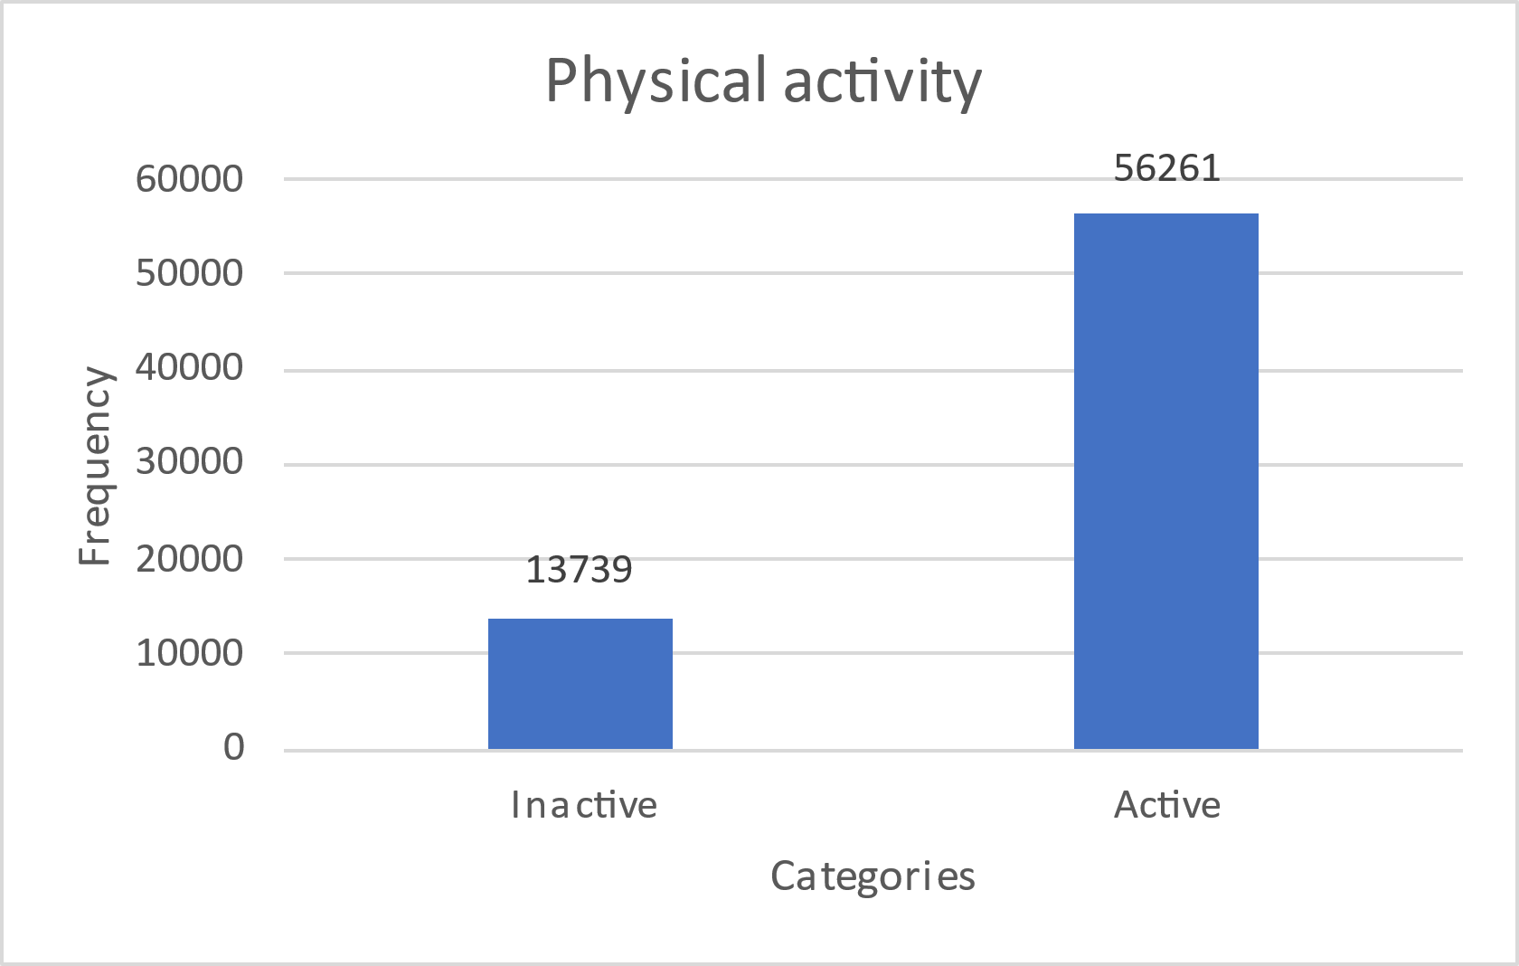
DATA EXPLORATION USING EXCEL
bp_lo
Mean | 81.30483
Standard Error | 0.035659
Median | 80
Mode | 80
Standard Deviation | 9.35758
Sample Variance | 87.56431
Kurtosis | 1.133352
Skewness | 0.273397
Range | 70
Minimum | 50
Maximum | 120
Sum | 5598976
Count | 68864
Confidence Level(95.0%) | 0.069891
Height
Statistics
Mean | 164.390911
Standard Error | 0.030278616
Median | 165
Mode | 165
Standard Deviation | 8.009538055
Sample Variance | 64.15269985
Kurtosis | 1.64223798
Skewness | -0.123534264
Range | 116
Minimum | 91
Maximum | 207
Sum | 11503254
Count | 69975
Largest(1) | 207
Smallest(1) | 91
Confidence Level(95.0%) | 0.059346023
Gender
Basic Stats
Column1 | Column2
Mean | 127.0027805
Standard Error | 0.054464311
Median | 120
Mode | 120
Standard Deviation | 14.38631247
Sample Variance | 206.9659864
Kurtosis | 1.779239087
Skewness | 0.915525609
Range | 170
Minimum | 70
Maximum | 240
Sum | 8861111
Count | 69771
Person Who Smoke (1)
 | Count | 6169
 | Percentage | 8.81
Person Who Doesn't Smoke (0) | Count | 63832
 | Percentage | 91.18

Slide 6
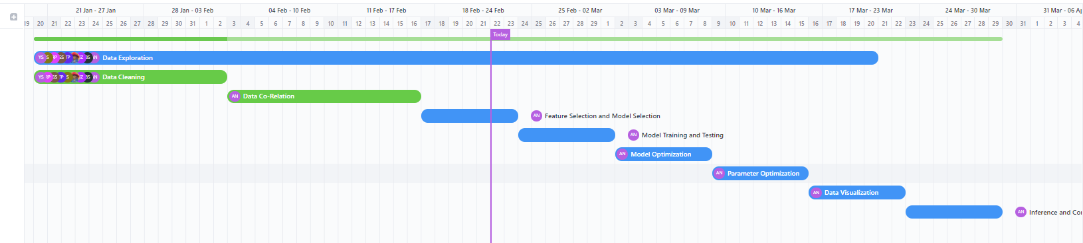
GANTT CHART

Slide 7
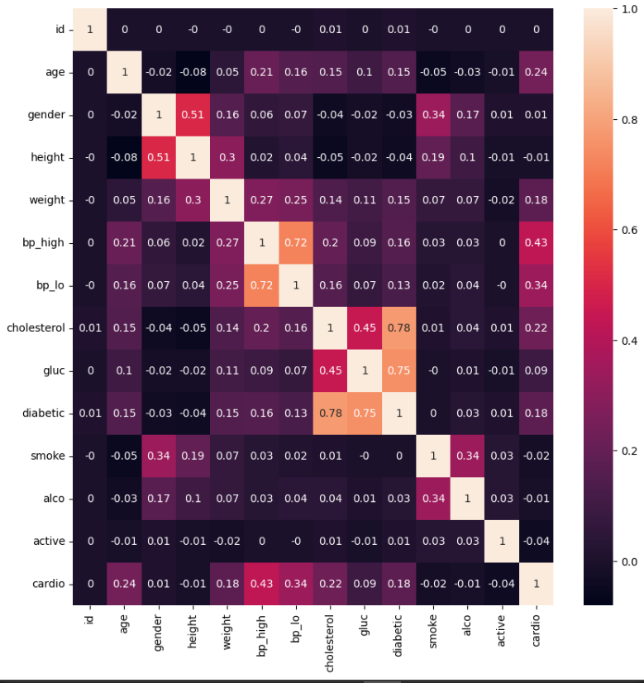
DATA CORRELATION
Calculated the correlation with heatmap of complete dataset.
Correlated target variable with :
bp_high
bp_lo
Weight
Alco
cholesterol
gluc
Diabetic
BMI

Slide 8
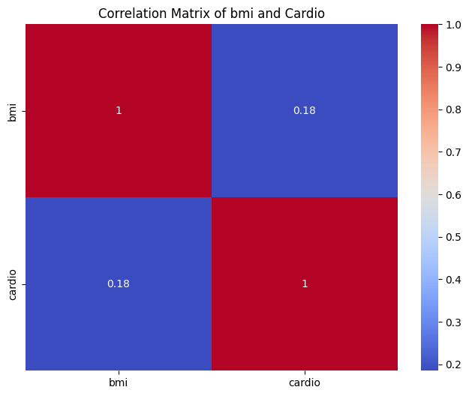
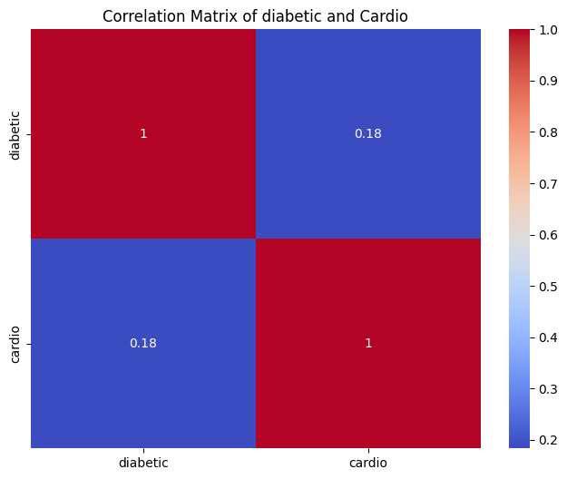
HEATMAP

Slide 9
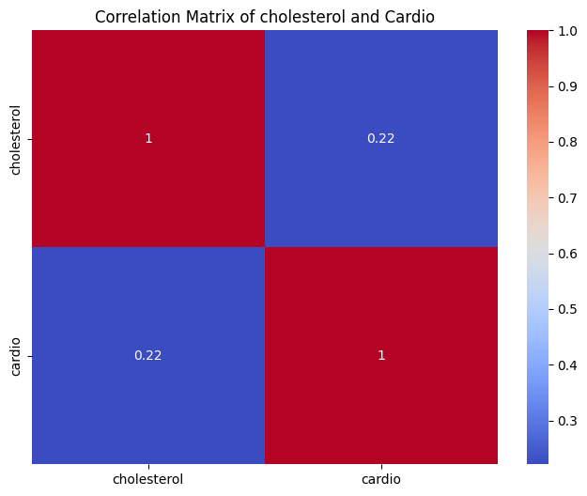

HEATMAP

Slide 10

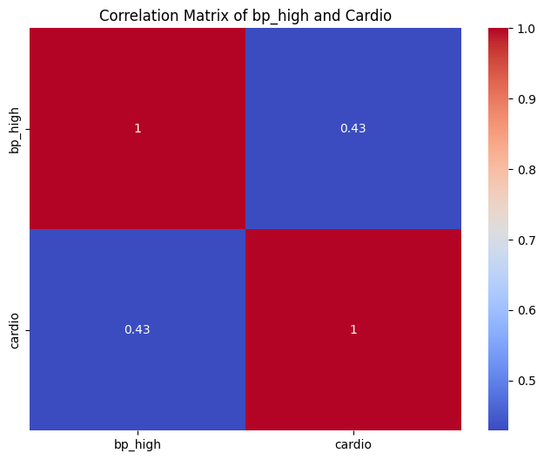
HEATMAP

Slide 11
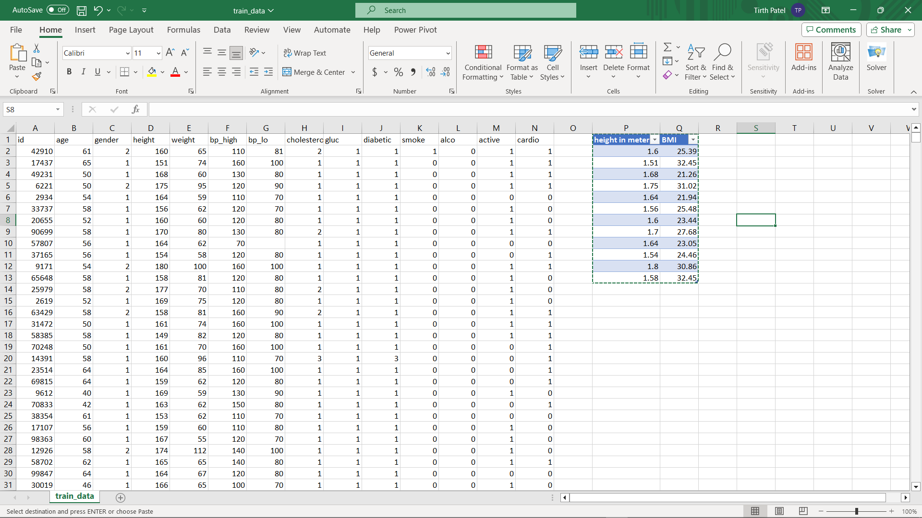
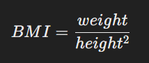
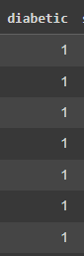
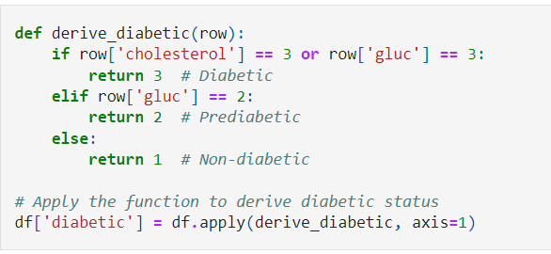
NEW DERIVIED FEATURES
Here we derived BMI from height and weight
Derived Diabetic column from cholesterol and gluc column

Slide 12
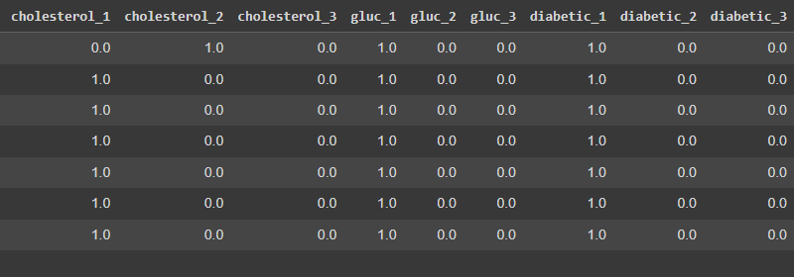
SCALING
Scaled few columns like cholesterol, glucose and diabetic with the help of Min-Max Scaling.
9 new features.

Slide 13
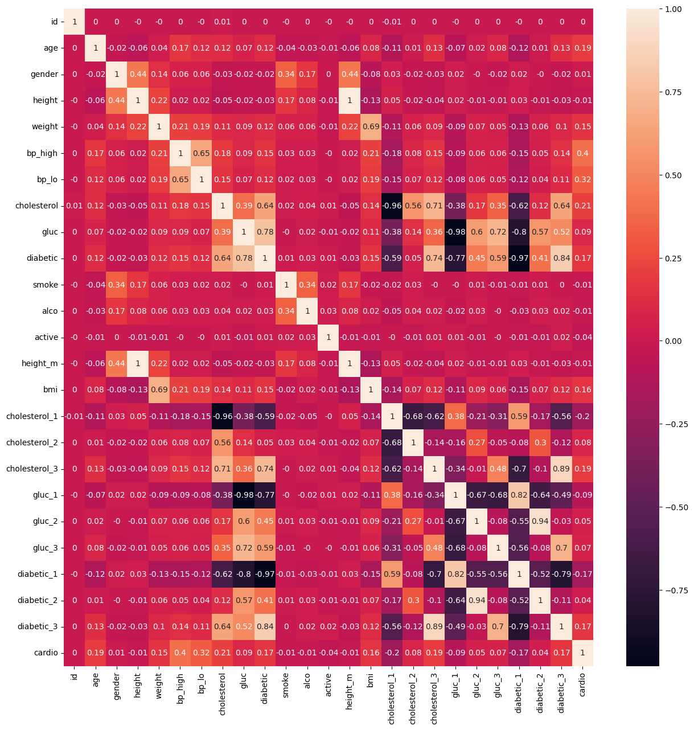
MULTICOLLINEARITY
What is multicollinearity???
Calculated Multicollinearity with the 3 methods
Pearson
Spearman
Kendall
Kendall is perfect for our model.
Can use for large dataset, doesn’t get influence by anomalies (outliers), works better with ordinal data set.

Slide 14
UNIVARIATE & BIVARIATE
Univariate analysis :
What is univariate?
Reason of using this method.
Distribute and characteristics of individual variable
Identifying outliers
Insight into independent variable behavior
Helping in feature selection
Enhancing model performance
Created boxplot for numerical data
Histogram for binary data

Slide 15
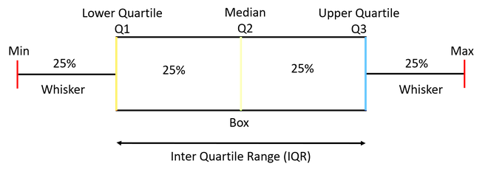
USE OF BOXPLOT & HISTOGRAM
Using Boxplot
To know outliers
Skewness
IQR or Median
Using Histogram
Used for plotting feature with binary values
To know frequency and spread of data

Slide 16
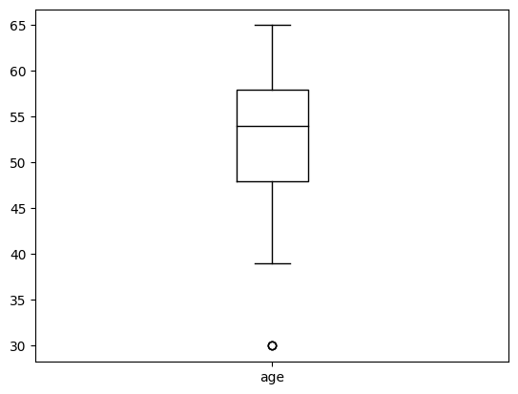
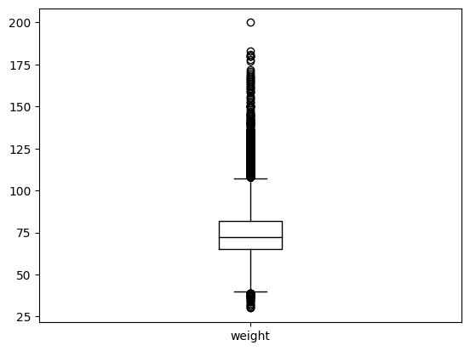
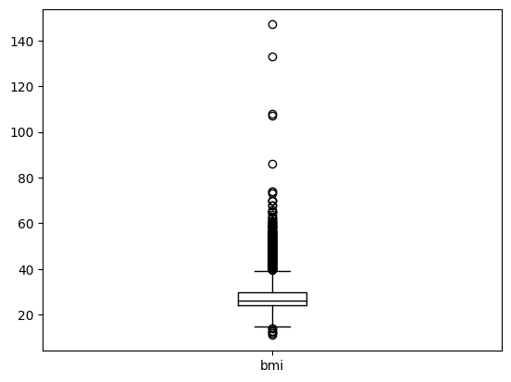
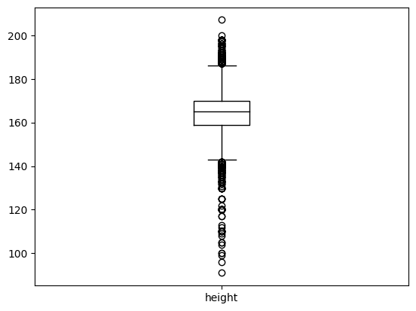
VISUALIZATION (Univariate)

Slide 17
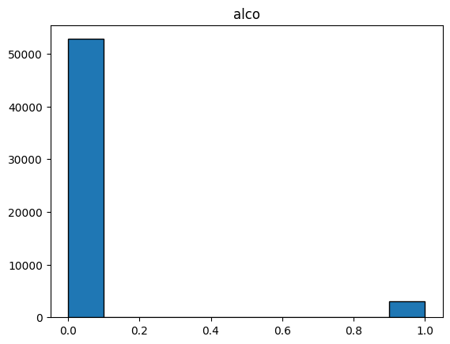
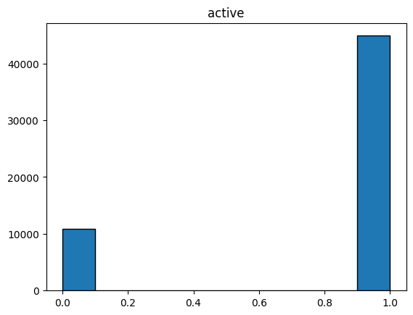
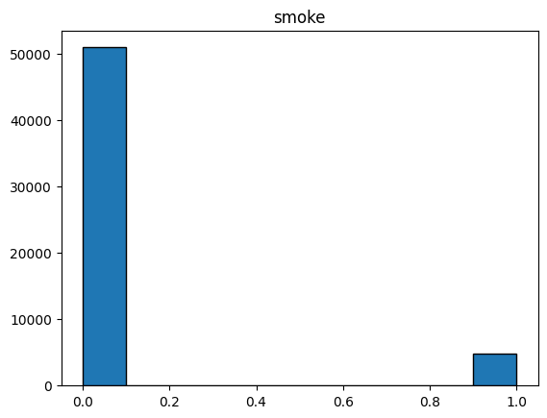
VISUALIZATION (Univariate)

Slide 18
UNIVARIATE & BIVARIATE
Bivariate analysis :
Reason of using this method
Explore relation between two variables
Changes in variable affects another variable
Helping in feature selection
Enhancing model performance
Divide data into numerical, categorical and binary.
Boxplot for numerical (height, weight, age, bp_high/lo)
Scatter and stacked for categorical
Stacked for binary (alco, smoke)

Slide 19
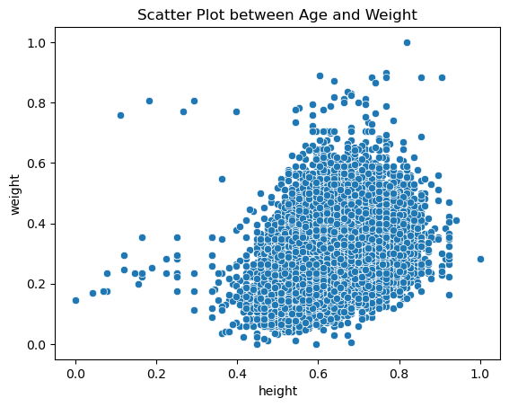
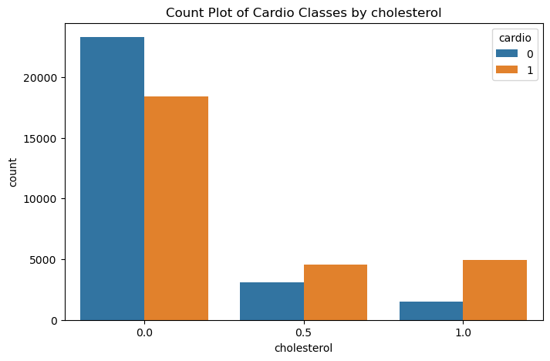
VISUALIZATION (Bivariate)

Slide 20
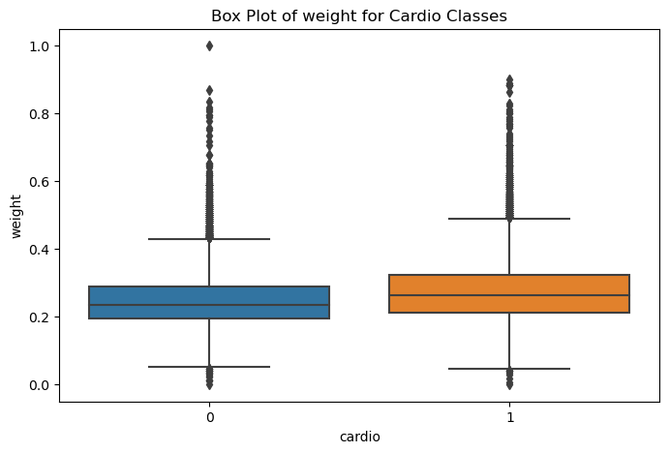
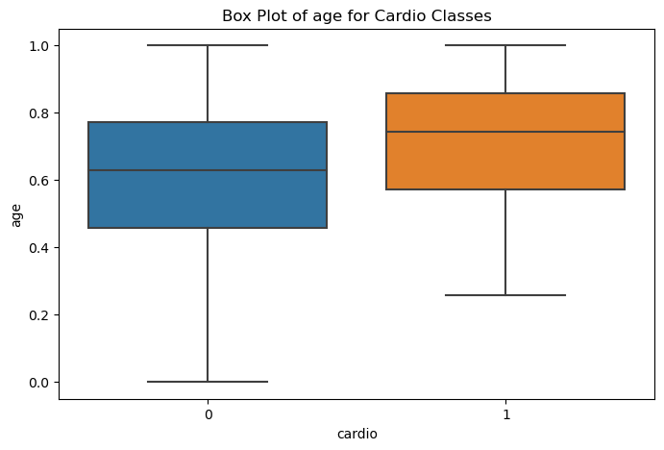
VISUALIZATION (Bivariate)

Slide 21
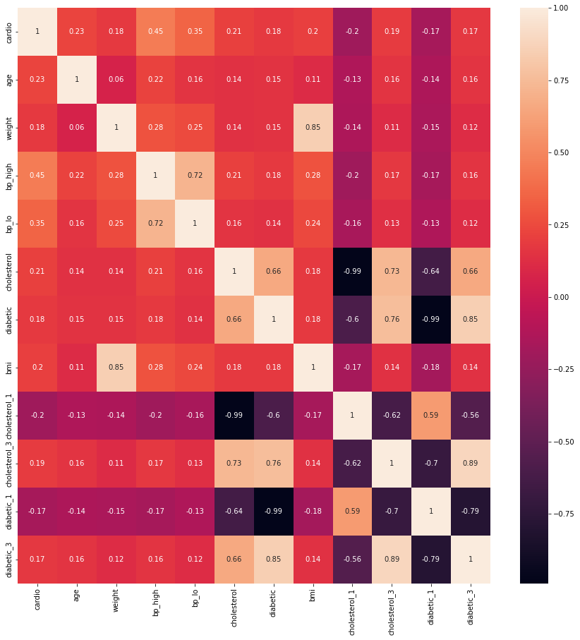
FEATURE SELECTION
Selected Features:
Age
Weight
Bp_high
Bp_lo
Cholesterol
Diabetics
Bmi
Cholesterol_1
Cholesterol_3
Diabetics_1
Diabetics_3

Slide 22

Thank You

