Slide 1
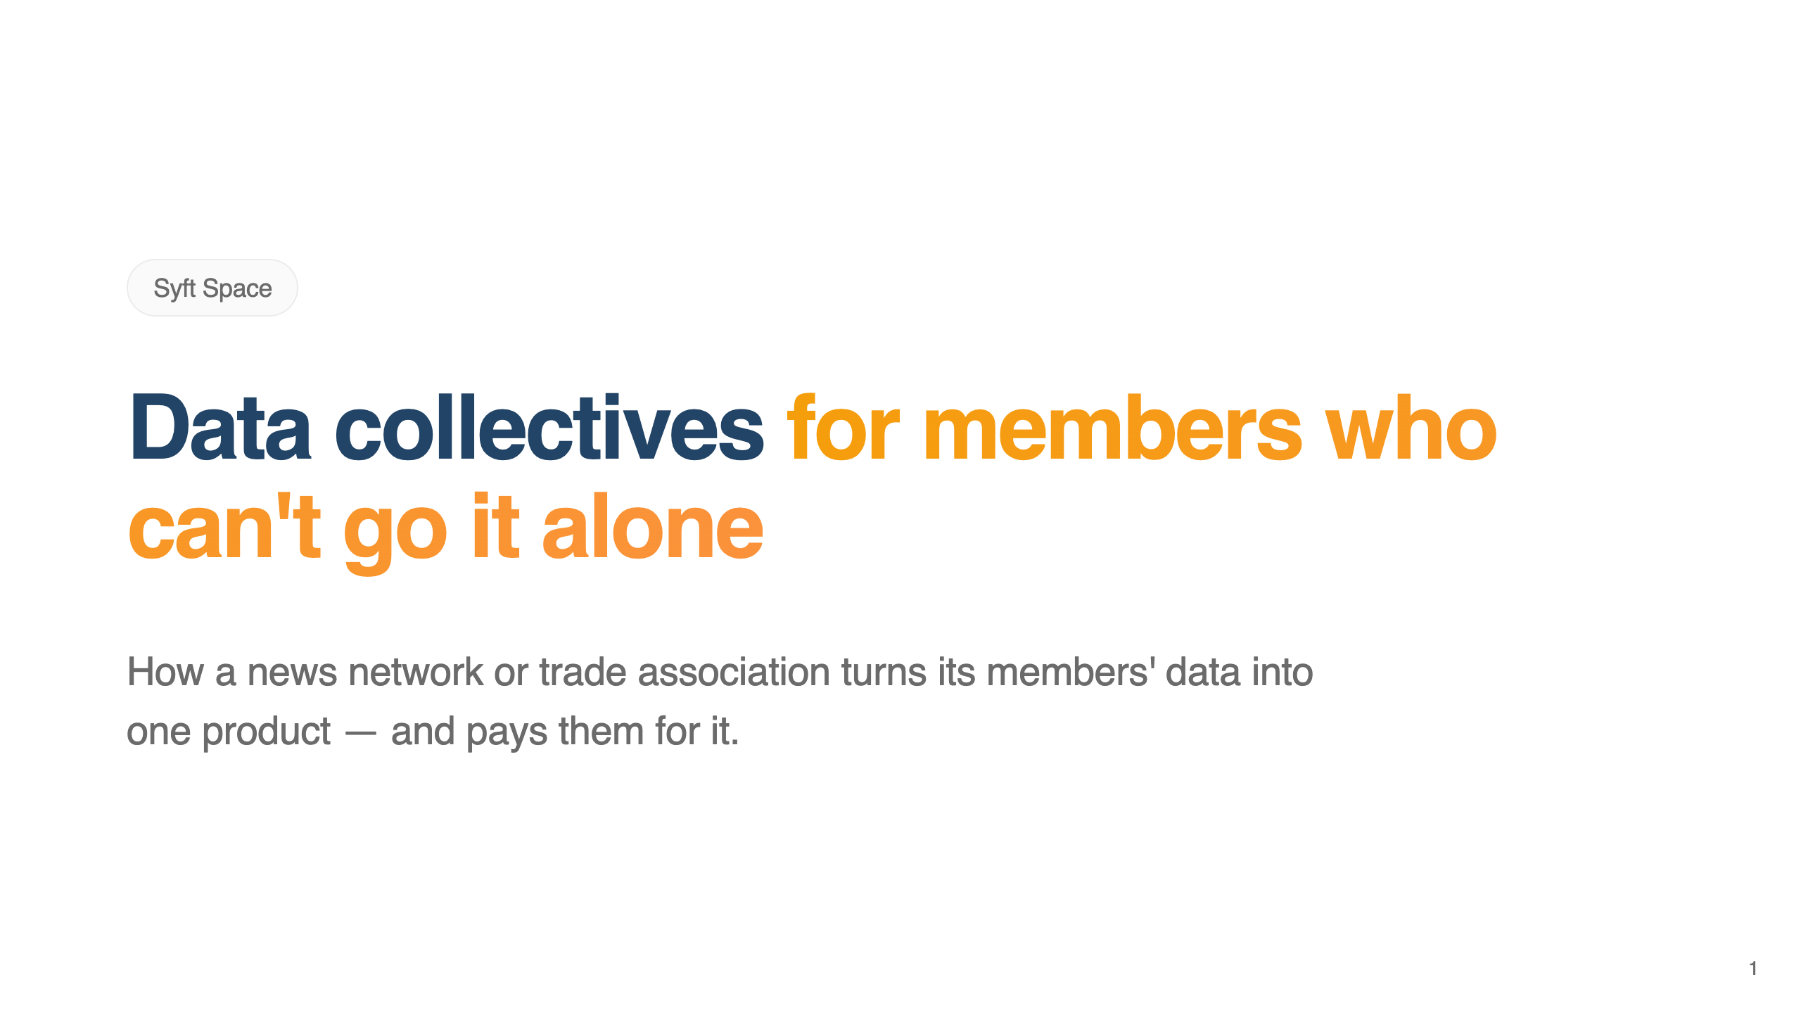

Slide 2
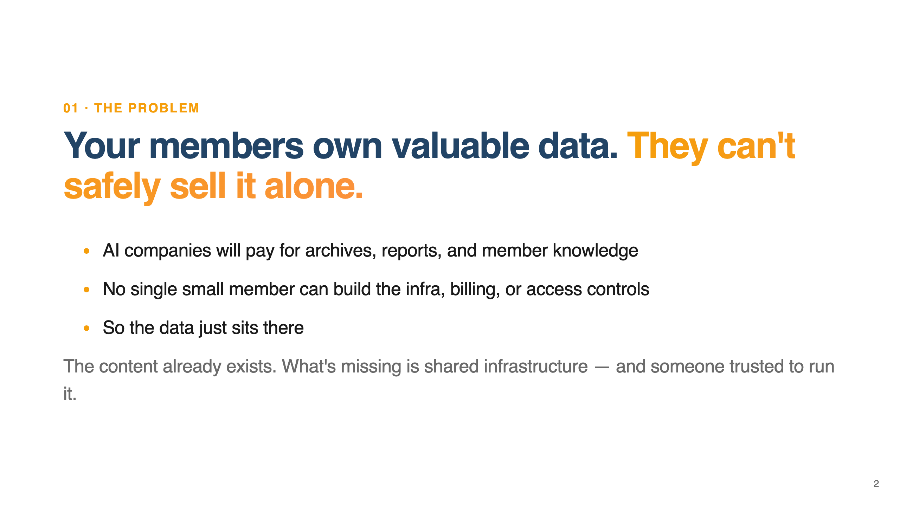
Notes:
THE PROBLEM. Say this: Every one of your members is sitting on something AI companies want to pay for. A newsroom has twenty years of archives. A trade association has decades of reports, standards, and member submissions. The demand is real and the money is real. But no single small member can build the infrastructure, set up billing, enforce who's allowed to use the data, and feel legally safe doing it. So the data just sits there. The content exists — what's missing is shared infrastructure and someone trusted to run it.

Slide 3
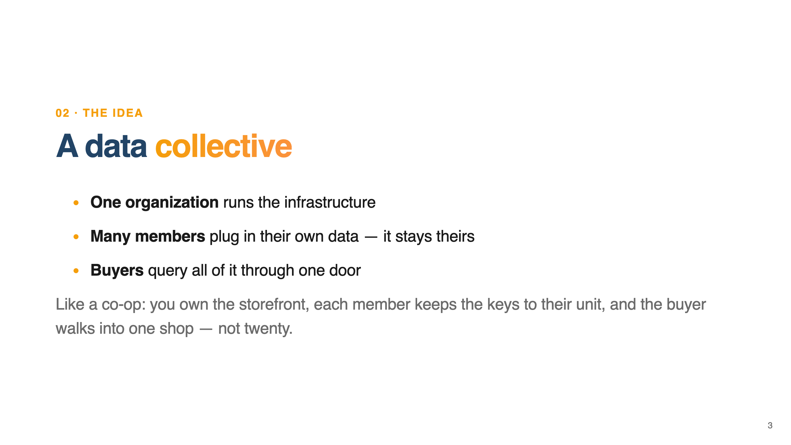
Notes:
THE IDEA. Say this: The idea is simple. One organization — you — runs a single system. Each member connects their own data to it, and their data stays theirs. Together those members add up to something a buyer can actually use: one place to query everyone's content at once. Think of it like a co-op. You own the building and the storefront. Each member keeps the keys to their own unit. The buyer walks into one shop instead of negotiating with twenty separate sellers.

Slide 4
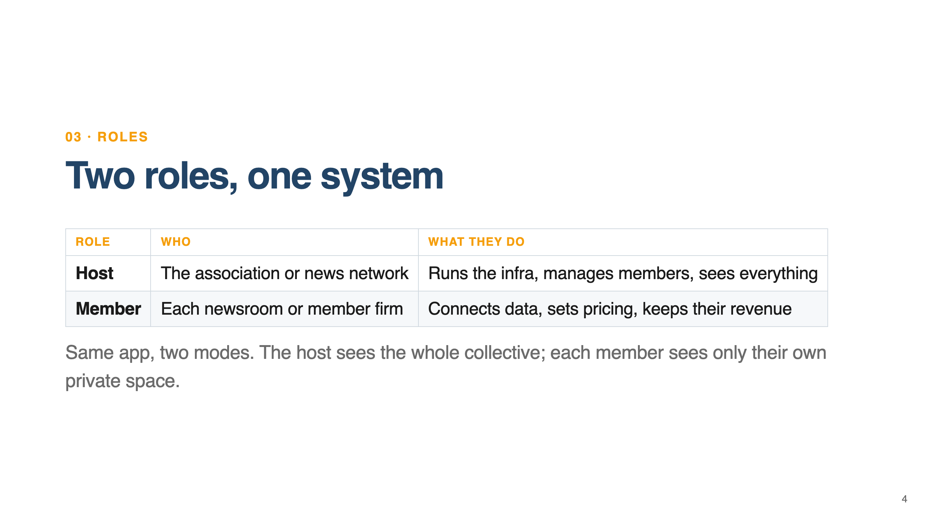
Notes:
TWO ROLES. Say this: There are exactly two roles. The host — that's you, the association or the news network — runs the infrastructure and oversees the whole collective. The members are your tenants: each one gets a normal, private workspace that just happens to live on your system. It's the same application either way. When you log in as the host, you see across the entire collective. When a member logs in, they only see their own space. No member ever sees another member's data.

Slide 5
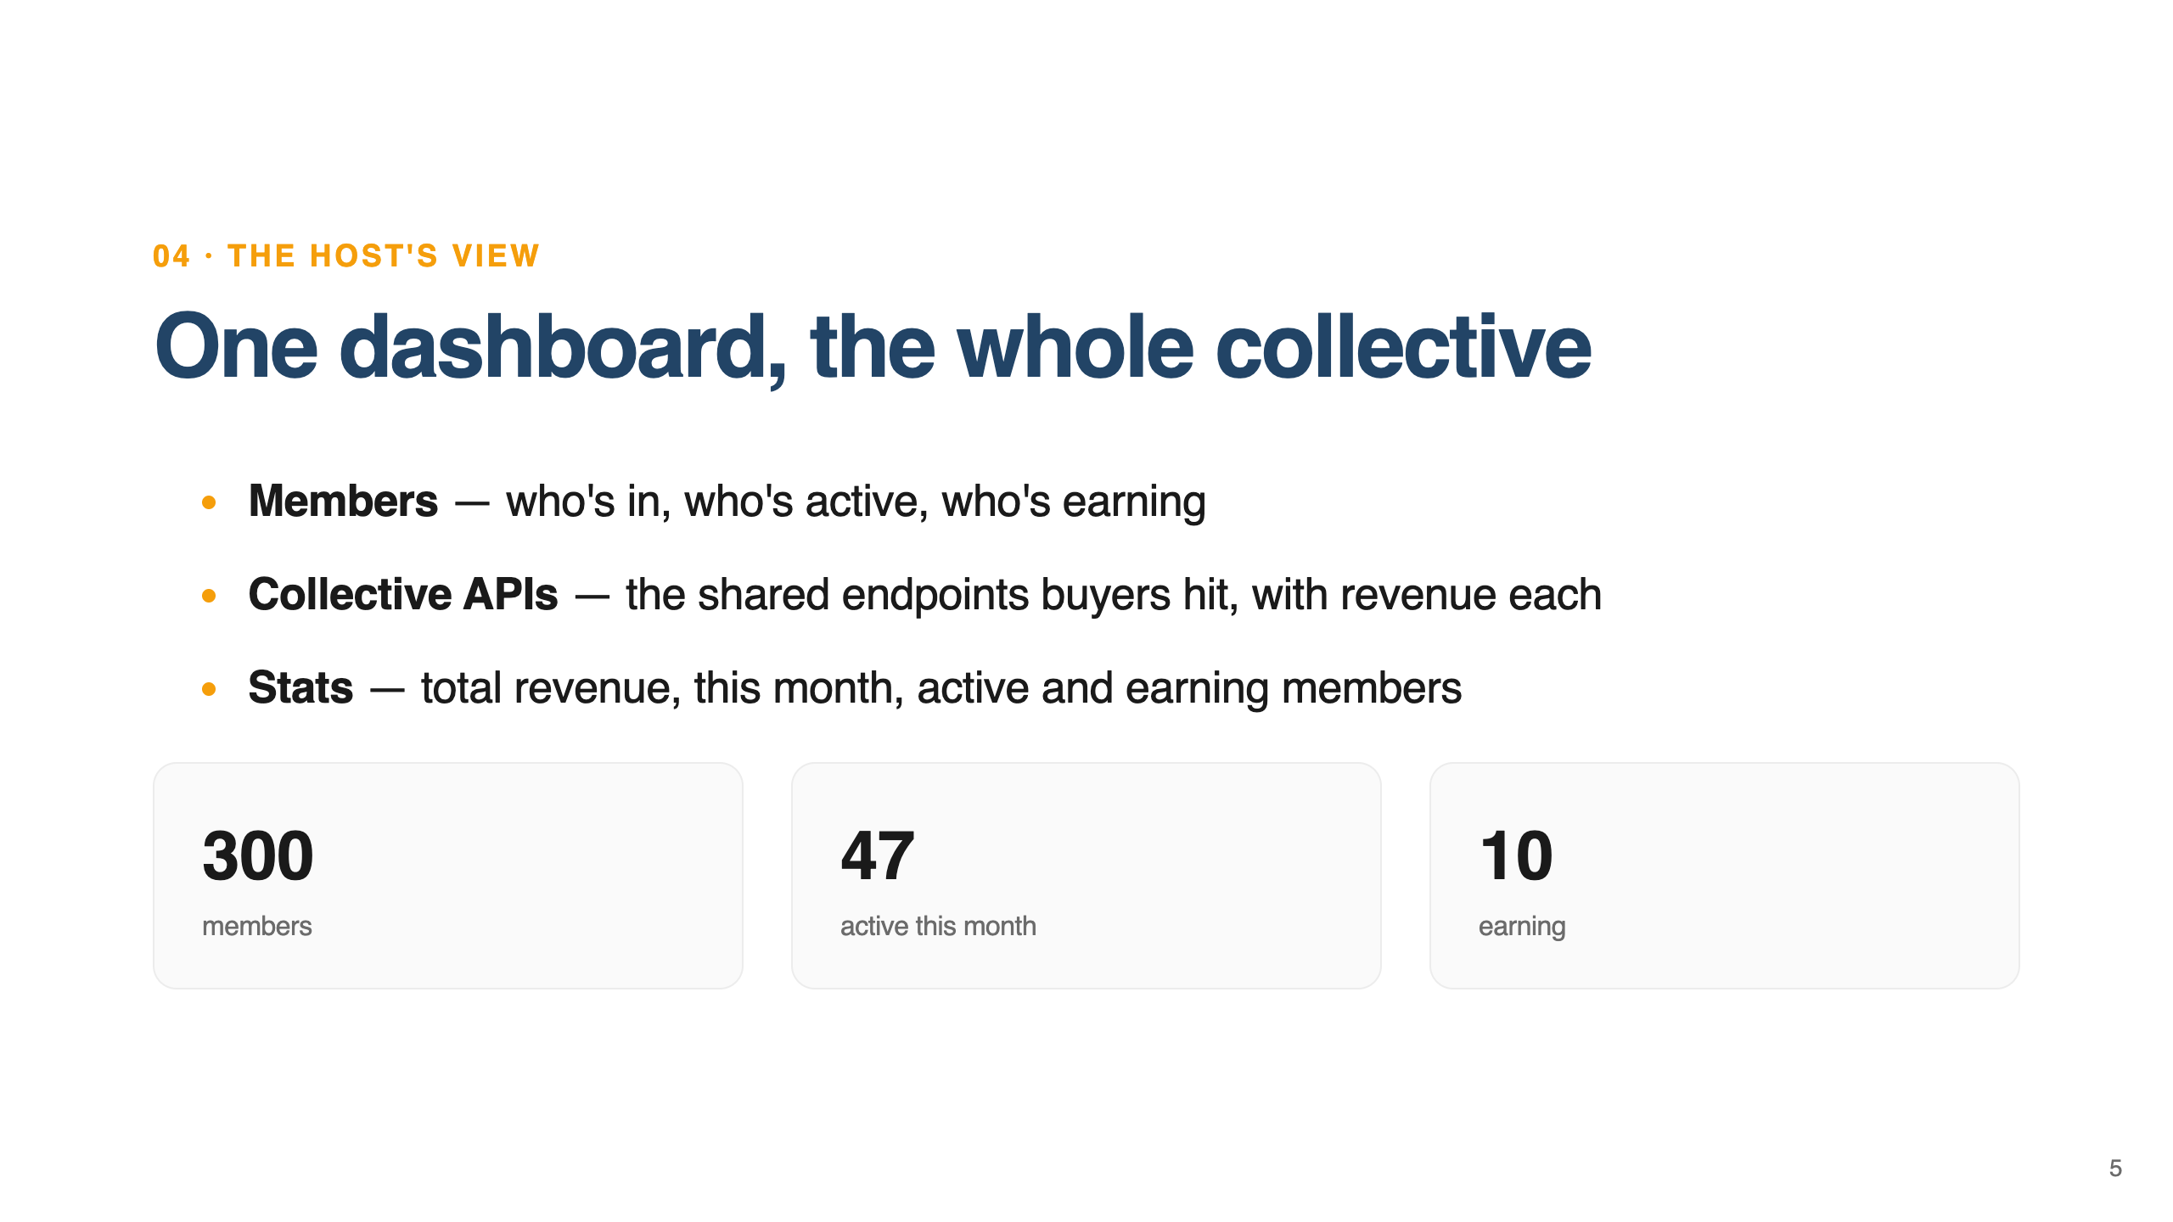
Notes:
WHAT THE HOST SEES. Say this: As the host, you get one dashboard for the whole collective. You see your members — who's joined, who's active this month, who's actually earning. You see the collective APIs, the shared endpoints buyers query, each with its own revenue and traffic. And you see the money: total revenue, revenue this month, how many members are active, how many are earning. In our demo that's three hundred members, forty-seven active, ten earning. One toggle flips you between this collective-wide view and your own private workspace.

Slide 6
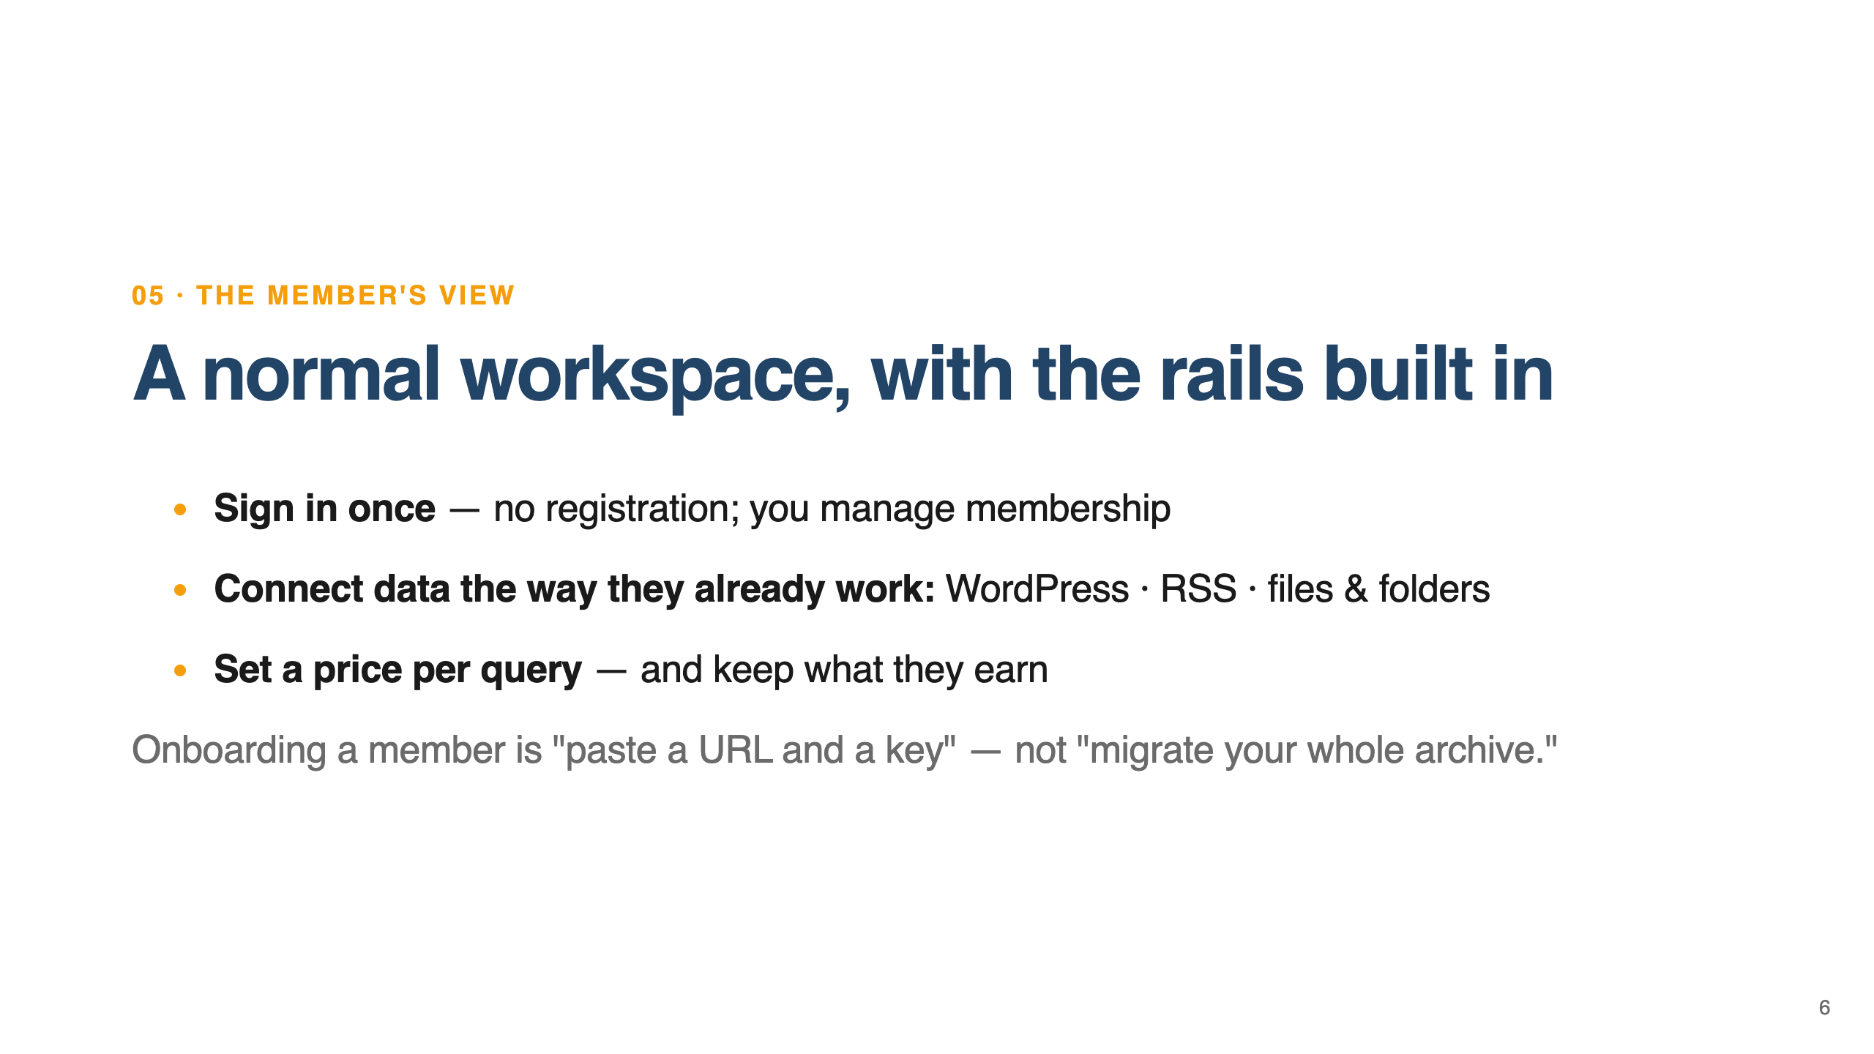
Notes:
WHAT A MEMBER SEES. Say this: A member's experience is deliberately boring — in a good way. They sign in once with a key; there's nothing to register, because you control who's a member. Then they connect their data the way they already work. A newsroom points it at their WordPress site and the posts sync in. They add an RSS feed and new articles flow in as they publish. Or they just upload archives and PDFs. They set a price per query, and they keep what they earn. Onboarding a member is "paste a URL and a key" — not "migrate your whole archive."

Slide 7
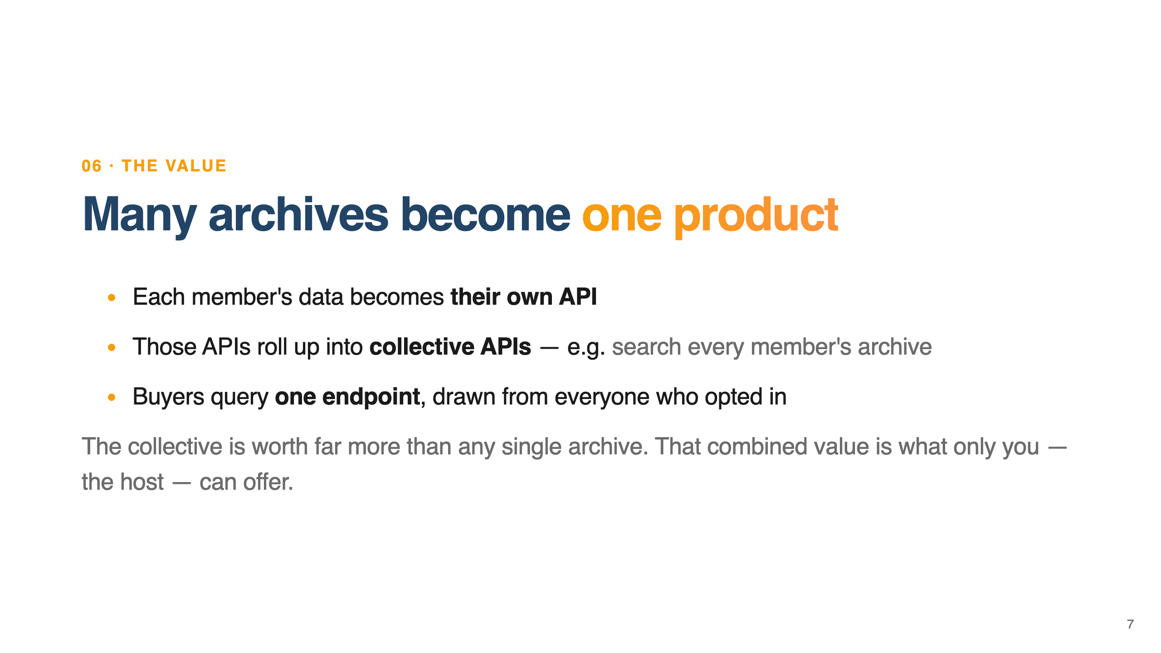
Notes:
ONE PRODUCT. Say this: Here's the part that makes it valuable. Each member's data becomes their own small API. The system rolls those individual APIs up into collective APIs — for example, "search every member's archive" or "retrieve documents across the whole network." The buyer never talks to twenty members. They query one endpoint and get answers drawn from everyone who opted in. The collective is worth far more than any single member's data, and that combined value is exactly what you can offer because you're the one running it.

Slide 8
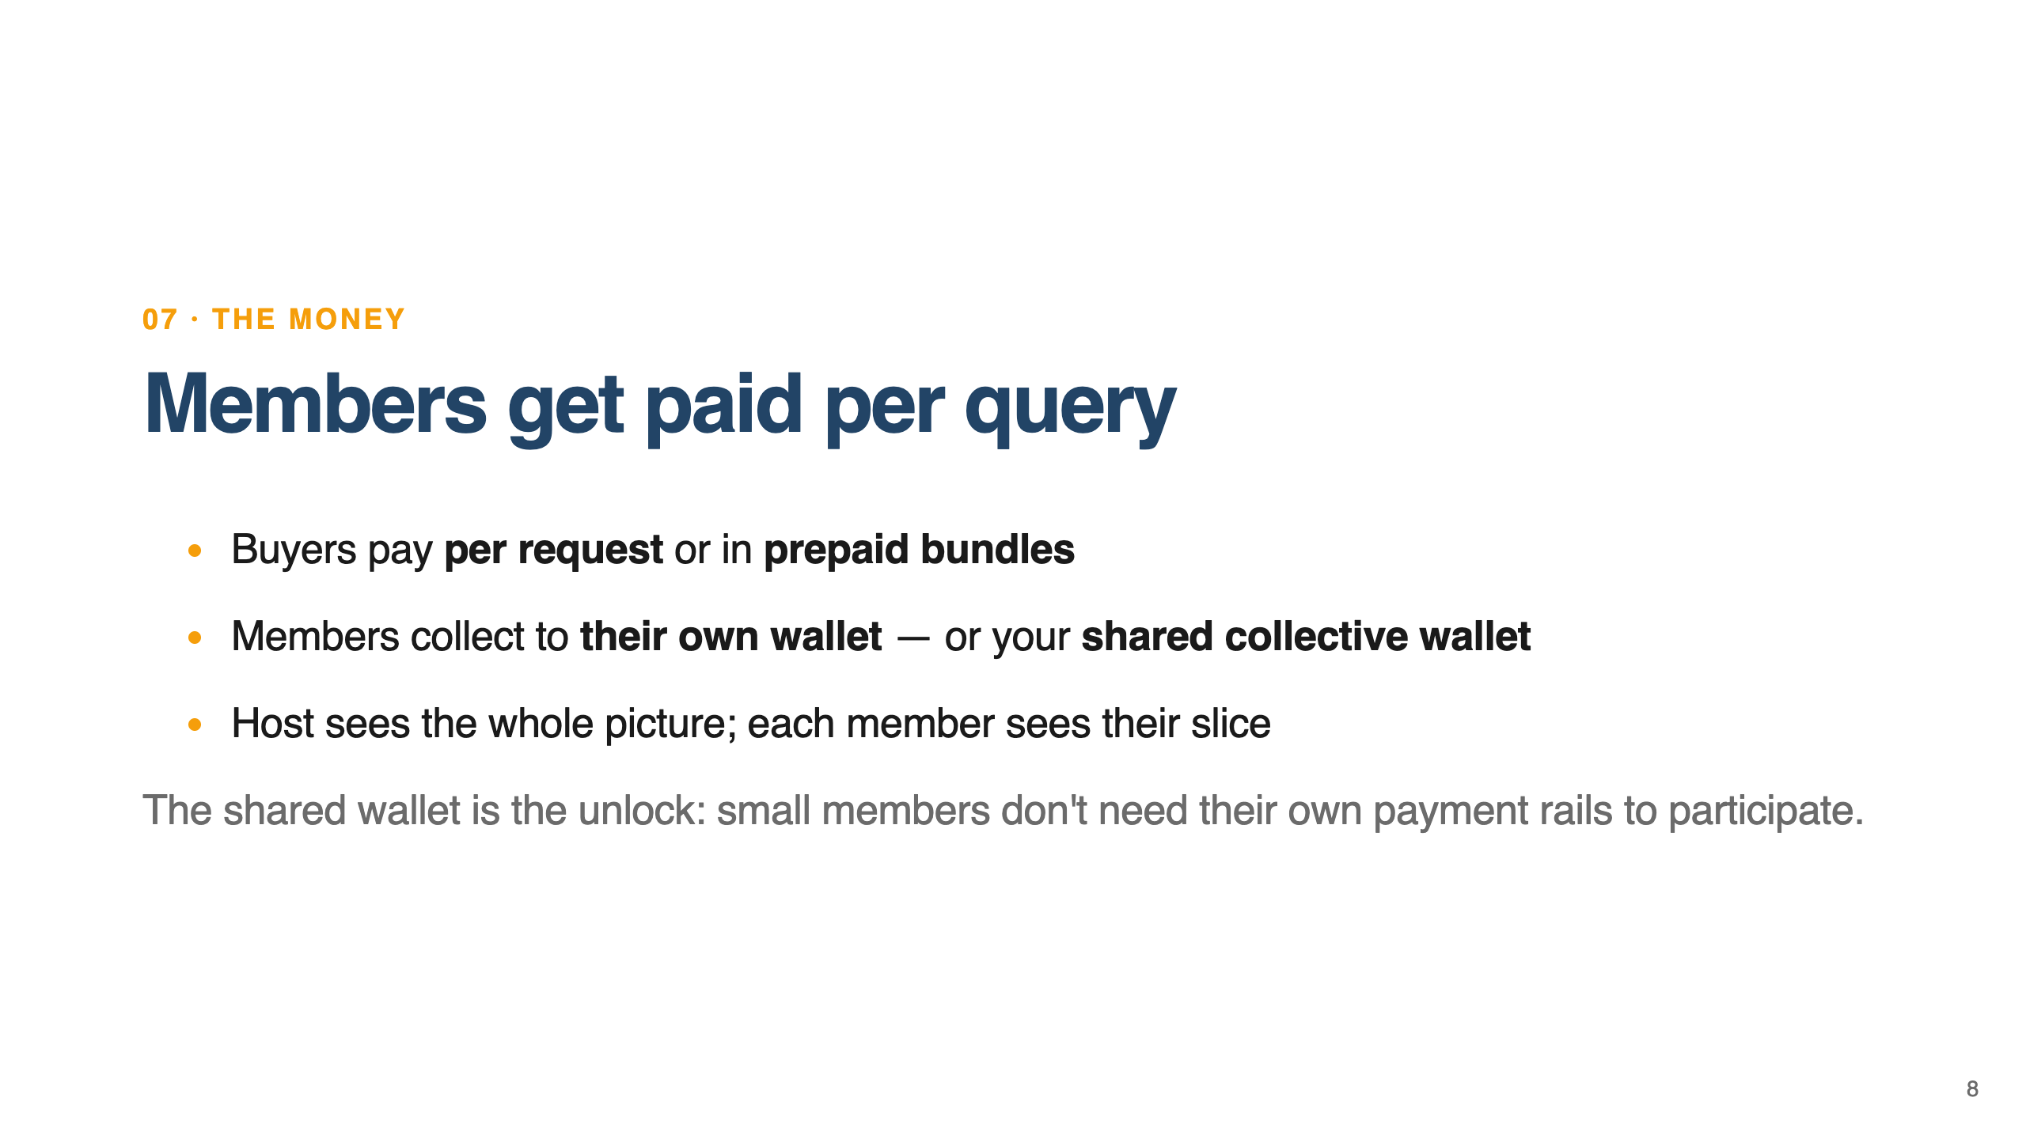
Notes:
MONEY. Say this: Money is per use. A buyer either pays a tiny amount per request, or buys a bundle up front. Every member decides where their share lands. A member who has their own payment setup uses their own wallet. A member who doesn't want to deal with that can route their earnings straight to a shared collective wallet you provide. That's the thing that unblocks small members — they don't need their own payment rails to participate. You see the full revenue picture; each member sees their own slice.

Slide 9
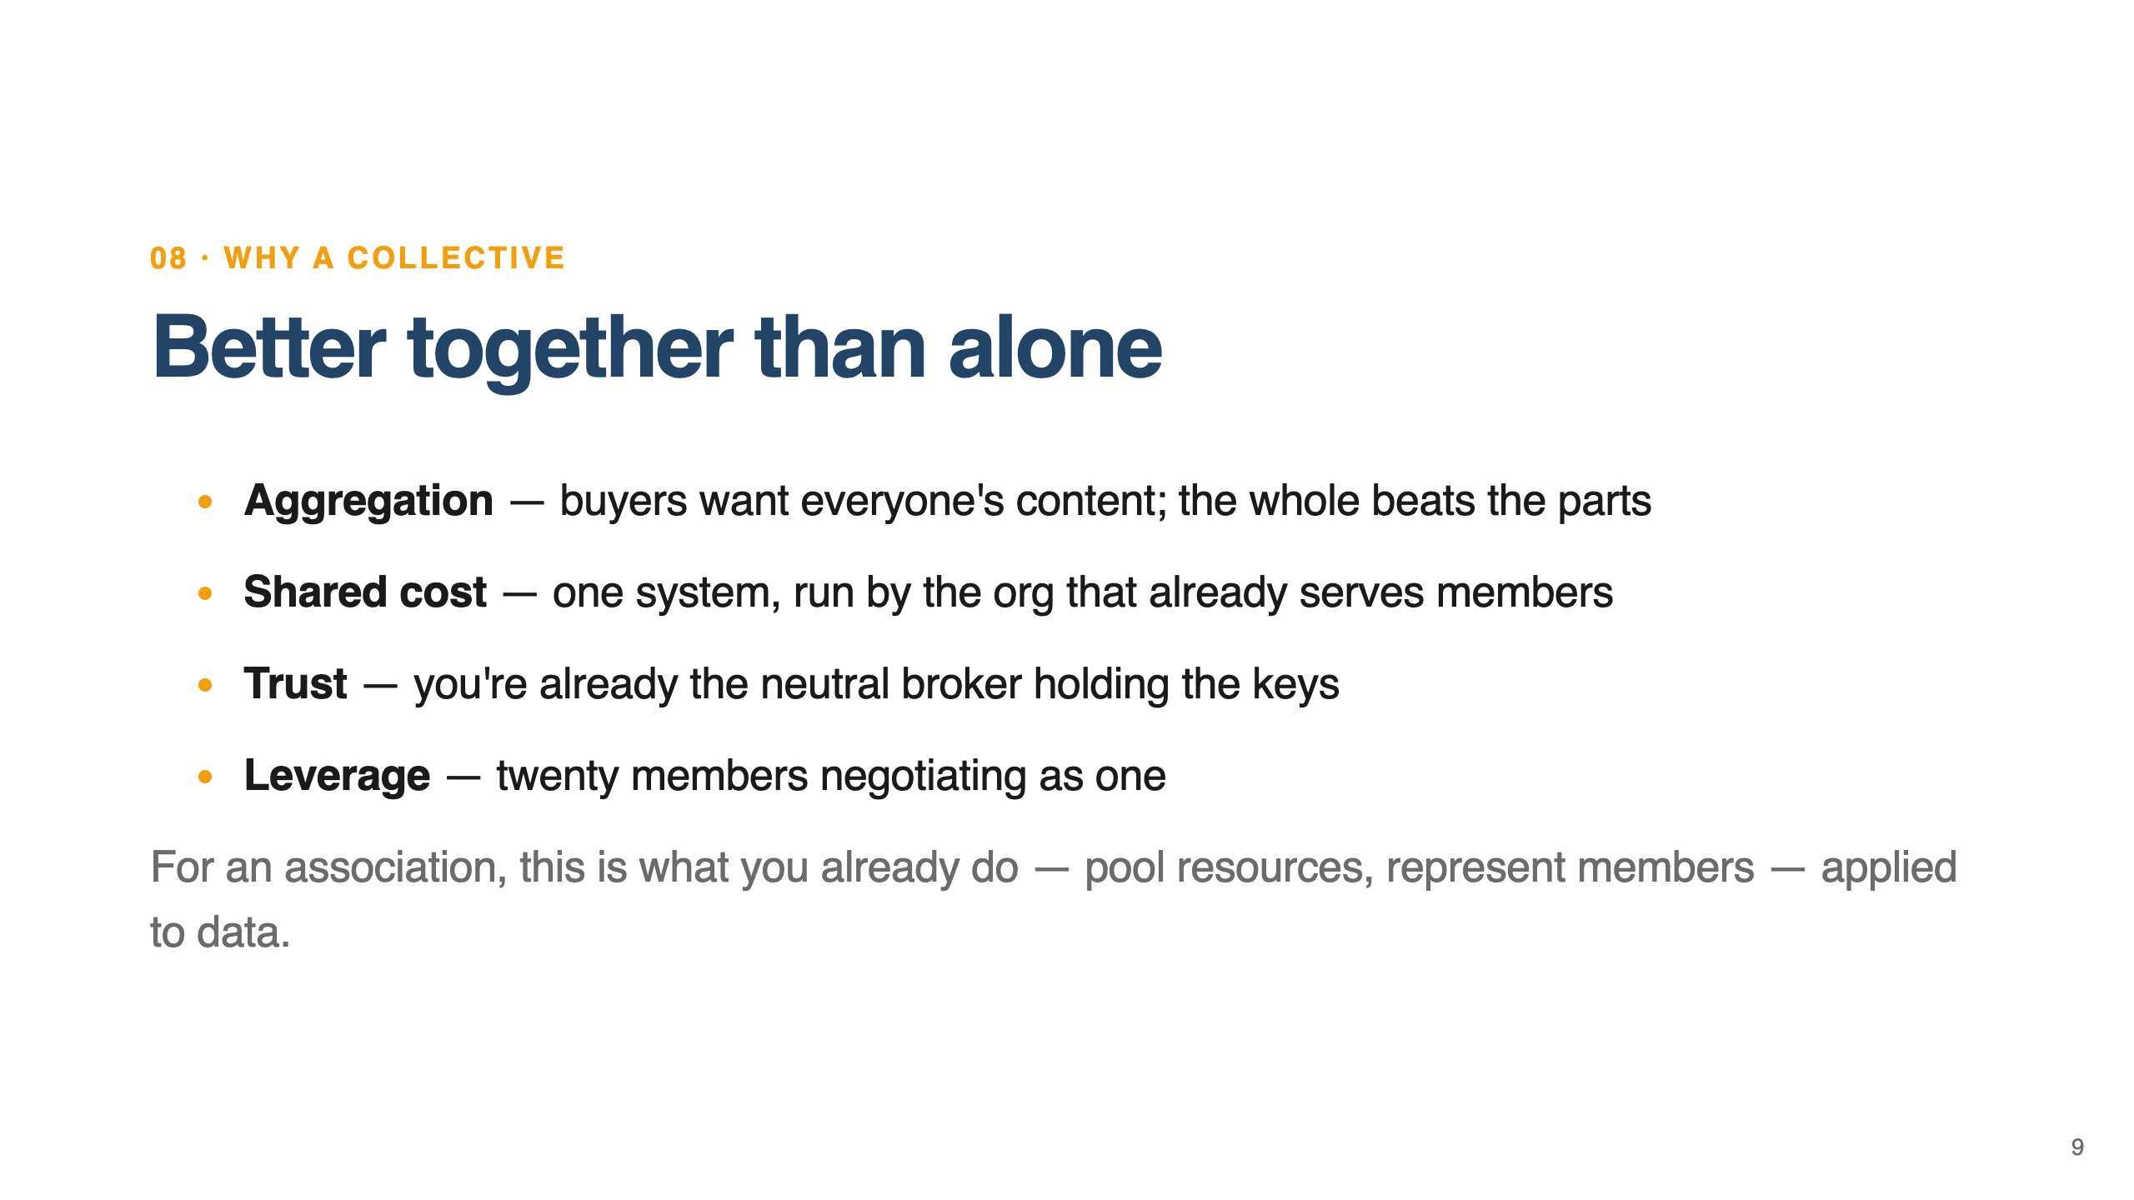
Notes:
WHY TOGETHER. Say this: Why do this together instead of everyone for themselves? Four reasons. First, aggregation: buyers want everyone's content, not one archive, so the whole is worth more than the parts. Second, cost: one system, one gateway, one billing setup, run by the organization that already serves the members. Third, trust: you're already the neutral party your members rely on — holding the keys and splitting revenue fairly is a natural extension of that. Fourth, leverage: twenty members negotiating as one have real bargaining power. For an association, this is just what you already do — pool resources and represent members collectively — applied to data.

Slide 10
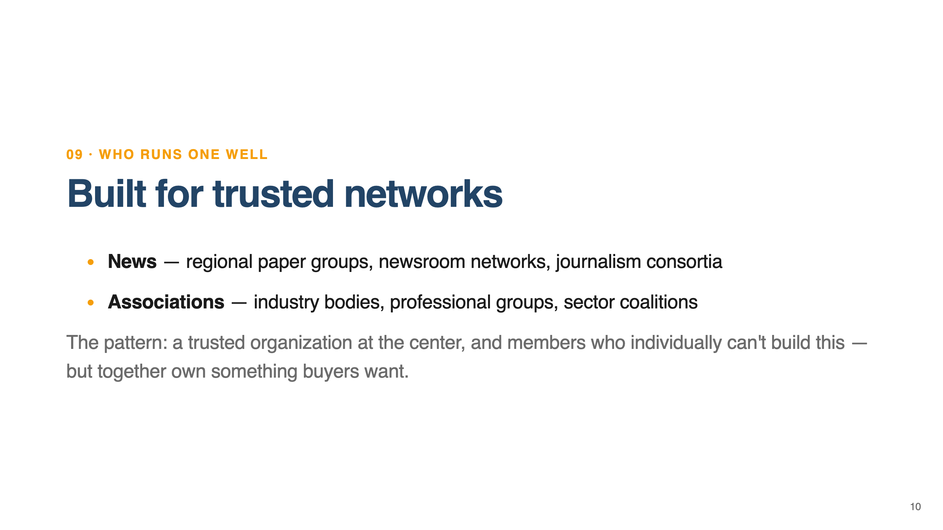
Notes:
WHO. Say this: Who is this for? On the news side: regional newspaper groups pooling archives, independent newsroom networks sharing investigative work, public-interest journalism consortia. On the association side: industry bodies with decades of reports, professional groups with member-contributed knowledge, sector coalitions where each member holds one piece of a valuable whole. The pattern is always the same — a trusted organization at the center, and members who individually can't build this, but together own something buyers want. If that describes you, you're exactly who this was built for.

Slide 11
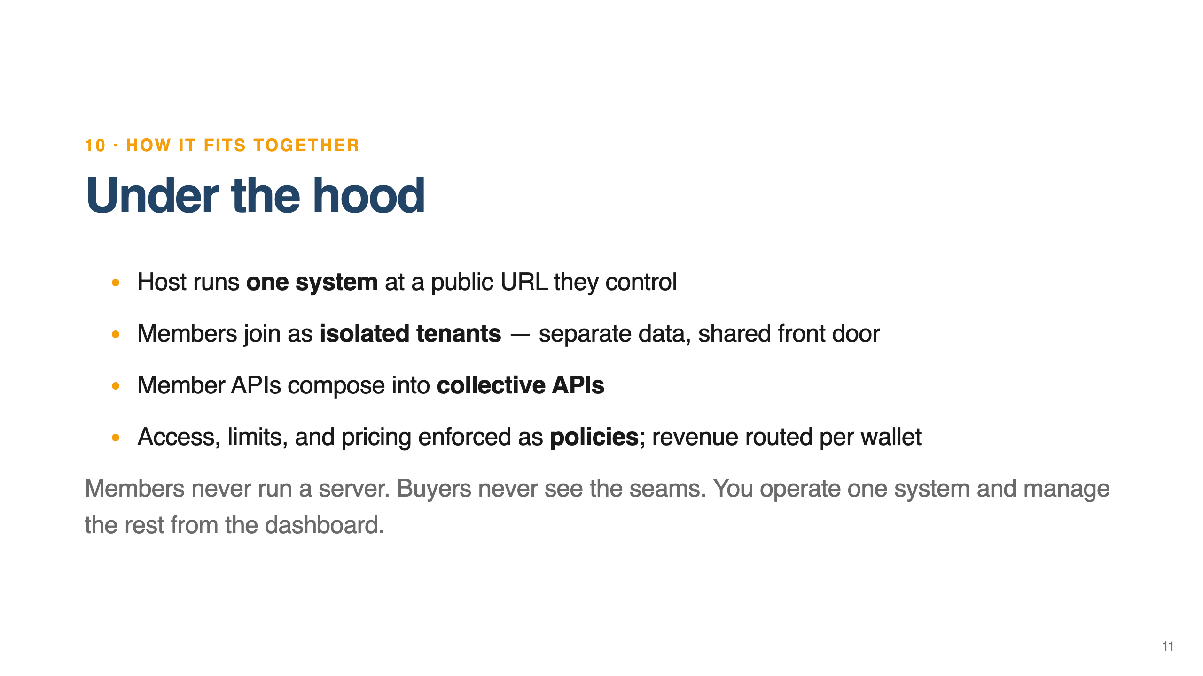
Notes:
PLUMBING. Say this: One slide on the plumbing, then we're done. You run a single system at a web address you control. Members join as isolated tenants — separate data, shared front door. Their APIs compose into the collective APIs buyers hit. Who's allowed in, how often they can query, and what they pay are all enforced automatically as policies, and revenue routes to the right wallet on every request. Members never run a server. Buyers never see the seams. You operate one system and manage everything else from the dashboard.

