Slide 1
OMA DMSO Working Group
Northbound API Workshop
25-September-23
Chairs Matthew Gillmore / Jaime Jimenez

Slide 2
Reminders
Intellectual Property Right
"Each Member will use its reasonable endeavours to inform timely the Open Mobile Alliance of Essential IPR as it becomes aware that the Essential IPR is related to the prepared or published Specification. Members shall submit to the General Manager of Operations of OMA the IPR Statement and the IPR Licensing Declaration. These forms are available from OMA or online at the OMA website at www.openmobilealliance.org."
OMA Antitrust Policy
“This is a reminder that all OMASpecWorks activities are subject to strict compliance with the below Antitrust Guidelines. Each individual participant and attendee at this meeting is responsible for knowing its contents, and for complying with it. Copies of the Antitrust Guidelines are available at: http://www.openmobilealliance.org/AboutOMA/Antitrust.aspx

Slide 3
What is oneM2M ?
A Global Standard for a Common IoT Service Layer
Formed in 2012 by 8 national standards bodies
Defines a global standardized framework for IoT interoperability and scalability
Large Ecosystem: Over 200 members including some of the largest global tech companies
https://onem2m.org

Slide 4
Why consider oneM2M ?
Mature, well adopted and very well documented
Release 3 ratified in 2018. Release 4 under review
Open, free public documentation
Allows any authorized IoT application to discover and interact with any IoT device
Ideal for distributed and cooperative solutions such as smart cities/factories
Reduces fragmentation, increase reusability, and provides economies of scale

Slide 5
API Considerations are Complex
Design patterns
Object Model
Transport Bindings
Security Architecture

Slide 6
oneM2M APIs
Very well-documented, RESTful, Request/Response model
Synchronous or Asynchronous with Callbacks
Technology independent object model publicly available
3 transport binding options: HTTP/TLS, CoAP/DTLS, MQTT/TLS
https://www.onem2m.org/using-onem2m/developers/api#n2a

Slide 7
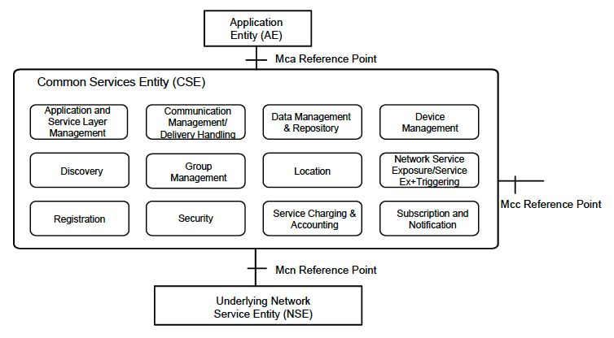
oneM2M Common Service Layer

Slide 8
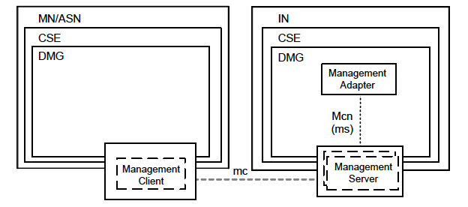
oneM2M Device Management
Provides an extensible facility to map any management technology (LwM2M, OMA-DM) to ReSTful northbound APIs

Slide 9
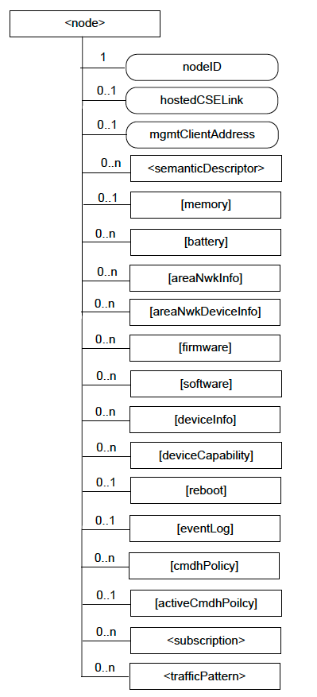
Extensible Device Management
Provides an extensible facility:
LwM2M Objects map to oneM2M mgmtObjs
LwM2M Resources map to oneM2M objAttr
Published harmonization with LwM2M core objs

Slide 10
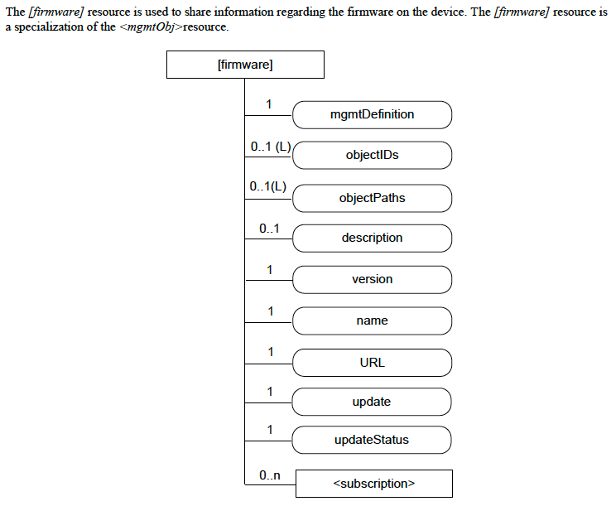
Mapping LwM2M Core Objects

Slide 11
Well-defined Security Architecture
Based on open standard protocols (IETF, NIST, etc)
Authentication: PSK or PKI
Authorization:
  Centralized accessControlPolicy resources
  De-centralized authorization tokens
API Transport Layer Security
  TLS or DTLS
  Privacy, message integrity, non-repudiation
https://www.onem2m.org/using-onem2m/developers/api#n2b

Slide 12
More Resources
https://www.onem2m.org/
XSD Schemas: https://git.onem2m.org/PRO/XSD/-/tree/master/v3_29_0
Developer Info: https://www.onem2m.org/using-onem2m/developers
oneM2M Github: https://github.com/oneM2M-Tutorials
Developer Tools: https://wiki.onem2m.org/index.php?title=Tools
Developer Guides: https://wiki.onem2m.org/index.php?title=Developer_Guides
Open-Source Projects: https://wiki.onem2m.org/index.php?title=Open_Source
oneM2M GitLab: https://git.onem2m.org/explore/projects
oneM2M on StackOverflow: https://stackoverflow.com/questions/tagged/onem2m
oneM2M on Hackster.io: https://www.hackster.io/onem2m
White Papers: https://www.onem2m.org/resources/white-papers

Slide 13
Thank you.

