Slide 1
A publish-subscribe architecture for CoAP
Jaime Jiménez
Ericsson Research HDE

Slide 2

Agenda
CoAP intro
CoAP PubSub Broker
Demo

Slide 3
CoAP Fundamentals
CoAP Protocol (RFC7252)
CoAP Observe (RFC7641)
CoRE Link Format (RFC6690)
– An application-layer, web transfer protocol like HTTP but for constrained devices (8KBRAM,16-bitCPU, …).
– Defines a set of method requests and responses, multicast use, a reliability mechanism, native support for intermediary proxies, and the caching & validation models and a URI scheme.
– A CoAP extension that enables an observation pattern over REST (subscribe to a data representation)
– An observer client receives automatic notifications as the resource representation is updated over time.
– D2D akin to webhooks over HTTP.
– Extends HTTP’s web linking for IoT specific uses.
– Provides new resource attributes, a new well-known URI, relation types and creates a parameter registry in IANA to be used by other SDOs.
IoT Device
Observe temperature
IoT Device
GET /.well-known/core?rt=fota
IoT Device
client
GET temperature
server
client
25 C
server
client
server
21 C
25 C
23 C
2.05 Content </firmware/v2.1>;rt=”fota";sz=262144

Slide 4
CoAP Fundamentals II
Resource Directory (RFC9176)
OSCORE (RFC8613)
CoAP Serializations
– A directory service for storing and retrieving links to endpoints and their resources.
- Extends CoAP web-linking to remove the discovery dependency on a constrained device.
– Application-layer protection of CoAP messages based on symmetric cryptography.
– Offers an alternative -or additional- protection to that of lower layers of security (TLS, IPSEC, etc).
– Transport agnostic (it works wherever CoAP works).
– End-to-end rather than hop-by-hop.
– SenML serializations for the data based on JSON
– CBOR , a concise data format.
GET /temperature
IoT Device
CoAP endpoint
RD
<Here is a response with a structure and also compressed.>
register
IoT Device
CoAP endpoint
You are here /rd/xyz
RD
IoT Device
lookup
client
OSCORE request
server
Here is some endpoints
OSCORE response 2.04 (changed)

Slide 5
Custom
Apps
WG
Resource Directory
IETF
LwM2M
interfaces
discovery
Pubsub
CoREConf
ACE
SUIT
EDHOC
2023
COSE
Links
CBOR
OSCORE
SenML
CoAP
DTLS
TLS
2018
UDP
TCP
IPv6
IPv6 / v4
Cellular
6lo
LoRa
Cellular
Wifi
Wired
802.15.4
BLE
NFC
2014

Slide 6
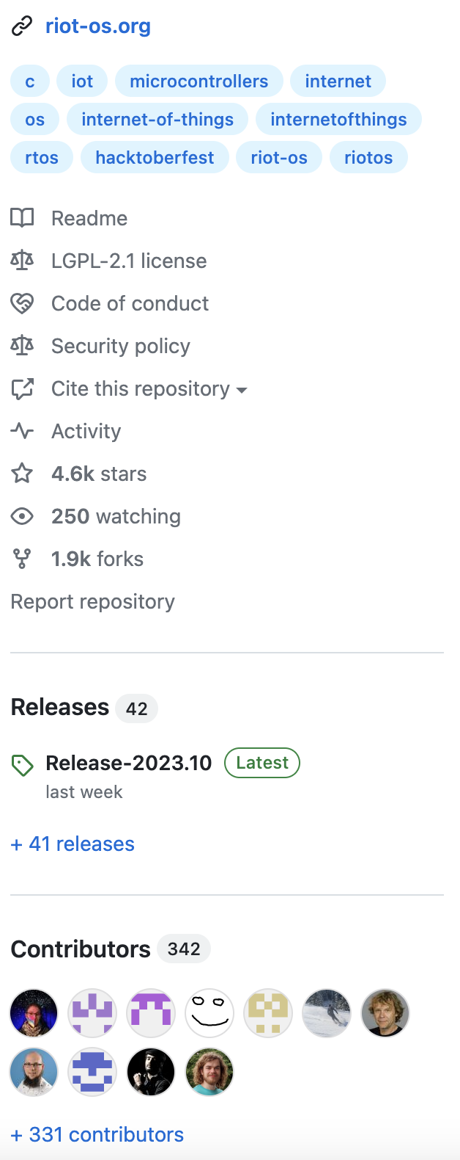
Where is CoAP present today (that I know of)
Implementations
IoT Op Systems
- coap.space/impls
- 20+ Open-Source implementations available
- dozens of languages and platforms
- FreeRTOS
- RIOT
- Mbed
- Oniro
- TinyOS
- …
Tools
- coap.space/tools
- Run CoAP interop tests
- Wireshark Dissector
- Tutorials, ABNF, Cheat Sheet…
Notes:
- FreeRTOS: FreeRTOS is primarily driven by Amazon Web Services (AWS). It was initially developed by Richard Barry and is now maintained and supported by AWS.
- RIOT: RIOT is an open-source project driven by a community of contributors from various organizations and individuals (Central European background). It is supported by the RIOT community, which includes researchers, developers, and enthusiasts in the IoT space.
- Mbed: Mbed is developed and maintained by Arm, a multinational semiconductor and software design company. Arm provides the Mbed OS, Mbed tools, and Mbed ecosystem to support the development of IoT devices.
- Oniro: Oniro is an open-source project driven by the Oniro Foundation, a non-profit organization focused on privacy and security in computing. Mostly Huawei behind. The foundation and community contribute to the development and advancement of the Oniro operating system.
- TinyOS: TinyOS is an open-source project developed primarily by researchers and contributors from the TinyOS community. It is driven by a collaborative effort from various academic institutions and individuals interested in wireless sensor networks.
- Home Assistant: Home Assistant is an open-source project driven by the Home Assistant community. The project was started by Paulus Schoutsen and is now supported by a large community of contributors who actively develop, maintain, and enhance

Slide 7
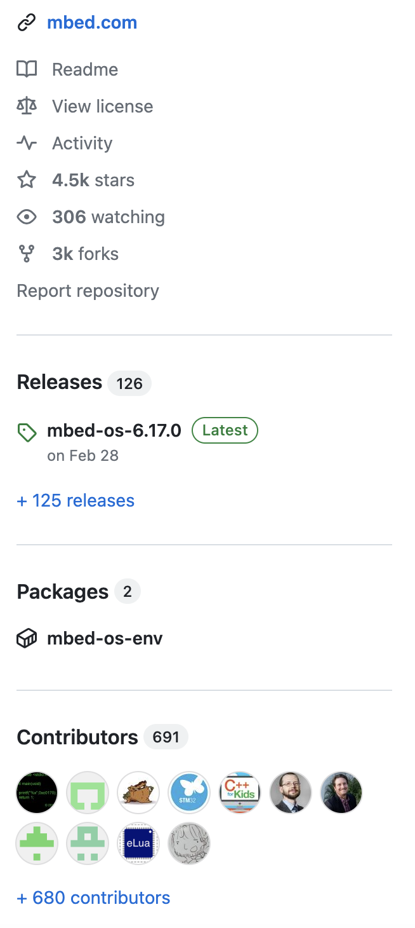
Where is CoAP present today (that I know of)
Implementations
IoT Op Systems
- coap.space/impls
- 20+ Open-Source implementations available
- dozens of languages and platforms
- FreeRTOS
- RIOT
- Mbed
- Oniro
- TinyOS
- …
Tools
- coap.space/tools
- Run CoAP interop tests
- Wireshark Dissector
- Tutorials, ABNF, Cheat Sheet…

Slide 8
Where is CoAP present today (that I know of)
SDOs
Products
OCF
Zigbee (CSA)
KNX
OMA LwM2M
Open Thread
GlobalPlatform
3GPP
TinyMesh
…
Siemens Buildings
Arm Pelion (device management)
Various IoT Gateways (openhab…)
Various LoRA modules (link)
Qualcomm Snapdragon Wear (link)
AVSystems Anjay
Assa Abloy (link)
Neoway N27 (link)
nRFC Cloud (link)
Golioth (link)
EMQX (link)
…
IKEA Tradfi (link)
Philips lights , AirPurifier
Shelly
Gardena
Itron Smart meters (link)
ThingWave Mining Bolts
Cisco IoT FND (link) ISP IoT platforms
  Deutsche Telekom (link)
  T-Mobile
  AT&T
  Softbank
  …
Network Modules
Qualcomm
ARM
NXP (link)
Nordic Semiconductor (link)
ST Micro STM32Cube
Quectel (link)
Sierra Wireless (link)
…

Slide 9

Agenda
CoAP intro
CoAP PubSub Broker
Demo

Slide 10
Basic Concepts
Can I not get notifications with REST?
REST & Pubsub
How does that work?
REST is about resources and transferring their representations between client and server. IoT aim is to minimize state for scale.
PubSub is about asynchronous events over a message queue. IoT aim is for publisher to fire and forget.
HTTP
- Comet (1996, now obsolete)
- Server-Sent Events (SSE) (2004)
- WebSocket (2008): full-duplex communication channels over a single TCP connection.
- WebTransport (Under development): bidirectional transport between browser and server.
- Braid: HTTP extension for state synchronization.
CoAP
- CoAP Observe (2015)
- Keep a TCP/QUIC connection open
HTTP/1.1, HTTP/2, and QUIC (underlying HTTP/3) support this approach.
- Callbacks
The client provides a callback function for the server to call when it has a response ready.
Useful in event-driven systems and high latency scenarios (IoT!).
HTTP Webhooks and CoAP Observe use this.
Then, why a broker?
thing
thing
broker
thing
thing
Notes:
Comet (1996, now obsolete): An early web technology for maintaining persistent connections between client and server. Comet on Wikipedia
Server-Sent Events (SSE) (2004): A standard allowing servers to push updates to clients. Server-Sent Events on Mozilla Developer Network
WebSocket (2008): A communication protocol providing full-duplex communication channels over a single TCP connection. WebSocket on Mozilla Developer Network
WebTransport (Under development): A protocol for bidirectional transport of arbitrary data between browser and server. WebTransport on Mozilla Developer Network
Mercure: A protocol for real-time updates in web applications. Mercure.rocks
Braid: An ambitious HTTP extension offering a comprehensive framework for state synchronization between server and client. Braid on IETF Datatracker
PREP (Per Resource Events Protocol): A proposal focusing on client notification for resource changes, particularly in decentralized web applications. PREP on IETF Datatracker
CoAP Observe (RFC 7641): A mechanism in the Constrained Application Protocol (CoAP) allowing clients to subscribe to resource changes. RFC 7641 on IETF

Slide 11
Brokers
Broker benefits
Brokers in RESTful IoT
CoAP pub-sub architecture
Having a broker as intermediary (like MQTT broker) has some benefits.
Message Persistence: they can store messages ensuring reliable message delivery (although any other server also can)
NAT traversal: brokers are always reachable and can help on NAT-traversal to ensure delivery also because of TCP (although a reverse proxy also can).
Fire & Forget: brokers allow constrained endpoints to simply send a message and go back to sleep.
Many use cases did not need a broker because of the local network topology (802.XX).
Many deployments implement similar custom-made solutions.
Full distribution often seen preferable over broker-mediated for resiliency.
Security concerns: TLS/DTLS security ends at broker, not end to end.
This work aims at:
Supporting endpoints with long breaks in connectivity.
Backwards compatibility with CoAP deployments.
Supporting very constrained endpoints.
Enable security end-to-end.
Enable security access control.
Normative standard reference in IETF CoRE.
Create a building block for the CoAP device ecosystem.

Slide 12
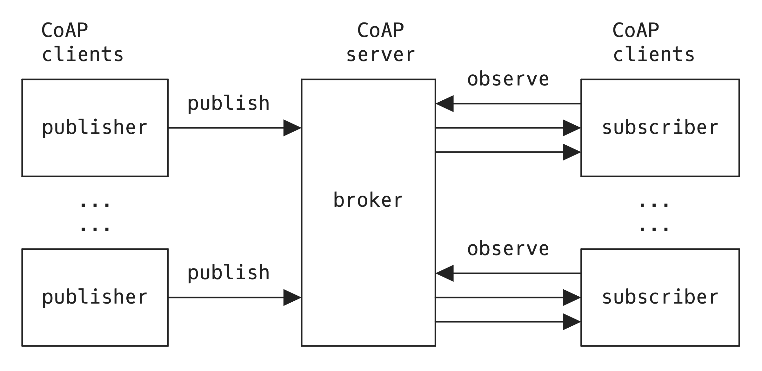
Publish-subscribe in CoAP
0.03 PUT <broker_URI>/ps/data/225acdd =>
{
"n": "temperature",
"u": "Cel",
"t": 1621452122,
"v": 23.5
}
2.04 Changed <=
<= 0.01 GET <broker_URI>/ps/data/225acdd
Observe: 0
=> 2.05 Content Observe: 10001
[... Payload data...]
=> 2.05 Content Observe: 10002
[... Payload data...]
...

Slide 13
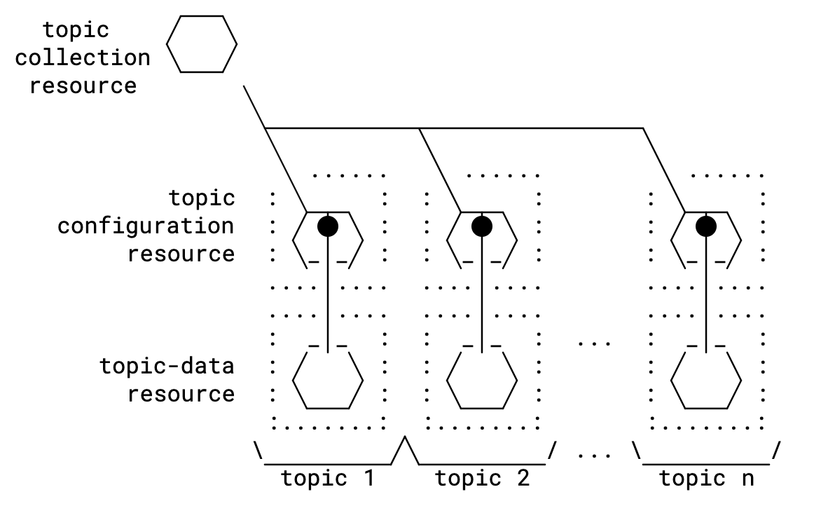
Interface Overview
Topic Collection resource
Retrieve (GET) the list of topics
Retrieve (FETCH) topics by properties
Create (POST) a topic resource
Topic resource (configuration)
Retrieve (GET) a topic resource
Retrieve (FETCH) part of a topic with a filter
Update (PUT) whole topic
Update (PATCH) part of a topic with a filter
Delete (DELETE) a topic resource
Topic Properties
Configuration parameters written by the administrator of the topic.
Optional informational parameters (e.g., max-subscribers)

Slide 14
Interface Overview
Topic Data resource
Publish (PUT) to a topic data (URI)
Subscribe (GET + obs=0) to a topic data (URI)
Unsubscribe (GET + obs=1) from a topic data (URI)
Read latest value (GET)
Delete (DELETE) a topic data

Slide 15
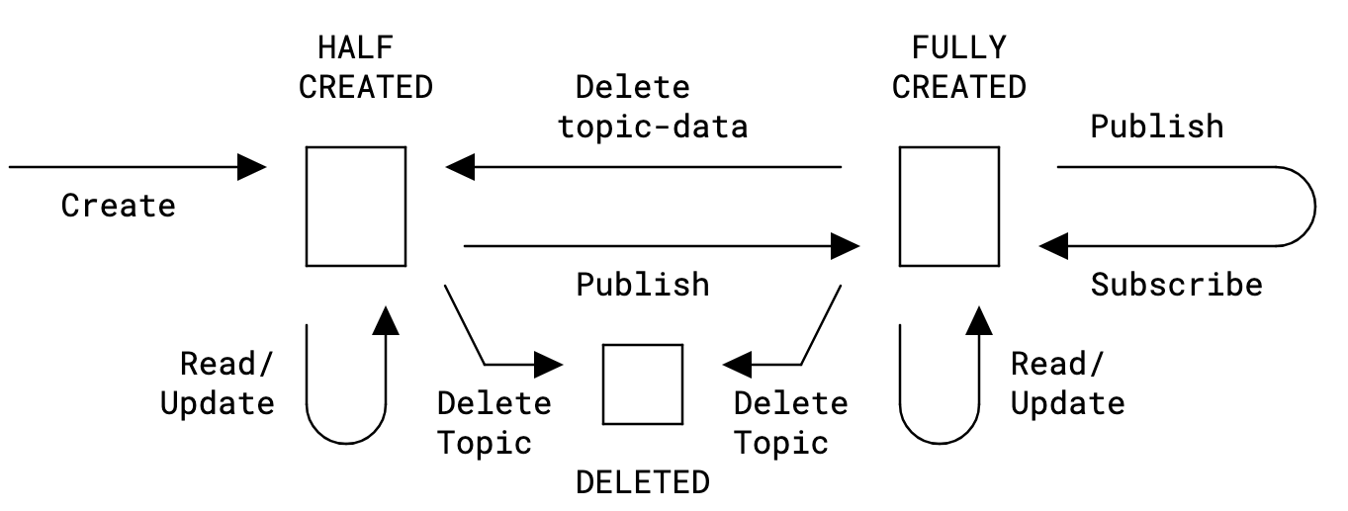
Topic Lifecycle
Topic configuration interactions, in the HALF CREATED state the topic is created but no data has been published to it.
=> POST /ps
{"topic-name": "Room Temperature Sensor", "resource-type": "core.ps.conf", "media-type": "application/json", "topic-type": "temperature", "expiration-date": "2023-04-05T23:59:59Z", "max-subscribers": 200, "observer-check": 86400}
<= 2.01 Created
location: /ps/9b7888
{
"topic-name": "Room Temperature Sensor",
"topic-data": "ps/data/7a0e64d",
"resource-type": "core.ps.conf",
"media-type": "application/json",
"topic-type": "temperature",
"expiration-date": "2023-04-05T23:59:59Z",
"max-subscribers": 200,
"observer-check": 86400
}
A publisher publishes on the topic data resource ps/data/7a0e64d
=> PUT /ps/data/7a0e64d
{n: temperature,u: Cel,t: 1621452122,v: 21.4}
The state changes to FULLY CREATED. Subscribers can now subscribe and publish on that resource.

Slide 16
CoAP Broker properties
Advantages
Caveats
Bridges REST and broker-based pubsub conceptual worlds while keeping the REST architecture.
  Dynamic discovery.
  Expressive topics.
  FETCH/(i)PATCH on configurations.
Readily usable by existing CoAP deployments (it is all CoAP under the hood).
Ideal for constrained endpoints.
Including management features
  topic-configurations.
  topic lifecycle
End-to-end security publisher-to-subscriber with COSE.
Not session based (SSH, RTP...) nor connection-oriented (although you can have CoAP over TCP).
  WebTransport streams has better throughput.
CoAP Parameters (e.g., N_START, timeouts…) should be tuned appropriately.
  See aiocoap constants.
  CoAP default values keep the network running and do not contribute to its degradation.
  TCP and QUIC can behave more aggressively.
Notes:
Apples vs Oranges
Expressive topics means, they are not just a text string, but contain metadata, link attributes, resource types, can use well-known core, rt based discovery, FETCH, etc..

Slide 17

Agenda
CoAP intro
CoAP PubSub broker
Demo

Slide 18
Implementation
IETF117 hackathon
IETF118 hackathon
Simple python implementation of the topic discovery, configuration and pub-sub topic data interactions on top of aiocoap.
The broker implements the following resource classes:
CollectionResource: The collection resource /ps for storing topics.
TopicResource: A resource for topic configurations.
TopicDataResource: A resource for topic data and for the publish-subscribe interactions over CoAP.
- Updates based on spec changes
- iPATCH to partially update topic configuration
- FETCH on the topic collection
- DELETE
- rt-based discovery (core.ps.coll, core.ps.conf, core.ps.data)
Open Sourced
github.com/jaimejim/aiocoap-pubsub-broker
Lab Instance
coap://colibri.nomadiclab.com

Slide 19
What about MQTT?
Title | Year
MQTT vulnerabilities, attack vectors and solutions in the internet of things (IoT) | 2023
Performance of CoAP in the Limited Resource Environment: An Empirical Study | 2023
Performance analysis of constrained application protocol (CoAP) | 2023
Comparative Analysis of MQTT and CoAP Using Wireshark | 2022
Knowledge-based edge computing framework based on CoAP and HTTP for enabling heterogeneous connectivity | 2022
A review on communication protocols of industrial internet of things | 2022
A survey on communication protocols and performance evaluations for Internet of Things | 2022
Preventing MQTT vulnerabilities using IoT-enabled intrusion detection system | 2022
A performance analysis of internet of things networking protocols: Evaluating MQTT, CoAP, OPC UA | 2021
Performance evaluation of CoAP and MQTT with security support for IoT environments | 2021
Performance comparison of MQTT and CoAP protocols in different simulation environments | 2021
Title | Year
IoT Protocols–MQTT versus CoAP | 2021
A comparative evaluation of AMQP, MQTT and HTTP protocols using real-time public smart city data | 2021
CoAP vs. MQTT-SN: Comparison and performance evaluation in publish-subscribe environments | 2021
A performance analysis of the security communication in CoAP and MQTT | 2021
Performance Evaluation of CoAP and MQTT_SN Protocols | 2021
Review of the IoT Protocol Literature at the Application Layer | 2021
A survey of application layer protocols for Internet of Things | 2021
Performance evaluation of a widely used implementation of the MQTT protocol with large payloads in normal operation and under a DoS attack | 2021
Implementation and Analysis of IoT Based Automation Using MQTT | 2021
Analysis of quic transported CoAP | 2021
Title | Year
Comparing application layer protocols for video transmission in IoT low power lossy networks: an analytic comparison | 2021
Comparing energy consumption of application layer protocols on IoT devices | 2021
An integration of personal health device and HL7 FHIR using CoAP | 2021
MQTT protocol use cases in the Internet of Things | 2021
The impact of networking protocols on massive M2M communication in the industrial IoT | 2021
IoT-based platform for environment data sharing in smart cities | 2021
Overview of Application Layer Protocol of Internet of Things | 2021
WLDT: A general purpose library to build IoT digital twins | 2021
Enabling seamless communication over several IoT messaging protocols in OpenFlow network | 2021
The Security of MQTT Against the Applications Protocols for IoT | 2021
CoAP and MQTT Measurements over LoRaWAN | 2020
A brief comparative analysis on application layer protocols of internet of things: MQTT, CoAP, AMQP and HTTP | 2020
Distributed UCON in CoAP and MQTT protocols | 2020
MQTT-CoAP interconnector: IoT interoperability solution for application layer protocols | 2020

Slide 20
What about MQTT?
Feature | CoAP | HTTP | MQTT
Protocol | UDP (TCP too) | v1,v2 TCP, v3 QUIC | TCP (UDP too)
Network layer | IPv4/6 | IPv4/6 | IPv4/6
Connection Oriented | No need (IP+UDP) | depends | Yes (TCP)
Multicast support | Yes | No | No
Architecture model | REST + Observe | REST + Webhooks/SSE | PubSub via Broker
Communication model | State transfer | State transfer | Event model
Asynchronous (non-blocking) | Yes | v1,v2 no, v3 yes (see hol-blocking) | Yes
Payloads | Small (blockwise for larger) | Big | Big
Resource Interaction | Direct (GET, PUT, POST, DELETE) | Direct (GET, PUT, POST, DELETE) | Message Queue
Content | Support for content negotiation and discovery | Support for content negotiation and discovery | Payload format must be known beforehand
Overhead | Little | More | Little
Use | IoT | Everything | IoT
NATs | Problems over UDP | TCP so OK | TCP so OK

