Slide 1
Towards a Text Generation Template Language for Modelica
Peter Fritzson*, Pavol Privitzer⁺, Martin Sjölund*, Adrian Pop*
⁺Institute of Pathological Physiology, First Faculty of Medicine,
University in Prague
and Creative Connection, s.r.o.
*PELAB – Programming Environment Lab, Dept. Computer Science
Linköping University, SE-581 83 Linköping, Sweden
pavol.privitzer@lf1.cuni.cz,
{petfr, marsj, adrpo}@ida.liu.se

Slide 2
Requirements and Motivation
need for a template language ?
performance
intended users
Towards a Text Generation Template Language for Modelica

Slide 3
Text with holes in it
'Hello <person>!'
instead of
print("Hello ");
print(person);
print("!");
Towards a Text Generation Template Language for Modelica

Slide 4
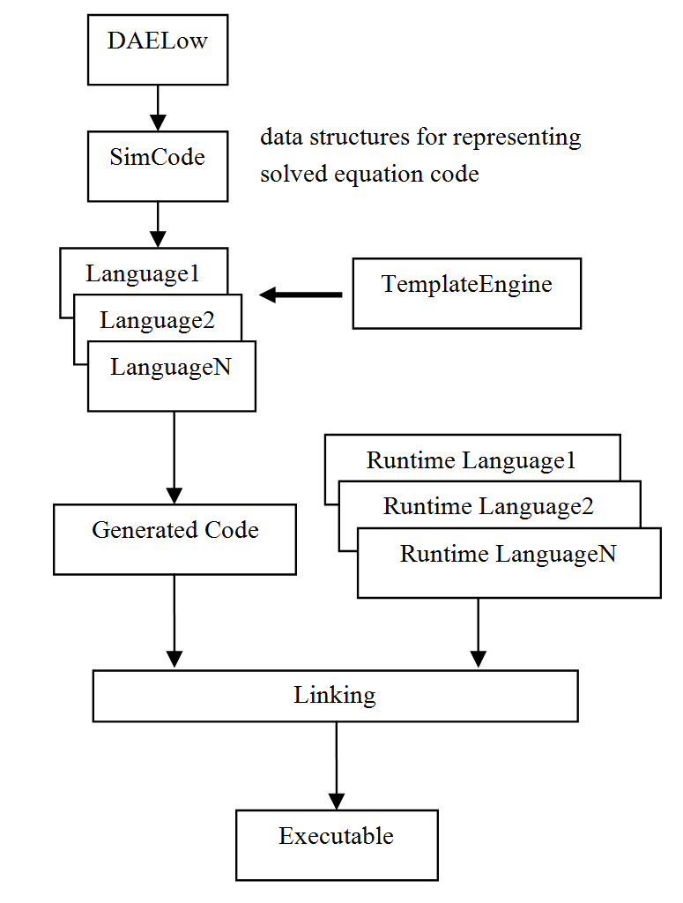
Applications in Code Generation
Separation of concerns
New target languages - e.g., C# or Java code generator
Also end-users (modelers) can develop code generators
Towards a Text Generation Template Language for Modelica

Slide 5
Model View Controller
Separation
Model – the data structure, e.g. an AST
Controller – controls the application of the view to the model, e.g., a tree traversal algorithm applying the templates to the tree nodes.
View – the actual templates in a template language.
-> more flexibility (multiple views)
-> easier maintainability
-> better reuse
-> increased ease-of-use, etc.
Towards a Text Generation Template Language for Modelica

Slide 6
Domain Specific Language?
internal DSL
external DSL
or host language extension
Towards a Text Generation Template Language for Modelica
Notes:
A language that addresses a specific problem domain is called domain specific language
Internal DSLs are particular ways of using a host language in a domain-specific way.

Slide 7
Language Design Principles
Conceptual clarity
Orthogonality
Readability
Conciseness
Expressive Power
Simplicity
Generality
Towards a Text Generation Template Language for Modelica

Slide 8
Three
Template Language Implementations
an unparser language for the DICE system
an interpretative template language in MetaModelica
a compiled template language - Susan
Towards a Text Generation Template Language for Modelica

Slide 9
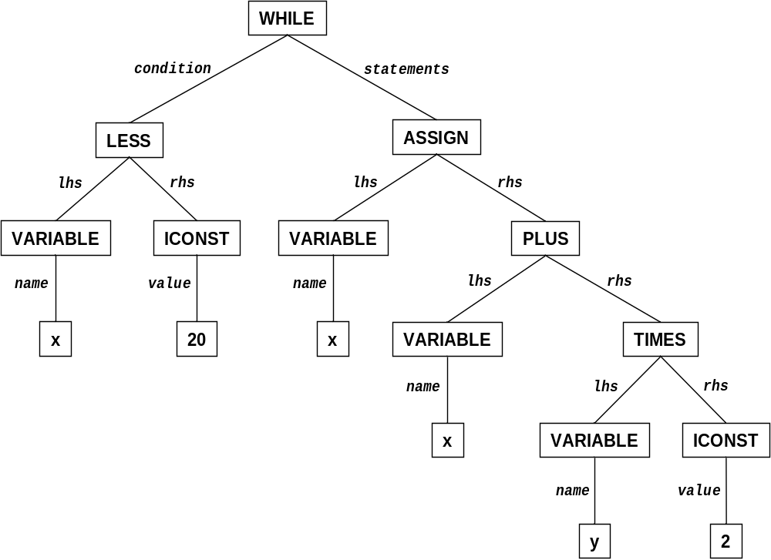
History – Ada, Pascal and Modelica
while x<20 loop
x := x + y*2;
end while;
a very concise unparser language:
ASSIGN : (lhs: PVAR; rhs: EXPR) : "@1 := @2";
WHILE : (condition: EXPR; statements: STM_LIST) :
"while @1 loop @+@n @2;@n@q@-@nend while;@n"
PLUS : (lhs:EXPR; rhs: EXPR) : "@1+@2" LPRIO 4;
TIMES : (lhs:EXPR; rhs: EXPR) : "@1*@2" LPRIO 5;
LESS : (lhs:EXPR; rhs: EXPR) : "@1<@2" BPRIO 3;
VARIABLE : (name: STRING) : "@1";
ICONST : (value: INTEGER) : "@1";
Towards a Text Generation Template Language for Modelica

Slide 10
A Small Interpretive
Template Language for Modelica
(February 2009)
dictionary of attribute values
dynamic lookup
template functions – can be compiled
$=WHILE$\n
while ($#boolExp$$:Exp$$/#) {
$^whileBody# $\n
}
$/=
$=ASSIGN$
\n$assignComponent.componentRef$ = $#value$$:Exp$$/#;
$/=
Towards a Text Generation Template Language for Modelica

Slide 11
A Proposed (Meta)Modelica Extension
function templString
input AST whileStm;
<<
The expression loops while
<$whileStm.boolExp.lhs.componentRef$> < <$whileStm.boolExp.rhs.value$>.
>>
Towards a Text Generation Template Language for Modelica

Slide 12
Susan a Compiled Template Language for Modelica
inspired by StringTemplate from ANTLR
strongly typed
has pattern matching
compiled to MetaModelica
Towards a Text Generation Template Language for Modelica

Slide 13
Template definition
hello(String person) ::= <<
Hello <person>!
>>
whileStmt(String cond, list<String> statements) ::=
<<
while(<cond>) {
<statements \n>
}
>>
Towards a Text Generation Template Language for Modelica

Slide 14
Template Calls
hello(String person) ::= <<
Hello <person>!
>>
hello2(String p1, String p2) ::= <<
Two hellos:
<hello(p1)> and <hello(p2)>
>>
Example:
hello2("Peter","Pavol") ->
Two hellos:
Hello Peter! and Hello Pavol!
Towards a Text Generation Template Language for Modelica

Slide 15
Map Template Expressions
Syntax:
value-expr [of elem-pattern]_{opt} : templ-expr
helloList(list<String> people) ::=
<<
Hello them all:
<people of person : hello(person) \n>
And once more time:
<people : hello() \n>
>>
Towards a Text Generation Template Language for Modelica

Slide 16
Type Views
uniontype Statement
record ASSIGN
Exp lhs; Exp rhs;
end ASSIGN;
record WHILE
Exp condition;
list<Statement> statements;
end WHILE;
end Statement;
uniontype Exp
record ICONST
Integer value;
end ICONST;
record VARIABLE
String name;
end VARIABLE;
record BINARY
Exp lhs; Operator op; Exp rhs;
end BINARY;
end Exp;
uniontype Operator
record PLUS end PLUS;
record TIME end TIMES;
record LESS end LESS;
end Operator;
Towards a Text Generation Template Language for Modelica

Slide 17
Pattern matching
uniontype Statement
record ASSIGN
Exp lhs; Exp rhs;
end ASSIGN;
record WHILE
Exp condition;
list<Statement> statements;
end WHILE;
end Statement;
uniontype Exp
record ICONST
Integer value;
end ICONST;
record VARIABLE
String name;
end VARIABLE;
record BINARY
Exp lhs; Operator op; Exp rhs;
end BINARY;
end Exp;
uniontype Operator
record PLUS end PLUS;
record TIME end TIMES;
record LESS end LESS;
end Operator;
statement(Statement stmt) ::=
match stmt
case ASSIGN then <<
<exp(lhs)> = <exp(rhs)>;
>>
case WHILE then <<
while(<exp(condition)>) {
<statements : statement() \n>
}
>>
exp(Exp) ::=
case ICONST then value
case VARIABLE then name
case BINARY then
'(<exp(lhs)> <oper(op)> <exp(rhs)>)'
oper(Operator) ::=
case PLUS then "+"
case TIMES then "*"
case LESS then "<"
Towards a Text Generation Template Language for Modelica

Slide 18
Pattern matching
statement(Statement stmt) ::=
match stmt
case ASSIGN then <<
<exp(lhs)> = <exp(rhs)>;
>>
case WHILE then <<
while(<exp(condition)>) {
<statements : statement() \n>
}
>>
exp(Exp) ::=
case ICONST then value
case VARIABLE then name
case BINARY then
'(<exp(lhs)> <oper(op)> <exp(rhs)>)'
oper(Operator) ::=
case PLUS then "+"
case TIMES then "*"
case LESS then "<"
input into statement():
WHILE(
BINARY( VARIABLE("x"),LESS(),ICONST(20)),
{ASSIGN( VARIABLE("x"),
BINARY( VARIABLE("x"),
PLUS(), BINARY( VARIABLE("y"),
TIMES(),ICONST(2))))})
results to:
while((x < 20)) {
x = (x + (y * 2));
}
Towards a Text Generation Template Language for Modelica

Slide 19
Conditional Expressions
Syntax:
if cond-expr then template-expr
[else template-expr₂]_{opt}
publicKeyword(Boolean isPublic) ::=
if isPublic then "public" else "protected"
nameValOpt(Option<tuple<String,String>> nvOpt) ::=
if nvOpt is SOME((name,value))
then '<name> = <value>;'
Towards a Text Generation Template Language for Modelica

Slide 20
Automatic Indentation and Options
indent2(list<String> lines) ::= <<
**<lines \n>
>>
indent4(list<String> lines) ::= <<
**<indent2(lines)>
>>
Towards a Text Generation Template Language for Modelica

Slide 21
Automatic Indentation and Options
intArr(list<Integer> values) ::= <<
int[] myArr = { <values ", "> };
>>
example output:
int[] myArr = { 1, 2, 3, 4, 5, 6, 7, 8, 9, 10 };
Towards a Text Generation Template Language for Modelica

Slide 22
Automatic Indentation and Options
intArr(list<Integer> values) ::= <<
int[] myArr = { <values ", "; align=10> };
>>
example output:
int[] myArr = { 1, 2, 3, 4, 5, 6, 7, 8, 9, 10,
11, 12, 13, 15, 16, 17, 18, 19, 20,
21, 22, 23 };
Towards a Text Generation Template Language for Modelica

Slide 23
Automatic Indentation and Options
intArr(list<Integer> values) ::= <<
int[] myArr = { <values ", "; align=10; anchor> };
>>
example output:
int[] myArr = { 1, 2, 3, 4, 5, 6, 7, 8, 9, 10,
11, 12, 13, 15, 16, 17, 18, 19, 20,
21,22,23 };
Towards a Text Generation Template Language for Modelica

Slide 24
Susan a Simple Functional Expression Oriented
Template Language
Template expression | Syntax
Textual | 'Output text <templ-exp>.‘ <<Output text <templ-exp>.>> "Constant text\n"
Named value reference | valueName
Template call | templName(par1, par2, …)
Match expression | match value-exp case pattern-exp₁ then templ-exp₁ ...
Conditional expression | if cond-expr then templ-exp₁ else templ-exp₂
Map expression | value-exp of el-pttrn : templ-exp
Options | <templ-exp sep; opt₁=val₁; opt₂; ...>

Slide 25
Susan Compiler
translates source code in the Susan language into the MetaModelica language
its own code generator was re-implemented using the Susan language
Towards a Text Generation Template Language for Modelica

Slide 26
Summary
text generation template languages for Modelica have been discussed
several template language designs – a difficult tradeoff between different design options
implementation is currently being done in the OpenModelica environment
Susan compiler is already operational
Towards a Text Generation Template Language for Modelica

Slide 27
Thank You
Towards a Text Generation Template Language for Modelica

