Slide 1
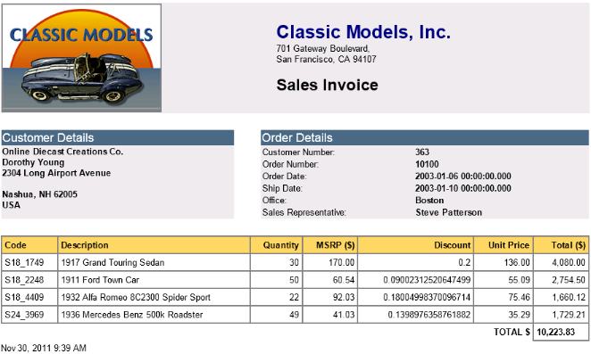
DomSQL
JDBC Access to Domino Data

Slide 2
Goals
Augment the Domino query capability with a new SQL engine working on top of the Domino data (views)
  Use SQL for dynamic queries, including custom selection, aggregation operators...
    Supports very complex queries on top of Domino data
  Dynamically re-sort view entries without creating an index
  Join data between multiple views, even coming from different databases/servers
  Aggregate data from different views/databases/servers
  Bring all the power of SQL to Domino data :-)
Make it easy to consume from an XPages application
  Tightly integrated with the XPages Extension Library RDBMS extension
  Execute queries with the rights of the XPages user (a.k.a “Web User”)
Expose Domino data to external applications
  Allow data analytics on top of Domino data
  Fully support the Notes/Domino security model – Use the Internet user/password
  Connect from any application that supports JDBC connectivity

Slide 3
DomSQL in a Nutshell
Gives read-only access to the data, by projecting the content of views as relational tables
Exposes the Domino data through a JDBC interface
  Includes data and metadata access
DomSQL is based on top of an award winning SQL engine: SQLite
  Very robust SQL engine used by many projects (http://www.sqlite.org/)
  Well known SQL grammar understood by many JDBC clients
Multiple execution modes
  Executes within the HTTP process for XPages consumption
    Maximum performance, no network connection involved
  Executes within the DOTS process when accessed remotely
    Remote server implemented using RMI
The engine is fully extensible, if needed
  The source code is provided under the Apache license, and it is only using the “C” toolkit public API.

Slide 4
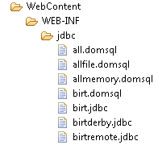
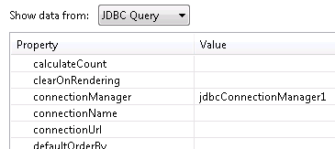
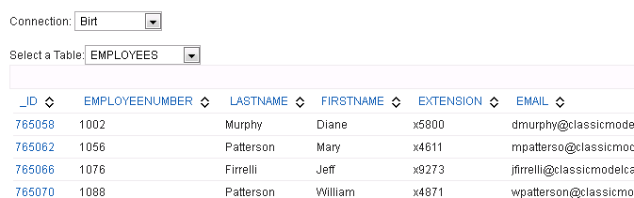
Use it From XPages with the Extension Library
Relational Datasource
(Extension Library)
Relational data definition
JDBC Connection
(Extension Library)
Any XPages Control that can bind to data
(views...)

Slide 5
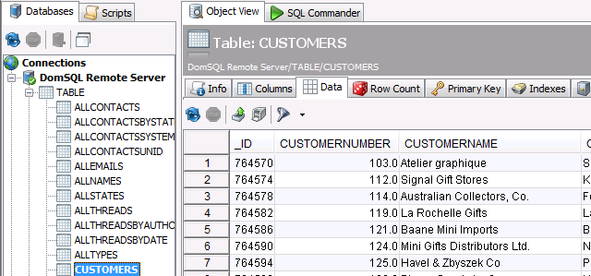
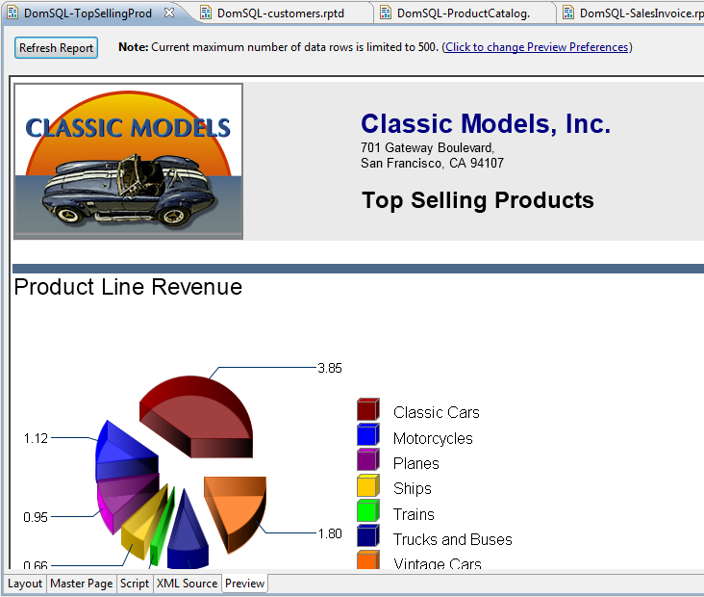
Or From Any Third Party Application That Supports JDBC Connectivity
Birt Report Editor
DBVizualizer

