Slide 1
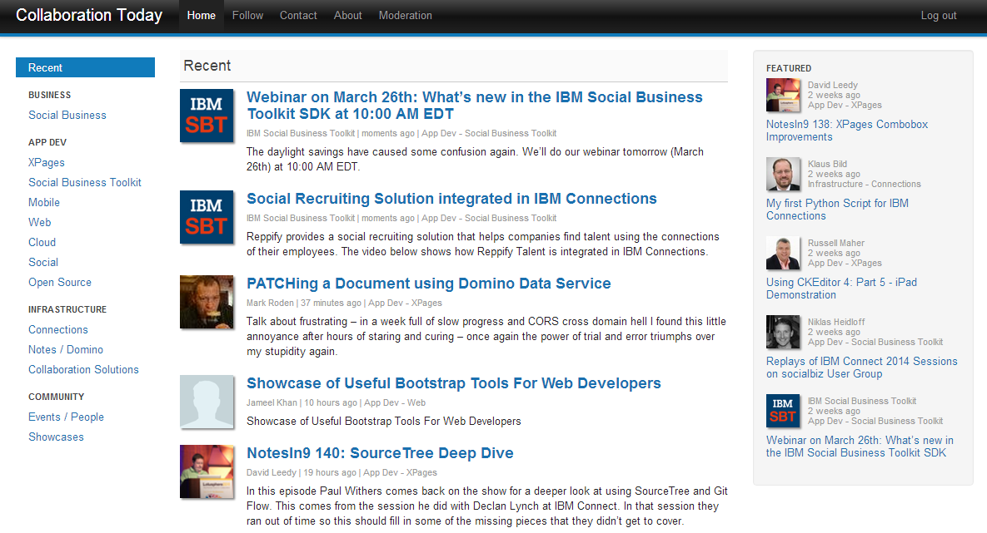
CollaborationToday.info
Curation Policies 03/25/14

Slide 2
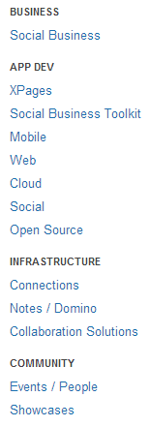
Responsibilities of Curators
Curators need to add content on a regular basis and need to be able to dedicate time (at least five entries per month)
For each entry these fields need to be defined ...
  Authors
    News entries have to have an author
    Use the actual author's name, not the platform where the blog is hosted
    For group blogs (e.g. openntf) use group name
    If the author hasn't been defined yet, curators need to add him/her
      Authors pictures must not be bigger than 10kb and need to
      have a minimal size of 64x64 px
  Title
    Titles must not repeat author names or include blog names
  Abstracts
    Abstracts shouldn't be longer than 2 – 4 sentences !
  Entries need to be categorized

Slide 3
Responsibilities of Curators
Curators can add entries via URL or feed monster
  Adding entries that are not found via the feed monster are preferred !
  Curators can use the bookmarklet to easily add URLs to Collaboration Today (watch the video: http://www.youtube.com/watch?v=PYzZT-UgreA)
  To add blogs to the feed monster, send mail to Niklas (requires Notes access)
Curators can define featured entries
  Need to change featured entries on the home page regulary
  Need to balance entries (e.g. not only four XPages entries under app dev)
  Featured entries shouldn't be older than 3-4 weeks
  There shouldn't be more than 10 featured entries

Slide 4
Content
Only IBM Collaboration Solutions relevant content can be added
  This includes everything directly related to ICS but also information which is relevant for ICS professionals
Only high quality content can be added
  Rule of thumb: Would this be covered by online magazines with a good reputation?
The following content must NOT be added
  Non-English articles
  Blog entries about non-business related topics
  News about competitive products
    Unless compared fair/objectively with ICS products (e.g. by analysts)
Handling of duplicates
  Content that is older can be added, but only if there isn't already a news entry
  If people blog links to other sites, only the sites should be added
    Unless people write additional information or opinions
Handling of news entries about commercial offerings
  News entries covering commercial offerings are only allowed if relevant to ICS professionals, e.g. products announcements
  Pure self promoting news are not allowed to be put on Collaboration Today
  These entries need to be put in the “Community-Showcases” category

Slide 5
How to become a Curator
Contact OpenNTF or use the contact page http://collaborationtoday.info/contact.xsp
After OpenNTF has assigned access you'll be able to access the curation pages using your OpenNTF credentials
  Log in: http://collaborationtoday.info/login

Slide 6
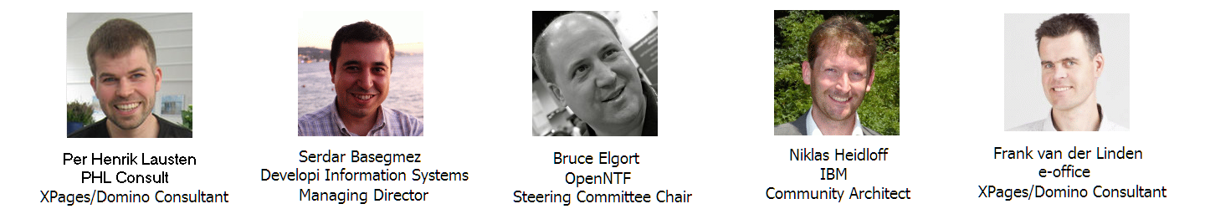
CollaborationToday.info
Developed by

