Slide 1
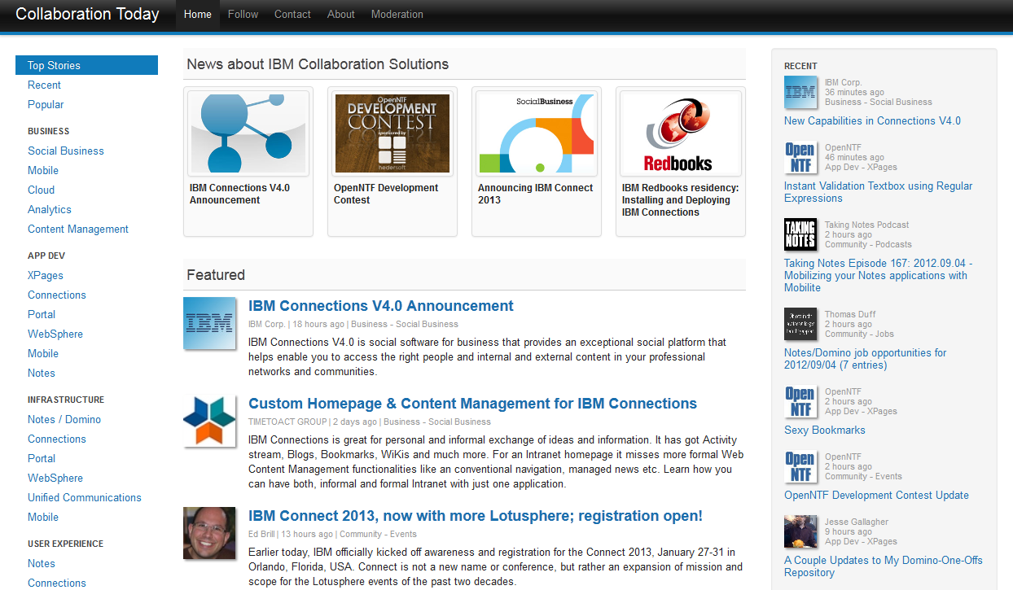
CollaborationToday.info
Moderation Policies

Slide 2
Types of Moderators
There are three types of moderators
  Category moderators
    Each moderator can moderate 1 – N categories of content
    Check the left navigator for a list of categories (example: social business)
    Category moderators do not moderate the "featured" section
    These news entries show up in the recent stream and the different category streams
  Spotlight moderators
    Spotlight moderators can define which news entries to display at the top of the home page
    Spotlight articles remain visible for 1 – 2 weeks
  Top stories moderators
    Top stories moderators can define which news entries show up on the home page in the different sections
    There are sections for featured, business, app dev, infrastructure, user experience and community
    Top stories remain visible for 1 – 3 days

Slide 3
Responsibilities of all Moderators
Moderators need to add content on a regular basis and need to be able to dedicate time
Moderators can use the bookmarklet to easily add URLs to Collaboration Today (watch the video: http://www.youtube.com/watch?v=PYzZT-UgreA)
Authors
  News entries have to have an author
  If the author hasn't been defined yet, moderators need to add him/her
    Authors pictures must not be bigger than 10kb and need to have a minimal size of 64x64 px
Title
  Titles should not repeat author names or include blog names
Abstracts
  Abstracts shouldn't be longer than 2 – 4 sentences
Entries need to be categorized

Slide 4
Responsibilities of Spotlight and Top Stories Moderators
Spotlight moderators
  Need to create high quality images
    260x180 px
    png or jpg
    As small as possible
  Need to change spotlight section regularly
Top stories moderators
  Need to change top stories on the home page regulary
  Need to balance entries (e.g. not only four XPages entries under app dev)

Slide 5
Content
Only IBM Collaboration Solutions related content can be added
Only high quality content can be added
  Moderators of specific categories define whether content is high quality content
The following content must NOT be added
  Non-English articles
  Blog entries about non-business related topics
  News about competitive products
    Unless compared fair/objectively with ICS products (e.g. by analysts)
Handling of duplicates
  Content that is older can be added, but only if there isn't already a news entry
  If people blog links to other sites, only the sites should be added
    Unless people write additional information or opinions
Handling of news entries about commercial offerings
  News entries covering commercial offerings are only allowed if relevant to ICS professionals, e.g. products announcements
  Pure self promoting news are not allowed to be put on Collaboration Today

Slide 6
How to become a Moderator
Contact OpenNTF or use the contact page http://collaborationtoday.info/contact.xsp
Tell us what type of moderator you want to be and for which categories
After OpenNTF has assigned access you'll be able to access the moderation pages using your OpenNTF credentials
  Log in: http://collaborationtoday.info/login

Slide 7
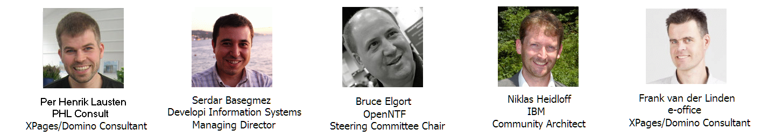
CollaborationToday.info
Developed by

