Slide 1
Occurrence Unpicked
Nigel Davis
20190908
See also (oimt2018.ND.034.xx_SpecModelApplication..)

Slide 2
Occurrence
Background
General model
Model appearance

Slide 3
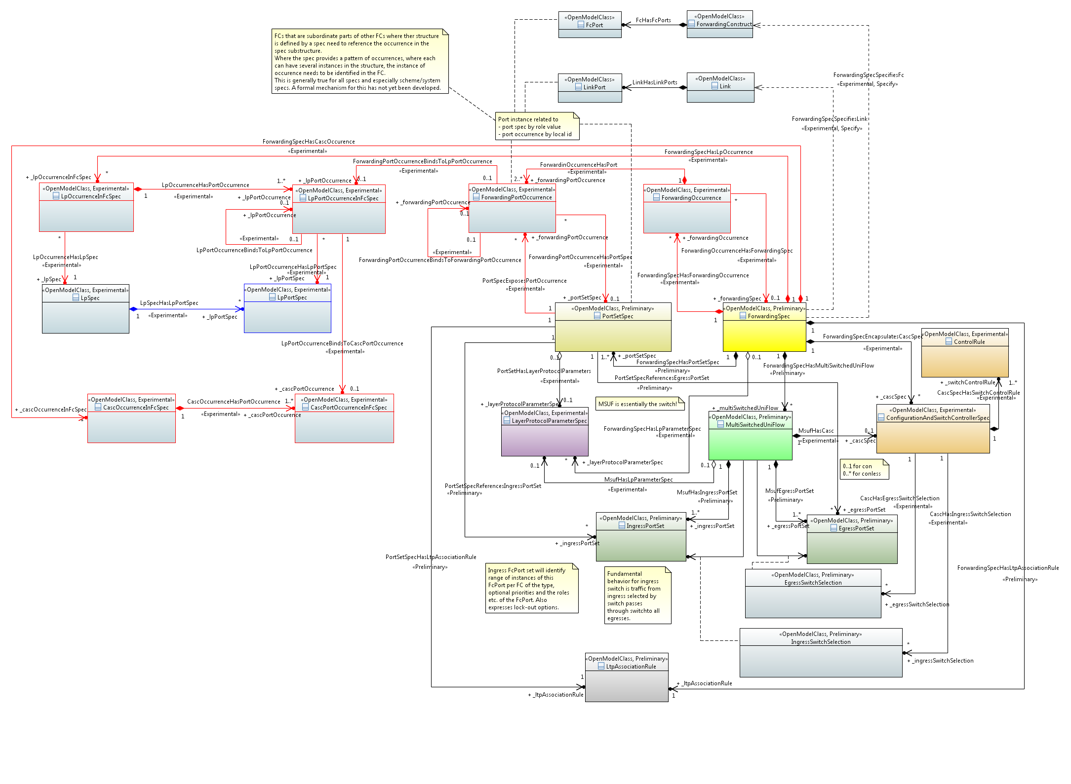
TR-512.7 1.4
TR-512.7 v1.4 introduced the occurrence into the specifications
Section 4.1.3 “Enhanced Forwarding Spec to cater for the photonic model” states…
Enable specification of a recursion of ForwardingSpecs to describe a recursion of Forwarding via the ForwardingOccurrence:
A ForwardingSpec may contain many occurrences of Forwarding where:
Each ForwardingOccurrence may have two or more ForwardingPortOccurrences and where the ForwardingPortOccurrences may be:
bound together via ForwardingPortOccurrenceBindsToForwardingPortOccurrence
exposed at the containing level via PortSpecExposesPortOccurrence
Each ForwardingOccurrence will have a ForwardingSpec that may have a further decomposition
….

Slide 4
TR-512.7 1.3 (& 1.4)
TR-512.7 v1.3 had introduced the need to represent “cases of use of” entities
It is apparent that “cases of use” are essentially “occurrences”
4.4 PC, ControlComponent and C&SC spec considerations states…
The pattern is generated using a pruning and refactoring process, where the pattern model is a pruned and refactored CIM. The pattern can include more than one case of each class, along with statements of rules (in OCL) that constrain the assembly.
The figure highlights use of occurrence (although prior to the model enhancement)
There are several occurrences of LTP in the base scheme spec in the diagram

Slide 5
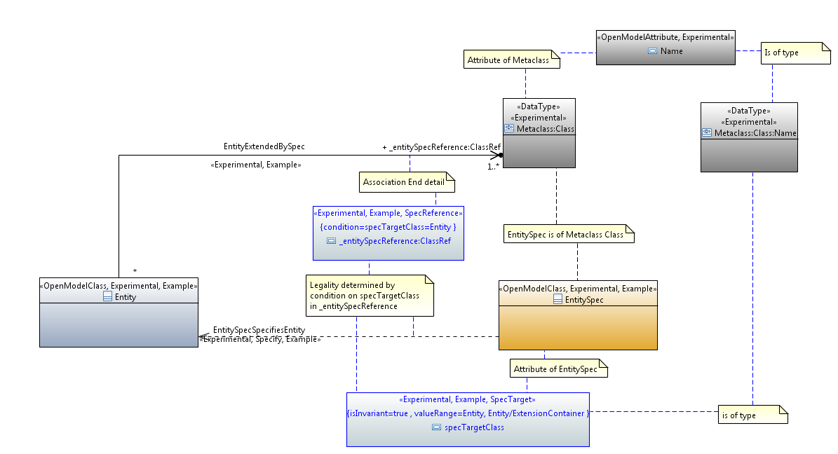
The general spec pattern
Currently we have a rather peculiar representation of the meta-level transition that takes place in the reference
An instance of a class points at a class (that specifies its detail).
This is essentially an exposure of a refinement of the UML metamodel where an instance is defined by a class
In the spec model an instance is defined by several classes
An alternative way of looking at the basic form is
An instance of a class is augmented with properties that are defined by another class
The augment is a way of inserting properties into the instance which essentially redefines the instance
The augmented instance is defined by several classes (the “base” class of the instance and the augmenting classes)
Yang augment can only introduce properties into the instance. In the core we need to:
Introduce properties
Introduce constraints
Redefine existing properties (narrowing them)
Provide invariant data
The instance is essentially fully defined by the combination of classes
The current model uses the association “EntityExtendedBySpec”
This should perhaps better be called “EntityFurtherDefinedBySpec”
This is not a simple use of UML

Slide 6
Occurrence
Similarly the Occurrence pattern is not a simple use of UML
In a spec there may be many occurrences of a particular class (e.g., FC)
The G.8032 scheme/system spec shows this clearly
The LTP, FC spec etc. are now also recognised as scheme specs
In the basic representation of the scheme spec a normal association has been used to show the multiplicity of occurrences
Each occurrence in a spec itself has a spec
There may be several occurrences with in a scheme/system that have the same spec
Occurrences of the same class in a particular scheme/system may have different specs
The classes associated with each occurrence with the same spec do not necessarily have the same associated occurrences
As a consequence, in the worst case it appears that each occurrence needs to be laid out individually (I will call a laid out occurrence an explicit occurrence)
This can be seen in the G.8032 scheme spec picture where there are many explicit occurrences of LTP
In some cases it may be sufficient to lay out the pattern of multiplicities (I will call this an explicit occurrence pattern)
There would appear to be a variable expansion of the essential spec model on a case by case basis
Because the occurrences are classes and there will be explicit occurrences formed from them that will also be classes, the association is NOT a normal association
This does also not appear to be a simple metamodel transition association as considered on the previous slide
It would appear that in the general pattern this association should be a stereotype of an ordinary association
It is apparent that the existing associations in the LTP and FC spec are actually occurrence associations
For example, in the FC spec, the MultiSwitchedUniFlow is a class, but in an actually FC spec there will be several explicit occurrences of that class with different property values etc. where some of the properties are fixed value and some are property definitions
The fixed value properties look like instance values in “slots” where as the property definitions look like attributes
So it appears that most/all spec associations are occurrence associations and that the multiplicity defines whether the spec allows the formation of one or more explicit occurrences
Of course the explicit occurrence, being a class, has a spec. Therefore this occurrence expansion is recursive

Slide 7
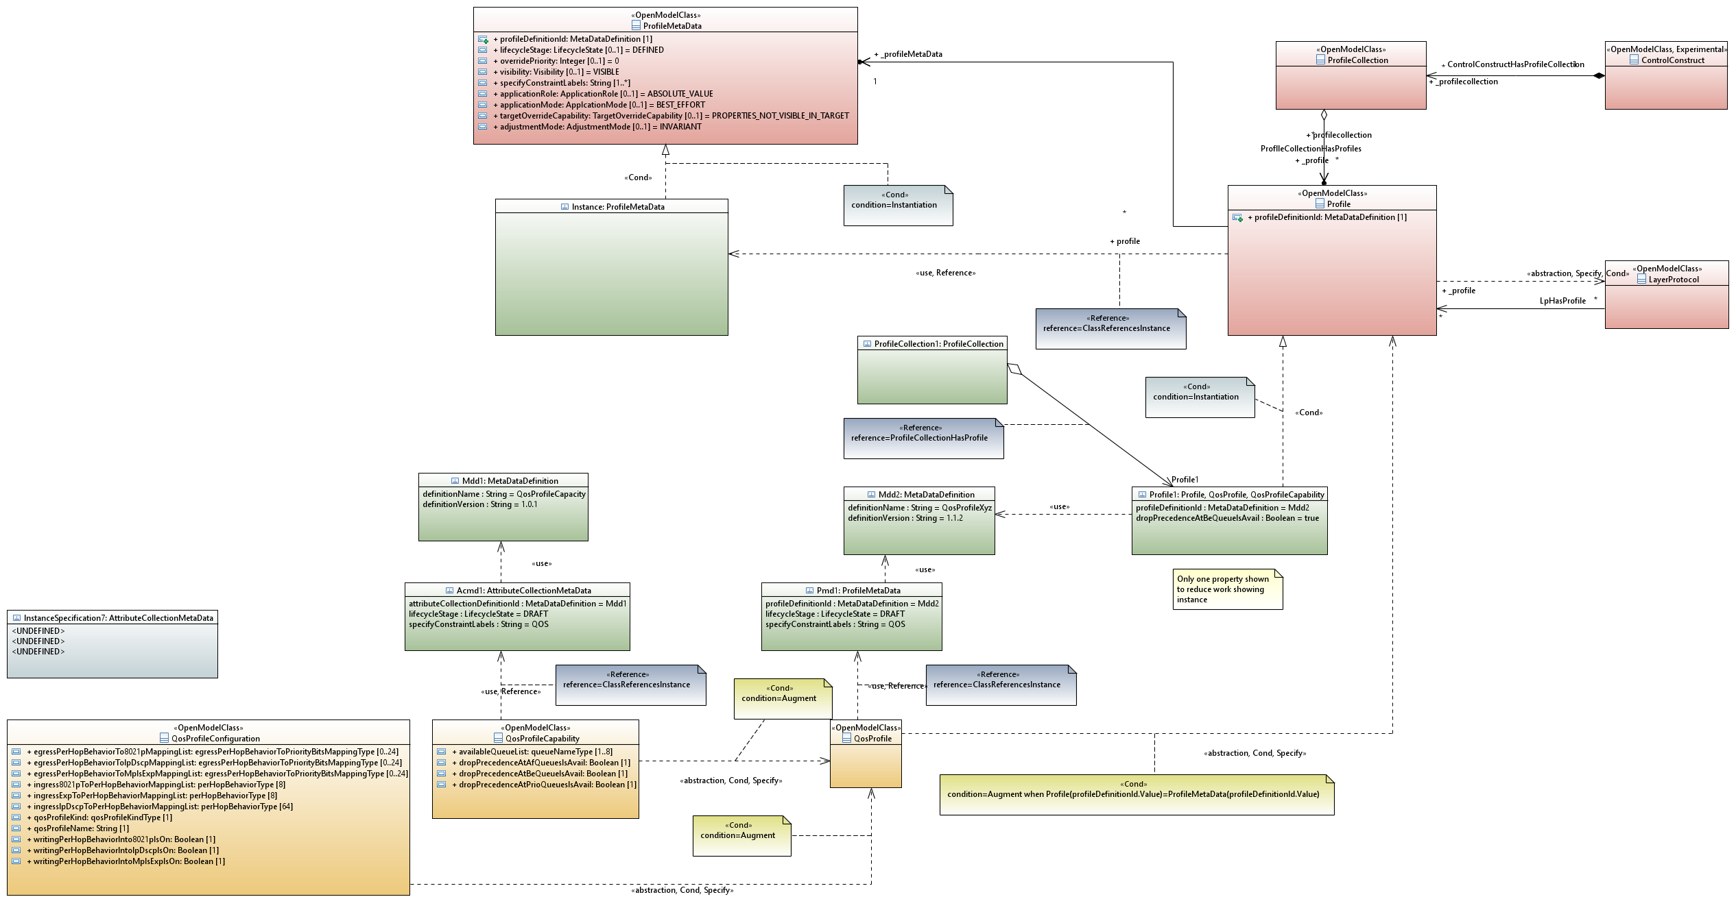
Class Instance conflation
During the Telefonica P&T work it became apparent that there was a need for a mix of classes and instances in the model
The model became a mixed meta-level model
Clearly each instance needed a class so the model became a multi-metal level model
An alternative, explored was to express the fixed value properties as severely constrained to be single values
This approach appeared more versatile and possibly more conformant with UML (although a pain to represent)
A class where all properties are severely constrained to have single values essentially has the same values as an instance
On that basis, an alternative way to represent an instance would be occurrences of severely constrained classes
Curiously, as we are now representing components as classes and would be representing instances as classes it would seem that UML could be further unified U²ML perhaps ☺
Considering that in the general case there will be things with a blend of absolute value statements and range statements, the “severely constrained attribute” approach appears more appropriate

Slide 8
FC spec rationalization
This is only partially worked at this point but…
The MultiSwitchedUniFlow is clearly a constrained FC
The MultiSwitchedUniFlow has a spec which is an assembly of uniflows and switches or the uniflow is a constrained MultiSwitchedUniFlow
If we take the constraint route then the FC spec is formed from FCs where those FCs may be constrained to be MultiSwitchedUniFlow or Uniflows
The constraint is expressed by the properties of the FC in the spec
If it is specified as uni but the ports multiplicity is >2 then it is a MultiSwitchedUniFlow
If it is specified as uni but the ports multiplicity is 2 and it has no switches then it is a uniflow
It would appear that the FC is specified by constrained forms of itself
Considering class instance conflation the constrained forms of property would be redefinitions of the versatile properties

Slide 9
Pruning and refactoring
Considering the spec pattern, there appears to be a need to replicate and refine classes to form new constrained variants of those classes
As noted in the Class Instance Conflation discussion, there appears to be an opportunity to constrain a class to represent an instance and completely replace the instance model
Clearly there is a need for a derived model to abide by the model from which it is derived and for that derivation to be traceable and verifiable as well as to update as the source model is updated
This appears to be the same need and process as what happens when we move from Core to TAPI
Hence this appears to be Pruning and Refactoring
This suggests that P&R tooling is a fundamental capability required for correct formation of specs (and also for U²ML☺)

Slide 10
LTP and FC emergence
The LTP and FC are defined by its appearance and externally visible behaviour
They are not defined by their internal detail, they are defined by what emerges from that internal detail
The LTP clearly, as we have discussed, has FCs within it, and the FC, similarly, has LTPs within it
But the FCs in an LTP spec may have LTPs within them and vice-versa
So, to trivialize, it is a repeating alternation ongoing
Clearly, there are LTPs and FCs at the same level so it is more of a recursive intertwining
The LTP and FC specs are essentially the same intertwining except that the top level of the FC is the FC phase of the intertwining and of the LTP is the LTP phase of the intertwining
Hence we need to converge the FC and LTP specs to a single spec form

Slide 11
Actions
Spec metamodel with the occurrence stereotype
General use of occurrence stereotype
Dealing with occurrences
How to distinguish spec occurrences
Whether to version spec occurrences
How to form system/scheme spec (and should we call them system specs)
How to derive a specific case of a system spec from the general case
E.g., Ciena G.8032 ring spec occurrence set from the general G.8032 ring spec occurrence set
Classes used as instances
Normalization and converge the FC and LTP spec models
Speculate more on U²ML (see also next)

Slide 12
Progression of sub-setting – Constraining Semantics
Thing has all possible properties.
Specific semantics relate to the specific modelled thing and are a narrowing of thing.
The definitions do NOT need to be orthogonal/disjoint although the intersections should be minimised.
Consider the LTP
Covers all aspects of termination and adaptation
Coverage includes recursive definition of encapsulated forwarding
All possible properties of termination and adaptation are within the allowed set
Specific properties are defined in specific specs. These properties are expressed in the appropriate instances.
Thing
Component
PC
Equipment
Information
LTP
Controller
Canonical

Slide 13
Face to Face activity
Depending upon time, expand various cases on the whiteboard to show the actual occurrences in the spec
Equipment (see next – also have a sketch of this one on paper)
Photonic (e.g. an amplifier)
G.8032 ring
For each case show an instance example

Slide 14
An Equipment case
Physical hardware represented by equipment and holder
Consider sub-rack (equipment) that has slots (say 10) where some have a common capability and some different
Assume that the equipments in the slots have SFP etc opportunity

Slide 15
Background
From CordBuild 2017

