Slide 1
Virtual face to face Model Restructuring
Nigel Davis (Ciena)
20200415

Slide 2
Background
Goal to improve:
Opportunity for collaborative development by improving coupling/cohesion
Readability of the model by improving visibility of focusses
This led to specific actions to:
Change the arrangement of the model to remove circular dependencies and make modules relatively independent
Focus packaging and arrangement on DDD Aggregate-like approach
With the following implications:
Significant work to regenerate documentation (with the obvious improvements)
Changes in association direction leading to backward compatibility concerns

Slide 3
Related considerations
Changes to approach to identity (and corresponding aspects). Agreed:
Remove the traditional hierarchy
Replacing common with separate model fragments covering identity, state etc.
Inject the identity aspect etc. into main model classes driven by the relevant fragment using tooling
We discussed this approach in TMF TIP in ~2008??
This approach leaves the model unrooted
The resulting implementation derived from the model could be unchanged
We have discussed use of tooling to deal with the properties of the Equipment model and hence all properties
We have no tooling funding! This is something we need to deal with now.

Slide 4
Compatibility
The key consideration should be semantic compatibility
Compatibility should be considered in the context of tooling and the pruning and refactoring process
Pruning and refactoring is the process we use to derive views of the model (such as TAPI)
Pruning reduces the semantic coverage
Refactoring simply rearranges the same semantic coverage
The formal process should be rigorous such that tooling can be applied
The tooling is driven by specific rule models for each derivation
A refactored model is semantically compatible so long as
There has been no loss of information in the refactoring process
Previously derived views can still be derived, even if this requires a change to the tooling
Refactoring activities
Changing of packaging content (e.g., DDD Aggregate-like clumping)
Changing the navigability of an expressed association (they are essentially semantically two way navigable always)
Changing the names of classes and properties (not really refactoring but…)
Changing the model granularity (this may increase information such that previous variants did not cover as much)
Changing the method by which particular properties are acquired (e.g., using injection instead of inheritance)

Slide 5
Minimal semantic model
Providing the minimum structure, with properties, that describes the essence of analysed space to some degree of depth (everything is strings “really”)
(I used to use the term Canonical Model but that is now appears to be defined as a superset which is misinterpretable)
No redundant information, so no loops or alternative navigations
UML does not provide the richness of expression to remove all redundant information
The Core model is roughly a semantic model with some redundancy
Should provide one and only one way of expressing each structure
Challenge is that the model necessarily presents views within views as the problem space is fractal/recursive

Slide 6
Considering evolution of representation
As the model is developed we gain insight that points to refactoring to better improve the representation of the semantics (same or extended)
Question: which redundant parts should we keep and which should we remove
Model package redundancy does not seem appropriate (although, if the model was arranged by view metadata rather than inherent structure we could present multiple arrangements of the parts)
As this happens in human language the dictionary keeps all the old semantics representations and relationships (well, roughly, but…)

Slide 7
Implications
Clearly, we should rearrange the model packaging (and not keep the old packaging)
We should deprecate but not remove old semantic representations
So LTP would keep the old associations as well as gain port, as we have already done with FD (see next slide)
I suggest that we consider reversal of navigation at decoupled package boundaries as “the same” representation (although it clearly changes the class content etc.)
For identity we use the same technique as for LTP

Slide 8
LtpPort (take 4)
We have discussed LtpPort in three separate face to face meetings. In each
Four options were discussed
The group settled on an approach that was not backward compatible although a backward compatible option was discussed
It is proposed here that we change to option 1
The old attributes and associations etc. should become «Deprecated»
We should warn in 1.5 that this is likely to happen with «LikelyToChange»

Slide 9
Restructuring further thoughts
Both LTP and Identity would benefit from tooling pruning out the deprecated associations to provide a clean view for a new application
Regardless, we should explain the migration
Ideally, it would be possible for tooling to remove the new forms and to present a clean view of the previous approach

Slide 10
Further discussion

Slide 11
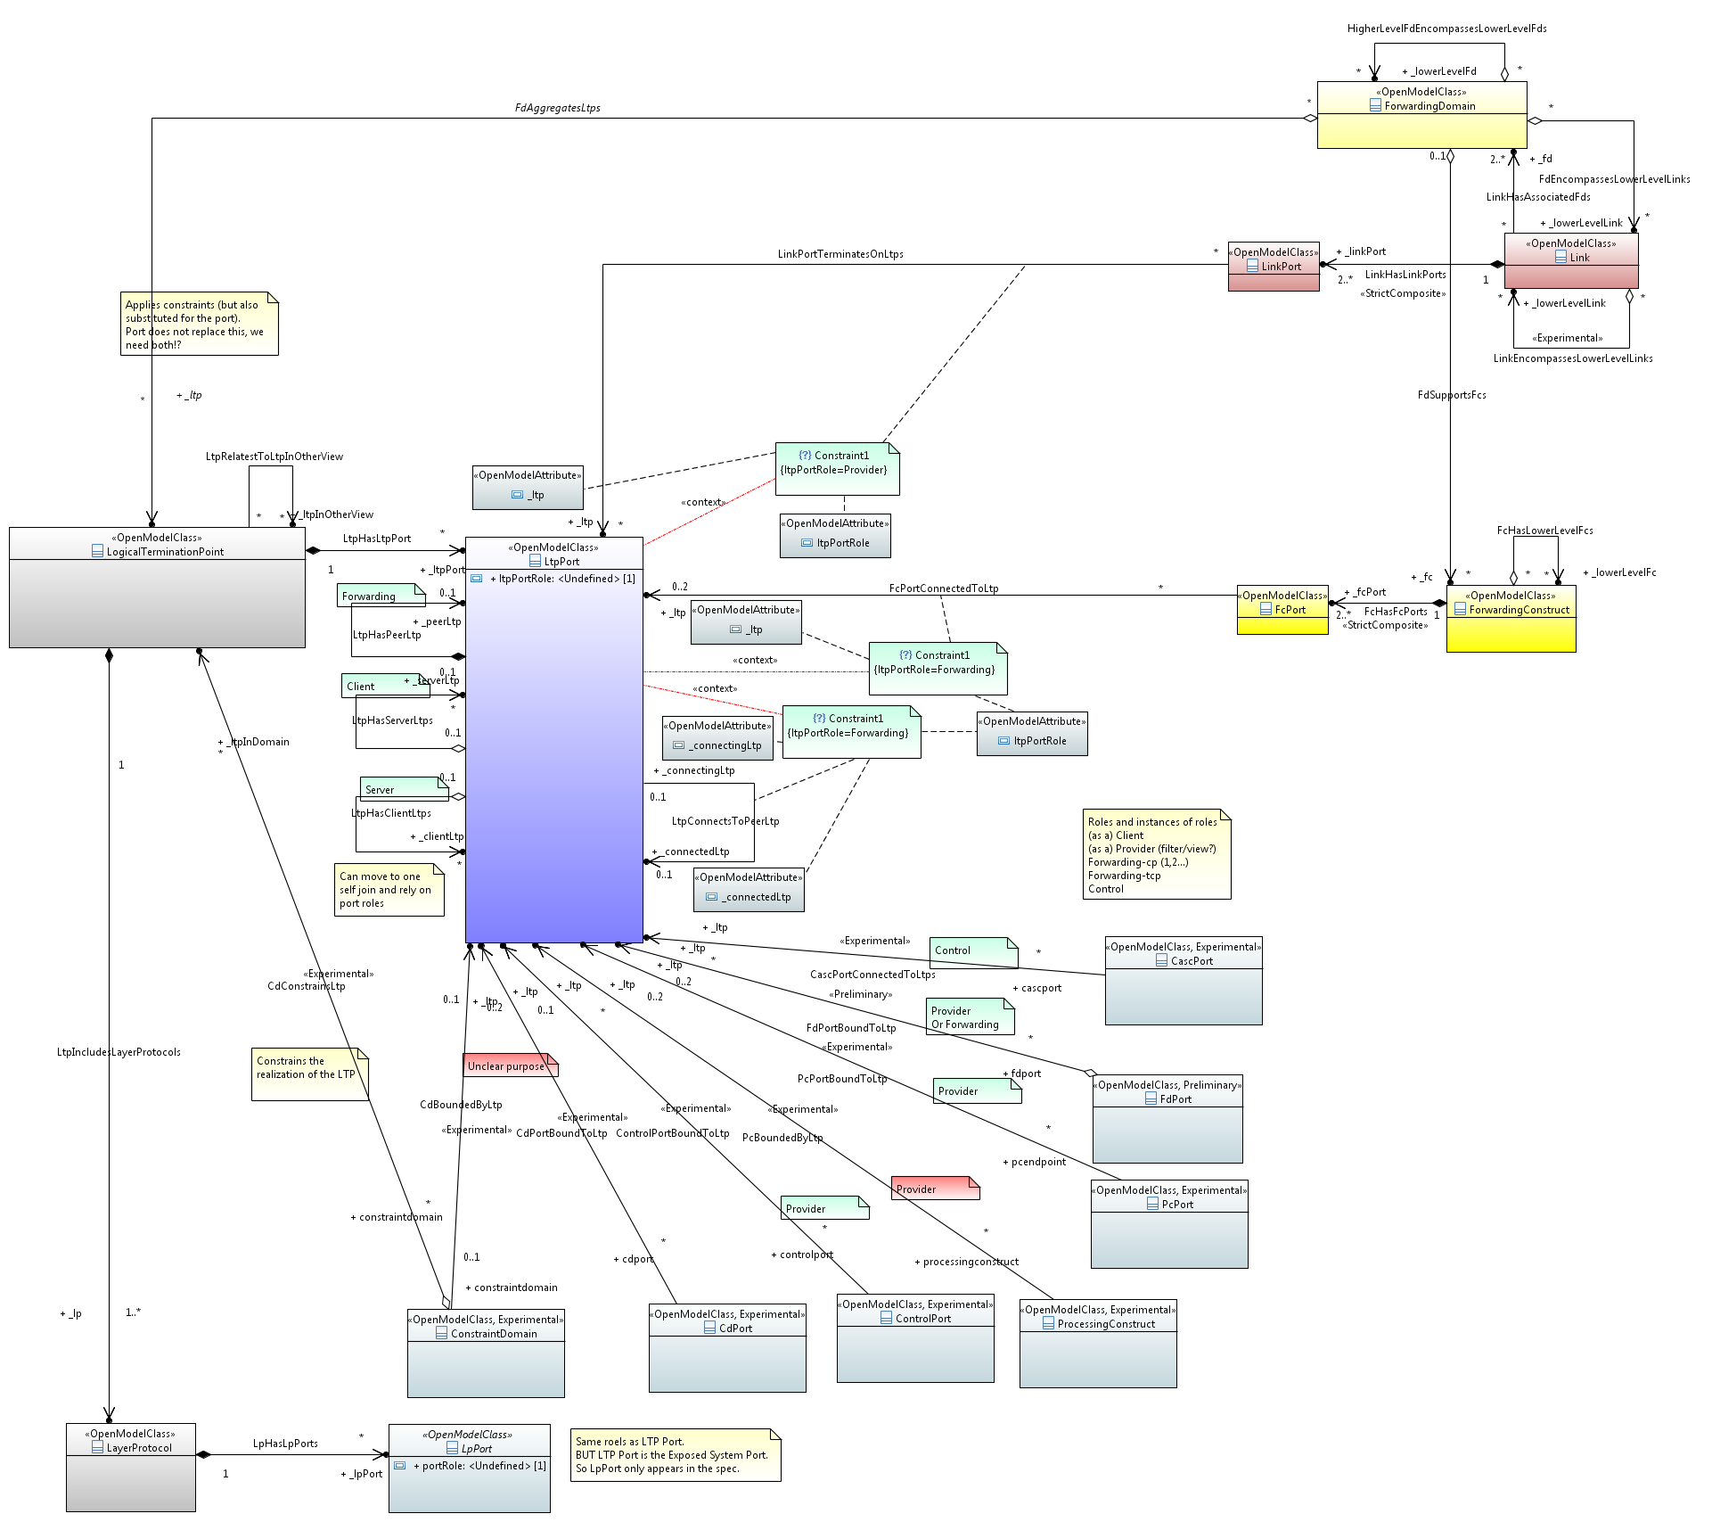
First cut LTP with Port (showing primary context)
LTP is now only aggregated by CD
Several .pptx diagrams need to change.
Should go to LtpPort
LTP port in one FD
Note that the view mapping function should describe the inter-view relationship.
It can be argued that this is a CONTROL port…
Look for other associations to LTP
Editorial approach: Changing LogicalTerminationPoint to LtpPort (and creating a new class LogicalTerminationPoint causes minimum disruption to the model, diagrams etc.
We could change the xmi ids to deal with the semantic split (new ids as neither LTP nor LtpPort are the same as the old LTP).
Or we could argue that LTP is LTP symmetric and hence can keep the old xmi id for LogicalTerminationPoint (i.e. swap the ids of the new classes).
The spec model will be impacted to some degree
Provider
Is there a relationship between LpPort and LtpPort…. Suspect not.
Spec covers this

Slide 12
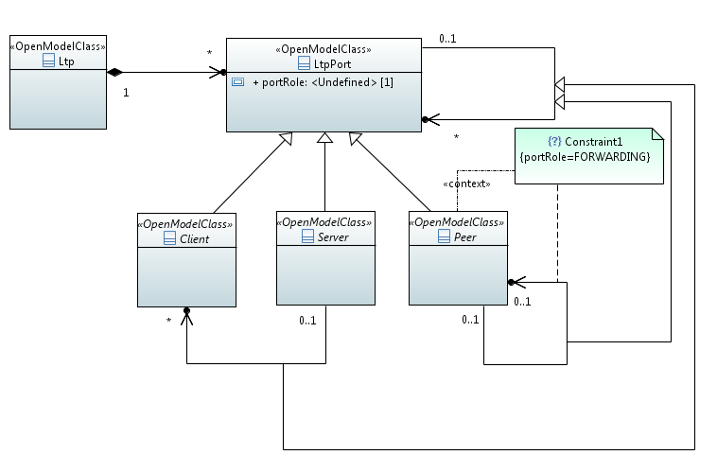
Dealing with port role complexity… suggestion for self-joins
The associations vary by role of port
The sketch shows a possible mechanism to support port role variety for the self joins
Only one rule is shown (in free hand)
Note that the “abstract” inheritance is to depict that the classes are NOT to be instantiated

