Slide 1
Component-System and Aggregates
Nigel Davis
20201112

Slide 2
Port on component through which function is accessed
Function
From TR-512.A.2
Consider cases:
A SOA component (ports are where services are accessed)
The port has no necessary physical aspect
An electronic component such as an integrated circuit where the pins are the ports
The port has a physical aspect
Component:
Is opaque such that the function of the component is only perceived as a result of interaction via its ports
The function can be described in a spec
Actions at one port often affect behaviour at other ports
Can be assembled with other components to form a system
Is realized by a system of components
The Component… defined by its ports and functions visible through the ports

Slide 3
Component realized by system of components
Function
Slight refinement to the component/system figure
Component (Opaque)
System (boundary) – a composition of Components (only visible in another view)
Function
Port
System Boundary Port perspective
Exposed Component Port persepective
Association between components of system
The realization detail is not visible.

Slide 4
Component understood as system of components
Apparent
Function
& Exposed
Properties
Component (the aggregate)
Aggregate System (boundary) – a composition of Function Components
Function Component (may have ports and may contain view components)
Apparent
Function
& Exposed
Properties
Port
System Boundary Port perspective
A single entity
Exposed Component Port persepective
Association “Within” Aggregate (either way allowed)
Apparent
Function
& Exposed
Properties
Apparent
Function
& Exposed
Properties
Apparent
Function
& Exposed
Properties
Association “Within” Aggregate (one way allowed)
Apparent
Function
& Exposed
Properties
Apparent
Function
& Exposed
Properties
The realization effect is visible.

Slide 5
Component understood as aggregation of properties
Apparent
Function
& Exposed
Properties
Apparent
Function
& Exposed
Properties
Apparent
Function
& Exposed
Properties
Apparent
Function
& Exposed
Properties
Apparent
Function
& Exposed
Properties
Apparent
Function
& Exposed
Properties
Apparent
Function
& Exposed
Properties
Apparent
Function
& Exposed
Properties
The realization effect is visible to some degree

Slide 6
Component understood partial as system of components
1) Agg-GlobalId.[Group-LocalId]^{n}.Property → Agg-GlobalId(=self).[Group-LocalId]^{n}(.Property) {inc. Agg-GlobalId(=self)}
2) Agg-GlobalId.[Group-LocalId]^{1..n}.Port-LocalId → Agg-GlobalId(=self).[Group-LocalId]^{n}.Port-LocalId OR Agg-GlobalId(=self).[Group-LocalId]^{1..n}
Component (the aggregate)
3) Agg-GlobalId.[Group-LocalId]^{n} → Agg-GlobalId(=self).[Group-LocalId]^{n}.Port-LocalId
Aggregate System (boundary) – a composition of Function Components
Function Component (may have ports and may contain view components)
GlobalId &
Properties
LocalId &
Properties
1
Port
2
System Boundary Port perspective
A single entity
LocalId &
Properties
Exposed Component Port persepctive
1
Association “Within” Aggregate (either way allowed)
LocalId &
Properties
Association “Within” Aggregate (one way allowed)
1
LocalId &
Properties
LocalId &
Properties
3
LocalId &
Properties
2
LocalId &
Properties
2
LocalId &
Properties
Effect view hybrid with some internal associations

Slide 7
1) Agg-GlobalId.Port-LocalId → Agg-GlobalId OR Agg-GlobalId.Port-LocalId
Association “Between” Aggregate (either way allowed)
2) Agg-GlobalId → Agg-GlobalId OR Agg-GlobalId.Port-LocalId OR Agg-GlobalId.[Group-LocalId]^{n}(.Property)
Association “Between” Aggregate/Port (one way allowed) where port is addressed
3) Agg-GlobalId.[Group-LocalId]^{n}.Property → Agg-GlobalId OR Agg-GlobalId.[Group-LocalId]^{n}(.Property)
Association “Between to within” Aggregate (using address)
X
Association not allowed
2
GlobalId &
Properties
LocalId &
Properties
GlobalId &
Properties
LocalId &
Properties
2
LocalId &
Properties
LocalId &
Properties
LocalId &
Properties
2
LocalId &
Properties
LocalId &
Properties
LocalId &
Properties
LocalId &
Properties
1
LocalId &
Properties
LocalId &
Properties
LocalId &
Properties
x
1
LocalId &
Properties
X
x
X
LocalId &
Properties
3
3
LocalId &
Properties
LocalId &
Properties
Interrelationships in a system of components

Slide 8
Further twists
In the ONF model we have deep views where the effect of realization is explained in terms of levels of system abstraction in ONE view
FC aggregates FCs etc. in one system view
Each FC is an aggregate and associations between aggregates expose layering
The components in the upper level components both provide internal views as well as exposure of the next level of abstraction
This hybrid view allows simultaneous examination of several levels of abstraction providing both the abstract summary and the “realization” detail
The component-system separation is intentionally collapsed and components are realized in terms of components directly
In TAPI there is a stronger separation between Node (component) and Topology (system) but TAPI still provides a single view with multi-level exposure

Slide 9
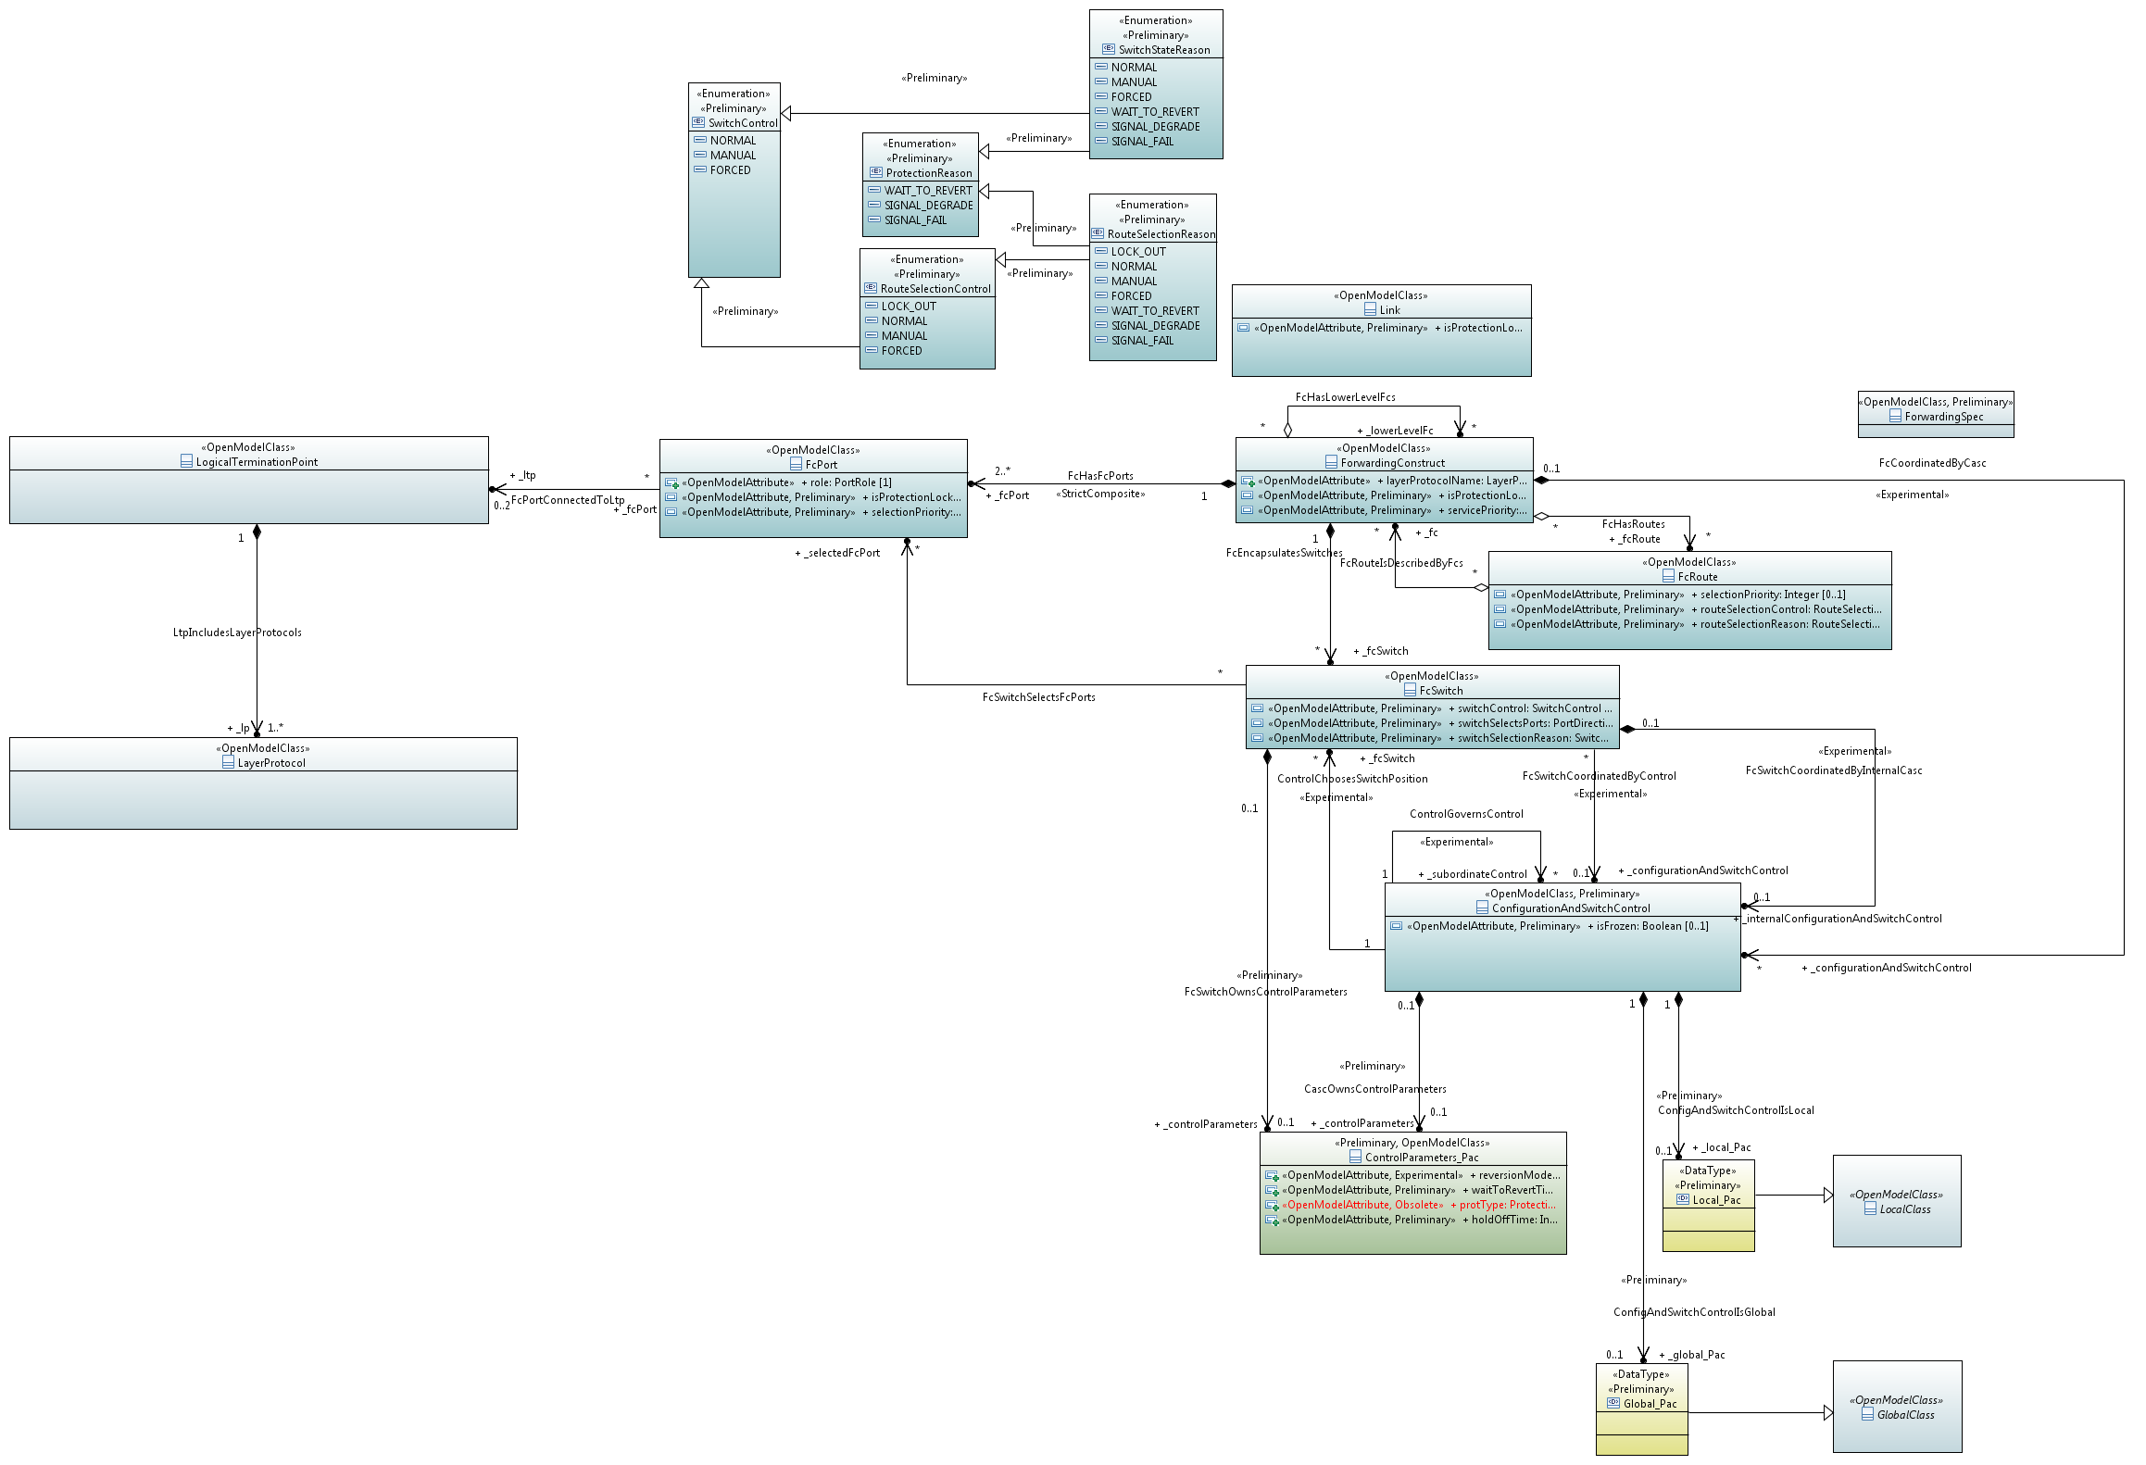

Slide 10
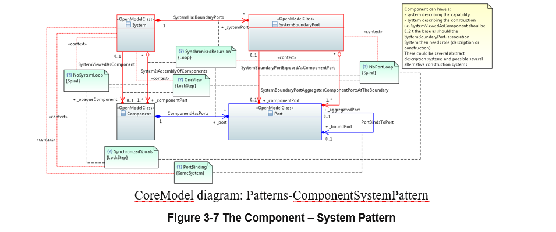

Slide 11
