Slide 1
Simplified Spec
Nigel Davis
(updated 20210907)

Slide 2
Considerations
Spec recap
Considering Equipment and Sensors
Some examples
General considerations

Slide 3
Spec recap (from TR-512.7)
Invariants: Formal definition of properties that are invariant for the type
That then need not be in each instance
Extension: Formal definition of extension properties and extension of specific properties
Narrowing: Reduction in range of properties defined elsewhere
Substitution: Alternative to model property definitions
Combinations: Combining properties from elsewhere in an instance and combining several properties into one property
Definition Traceability: Deep model-based definition and traceability
Structures: Expressing constraints, structures and assemblies
Dynamic: Run-time application of new definitions

Slide 4
Progression of sub-setting – Constraining Semantics
Discuss…
CH : I think this is the wrong way of thinking of the problem. Don’t start with thing and try and cull it, assemble small bits. Don’t try and decompose or narrow Thing:
From oimt.2019.ND.012.01_SpecModelRework
Thing has all possible properties.
Specific semantics relate to the specific modelled thing and are a narrowing of thing.
The definitions do NOT need to be orthogonal/disjoint although the intersections should be minimised.
Consider the LTP
Covers all aspects of termination and adaptation
Coverage includes recursive definition of encapsulated forwarding
All possible properties of termination and adaptation are within the allowed set
Specific properties are defined in specific specs. These properties are expressed in the appropriate instances.
Thing
Component
PC
Equipment
Information
LTP
Controller
Canonical

Slide 5
Target
From oimt2020.ND.008-Spec
Component-System spec pattern with occurrence
There is an issue with the current occurrence model in the core that needs to be reworked
Specialize the pattern by subset semantic approach to form structures for FC and LTP spec
Show how the FC and LTP specs are simply different phases of recursion of the same structure
Develop PC spec from the pattern

Slide 6
Occurrence (interpreting oimt.2019.ND.019.00-Occurrence.pptx)
An instance of a class points at a spec that defines (as per previous slide) the properties of that instance
The spec is used for many instances of that class
The spec corresponds to a type or case of the class
A spec is a combination of:
Invariant (instance) data
Where that data has its one spec/class
Property/attribute definitions
Where the definitions may be derived from others and where they may influence existing class definitions
Associations within and between specs relating parts forming structure
Where the relationships relate to flow of signal or some propagating effect
Constraints
Where the constraints may be on values, value combinations (defining n-dimensional envelopes), associations
There may be many occurrences of spec (where occurrences are similar)
Circuit Pack Specs
A spec may be built from occurrences of other specs
There may be many occurrences of the same type of thing in a spec definition of a type of thing
Memory cells in a memory chip

Slide 7
A simple example
An equipment type “CPA1B2” that
Is a Circuit Pack (slide in unit)
Has four temperature sensors where:
two simply measure normal room temperatures
two measure temperature which is tightly controlled and is required to be within a very narrow fixed range where the temperature is reported and over temperature alerts are provided
Is manufactured by ABC Company
Has a restricted “user name” that can only have a 16 alpha capitals and numeric characters
Fits in two backplane types “BPAB” and “BPCD”

Slide 8
Expanding the example
Sketch of 4 types of equipment
Some slots in each BP take both Circuit Pack types, some only one type
Sensor positions are important for diagnostics
An instance of BPAB has 3 instances of slot
So, the spec BPAB has 3 occurrences of slot spec
BPAB
CPA1B2
1
2
3
BPCD
CPC3D4
Key
temperature tightly controlled within a very narrow fixed range where the temperature is reported and over temperature alerts are provided
measure normal room temperatures
1
2

Slide 9
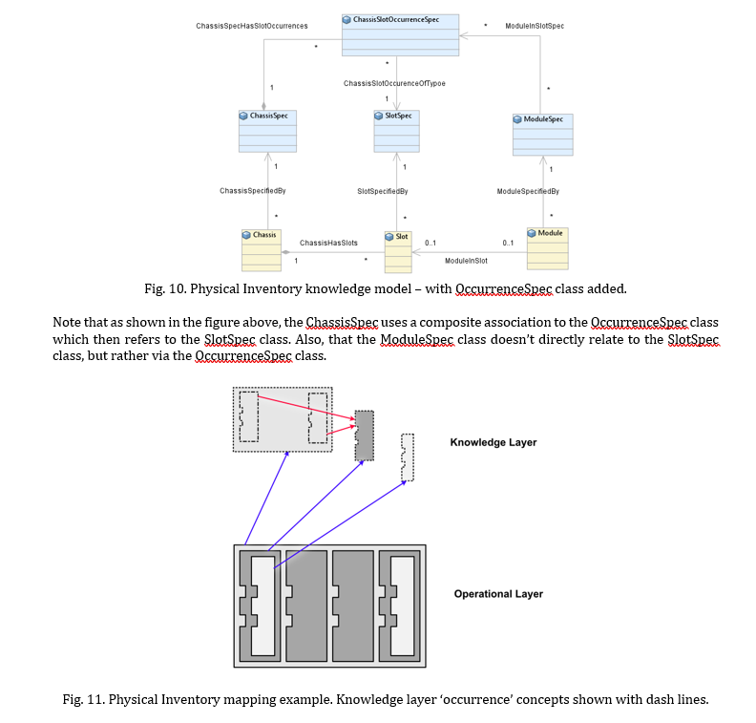
Extract from PLoP paper
The following slides use this essential pattern…

Slide 10
Expanded Spec (rough)
Entity Type Spec
Occurrence Type Rules
Entity Type Spec
Occurrence Type Rules
Compatible with
Occurrence Type
Invariant
Values
Entity Type Spec
Occurrence Type
Invariant
Values
Entity Type Rules
Entity Type Rules
Entity Type Rules
Entity Type Rules
Entity Instance
Property
Definition
Entity Instance
Property
Definition
Entity Type
Invariant
Values
Entity Type
Invariant
Values
Association
X
Entity Type
Invariant
Values
Entity Type
Invariant
Values
Type = “ABC”
Manufacturer = “ABCD”
Entity Instance
Property
Definition
Holder
Occurrence
1
Entity Instance
Property
Definition
Association
Holder Occupied By
Entity Instance
Property
Definition
Sensor Occurrence
1
Entity Instance
Property
Definition
Measure (RO)
Threshold setting (RW)
Etc.
Serial number = String
Spec values
Equipment
Type = “BPAB”
Holder
Occurrence
2
Spec values
Holder
Type = “Hxx”
Connector Occurrence
1
Spec values
Equipment
Type = “CPA1B2”
Sensor Occurrence
2
Spec values
Sensor
Type = “LowTemp”
Holder
Occurrence#
3
Connector Occurrence
2
May be reversed as per PLoP
Sensor Occurrence
3
Al properties have range restrictions etc. defined
Spec values
Holder
Type = “Hyy”
Spec values
Equipment
Type = “CPC3D4”
Sensor Occurrence
4
Spec values
Sensor
Type= “HighTemp”
Key
Instance (e.g., in JSON value)
Spec ref
Type (e.g., in Yang schema)
Spec structure
Constraints (e.g., in OCL)
Enumeration
1
2
3
1
2
3
BPAB
BPAB
CPA1B2
CPA1B2

Slide 11
valid-value
references … (when) … is-one-of
is-one-of, range etc. … (when x is-one-of)
available-when
preferred-value (may be equation)
value-priority
excluded-value
value-missing
value-suspect

Slide 12
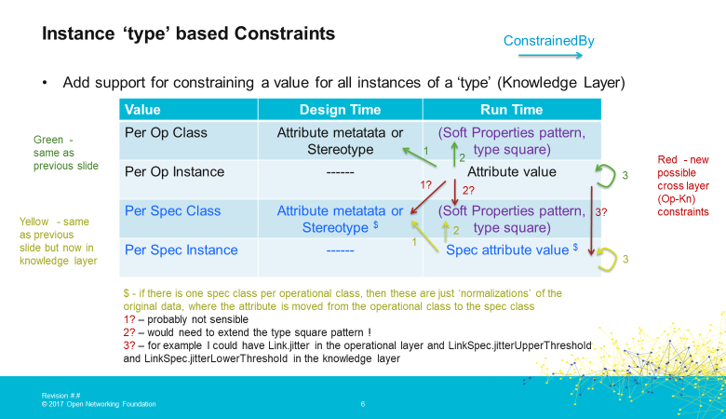
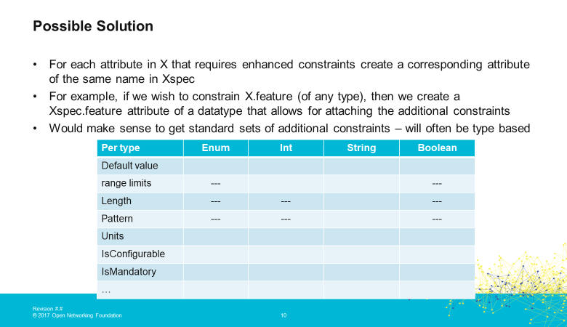
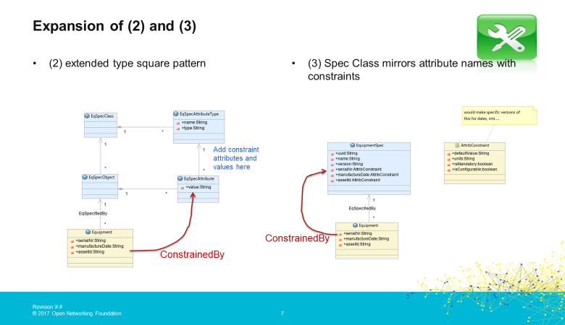
Operational Layer
Knowledge Layer

Slide 13
Spec recap (from TR-512.7)
Invariants: Formal definition of properties that are invariant for the type
That then need not be in each instance
Extension: Formal definition of extension properties and extension of specific properties
Narrowing: Reduction in range of properties defined elsewhere
Substitution: Alternative to model property definitions
Combinations: Combining properties from elsewhere in an instance and combining several properties into one property
Definition Traceability: Deep model-based definition and traceability
Structures: Expressing constraints, structures and assemblies
Dynamic: Run-time application of new definitions
CH: Are these YANG features?
a table would be good to match with solutions

Slide 14
Extraction from spec showing examples
|
|
Entity Type Spec
Each definition can use the yang opportunities to constrain the properties.
leaf abcd {
if-feature xxxx;
type uint64; string; Boolean;
range “1..4 | 10..20”;
length “1..25”;
pattern “[0-9a-fA-F]*”
default “4”;
units “Celsius”;
config false;
mandatory true;
description "none";
reference “spec abc”;
status “current”, “deprecated”, “obsolete”
when
}
list defg {
type…
ordered-by user;
key 'position-sequence’;
unique “leaf1 leaf2”
max-elements 12;
min-elements 3;
uses defg;
description "none";
}
Deviate "not-supported", "add", "replace", or "delete“ 7.18.3.2.
Add Enum as identity…
Must and error-message (constraints on valid data), position (bit position), refine,
“entity-type-invariants”: [ { “manufacturer”: “CIEN”
“equipment-type”: “BPAB”, “humidity-rating”: “…”, }, ],
Run-time augment with formal properties, not soft properties.
Entity Type Rules
Entity Type
Invariant
Values
Entity Type
Property
Definition
container entity-type-invariants {
leaf manufacturer {..}
leaf equipment-type {..}
leaf humidity-rating {..}
}
Derivation reference
Entity Instance
Property
Definition
container entity-instance-properties {
leaf serial-number {..}
leaf manufacture-date {..}
leaf asset-instance-identifier {..}
}
These properties appear as attributes in the instance.
Spec values
Property
Definition
container spec {
leaf spec-type {..}
leaf spec-uuid {..}
leaf spec-name {..}
leaf spec-version {..}
}
Spec values
Equipment
Type = “BPAB”
“spec”: [ { “spec-type”: “EquipmentSpec”
“spec-uuid”: “4e537278-79f8-39ad-804b-f0b553cb2ffb”, “spec-name”: “BPAB”, “spec-version”: “5” }, ],
Note that each attribute is defined formally using Yang.
We may need to add references to origin for each attribute etc.
Some properties are pruned/refactored versions of other properties in other areas.
Key
Instance (e.g., in JSON value)
Spec ref
Type (e.g., in Yang schema)
Spec structure
Constraints (e.g., in OCL)
Enumeration
1
2
3
1
2
3
BPAB
BPAB
CPA1B2
CPA1B2

Slide 15
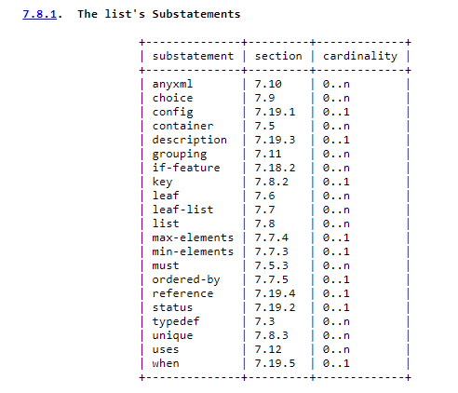
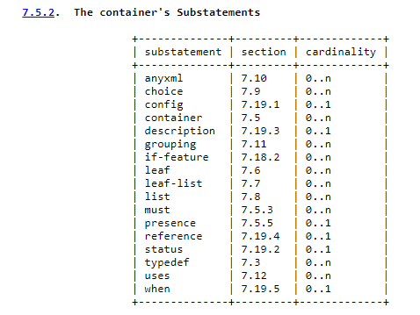
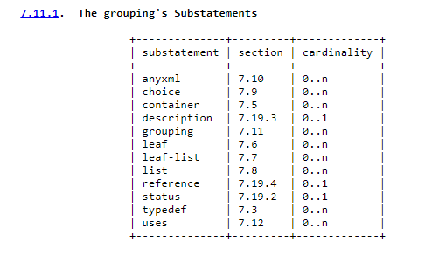
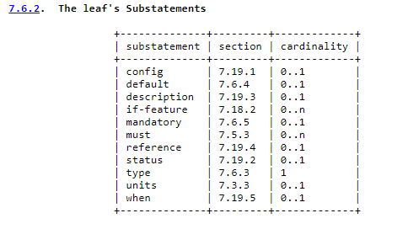
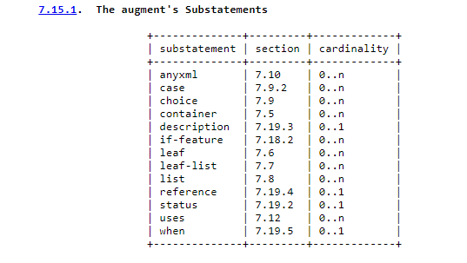
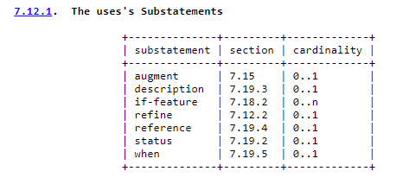

Slide 16
Notes from Martin S during call this week
augment /network-function/all-possible-circuit-packs-yesterday-now-and-in-future/occurrence {
when '/network-function/holder/position = 1'; "Driving!"
leaf selected-circuit-pack {
must "/network-function/supported-circuit-packs/identifier = 'A' or "Constrains!"
/network-function/supported-circuit-packs/identifier = 'B' or
/network-function/supported-circuit-packs/identifier = 'C'"
..... = [.....]
type leafref {
path "/network-function/supported-circuit-packs/identifier";
}
}
leaf-constrains slot-type {
allowed-values: [...];
}
// add here the differences (somehow :))
description
"This section describes the constrains on the any if it is mounted in
holder of position equals to 1.";
}

Slide 17
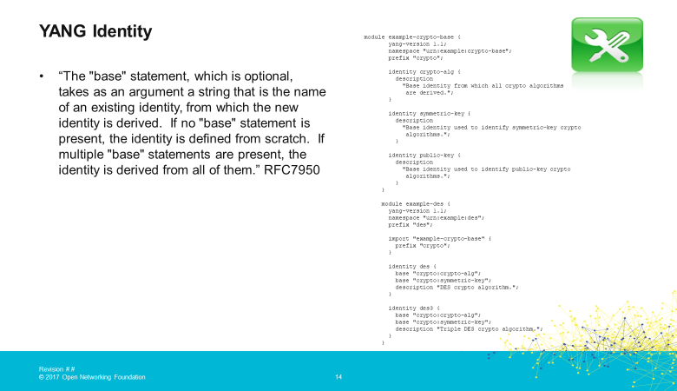

Slide 18
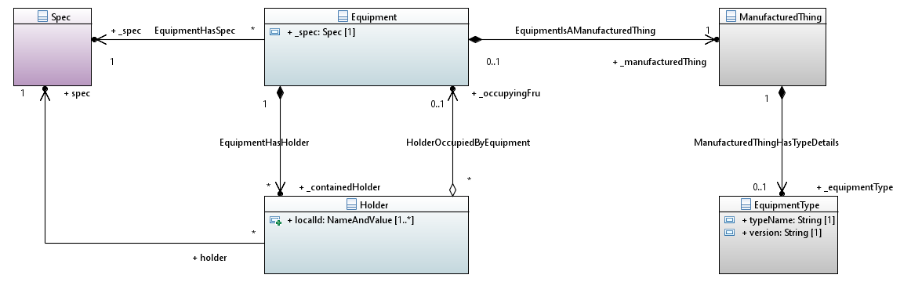
Interpretation – Occurrence and Constraint
.. .. ..{
when '.._containedHolder/localId = 1'; “Each Occurrence is set out… note: partial form for localId (as it is an NVP list)”
leaf _occupyingFru {
must “.. Equipment/_spec = 'A' or "Constrains!"
.. Equipment/_spec = ‘B’ or
.. Equipment/_spec = ‘C’”
…
…
when '.._containedHolder/localId = 2';
leaf _occupyingFru { ….
This is a separate definition that needs to abide by and draw from the equipment yang
This does not deal with the general property constraints yet.
This does not deal with the constraint on localId (as an example of a general property constraint)

Slide 19
Spec recap (from TR-512.7)
Invariants: Formal definition of properties that are invariant for the type
That then need not be in each instance
Extension: Formal definition of extension properties and extension of specific properties
Narrowing: Reduction in range of properties defined elsewhere
Substitution: Alternative to model property definitions
Combinations: Combining properties from elsewhere in an instance and combining several properties into one property
Definition Traceability: Deep model-based definition and traceability
Structures: Expressing constraints, structures and assemblies
Dynamic: Run-time application of new definitions

Slide 20
Structure
General structure
Pruned structure (vendor and/or application)
Driven by P&R spec
Specialized pruned structure (vendor and/or application)
P&R Occurrences and assemblies with general specs defining distinguishing content
Minimal augmentation
Property units
Generalized superset statement
Augment with condition

Slide 21
Extraction from spec showing examples
“occurrence-type-invariants”: [ { “physical-position”: “…”
“temperature-range”: “…”, }, ],
Occurrence Type Rules
container occurrence-type-invariants {
leaf physical-position {..}
leaf temperature-range {..}
}
Occurrence
Type
Property
Definition
Occurrence Type
Invariant
Values
container entity-type-invariants {
leaf temperature {..}
leaf high-threshold-crossed {..}
}
Entity Instance
Property
Definition
container sensor-occurrence-invariants {
leaf local-identifier {..}
}
Sensor Occurrence
Property
Definition
Sensor Occurrence
1
“sensor-occurrence-invariants”: [ { “local-identifier”: “1”
}, ],
Key
Instance (e.g., in JSON value)
Spec ref
Type (e.g., in Yang schema)
Spec structure
Constraints (e.g., in OCL)
Enumeration
1
2
3
1
2
3
BPAB
BPAB
CPA1B2
CPA1B2

Slide 22
Essential pattern
Entity Type Spec
Occurrence in Entity
Entity Type Rules
Association
X
Occurrence Type Rules
Association
X
Entity Type
Invariant
Values
Alternatives
Dependent
Associates
Occurrence Type
Invariant
Values
Alternatives
Dependent
Associates
Entity Instance
Property
Definition
Occurrence Instance
Property
Definition
Spec values
(Type = “…”
Etc.)
*
Occurrence
*
1
Key
Occurrence (not replaceable) is a slot, sensor, connector etc.
Instance (e.g., in JSON value)
Spec ref for the occurrence (can be folded into the occurrence perhaps)
Type (e.g., in Yang schema)
Spec structure
Constraints (e.g., in OCL)
List of alternative associates for the occurrence
Spec ref allowing specs to be modularized and common elements shared

Slide 23
Occurrence
From oimt.2019.ND.019.00-Occurrence.pptx
Similarly the Occurrence pattern is not a simple use of UML
In a spec there may be many occurrences of a particular class (e.g., FC)
The G.8032 scheme/system spec shows this clearly
The LTP, FC spec etc. are now also recognised as scheme specs
In the basic representation of the scheme spec a normal association has been used to show the multiplicity of occurrences
Each occurrence in a spec itself has a spec
There may be several occurrences with in a scheme/system that have the same spec
Occurrences of the same class in a particular scheme/system may have different specs
The classes associated with each occurrence with the same spec do not necessarily have the same associated occurrences
As a consequence, in the worst case it appears that each occurrence needs to be laid out individually (I will call a laid out occurrence an explicit occurrence)
This can be seen in the G.8032 scheme spec picture where there are many explicit occurrences of LTP
In some cases it may be sufficient to lay out the pattern of multiplicities (I will call this an explicit occurrence pattern)
There would appear to be a variable expansion of the essential spec model on a case by case basis

Slide 24
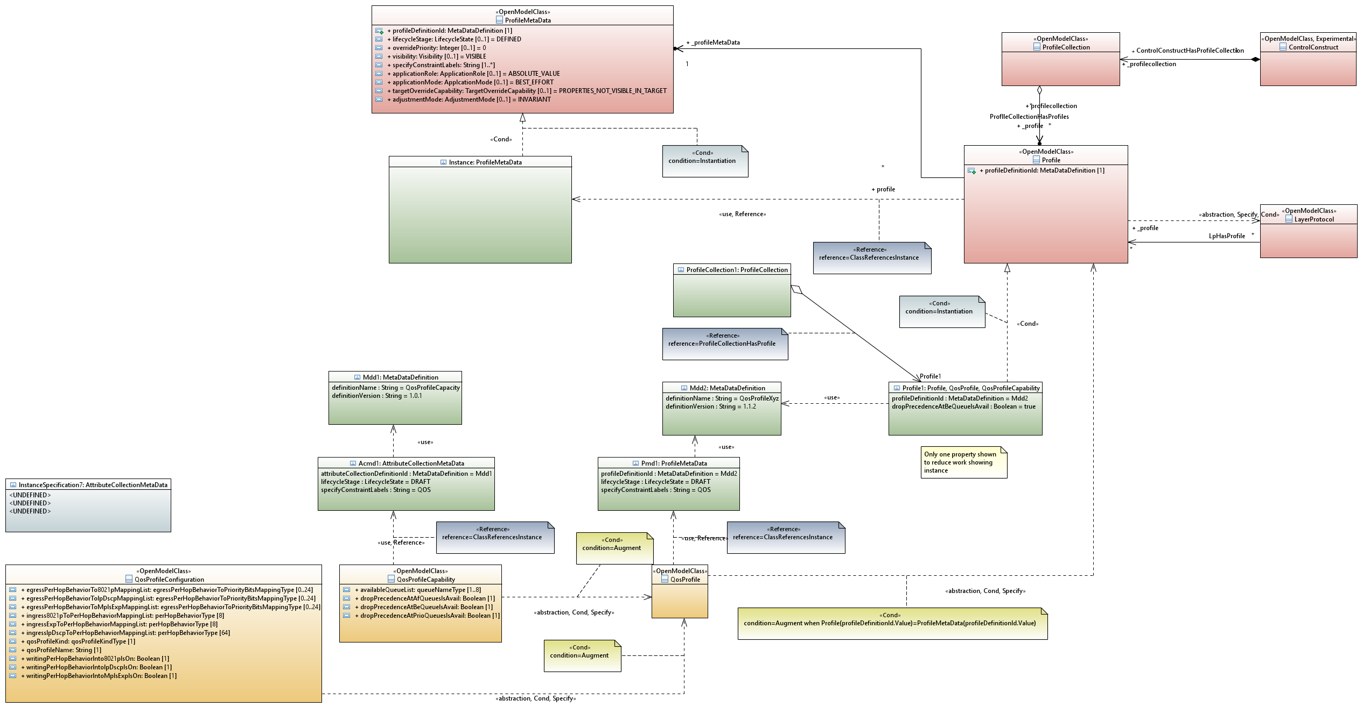
Class Instance conflation
From oimt.2019.ND.019.00-Occurrence.pptx
During the TMF P&T work it became apparent that there was a need for a mix of classes and instances in the model
The model became a mixed meta-level model
Clearly each instance needed a class so the model became a multi-metal level model
An alternative, explored was to express the fixed value properties as severely constrained to be single values
This approach appeared more versatile and possibly more conformant with UML (although a pain to represent)
A class where all properties are severely constrained to have single values essentially has the same values as an instance
On that basis, an alternative way to represent an instance would be occurrences of severely constrained classes
Curiously, as we are now representing components as classes and would be representing instances as classes it would seem that UML could be further unified U²ML perhaps ☺
Considering that in the general case there will be things with a blend of absolute value statements and range statements, the “severely constrained attribute” approach appears more appropriate

Slide 25
Occurrence
Because the occurrences are classes and there will be explicit occurrences formed from them that will also be classes, the association is NOT a normal association
This does also not appear to be a simple metamodel transition association as considered on the previous slide
It would appear that in the general pattern this association should be a stereotype of an ordinary association
It is apparent that the existing associations in the LTP and FC spec are actually occurrence associations
For example, in the FC spec, the MultiSwitchedUniFlow is a class, but in an actually FC spec there will be several explicit occurrences of that class with different property values etc. where some of the properties are fixed value and some are property definitions
The fixed value properties look like instance values in “slots” where as the property definitions look like attributes
So it appears that most/all spec associations are occurrence associations and that the multiplicity defines whether the spec allows the formation of one or more explicit occurrences
Of course the explicit occurrence, being a class, has a spec. Therefore this occurrence expansion is recursive

Slide 26
General application of occurence
Vendor Application Occurrence Structure
Vendor Application focussed Occurrence
Case spec invariant values
Case spec invariant values
Case based property definitions
Uses
Case based property definitions
Case Invariant Values
Case Invariant Values
Structure Constraint
Property Usage Constraint
P&R
Pattern Structure
OR
Application focussed Occurrence Structure
P&R
Case spec invariant values
Structure definitions
Instance
Case based property definitions
P&R
Structure Constraints
Instance
Case Invariant Values
Structure Constraint
Base
Application focussed Occurrence
Case spec invariant values
Case based property definitions
Case Invariant Values
General Augment definition
Instance
Augment
Property Usage Constraint
P&R
General spec definitions
Instance
Application based Augment
Instance
P&R
Case spec invariant values
Constraint
Case based property definitions
Standard augment property set
Case based Augment
Case Invariant Values
General spec invariant values
Case spec invariant values
Property Usage Constraint
General property definitions
P&R
Case based property definitions
Instance
Property Usage Constraint
Case Invariant Values
Property Usage Constraint

Slide 27
Discussion

Slide 28
Background
From CordBuild 2017

Slide 29
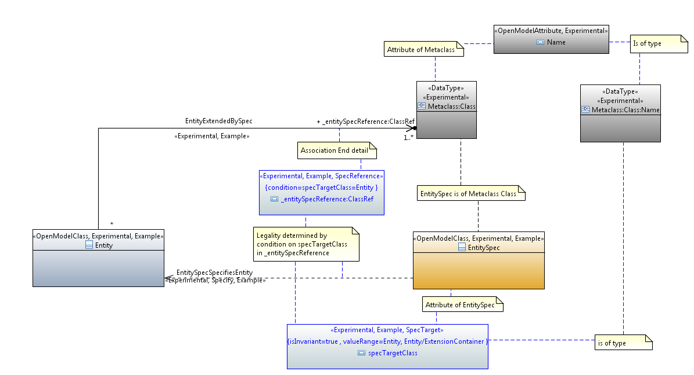
The general spec pattern
Currently we have a rather peculiar representation of the meta-level transition that takes place in the reference
An instance of a class points at a class (that specifies its detail).
This is essentially an exposure of a refinement of the UML metamodel where an instance is defined by a class
In the spec model an instance is defined by several classes
An alternative way of looking at the basic form is
An instance of a class is augmented with properties that are defined by another class
The augment is a way of inserting properties into the instance which essentially redefines the instance
The augmented instance is defined by several classes (the “base” class of the instance and the augmenting classes)
Yang augment can only introduce properties into the instance. In the core we need to:
Introduce properties
Introduce constraints
Redefine existing properties (narrowing them)
Provide invariant data
The instance is essentially fully defined by the combination of classes
The current model uses the association “EntityExtendedBySpec”
This should perhaps better be called “EntityFurtherDefinedBySpec”
This is not a simple use of UML

Slide 30
Considering LTP

Slide 31
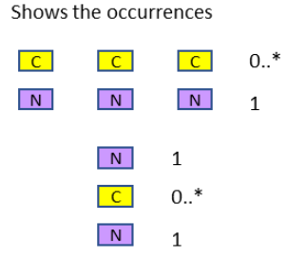
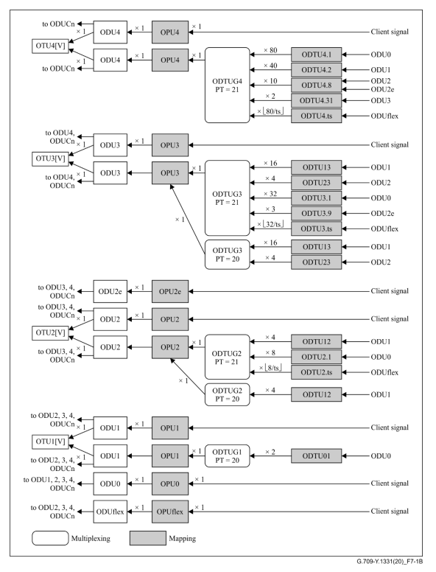
Layer stack
Each CEP “occurrence set” has a collection of capabilities
The capabilities of a CEP “occurrence set” may be a subset of the standard definition and may have proprietary features
CEP “occurrence set” per mapping option
The mapping options may be a subset of the standard
The standard is not machine interpretable and hence has to be stated.
It is not sufficient to state “as G.709” as that then has to be coded
The structure is essentially the same as equipment in slot
The coding form can be the same as equipment in slot
The current LTP spec structure attempts to account for this
It is particularly complex
A simplified entry is required
Using TAPI pictorial symbols
CEP occurrences per stack differ only in identifier
NEP occurrences differ in mapping
CEP occurrences differ only in identifier.

Slide 32
General principles (rough)
Start with a broad definition
Recursively narrow the definition
Some properties are dropped
Some properties get constrained
Some properties become single value
Once a property becomes a single value it does not need to be reflected in the next narrowing
This is essentially pruning (from pruning and refactoring)
“leaf” : {
“name” : “x”,
“type” : “string”
},
“leaf” : {
“name” : “y”,
“type” : “integer”
},
“leaf” : {
“name” : “z”,
“type” : “Boolean”
},
…
“leaf” : {
“name” : “x”,
“range” : “A..Z,_”
},
“leaf” : {
“name” : “y”,
“range” : “0..100”,
“units” : “Celsius”
},
“leaf” : “z”,
…
“leaf” : “x”,
“leaf” : “y”,
…
“z” dropped
“z” unchanged from previous definition.
Definition from previous level need not be stated
“leaf” : {
“name” : “x”,
“value” : “FIXED_VALUE”
},
“leaf” : {
“name” : “y”,
“range” : “10..50”,
},
…
“x” : “FIXED_VALUE”,
“leaf” : {
“name” : “y”,
“range” : “10..50”,
},
…
“y” : “25”,
…
Which is
This is the “instance”.
x is omitted as it is fixed in the previous level
As name and value is the normal form
This leads to there being several property name value constraints “name” : “name” is not allowed etc. Hence may want to shift the label space for the yang to not overlap with useful domain labels.

Slide 33
Further considerations
Definitions may be merged into new definition
Proprietary properties may be added via Augment
An “enumeration” may be extended so long as the values can be considered as within the original semantics
The expression of a property could be transformed if within the original semantics
Temperature can be transformed to Kelvin from Celsius
Colour can be transformed from Enumeration to RGB

Slide 34
Considering nested definition
The definition can be built from a merge of (roughly)
The intention is to reduce the need for specification repetition.
The definition below is longhand.
"leaf" : {
"name" : "temperature",
"type" : "decimal64",
"range" : "0.0... 100.0",
"units" : "Celcius",
“config” : “false”
},
…
"leaf" : {
"threshold-definition" : [
{
"name" : "upper-threshold",
“type” : “decimal64”,
"config" : "true";
“leaf” : {
“name” : “granularity-step“,
“type” : “integer”,
“default” : "1“,
},
“leaf” : {
“name” : "hysteresis“,
“type” : “signed-integer”
},
"orientation" : "increasing",
…
"leaf" : {
"name" : "temperature",
"type" : "decimal64",
"range" : "0.0... 100.0",
"units" : "Celcius",
“config” : “false”
"threshold-definition" : [
{
"name" : "upper-threshold",
"config" : "true";
"granularity-step" : "1",
"orientation" : "increasing",
"range" : "40.0 .. 99.0",
"hysteresis" : "-2",
"interrelationship" {
"related-property" : "lower-threshold",
"related-consideration" : "value",
"relationship" : "greater-than“
},
…
And this can be refined to below
"leaf" : {
"name" : "temperature",
"threshold-definition" : [
{
"name" : "upper-threshold",
"range" : "40.0 .. 99.0",
"hysteresis" : "-2",
"interrelationship" {
"related-property" : "lower-threshold",
"related-consideration" : "value",
"relationship" : "greater-than“
}
…
The results of the definition is
"temperature“ : “90.2”,
“temperature_upper-threshold“ : “45.2”,
…

Slide 35
Discussion

Slide 36
Complex TPs

Slide 37
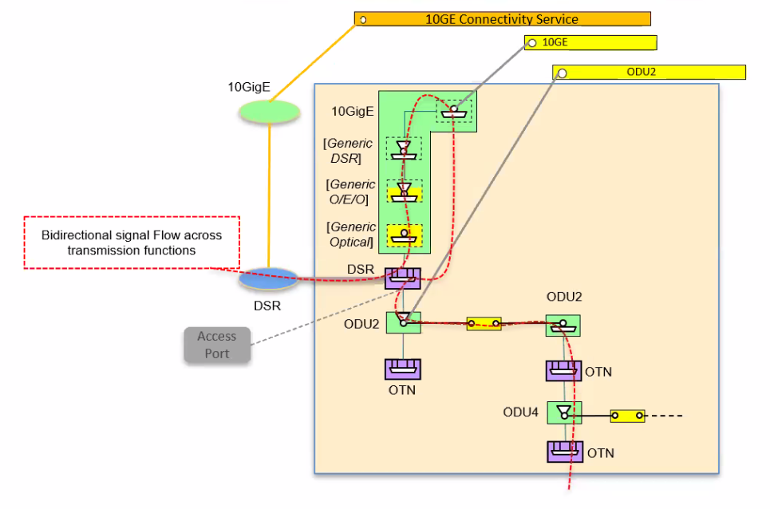
10GE
DSR
ODU2
O/E/O
ODU4
Opt

Slide 41
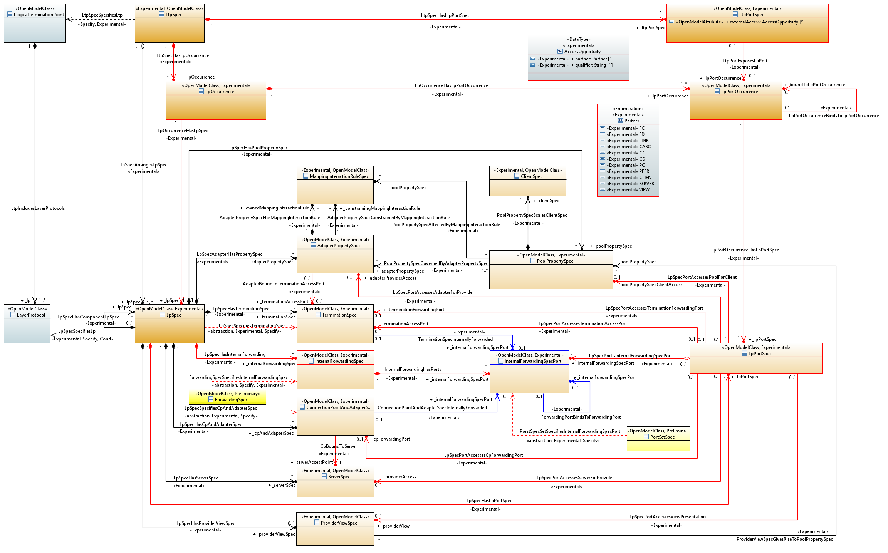

Slide 43
InternalForwardingSpecPort Occurrence
Adapter/Mapping Occurrence
TerminationSpec Occurrence
InternalForwardingSpec Occurrence
ConnectionPointAndAdapterSpec Occurrence
LpSpec Occurrence
LpPortSpec Occurrence
LtpSpec Occurence

Slide 44
44

Slide 45
45

Slide 46
46

