Slide 1
Modelling Boundaries Expressing Intent, Capability, Partial Visibility etc.
Nigel Davis (Ciena)
20220905

Slide 2
Overall Exploration
Summary overview
Examples of modern solution concepts
Complexity similarities
The nature of the solution
Solution Metamodel considerations
Target and next steps
Notes:
Content: A brief sketch of draft-davis-netmod-modelling-boundaries
There is not time in this presentation to dig into each area
Terminology: Each key term used in this document has specific local meaning
It is probable that the definitions here are currently too vague to ensure full shared understanding
Background: 24+ years of grappling with this challenge

Slide 3
Summary Overview
Control interactions depend upon statements of constraint
Constraint statements gradually narrow/tighten (or evolve in some way) as interaction progresses
Constraint statements are at the core of expression of:
Intent
Capability
Partial visibility
Policy
Negotiation
Etc.
Modelling languages tend to focus on rigidity of boundary representation including the:
Absoluteness of value for native types
Process of classification
Statement of constraint requires modelling of uncertain/vague boundaries
In modelling languages, the representation of constraint often appear to be an afterthought
When describing solutions, a softer approach seems necessary
If such a representation were achieved, intelligent control could take advantage of partial compatibilities etc.
The solution appears to require
Expression of range and of focus as a fundamental part of the metamodel
Recursive gradual narrowing/tightening of constraints as a native part of the technique
Enhancement could be within, as extensions to, and compatible with current definitions.
YANG is a language used to define properties
YANG is appropriately formed to accommodate such extensions.

Slide 4
Examples of modern solution concepts
Specification of Intent (Expectation/Intention used in the I-D)
Statement of desired outcome in terms of constraints
Includes statement of preference and acceptable value ranges etc.
Specification of Capability
Statement of opportunity for behaviour to be exhibited (the effect, not the realization)
Includes statement of possible ranges and interdependencies
Expression of Partial Visibility of state etc.
Statement made in a noisy/lossy/imprecise environment about behaviour/characteristics
Includes statements of probability, uncertainty and vagueness

Slide 5
Observation: Progressive narrowing of Capability
Standard definition: Broad and all encompassing
Vendor solution: Narrower capability:
Perhaps due to a target price point
Perhaps several different narrowing
Application: Further narrowing of capability
Perhaps due to deployment combinatorial effects
Use at particular point/role in an application: Further narrowing of capability
Perhaps as a result of need or policy at that point
Under particular circumstances: Even narrower allowed capability
Proof of concept (PoC) of the solution: Even narrower allowed capability
Single use case in the PoC: Extremely narrow definition of capability
With delegated control: Even the fully refined "instance", may be specified in terms of constrained definition as opposed to absolute value. Etc.

Slide 6
Observation: Partial Compatibility
Semantic
Intersection
Interface
Definition
Component
A
Component
B
Application
Note that the diagram above was republished in ONF TR-512 with agreement from TM Forum and is publicly available via the ONF publication at TR-512_v1.5_OnfCoreIm-info.zip

Slide 7
Exploration: The nature of the solution
A property is stated in terms of ranges with focusses and fuzzy boundaries
A property statement may interrelate to statements for another property (or for other properties)
The statement may have multiple boundary preference level and/or probability levels
Note that preference and importance is per interaction and not an aspect of fundamental definition
The statement describes a semantic volume
The statement may be expressed as a narrowing of a previously expressed volume (i.e., a further narrowing)
A single point value is a very narrow range (many single values are actually abstractions of complex ranges, e.g. 2Mbit/s is +/-15ppm)
The expression should be such that the complexity of expression “folds away” for simple statements
No distinction in expression opportunity between a statement of
Capability definition
Intent definition
Actual value
All expressions are of the same essential form
This is a fundamental change in the nature of the solution… a change in paradigm and metamodel
Fuzzy bounded/focused spaces related to other fuzzy bounded/focused spaces with preferred/probable positions etc.
Clarification: Complex/Blurry/Fuzzy boundaries in the solution
Colour Intent
preferred = red
acceptable = green
mandatory if for use in daytime
Colour Spec
green, blue, yellow
Colour Actual
green (254 > value > 220)

Slide 8
Observation: No longer instance config…
An “instance specification” is actually a tight statement of “intent” and hence not something distinct
The lowest available visible view of a realization may not be precise
Intent has a mix of degrees of tightness of statement from vague to single value
The intent expression should be suitable to use for all cases including “instance specification”
A single expression method should enable expression of a mix of ranges and of single values
An “instance state” is an abstraction of real state viewed through a detector
Detectors
Are imprecise
May fail to operate
The information from a detector may be
Temporarily unavailable
Delayed
Etc.

Slide 9
Exploration: Focusses, boundaries…
Thing
Consider the Termination
Covers all aspects of “carrier” signal processing
Coverage includes recursive definition of encapsulated forwarding
All possible properties of termination including adaptation are within the allowed set
Specific properties are defined in specific specifications.
Property values are expressed in “instances”
Component
Thing has all possible characteristics.
Specific semantics relate to the specific modelled thing and are a narrowing of thing.
The definitions do NOT need to be orthogonal/disjoint.
Physical
Forwarding
Equipment
Sand
Function
Termination
Information
This presentation primarily considers Components

Slide 10
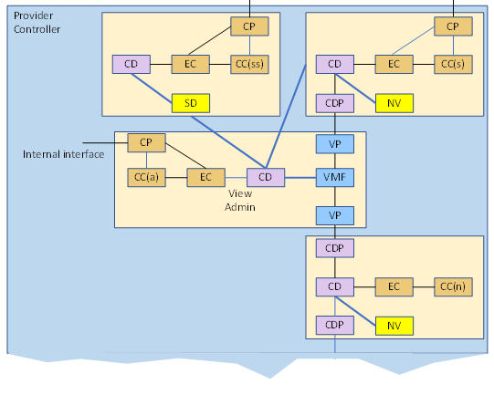
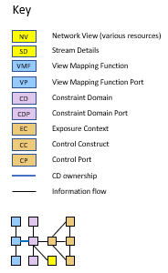
Observations: Occurrence
A System structure may make repeated use of the same type of component
This use has been called an “Occurrence” in ONF work (see TR-512_v1.5_OnfCoreIm-info.zip)
An Occurrence is a use of a particular component type in a system structure where each use may have subtly different narrowing of capabilities to each other
Capability, intent and realization are all specified in terms of system structures
Note also that the pictures of devices in a network structure example diagram are essentially Occurrences.
Terms are from the ONF Core Model
https://wiki.opennetworking.org/display/OIMT/

Slide 11
Solution: Metamodel considerations
Each property is specified in terms of constraints which may be narrowing of prior definitions
A standard may narrow an integer range
A usage may narrow the standard integer range
Etc.
Any property, e.g., temperature, may have:
A detector
Allowing opportunity for approximate, unknown, range etc.
Allowing notification of change with definable approach to hysteresis etc.
An associated control
Which has intent, achievement etc.
Especially where it takes time to take the control action may have some progress on the action etc.
Have Thresholds etc.
Which has intent (as above)
Which has an associated state (allowing opportunity for approximate etc.), notification etc.
Have Property interrelationships for any of the above
Have Units for any of the above
Where any property and its range of opportunities is stated in a specification
Where any invariant values in the specification are not be reported in the state of the “instance” (unless the instance is no longer behaving as defined in its specification)
Ideally the metamodel should be such that, when a model designer chooses to define a property, they pick which of the above features are relevant and need not specify each separately.
Automatic name generation etc. where the name structure can be predefined.

Slide 12
Target and next steps
There does not seem to be readily available terminology to label/define the concepts in the problem space
Hence it has been difficult to discuss what properties the language needs to possess.
Action: Improve terminology definitions
It appears that there is not a good language suited to solve this problem fully.
This may only appear to be the case, i.e., there may be a language out there (as it has proved very difficult to describe the problem)
Action: Continue to explore and refine
It is possible that Yang could evolve to be more suitable
Yang does not have the necessary structures or recursion
A proposal is being worked slowly using a JSON form of Yang to unify the class and instance statement representation
Action: Work the proposal to suitable maturity (requirements first) and take to IETF
Note that the problem appears in expression:
Intent
Capability
Partial Visibility
Planning
Negotiation
Policy
Profile/Template
Occurrence
Etc.

Slide 13
Thank you!
Questions?

Slide 14
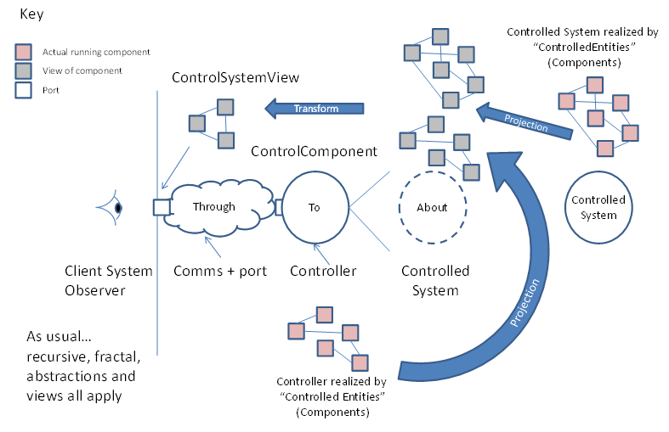
Observation: Two distinct viewpoints
The external perspective (the effect) – “exposed”
Capability (advertised to enable negotiation and selection)
Intent (the agreement resulting from the selection at the end of negotiation)
Achievement of intent
The internal perspective (the realization) – “private”
Realizations (alternative system design approaches to achieve exposed capabilities)
Specific chosen realization (the system to be deployed)
Actual realization achievement
Both viewpoints are expressed using the same metamodel
A Component described in terms of a System of Components
Note that the external perspective relates to “CFS” and the internal perspective to “RFS”, BUT the approach is used recursively throughout the entire solution
At any arbitrary demarcation, the same approach may be applied
The actual chosen demarcation may shift through evolution

Slide 15
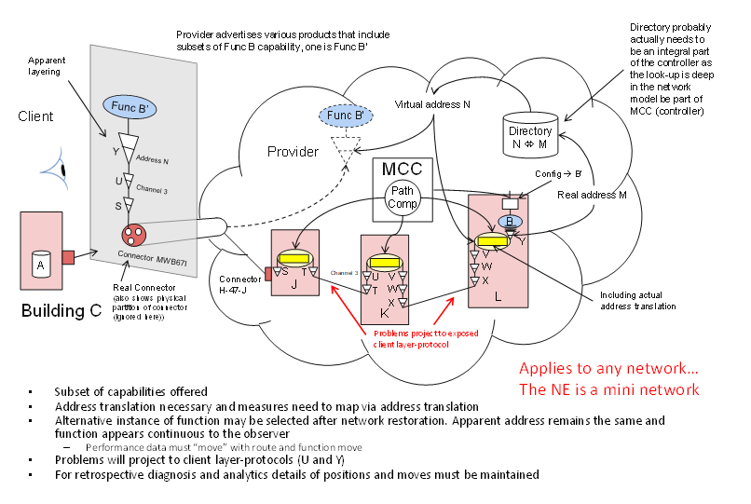
Observations: Capability
Capability is the expression of effect and is not the specific realization
It is NOT exposing intellectual property related to how the capability is achieved
It will include performance and cost (environmental footprint etc.) parameters etc.

Slide 16
Observation: Outcome and experience
An outcome may:
Be a fixed state (first order)
Be a fixed change of state (second order)
Be a… (nth order)
Abide by some defined algorithm
Etc.
Experience is the recipient’s “perception” of the outcome
Both outcome and experience can be expressed in using the same approach discussed.
A connectivity example outcome is an E-Line (a resource!) and the experience is apparent adjacency (the true “service”)

Slide 17
Observation: Other solution elements that benefit
Policy: The condition statement could benefit from a generalized metamodel approach to range etc.
Profile/Template/Redefine: Various methods that allow application of constraints on multiple instances from a single statement. The constraint statement would benefit
Constraints: In UML… An add-on that tends to be “beyond” the normal model. The essential metamodel would inherently include interaction constraints.
Etc.

