Slide 1
Intent for use of capability replaces Service-Resource and unifies network and virtual network (stimulated by discussion on TAPI Virtual Network)
Nigel Davis
20190508
(reiterating presentation from the Sydney meeting and proposing some actions)

Slide 2
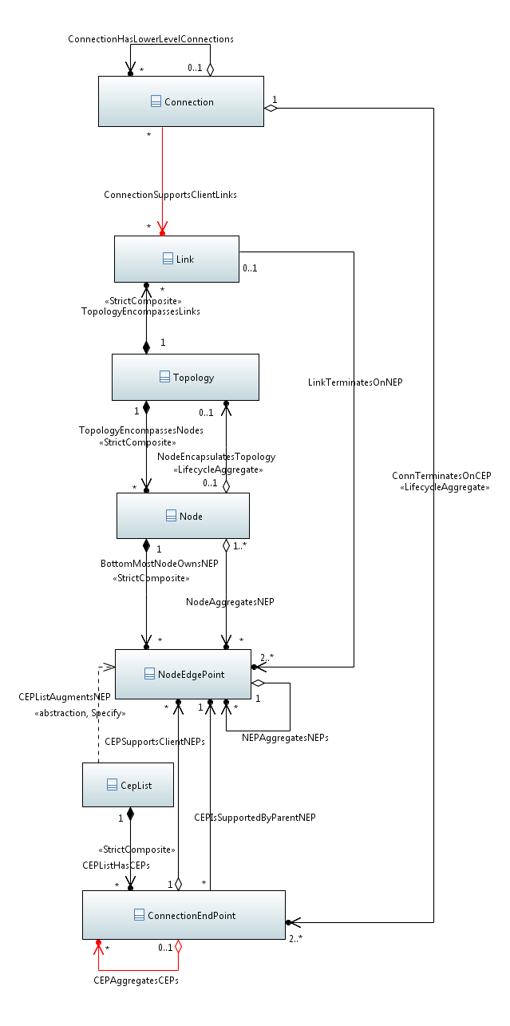
TAPI 2.1.1 Capacity/Capability/Use model
Arc/Edge/Hypergraph
Use/Enabled
Network as a graph/System
Network as a point/Component
Capacity/Capability/Potential
Point/Node

Slide 5
Regardless of the model
View
- Exposed
- Available
 | Intention | Expectation | Actual | comments
Historic | yes | yes | yes | Many, one per time
Current | yes | yes | yes | One rolling
Future | yes | yes | no | Many x many

Slide 6
Regardless of the model
View
- Exposed
- Available
 | Intention | Expectation | Actual | comments
Type | Agreement (contract) with client in terms of constraints on required capability and hence constraints on the provider design. Described in agreed view presented to client by provider. | Results of design process representing agreement (contract) with the provider in terms of capability to be provided (tends towards absolute (partial)). Described in agreed view presented to client. | Behaviour of the provided capability Absolute (complete), but presented as abstracted (and hence is partial view that could be in terms of ranges etc.). | All provide a partial view. Intention/expectation provide a degree of flexibility. Higher up the solution there is greater flexibility, lower down the intent tends to be quite absolute.
Traditional | Service | Resource | Resource
Evolution | Capability/Use | Capability/Use | Capability/Use

Slide 7
Rough “proposal”
Intention/expectation and actual should all be in terms of capability in the context/view
From a core perspective FD, FC etc. are all statements of capability
Intention/expectation will normally be in terms of capability constraints although can be absolute values in the context of the view
Actual will normally be in terms of absolute capability although could be in terms of constraint
For example, an Intention may be to provide an FC of 10-20G between ports in a building or may be to provide a precise FC
We do NOT need new classes, just a generalized way of stating constraints in terms of the existing classes and their properties.
Hence we DO NOT NEED a “Virtual Network” or a “Service” class in the Core (or in TAPI)
Virtual Network: All networks are virtual to some degree, FD and Link provide the view of capacity of a network and hence are the classes to use to express capability both in a request (constraints) and for actual existing capability.
The request for a virtual network is simply the request for the construction of a particular view of FD/Link capability in a context, stated in terms of constraints
Service: All resources provide service (and as discussed before, almost all claimed statements of service are simply descriptions of resource) and all resources/services are really expressions of capability. Connectivity/Access capability is expressed in terms of FCs and LTPs.
The request for a connectivity service is simply the request for the construction of a particular FC/LTP capability combination in a context, stated in terms of constraints
We DO NEED a generalized approach to stating constraints (the operations pattern provides a rudimentary form of this) that can be applied to any classes for requests as well as for responses

Slide 8
Action plan
Reach agreement that the proposed approach is worth pursuing
i.e., the canonical model along with the opportunity to express a presentation in terms of constraints
E.g., 10G between two cities in terms of a link and two abstract TPs.
Develop expression of generalized constraint and approach to applying this to all properties etc. in the core
Develop approach to constraint expression for removing opportunities for specific cases
Such that a particular parameter in a particular usage must take a single value rather than be a range statement
Propose PoCs to explore and exercise the approach
Depending upon outcomes propose advancements to TAPI etc.

Slide 9
Some background detail on lifecycle

Slide 10
Considering the lifecycle of offered capability
Invention, validation and options for support
Market assessment and infrastructure design preparation
Infrastructure acquisition
Offer, negotiate and agree contract (capacity, control)
Expose capacity/control
Offer, negotiate and agree contract (forwarding)

Slide 11
Mode of operation
Stage
Invention of capability types to offer into the external market place
Network capacity
Forwarding
Control
Validate realism by identifying supporting capabilities
Design capability support options
Position
Capability catalogue entries
Capability design patterns in catalogue backend

Slide 12
Mode of operation
Stage
Assessment of market place for specific external demand
Design of physical/functional system structure to provide necessary infrastructure capability to support external demand
Position
Understanding of expected demand for each capability type
Known design for network to support current expected demand of capability
Specific physical layouts including: Equipment, inside plant, outside plant
Specific functional layouts including: LTPs, FCs, ControlConstructs ec.
Expectation of equipments in inventory (with serial numbers NOT populated)

Slide 13
Mode of operation
Stage
Acquisition of functional capabilities from suppliers
Acquisition of physical equipment
Deployment of physical structures
Layout of functional system on physical to provide infrastructure
Position
All necessary physical devices in place and validated
Physical installation provides serial numbers to augment equipment representation in inventory
All necessary LTPs and FCs in place and validated
So arrive as consequence of equipment installation, others need to be caused to be realized by control action (equivalent to intent – see next)

Slide 14
Mode of operation
Stage
Offer into the market place:
Network capacity capability (exposed as normal network entities)
Forwarding capability (exposed as normal forwarding entities)
Control capability in conjunction with Network/Forwarding capability
Negotiate capability
Trial design capability realization
Contract capability
Intent to supply = Client Expectation
Position
Feasible intent ready to design/deploy

Slide 15
Mode of operation
Stage
Expose network capacity capability to client
Assume that this is a view of existing infrastructure
Expose control capability to client
Assume that this is a view of existing control capability in the context of a view of existing infrastructure
Position
Representation of capacity capability and control exposed to client
Mapping from infrastructure to exposed capability available to system capability controller

Slide 16
Mode of operation
Stage
Design from forwarding intent to expectation on infrastructure in the context of the capacity exposed to the client
Negotiate etc. any relationships and contract with providers
Deploy expectation
Activate capability
Position
Capability to support expectation deployed and operational
Challenge
Potentially sub-optimum nature of design due to partial visibility of infrastructure

Slide 17
Capability to use

Slide 18
Contracting a “Service”
Provider
User
Access ports known but not authorize
See also TR-512.4 Figures 4-15 - 4-18 (V1.4)
Device added to access plug
0
0
Network present (but no capacity allocated)
[Port authorized]
10
10
Capacity allocated
Enabled capacity allowing flow
(subset)

Slide 19
Point
Between points
Multi-point
To be developed further
10
0
City B
Allocated first
5
5
20
100
Simple cases first…. List case
2
City A
City C

Slide 20
Partial visibility

Slide 21
Partial visibility of infrastructure
Cases:
Inter-operator
Intra-operator domains
Vendor domains
Vendor fragments
Challenges
Geographical spread
Geographical overlap
Partial visibility of constraints

Slide 22
A few pictorial cases
a
5
1
2
b
2
1
c
5
a
b
c

