Slide 1
Profiles and Templates
Nigel Davis (building on work by Chris Hartley)
20190502

Slide 2
Central feature – The Basic Profile
Basic profile: A class where an instance of that class, a profile instance:
Has a set of attributes where that set is a subset of a larger set defined in another class of set of classes (specs or _pacs)
May have a different set of attributes to another instance of the same class
Has attributes that take single defined values
Is referenced by an instance of another class (the target) and when referenced is such that that other class (the target) adopts the values of the Profile instance
Work in TM Forum on this topic led to recognition of a number of complex cases and considerations for a more general profile
Multiple conflicting profiles applied
Best effort application of profile v rejection of incompatible profile
Changing the profile applies to existing instances
Reflecting the property in the target class
Allowing adjustment of the reflected properties in the target class and indicating that they are no-longer aligned with the applied profile
Using the profile as a provider of initial values v permanent application
Using the profile to constrain the range of legal values for the property in the target rather than to force one value
Profile invisibility
In general a profile can have a mixed role in that some attributes may have different purposes
For this initial feature the profile is basic

Slide 3
Requested capability An interpretation of the Telefonica need
IP interface definition leads to need to support property value profiles as usually such definitions are existing “in the device”
The device based profile can be referenced in several instances of IP interfaces
The definitions exist independently any instance of IP interfaces
The property definitions allow for single values, not value ranges.
The properties are invariant (and hence write-create, i.e., configured at create and not changeable from then on)
Properties cannot be added/removed from a profile
There is no requirement to override the values on a per referencing instance basis
A best effort application of the profiles is acceptable
Properties that are not compatible are ignored
Several profiles might be referenced in an instance of the LTP, but they would be expected to be disjoint
Ideally non-disjoint profile application would be rejected but unpredictable behaviour would result if not
If a property required by the device is not present in the profile it will take a default value
The default value will not be visible in the instance

Slide 4
Basic capability framework
All classes will provide a profile reference pointer list
A profile class will be defined that includes
Identifiers and names (for the profile instances)
Version (a specific named profile may have several versions – they would all have different identifiers)
Admin state (allows a profile to be taken “out of service” in a controlled fashion)
Lifecycle state (the profile lifecycle state may determine whether the profile can be applied in a running system or not)
Draft
Defined
Admin state (if a profile instance is shutting down then it cannot be applied to new instances but it will remain applied to existing instances)
Override priority (whether a profile can be overridden by another profile or not (where both profiles have properties in common))
Run time visibility (whether the profile can be seen on the running system or not)
Visible
Invisible
Application role (whether the profile applies on an ongoing basis or not and whether it can have range values to constrain the setting of properties)
Initialization
Absolute value
Constraints
Application mode (whether, for the profile to apply, the target instance must be able to adopt all values specified or not)
Best Effort
Complete Match reject on mismatch (interesting challenge when a value is changed that an instance already referencing the profile cannot adopt!)
Target override capability (whether the target also reflects the property and whether that property can be adjusted)
Properties Not Visible in target
Properties Visible Read Only
Properties Changeable Within Profile
Properties Changeable Beyond Profile
Adjustment mode (degree of change that can occur in the profile)
Invariant
Changeable
ExtendAndShrink
Bold = default
Default need not be stated

Slide 5
Questions
Do we need ?
Profile Object instance (Template) version ? Propose no. A specific named instance of properties applied to an instance is equivalent to an FC with a composed part and we do not version an FC when we change a value in a composed part etc. It may however need an application maturity level (as the specific set of values may be experimental) and an application purpose name (i.e., why this set of values is relevant).
Profile Class version ? Propose potentially yes, with the caveat that it is the set of attributes with their qualities that is being versioned (more of an occurrence) and not the overall profile mechanism. The profile class (occurrence) may have properties added or removed. This seems much more like changes to the class model. BUT we do not version our classes. So perhaps the profile class (occurrence) should simply change with no explicit versioning.
Do you want a class / attribute style structure or a (Yang like) tree style structure or just a bag of attributes (no structure) ? Propose that we have an opportunity for a structure not just a bag or tree.
Use of generics will simplify the result with type safety
Also need to consider event / Kafka support !
The profile instance should be reported as for any other instance.
Basic Type Square Pattern

Slide 6
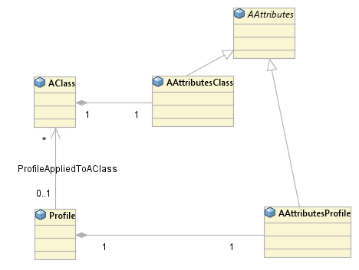
There are 4 basic hard / soft representation options
 |  | Model
 |  | Soft | Hard
Profile / Template | Soft |  | 
 | Hard | Not sensible | 
Soft = Soft Properties, Hard = normal attribute
For the hard – hard option
Need the attributes in a ‘PAC’
Then the profile is just an instance of the PAC
Do we need the profile to populate ALL values in the PAC ? Do we need all the attributes in the PAC to allow null ? Or extend the metamodel to allow for this ?? (see later sketch)
Some attributes may not be profile settable and this can be represented too (2)
Aiming for hard-hard but with the necessary flexibility.
(1)
(2)
Hard-hard pattern
(3)
Profile metadata attribs

Slide 7
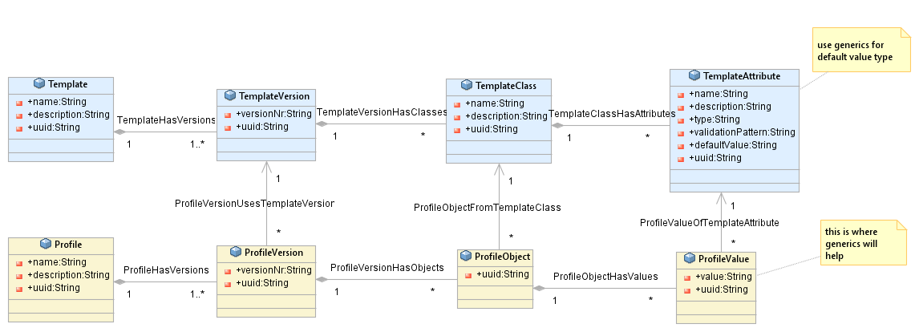
Basic Starting Point Soft Properties based model

Slide 8
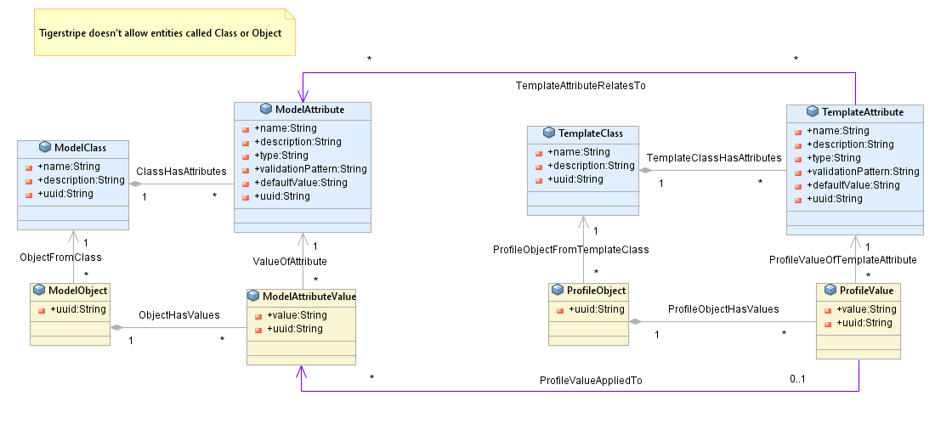
Applying a Soft Template to a Soft Model – attempt 1
There is an obvious issue because we don’t really want separate Template attribute definitions
!!!

Slide 9
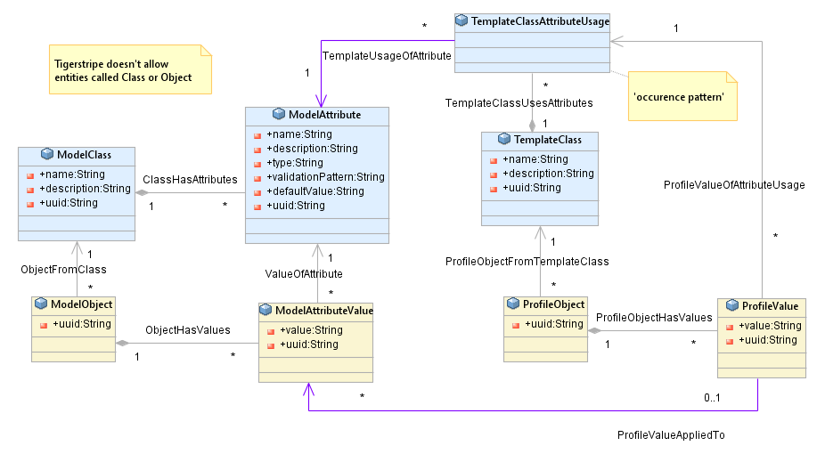
Applying a Soft Template to a Soft Model – with the Occurrence pattern
Soft-soft pattern
Note that there is a temporal aspect here that we don’t show, when the profile was applied to the model. We also can’t know if the application actually changed the value or not.
This would be much better in a Kafka log where we can see the changes over time
Profile Application

Slide 10
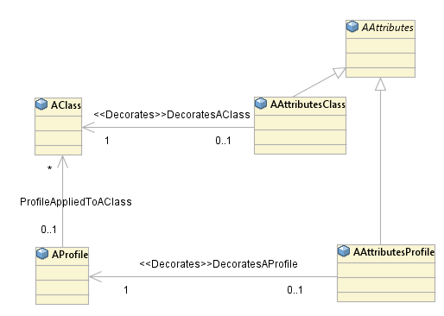
Don’t forget to apply the decoration pattern here too
Could be mix of both – composed core attributes and decorated feature attributes
Default values ?

Slide 11
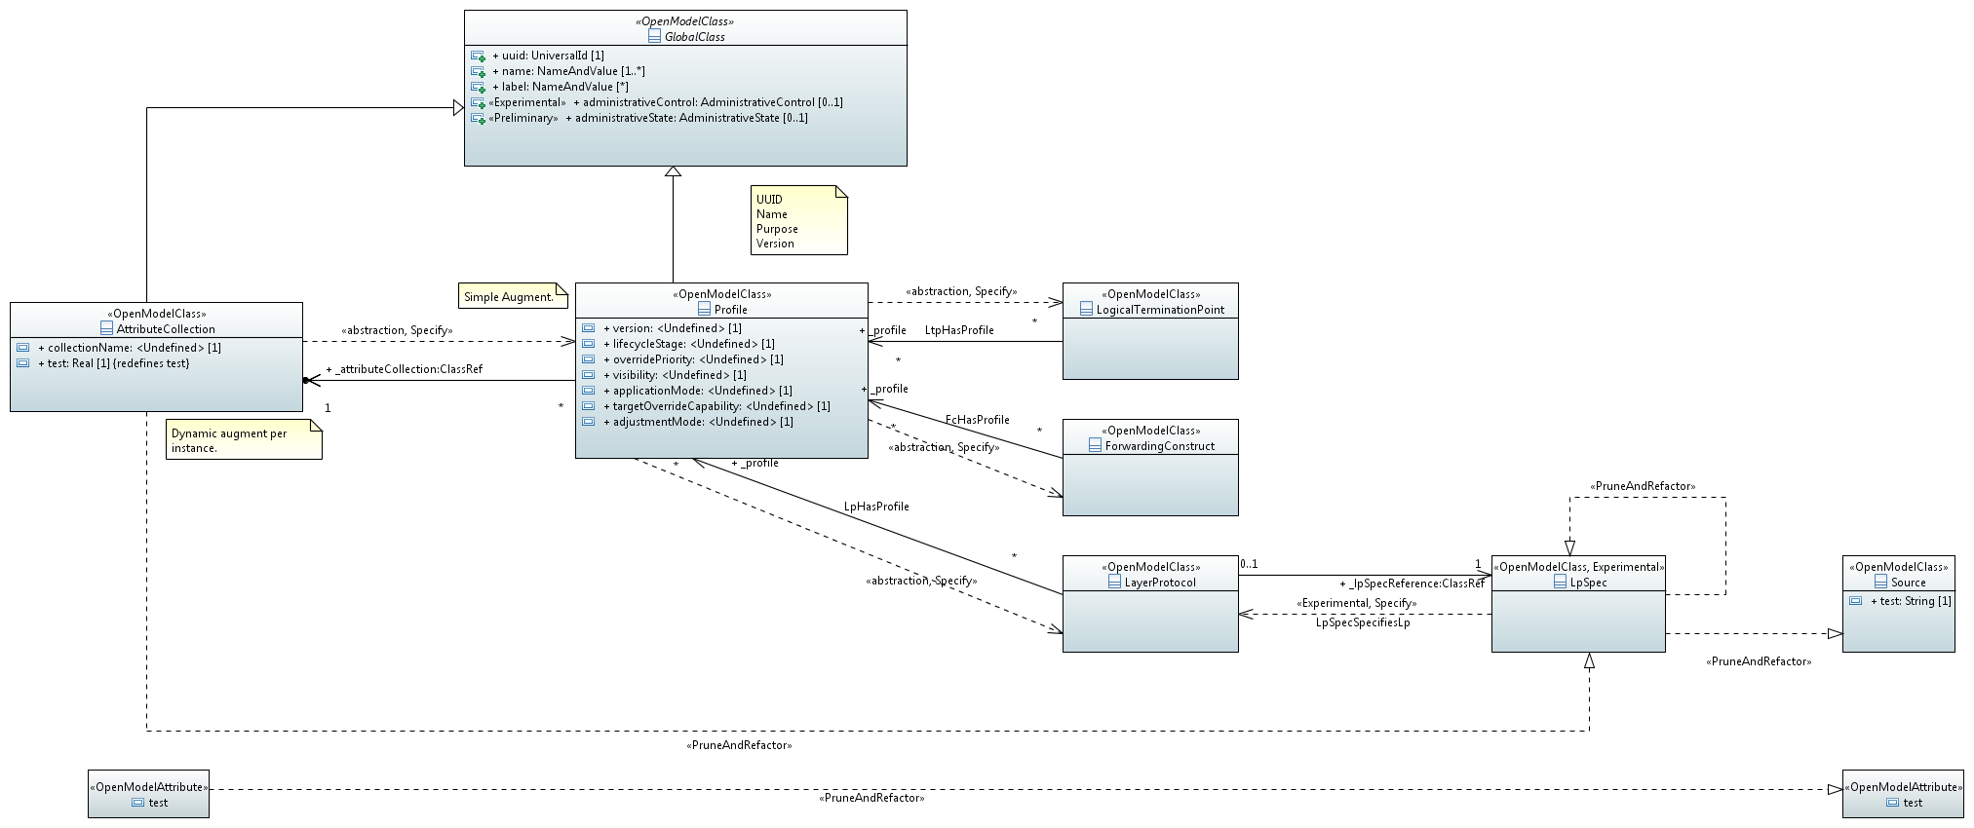
Positioning the Profile
Canonical capability – OIMT (Core)
Profile pattern and general application to all core classes
It is unclear at this point whether mixed profiles with per-attribute behaviour variety (e.g., override capability etc.) should be supported
Interface capability – OTCC (TAPI, WT)
Specific profile class derived from classes of the core
Technology – OTCC (OTIM, TAPI, WT), OIMT (Core), vendors, network operators
Profiles are drawn from the superset of capabilities of all ports in a device/network
In the long run, profile application may be such that each property has distinct effort etc.
Network structures – OIMT (Core), OTCC (TAPI, WT), network operators vendor
Notice the meta-level violating associations.
The Profile instance references an AttributeCollection class that defines its properties.
The properties are applied to the specific instances that reference the collection
The attribute collection class is obscure as it should force values for version etc. of the profile (assuming that these are per case of attribute collection and not per actual instance of the profile value set) but should allow various freedoms for the other properties (i.e., I have not got this right yet – I keep having trouble with the legal meta-level violation association).
I think what I should do is have both a meta-level violation and an associated normal association where the normal association is to a class whose instance is set to the instance corresponding to the attribute collection definition.
Hence the instance of profile has attributes from the instance of the class corresponding to the version etc. (i.e., fixed values) of the attribute collection and also attributes from the attribute collection.
Alternatively, the attribute collection could define properties that are invariant and have read only values where the default is adjusted per attribute collection to force the value of the read only property

Slide 12
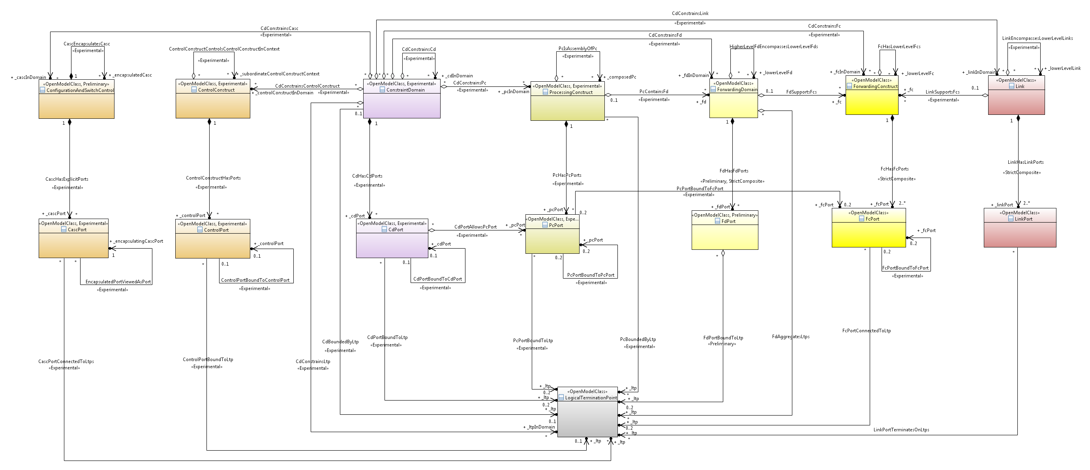
There are 8 key classes in the ONF CIM Core Model
All classes may require the Profile mechanism
Canonical

Slide 13
Technology extensions considering Profiles
Utilise Core model spec approach
This is available in TAPI and being adopted by WT
Take work from external body, rearrange into appropriate spec structures
Note that the core LTP spec is being enhanced to support more complex structure
Attach specs to appropriate model class (TAPI/WT)
Whilst these specs could be used as they are, the expectation is that vendors produce their own variants that provide a clear statement of per device combination capability
Technology extensions should have a run-time dynamic application
Technology

Slide 14
Progression of sub-setting – Constraining Semantics
Thing has all possible properties.
Specific semantics relate to the specific modelled thing and are a narrowing of thing.
The definitions do NOT need to be orthogonal/disjoint although the intersections should be minimised.
Consider the LTP
Covers all aspects of termination and adaptation
Coverage includes recursive definition of encapsulated forwarding
All possible properties of termination and adaptation are within the allowed set
Specific properties are defined in specific specs. These properties are expressed in the appropriate instances.
Thing
Component
PC
Equipment
Information
LTP
Controller
Canonical

Slide 15
Further thoughts
The detailed capability of a thing is expressed by decorating with parts that themselves have constrained semantics that fit within the definition of the thing
The capabilities may be expressed in terms of apparent subordinate parts where these parts can be positioned on the constrained semantic map
An LTP may have controllers within it but those controllers only emerges when the LTP is dismantled or its behaviour is expressed.
Canonical

Slide 16
Observations
The method discussed so far applies a set of predefined properties for a specific technology to the CEP
The extension is provided as part of the TAPI standard
The spec simply causes an augment and hence the specify stereotype triggers the construction of Yang augment
There is a broader set of requirements for the Spec which will be discussed under the “Spec Rework” Topic

Slide 17

Rough sketch of Basic Profile (for further discussion)
Specify opportunities for referencing instance include:
Augmentation (decorates… inserting attributes into class that drives the instance)
P&R allows for:
Constrained redefine of attributes
Narrow range
Becomes read only
Removal of non-mandatory attributes
Constrained restructuring of the Technology Model
Addition of ONF specific properties and stereotypes
Implied (HasSpec)
Specify
P&R
Pattern
Core Model
Class
Refined Tech Spec Model
TechnologyModel
Specific class to class relationships
Trace
Back
P&R,
Instantiate
P&R,
Occurrence
P&R,
Occurrence
Implied (HasSpec (Class-instance))
Augment
P&R
Application
Instance
Refined Tech Spec Occurrence
Tech Model Occurrence
RunTime
Disjoint OR ReadOnly
Related
Augment
P&R
Profile Instance
Refined Tech Spec Occurrence
RunTime
HasProfile (Class-Instance)

Slide 18
Several sub cases
Attribute in profile as read/write and one of:
Attribute NOT in instance, instance takes default value for attribute if profile not applied
Attribute visible as read only in instance
Instance takes default value if profile not applied
Attribute keeps last set value from profile when profile removed
Attribute visible in instance
Read only when profile is applied
Read/write when profile not applied
Takes last set value from profile when profile removed (starting at a create value)
Takes default value if profile removed

Slide 19
Discussion

Slide 20
Backup

Slide 21
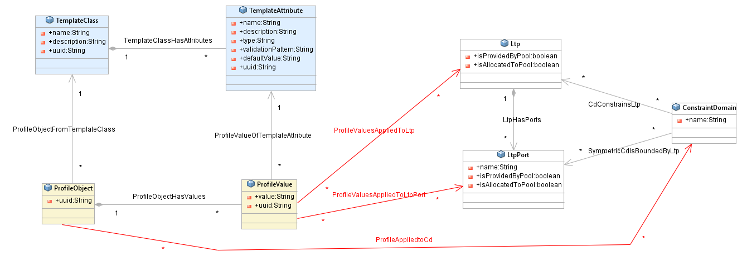
There is an issue with applying a soft profile to a hard class model
We don’t have an easy way of relating a soft property to a ‘hard’ attribute
The underlying problem is that the soft property model is representing the UML metamodel as a model so for hard-soft we are trying to associate across meta-layers !
In fact it’s even worse than that, as the soft model could relate to any / every attribute / Entity in the ‘hard’ model – and we don’t want a Top class that it could relate to
Even ‘just’ trying to do it for LTP/port shows the sort of issues to be faced

Slide 22
This produces a Common Protocol / Feature Structure
Decoration association used instead of inheritance
Key Component #
Key Component Port #
1
1
<<specify>>
<<specify>>
Feature Module
Port attributes for the protocol
0..1
0..1
Component Properties
Port Properties
Feature ConceptA
Protocol specific concepts
Feature ConceptC
Feature ConceptB
# the Key Components defined in the ONF CIM core model are : LTP, FC, FD, Link, Control Construct, CD and PC

Slide 23
How the Protocols / Features add up
ERPS Module
PTP Clock Module
PTP ConceptB
<<specify>>
<<specify>>
ERPS Properties
Key Component #
PTP Properties
ERPS ConceptA
ERPS ConceptB
<<specify>>
<<spcify>>
PTP ConceptA
ERPS Port Properties
Key Component Port #
PTP Port Properties
# the Key Components defined in the ONF CIM core model are : LTP, FC, FD, Link, Control Construct, CD and PC

