Slide 1
Protocol Independent Forwarding (PIF) project
ONF SDN Evolution workday session / September, 2016

Slide 2
PIF Open Source SDN software project … and also ONF Specifications Area group
P4
PIFL
PX
Focus areas of PIF project:
Intermediate representation
Intermediate Representation elements
Use cases
Runtime APIs
Feeds into ONF “SDN Evolution” specification activity

Slide 3
BIR (pronounced “beer”): the “B” IR
Intended to capture the different threads of IR-related discussions
Intended to be at the “right” level for this domain-specific IR
Intended to be more language/target neutral than the AIR strawman
Candidate as programmable datapath model for evolved SDN
Open source software simulator based on Meta-IR infrastructure

Slide 4
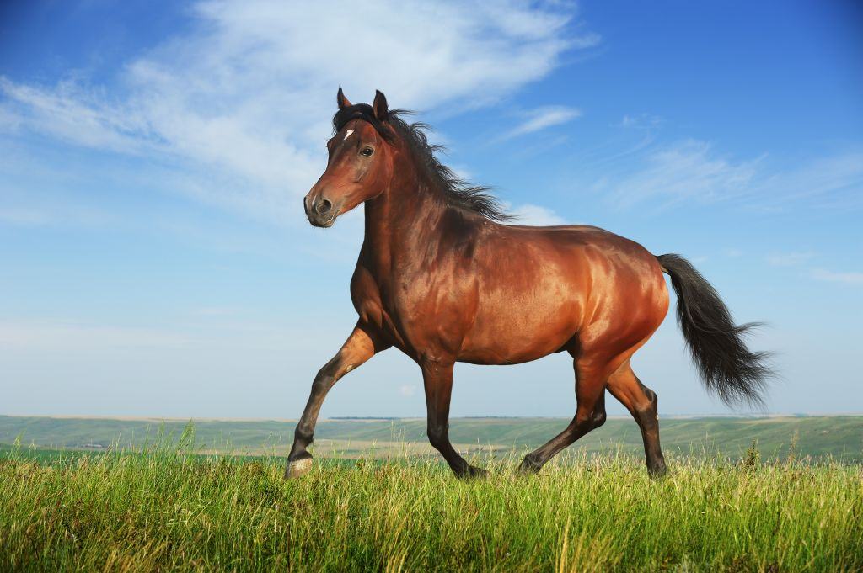
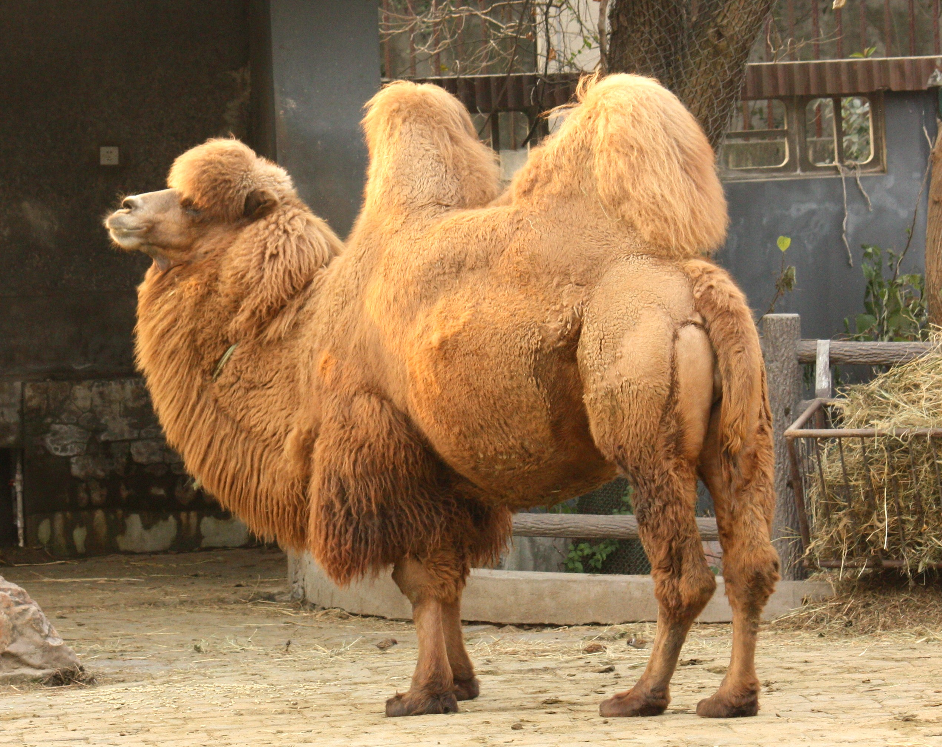
Main influences
PIF group discussions
P4, RMT, AIR
school
BIR
POF
school
NetASM, Banzai
school
PX
school
rather than
Design

Slide 5
The BIR packet processing model
Top-level static packet data flow graph (linear pipeline at first)
User-defined metadata collection(s) associated with each packet in transit
Each node is a “packet processor”
Either a “control flow”: programmed processor
Or an “other processor”: supplied processor
Could be described as “µVNF chaining”
A control flow involves traversing “basic blocks” to completion
A basic block:
Has optional defined local contexts of: header type, table
Is passed a packet and an offset into that packet
Carries out an unconditional sequence of header/metadata updates and/or calls on library methods
Calculates next offset and next basic block at end

Slide 6
Control Flow motivation
Recognizes that packet processing is driven by two dynamic factors:
Packet data (data plane input)
Table data (control plane input)
Therefore, context for a basic block:
Particular header in packet: can be read or written
Particular table:
Lookup takes a struct containing expressions for values
Result is a struct containing values: some can be decoded as actions
Metadata collections can be associated with each packet
Can represent fine- and coarse-grain parsing and match-action pipelines

Slide 7
Example: Three-stage processor pipeline
Control Flow
Other Processor
Control Flow
Start Control State
Compute Packet_offset
Select Basic_block
Start Control State
Terminate
Terminate
Basic Block
Instruction 1
Instruction 2
. . .
Instruction N
BB
BB
BB
Header format
BB
BB
BB
BB
BB
BB
Next Control State
Compute Packet_offset
Select Basic_block
BB

Slide 8
BIR open source software
GitHub:
OpenNetworkingFoundation/PIF-Open-Intermediate-Representation
Refactoring of original PIF AIR-IRI software framework
Meta-IR for defining experimental IRs
BIR model defined using Meta-IR
Switches defined as BIR instances
YAML used to represent BIR model, and BIR-defined switches
Some to-do items …

Slide 9
BIR technical report
Currently version 1.1 – updated version 1.2 imminent
In the OSSDN PIF GitHub repository
Also in the ONF ARO repository
Open for wider (extra-PIF) review
Appendix summarizes some issues under discussion
Step towards a ONF “Open IR” specification

Slide 10
Runtime API setting
P4
PIFL
PX
HLL’s API
Generates
Adapter
Intermediate representation
IR’s API
Generates
Adapter
Target’s API

Slide 11
Summary of PIF work areas
Experimentation with IR features and capabilities:
to lead to a final IR proposal
Investigating diverse use cases for the IR:
to ensure apt coverage
Runtime API for the IR:
to feed into next-generation OpenFlow

Slide 12
How to join in the PIF project
PIF Open Source SDN project at:
https://groups.opensourcesdn.org/wg/PIF/dashboard
Contains calendar, mail archive, documents, etc.
PIF GitHub:
https://github.com/OpenNetworkingFoundation/PIF-Open-Intermediate-Representation
Join the weekly call:
Tuesdays 11am -12 noon Pacific
See calendar entry for full information
Join the mailing list (pif@community.opensourcesdn.org)

