Slide 1
Nu-Link2-Pro Offline ISP
Notes:
115/11/08

Slide 2
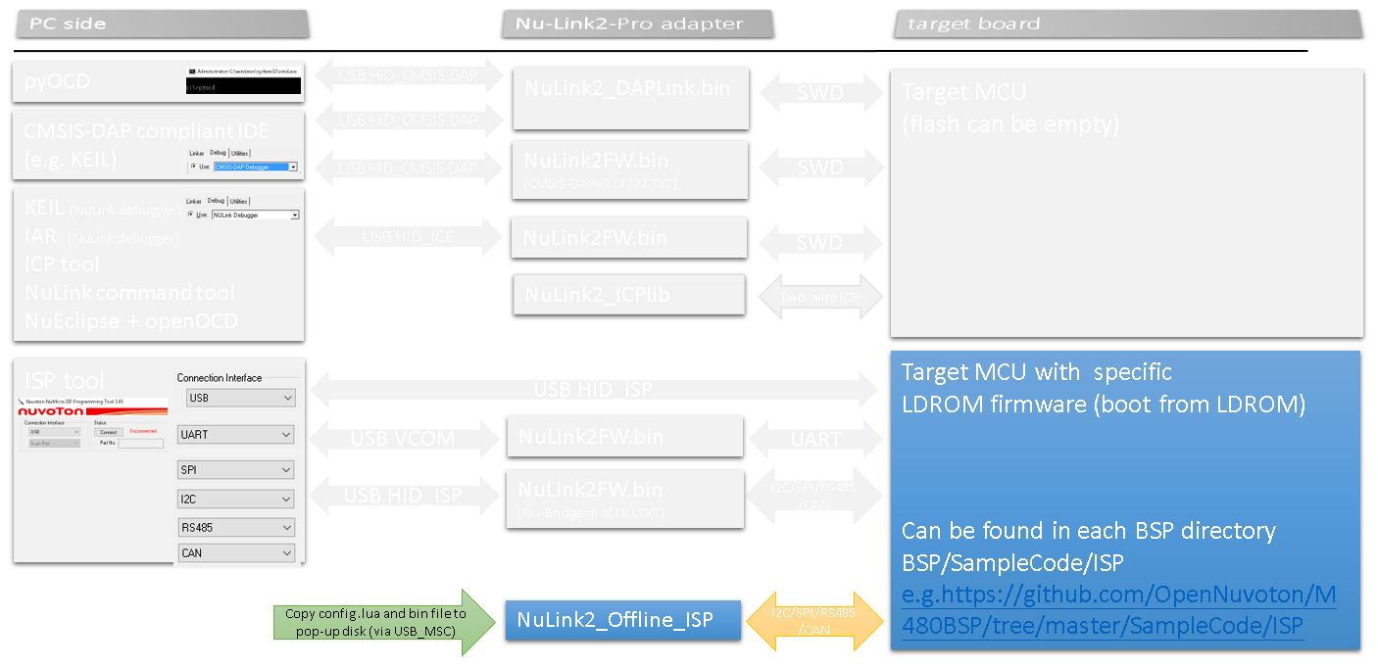
Overview
Example code running on Nu-Link2-Pro
Press button and program target flash via CON6 connectors.

Slide 3
Build project
Project path:
  .\SampleCode\StdDriver\HSUSBD_Mass_Storage_OFFLINE_ISP\KEIL
Build the code by KEIL uVision v5.25
  Build library first
    Library: OFFLINE_LIB.uvproj
  Build firmware bin file
    ISP FW: OFFLINE_ISP.uvproj
Upgrade Nu-Link2-Pro firmware: Program “HSUSBD_Mass_Storage_Offline_ISP.bin” to NuLink2-Pro APROM

Slide 4
LUA Script
local status, err = pcall(function()
File_name="0:\\test.bin" --bin file for isp aprom
temp=string.format("strage=0x%x",ISP_SHOW_STORAGE())
print(temp)
--ISP_AP_FILE_CHECKSUM for read file size
filesize=ISP_AP_FILE_SIZE(File_name)
if (filesize==0)
then
print("no file exit")
return
end
temp=string.format("APROM SIZE=%d",filesize)
print(temp)
--ISP_AP_FILE_CHECKSUM for read file size checksum
filechecksum=ISP_AP_FILE_CHECKSUM(File_name)
temp=string.format("APROM checksum=0x%x",filechecksum)
print(temp)
Disk stroage
0:=>SPI FLASH
1:=>SDCARD
2:=>USB HOST with USB DISK
Note: USB host disk and USB ISP
can’t operate on the same time.
(only one USB port)
The macro define USBHOST_DISK in FW
LUA File access API:
ISP_SHOW_STORAGE
ISP_AP_FILE_SIZE
ISP_AP_FILE_CHECKSUM

Slide 5

LUA Script (CONT’)
--initial interface 0 uart.
ISP_INTERFACE_INIT(5)=>USB HOST COMMAND
print("sync:")
--sync isp protocol package
if(ISP_CmdSyncPackno()==1)
then
print("sync false")
return
end
print("sync pass")
--read device id
devid=ISP_CmdGetDeviceID()
temp=string.format("devce id=0x%x",devid)
print(temp)
--read target chip isp fw version
tb=ISP_CmdFWVersion()
temp=(tb[1]<<24)|(tb[2]<<16)|(tb[3]<<8)|tb[4]
print(string.format("fw version=0x%x",temp))
ISP_INTERFACE_INIT
Support interface:
UART_BUS, =>0
CAN_BUS,=>1
SPI_BUS,=>2
I2C_BUS,=>3
RS485_BUS,=>4
USBH_HID_BUS,=>5

Slide 6
LUA Script (CONT’)
--read config bit
tb=ISP_CmdGetConfig()
local config0=(tb[1]<<24)|(tb[2]<<16)|(tb[3]<<8)|tb[4]
print(string.format("config0=0x%x",config0))
config1=(tb[5]<<24)|(tb[6]<<16)|(tb[7]<<8)|tb[8]
print(string.format("config0=0x%x",config1))
--read target chip boot mode
if(ISP_CmdGetFlashMode()==2)
then
print("MCU in LDROM")
else
print("MCU in APROM")
end
--set program
ISP_SET_PFILE(File_name)
--do isp program flow
if(ISP_PROGRAM(0,filesize)==0)
then
print("program pass")
end
ISP Command:
ISP_AUTO_DETECT=>only support RS485 and UART
ISP_CmdSyncPackno
ISP_CmdGetDeviceID
ISP_CmdGetFlashMode
ISP_CmdGetConfig
ISP_CmdGetFlashMode
ISP_SET_PFIL =>set bin for project
ISP_PROGRAM

Slide 7
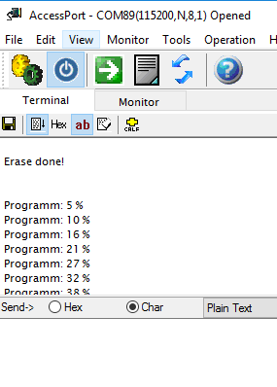
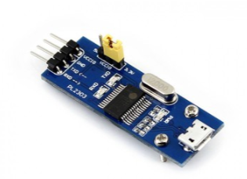
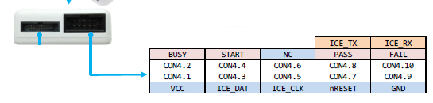
Print Message
ICE TX and ICE RX to print debug and log message
Dump message

Slide 8
NULINK OFFLINE ISP
USB
Notes:
115/11/08

Slide 9

USB Interface
Set target chip boot in LDORM and programming target LDROM FW
  Use Nano100B board to demo
  \Nano100B_BSP-master\SampleCode\ISP\ISP_HID
Target chip PB15 keep low for ISP boot in LDROM
Target board USB connect to NuLink2-Pro USB HOST
Pull isp.lua and test.bin to NuLink2-Pro USB DISK
Press Button in NuLink2-Pro, Start to program
Note: NuLink2-Pro only support OHCI host for USB full speed ISP.

Slide 10

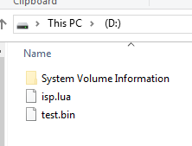
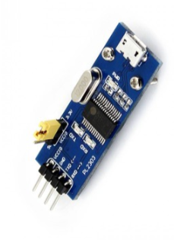
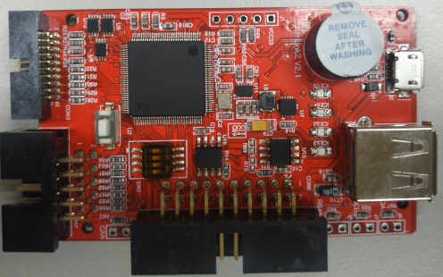
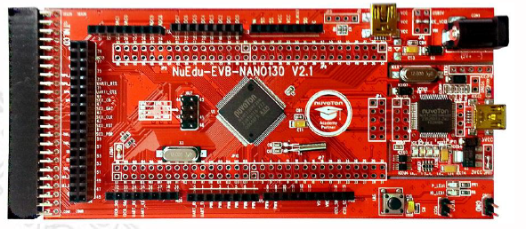
USB ENV. Set
For printf message
Press key start to program
USB DISK
Target CHIP to USB HOST PORT
UART tx for message
PB15 to GND
Target chip power

Slide 11
NULINK OFFLINE ISP
UART and RS485
Notes:
115/11/08

Slide 12
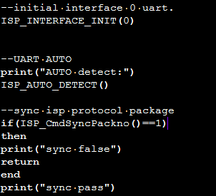

UART
The ISP_AUTO_DETECT command only support RS485 and UART

Slide 13
UART Interface
Set target chip boot in LDORM and programming target LDROM FW
  Use Nano100B board to demo
  \Nano100B_BSP-master\SampleCode\ISP\ISP_UART
Target board UART(PA14 RX, PA15 TX) connect to NuLink2-Pro UART PORT
Target board GND connect to NuLink2-Pro GND
Pull isp.lua and test.bin to NuLink2-Pro USB DISK
Press Button in NuLink2-Pro, Start to “auto detect”
Press reset button in Target chip

Slide 14
UART ENV. Set
For printf message
Press key start to program
USB DISK
UART tx for message
UART TX, RX and GND
Target chip power

Slide 15
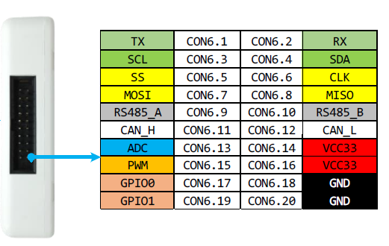
NuLink2-Pro
NULINK CON6.1 TX and CON6.2 RX connect target chip TX

Slide 16
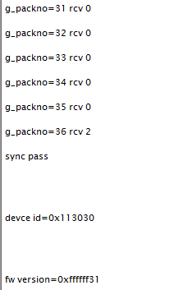
NuLink2-Pro UART Message
Host send auto detect package wait detect
After target chip reset and connect
Nulink send Auto detect
Target board reset and reboot in LDROM
Connect and program

Slide 17
NULINK OFFLINE ISP
I2C
Notes:
115/11/08

Slide 18
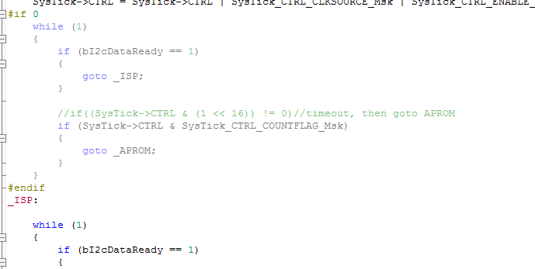
Target I2C ISP fw
The Nulink ISP FW not supports I2C auto detect.
The target chip FW need modified

Slide 19


I2C LUA SETTING

Slide 20
I2C Interface
Set target chip boot in LDORM and programming target LDROM FW
  Use Nano100B board to demo
  \Nano100B_BSP-master\SampleCode\ISP\ISP_I2C
Target board I2C(PA11 I2C SCL, PA10 I2C SDA) connect to NuLink2-Pro I2C PORT
Target board GND connect to NuLink2-Pro GND
Pull isp.lua and test.bin to NuLink2-Pro USB DISK
Press reset button in Target chip
Press Button in NuLink2-Pro, Start to program

Slide 21
NuLink2-Pro
NULINK CON6.3 SCL and CON6.4 SDA connect target chip TX

Slide 22
I2C ENV. Set
For printf message
Press key start to program
USB DISK
UART tx for message
I2C SCL, SDA and GND
Target chip power

Slide 23
NULINK OFFLINE ISP
SPI
Notes:
115/11/08

Slide 24
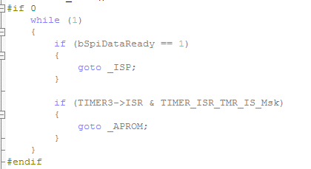
Target SPI ISP fw
The Nulink ISP FW not supports SPI auto detect.
The target chip FW need modified

Slide 25
SPI Interface
Set target chip boot in LDORM and programming target LDROM FW
  Use Nano100B board to demo
  \Nano100B_BSP-master\SampleCode\ISP\ISP_SPI
Target board SPI () connect to NuLink2-Pro SPI PORT
Target board GND connect to NuLink2-Pro GND
Pull isp.lua and test.bin to NuLink2-Pro USB DISK
Press reset button in Target chip
Press Button in NuLink2-Pro, Start to program

Slide 26


SPI LUA SETTING

Slide 27
NuLink2-Pro
NULINK CON6.5 SS, CON6.6 CLK, CON6.7 MOSI, CON6.8 MISO connect target chip TX

Slide 28
SPI ENV. Set
For printf message
Press key start to program
USB DISK
UART tx for message
SPI ss, clk, miso, mosi and GND
Target chip power

Slide 29
NULINK OFFLINE ISP
CAN
Notes:
115/11/08

Slide 30
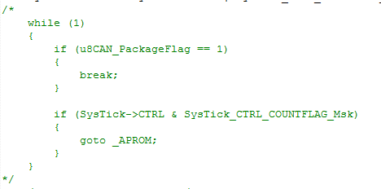
Target SPI ISP fw
The Nulink ISP FW not supports CAN auto detect.
The target chip FW need modified

Slide 31
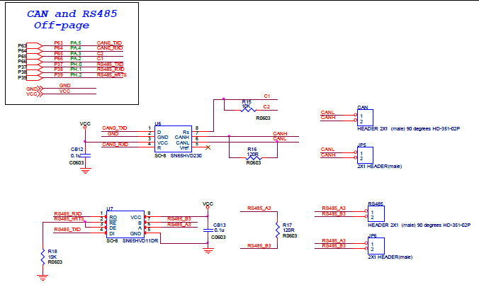
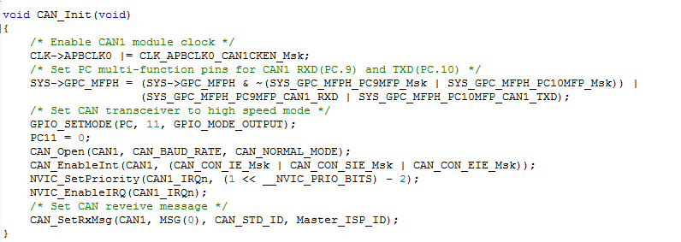
CAN IO PIN
Some M487 board use different CAN pin out from BSP, e.g. PA5 CAN TX, PA4 CAN RX, PA2, PA3 control speed, ISP code may need to customize pin define in CAN_Init().

Slide 32
CAN Interface
Set target chip boot in LDORM and programming target LDROM FW
  Use M487 board to demo
  \M487_BSP-master\SampleCode\ISP\ISP_CAN
Target board CAN A, B connect to NuLink2-Pro CAN PORT
Target board GND connect to NuLink2-Pro GND
Pull isp.lua and test.bin to NuLink2-Pro USB DISK
Press reset button in Target chip
Press Button in NuLink2-Pro, Start to program

Slide 33


CAN LUA SETTING

Slide 34
NuLink2-Pro
NULINK CON6.5 SS, CON6.6 CLK, CON6.7 MOSI, CON6.8 MISO connect target chip TX

Slide 35
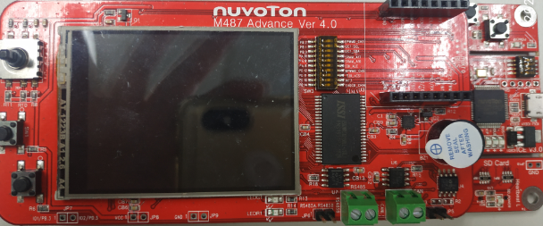
CAN ENV. Set
For printf message
Press key start to program
USB DISK
UART tx for message
CAN and GND
Target chip power

Slide 36
FAQ
User can modify lua directly on USB disk
CAN, SPI, I2C doesn’t support AUTO detect command, most uses of these interfaces are on SOC, jump to LDROM by vendor command and do ISP.
CAN, RS485 need to have PHY (transceiver) on board.

