Slide 1


ENGINEERING WRITE-UP
Three-board GPIO daisy chain
Autonomous sensor, relay/dimmer and lighting control with live OLED diagnostics
Sense locally.
Move packets.
Show the system working.
01 SENSOR
PB5 + digital ALS
02 RELAY
Motion + ambient PWM
NuMaker NDA102SD2 boards linked through DA_JP1 TX/RX
test points, with a digital TSL25721 ambient sensor.
03 LIGHTING
RGB + warm/cool
3
1000 baud
15 s / 10 s
autonomous nodes
software UART
warmup / motion burst
Bench firmware and verification artifacts
NUMAKER / GPIO RING + AMBIENT LIGHT / 11 NOV 2026
01
Notes:
This deck records the implemented bench prototype as of 11 November 2026. The physical topology is a directed ring assembled as a daisy chain with a return wire. The boards run their application without USB control commands. Nuvoton and Winbond logos are included as requested; the actual application runs from the Nuvoton MCUs' internal APROM. The report distinguishes implemented behavior, bench observations, and pending diagnostic experiments.
SOURCES
firmware/header_link.h; header_ring.h; standalone_demo.h; demo_startup.h; demo_effects.h; main.c
https://www.nuvoton.com/ ; https://www.winbond.com/hq/

Slide 2
SYSTEM ARCHITECTURE
Three local applications form one visible system
Each node owns its hardware; addressed packets carry readings and output state.
01 SENSOR / ORIGIN
02 RELAY / ROUTER
03 LIGHTING / ACK
PB5 voltage via MCU ADC CH5
TSL25721 over I²C
Sample locally; publish once per
second
PC2 active-low motion relay
PA6 ambient dimmer PWM
Authoritative 10-second event
timer
Red/blue motion strobe
Smooth warm/cool white fade
Return state and
acknowledgment
SENSOR → RELAY → LIGHTING → SENSOR | USB supplies optional diagnostics
Bench firmware and verification artifacts
NUMAKER / GPIO RING + AMBIENT LIGHT / 11 NOV 2026
02
Notes:
All three baseboards were identified as NDA102SD2 targets by the guarded programmer. The source samples inputs independently of the host. The relay consumes sensor packets and creates lighting state packets. Lighting consumes relay state and creates the return acknowledgment. Generic ring forwarding also supports destinations beyond the immediate neighbor; the normal demo uses successive neighbor destinations.
SOURCES
firmware/header_link.h; header_ring.h; standalone_demo.h; demo_startup.h; demo_effects.h; main.c

Slide 3
PHYSICAL WIRING
Wire TX to the next board’s RX
DA_JP1 logic-side test points • common ground • compatible logic supplies
FROM
TO
PURPOSE
Sensor D_TX / PC14
Relay D_RX / PB15
Sensor readings + motion requests
Relay D_TX / PC14
Lighting D_RX / PB15
Relay state + dimmer + event timer
Lighting D_TX / PC14
Sensor D_RX / PB15
State + motion acknowledgment
Sensor GND
Relay GND + lighting GND
Shared signal reference
Keep one transmitter per receive wire; the third board needs the return link to close the ring.
Power each board correctly. Do not connect the DALI bus-voltage terminals to these logic jumpers.
Bench firmware and verification artifacts
NUMAKER / GPIO RING + AMBIENT LIGHT / 11 NOV 2026
03
Notes:
The DA_JP1 points map to PC14 TX and PB15 RX in the implementation and baseboard reference. Connect the three directed links exactly as shown. These logic jumpers use a common ground; there is no shared multi-transmitter bus arbitration. Match the board logic supply configuration before connecting. The DALI line interface and its bus-voltage terminals are a separate electrical domain. Board power arrangements remain an independent bring-up item; closing host serial ports does not test operation after physically removing USB power.
SOURCES
https://cdn.ozdisan.com/ETicaret_Dosya/952782_212238.pdf
firmware/header_link.h; header_ring.h; standalone_demo.h; demo_startup.h; demo_effects.h; main.c

Slide 4
ELECTRICAL + SIGNALING LAYERS
GPIO software UART on DALI test points
The header location and the waveform protocol are separate design choices.
IMPLEMENTED ON THE JUMPERS
DALI INTERFACE CONTEXT
1000 baud, 8 data bits, no parity, 1 stop bit
PC14 open-drain TX; PB15 input
20 kHz SysTick services TX/RX queues
The baseboard includes a DALI transceiver interface
with bus conditioning and isolation circuitry.
This demo exchanges custom serial frames at the
MCU-side test points.
The current demo uses a private UART-style packet protocol; it does not implement DALI framing.
Bench firmware and verification artifacts
NUMAKER / GPIO RING + AMBIENT LIGHT / 11 NOV 2026
04
Notes:
The GPIO transport uses twenty 50-microsecond timer ticks per serial bit. Receive sampling is scheduled at the bit center. TX and RX run in the SysTick handler; queued bytes are parsed in the cooperative main loop. PC14 is driven open-drain to avoid a push-pull high against the attached receive circuitry. The baseboard's DALI schematic provides the context for these test points; using those points does not by itself make the software a DALI stack. A standards-compliant DALI implementation would require different physical timing and message handling.
SOURCES
firmware/header_link.h; header_ring.h; standalone_demo.h; demo_startup.h; demo_effects.h; main.c
https://cdn.ozdisan.com/ETicaret_Dosya/952782_212238.pdf

Slide 5
PROTOCOL
A compact frame carries addresses, state and integrity
CRC16 rejects damaged frames; TTL bounds generic forwarding.
A5 5A
VER
SRC
DST
TTL
SEQ
LEN
PAYLOAD
CRC
2 bytes
1 byte
1 byte
1 byte
1 byte
1 byte
1 byte
16 bytes
2 bytes
TRANSPORT RULES
DEMO PAYLOAD / VERSION 2
1–16 payload bytes; 26 bytes for the demo
CRC16-CCITT-FALSE, big-endian CRC
Destination consumes; others decrement TTL
Validity flags, PB5 raw count, lux
PWM %, relay, event ID + elapsed ms
Warmup, ready mask, motion ID + ACK
Bench firmware and verification artifacts
NUMAKER / GPIO RING + AMBIENT LIGHT / 11 NOV 2026
05
Notes:
Frame bytes are A5 5A 01 source destination TTL sequence length payload CRC16-BE. CRC uses polynomial 0x1021, initial 0xFFFF, no final XOR, and covers header plus payload. The demo has 16 payload bytes: [0] kind 0x10/0x11/0x12; [1] flags (lux valid bit0, PIR valid bit1, PIR armed bit3); [2:3] PB5 little-endian; [4:5] lux little-endian; [6] PWM; [7] relay; [8] event ID; [9:10] elapsed ms little-endian; [11] schema marker 2; [12] local warmup seconds; [13] three-bit ready mask; [14] motion sequence; [15] pending request bit0 or accepted acknowledgment bit1. Partial frames time out after 100 ms between parser services; CRC and framing counters remain inspectable. This is integrity/error handling, not cryptographic authentication.
SOURCES
firmware/header_link.h; header_ring.h; standalone_demo.h; demo_startup.h; demo_effects.h; main.c

Slide 6
PACKET FLOW
One reading becomes an acknowledged output state
The source sends at 1 Hz; the two downstream nodes respond to received packets.
SENSOR
RELAY
LIGHTING
0x10 readings + motion request
0x11 output state + event clock
0x12 state + accepted motion ACK
26 bytes × 10 serial bits ÷ 1000 baud = 260 ms airtime per hop; about 780 ms around the ring.
Bench firmware and verification artifacts
NUMAKER / GPIO RING + AMBIENT LIGHT / 11 NOV 2026
06
Notes:
Airtime is a calculation for the current full 26-byte demo frame. It excludes scheduling, queueing, sampling phase, parser service and OLED overhead, so it is not a guaranteed round-trip deadline. The source publishes approximately once per second; a fresh physical event can wait for the next publication. The local pending motion sequence remains until the matching acceptance ACK returns. The relay carries the authoritative event ID and elapsed time. Receivers compensate one frame's 260 ms airtime and prevent the stopwatch from running backward; this is approximate alignment, not shared-clock synchronization.
SOURCES
firmware/header_link.h; header_ring.h; standalone_demo.h; demo_startup.h; demo_effects.h; main.c

Slide 7
STANDALONE STARTUP + MOTION
15-second warmup, then a fixed 10-second burst
Warmup protects startup; readiness and PIR rearming handle runtime conditions.
1 WARMUP
2 READY + CLEAR
3 FIRST TRIGGER
Each MCU counts 15 s.
The ring and ambient paths keep
running.
Fresh S/R/L bits reach 111.
PB5 is valid and has been
inactive long enough to arm.
Accept a fresh motion ID.
Run relay + strobe for 10 s;
repeated HIGH does not extend
it.
A new burst requires PB5 to clear and rise again. A held HIGH is not a new motion edge.
Bench firmware and verification artifacts
NUMAKER / GPIO RING + AMBIENT LIGHT / 11 NOV 2026
07
Notes:
PIR is sampled on a 50 ms target schedule. Threshold hysteresis is >1800 counts for HIGH and <100 for LOW. The current policy requires 100 ms stable HIGH and 200 ms stable LOW. It arms only after local warmup and an inactive level; a startup HIGH is suppressed. New accepted motion starts a fixed 200000-SysTick-tick interval (10 s). Interrupt-level cutoff is independent of OLED rendering. Continued HIGH cannot extend the burst. Peer readiness is removed when received state is stale for 3 s, and propagates again after traffic returns. Startup is not a one-shot fragile synchronization exchange.
SOURCES
firmware/header_link.h; header_ring.h; standalone_demo.h; demo_startup.h; demo_effects.h; main.c

Slide 8
INDEPENDENT APPLICATION PATHS
Motion and ambient light have separate state
They share a CPU and ring transport, while keeping trigger and brightness decisions independent.
PB5 / MOTION PATH
TSL25721 / AMBIENT PATH
MCU ADC CH5 → raw PB5
50 ms target sample interval
Hysteresis → debounce → motion ID
Fixed relay/strobe deadline + ACK
I²C registers → two raw channels → lux
200 ms target polling interval
Lux validity → PWM target → local ramp
Tunable-white brightness + color mix
Ambient read errors retain the last dimmer target; they do not reset motion capture or its deadline.
Bench firmware and verification artifacts
NUMAKER / GPIO RING + AMBIENT LIGHT / 11 NOV 2026
08
Notes:
The sensor uses distinct PIR and lux sampling timestamps and counters. Ambient sensor startup uses a nonblocking power-up delay and bounded I2C operations. Relay processing is split into motion acceptance and lux target calculation. An invalid PIR sample does not invalidate lux, and invalid lux does not invalidate PIR. Scheduling is cooperative, so sampling intervals are targets and can be delayed by other work; separating state does not make the tasks electrically isolated or provide hard realtime sampling guarantees. Native fixtures cover missing, saturated and recovering ambient readings, invalid PIR, pending-event retention, rearming, and timer independence.
SOURCES
firmware/header_link.h; header_ring.h; standalone_demo.h; demo_startup.h; demo_effects.h; main.c
tools/test_demo_sensor_paths.c
tools/test_standalone_demo.c

Slide 9
AMBIENT LIGHT SENSOR
The TSL25721 performs its own analog conversion
The MCU reads digital I²C registers; its PB5 ADC is a separate measurement path.
CH0 + CH1
DIGITAL DATA
SENSOR MCU
CH0: visible + infrared
CH1: primarily infrared
Two on-sensor integrating
ADCs
Two 16-bit result registers
I²C slave address 0x39
Observed chip ID: 0x34
PC0 = SDA; PC1 = SCL
Software I²C master
Compute lux and publish it
No MCU ADC for ambient light
Separate buses: ambient sensor on PC0/PC1 at 0x39; OLED on PB0/PB1 at 0x3C. Neither is
the PC14/PB15 GPIO ring.
Sources: ams OSRAM TSL2572 DS000178 pp.14–15; bench identification; sensor firmware
NUMAKER / GPIO RING + AMBIENT LIGHT / 11 NOV 2026
09
Notes:
Bench identification read chip ID 0x34 at I2C address 0x39, matching TSL25721. The TSL2572 datasheet describes a broadband channel and a primarily infrared channel with simultaneous internal conversion. Two-channel compensation produces a lux estimate. The MCU's EADC is not part of this ambient acquisition path. The I2C pins and the separate OLED bus are implemented in the sensor profile. Sensor conversion integration is nominally 51.87 ms, while firmware polling occurs on a 200 ms target interval; conversion rate and host polling rate are distinct.
SOURCES
https://look.ams-osram.com/m/7501e2380e896801/original/TSL2572-DS000178.pdf
https://ams-osram.com/products/sensor-solutions/ambient-light-color-spectral-proximity-sensors/ams-tsl25721-ambient-light-sensor
build/ambient-sensor-working.json
firmware/header_link.h; header_ring.h; standalone_demo.h; demo_startup.h; demo_effects.h; main.c

Slide 10
AMBIENT SENSOR INITIALIZATION
Configure gain and integration, then enable ALS
Values below are command bytes used on the wire, including the register-command bit.
STEP
COMMAND / VALUE
WHAT IT DOES
Identify
Read 0x92 → expect 0x34
Verify the TSL25721 identity
Power
Write 0x80 = 0x01
Enable oscillator / PON
Wait
At least 3 ms, nonblocking
Allow startup before ALS configuration
Integration
Write 0x81 = 0xED
(256 − 237) × 2.73 ms = 51.87 ms
Gain + config
0x8F = 0x00; 0x8D = 0x00
1× gain; standard gain mode
Acquire
Write 0x80 = 0x03
PON + AEN; continuous ALS conversions
Sensor-register offsets are 0x12, 0x00, 0x01, 0x0F and 0x0D; 0x80 selects the command register.
Sources: sensor firmware; ams OSRAM DS000178 register map, ENABLE, ATIME, CONFIG and CONTROL
NUMAKER / GPIO RING + AMBIENT LIGHT / 11 NOV 2026
10
Notes:
Firmware demo_sensor_init reads command 0x92, writes ENABLE command 0x80 with PON, and records a timestamp. A later ambient service pass completes configuration after the minimum 3 ms. The actual elapsed time can exceed 3 ms because the ambient task is scheduled separately. ATIME=0xED is 19 integration steps. CONTROL=0 chooses 1x gain; CONFIG=0 leaves the low-gain divider disabled. ENABLE=3 leaves PON and AEN enabled, allowing continuous integrations. Failed initialization is retried by the ambient path without resetting PIR state. The MCU initially found the sensor in standby during earlier bring-up.
SOURCES
https://look.ams-osram.com/m/7501e2380e896801/original/TSL2572-DS000178.pdf
firmware/header_link.h; header_ring.h; standalone_demo.h; demo_startup.h; demo_effects.h; main.c
tools/tsl2572.ps1

Slide 11
AMBIENT READOUT TRANSACTION
Read four bytes, then assemble two 16-bit counts
The data registers are digital values produced by the sensor’s internal ADCs.
START 0x72 W 0xB4 RESTART 0x73 R
C0_LO C0_HI C1_LO C1_HI NACK STOP
REGISTER AND BUS DETAILS
ASSEMBLY + VALIDITY
0x39 is the 7-bit slave address.
0x72 / 0x73 are address + R/W bytes.
0xB4 = 0xA0 | 0x14: auto-increment
from channel-0 low byte.
C0 = byte[0] | byte[1] << 8
C1 = byte[2] | byte[3] << 8
Read 0x93 first; require AVALID bit 0.
Reject either channel ≥19456 counts.
Sources: sensor firmware demo_sensor_io/demo_lux_sample; ams OSRAM DS000178 pp.18–20, 27
NUMAKER / GPIO RING + AMBIENT LIGHT / 11 NOV 2026
11
Notes:
Each written byte is acknowledged by the sensor. The four-byte read acknowledges the first three data bytes and NACKs the last before STOP. The wire diagram omits intermediate ACK symbols for readability. Firmware first reads STATUS via command 0x93 and requires AVALID. It then reads four consecutive bytes starting at C0DATA using auto-increment command 0xB4. Register pairs are low byte then high byte. The code's saturation policy rejects either channel at or above 19456 with this ATIME setting. Read failure, missing AVALID, or saturation clears the lux-valid flag; relay PWM then retains its existing target. Firmware does not use a sensor interrupt in this polling implementation.
SOURCES
https://look.ams-osram.com/m/7501e2380e896801/original/TSL2572-DS000178.pdf
firmware/header_link.h; header_ring.h; standalone_demo.h; demo_startup.h; demo_effects.h; main.c

Slide 12
LUX CALCULATION
Compensate infrared, then scale by integration and gain
Measured example: C0 = 751 and C1 = 122 → approximately 604.81 lux.
CPL = (51.87 ms × 1) / (1 × 60)
= 0.8645 counts / lux
L1 = (C0 − 1.87 × C1) / CPL
L2 = (0.63 × C0 − C1) / CPL
Lux = max(L1, L2, 0)
WORKED REGISTER READ
Bytes: EF 02 7A 00
C0: 0x02EF = 751
C1: 0x007A = 122
Float calculation: 604.81 lux
MCU integer result: 604 lux
The prototype uses glass factor 1 and fixed gain. Values are estimates; no enclosure or optical calibration has been applied.
Sources: ams OSRAM DS000178 Lux Equation; build/ambient-sensor-working.json; integer firmware implementation
NUMAKER / GPIO RING + AMBIENT LIGHT / 11 NOV 2026
12
Notes:
CPL is counts per lux. Nominal integration is 51.87 ms, gain is 1x and glass attenuation factor is 1. Firmware avoids floating point by computing L1=(100*C0−187*C1)*60/5187 and L2=(63*C0−100*C1)*60/5187 with integer arithmetic. It chooses the larger value, clamps below zero, and limits the transported result to 65535. Division truncates toward zero; the numerical result may differ by about one lux from a floating-point implementation. This worked example comes from an actual earlier ambient-sensor capture, not an invented bench measurement. Gain or integration changes require corresponding CPL and saturation-policy changes.
SOURCES
https://look.ams-osram.com/m/7501e2380e896801/original/TSL2572-DS000178.pdf
build/ambient-sensor-working.json
firmware/header_link.h; header_ring.h; standalone_demo.h; demo_startup.h; demo_effects.h; main.c

Slide 13
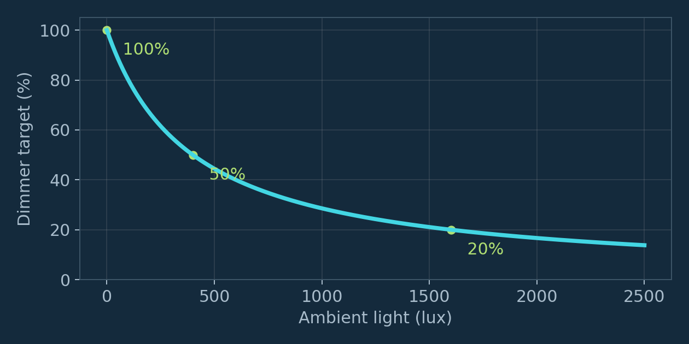
AMBIENT LIGHTING RESPONSE
Lux controls brightness; dimmer duty controls white mix
Motion drives relay/RGB. Ambient light independently drives PWM and warm/cool white.
CONTROL LAW
PWM target = round(40000 / (400 + lux))
0 lux → 100% | 400 lux → 50%
7000 lux → 5%
Relay ramps one point per 80 ms.
White fade: up to 12.5 points/s.
For smoothed duty b: warm = round(b² / 100), cool = b − warm. Example: b = 50 → 25 / 25.
Bench firmware and verification artifacts
NUMAKER / GPIO RING + AMBIENT LIGHT / 11 NOV 2026
13
Notes:
The relay calculates an integer dimmer target on each valid ambient packet. The local PA6 hardware PWM is 20 kHz and its commanded duty moves by one percentage point per 80 ms service interval. The lighting board receives that duty and ramps a Q8 brightness value by 0.25 percentage point every 20 ms, giving 12.5 points per second maximum. Warm and cool channel duties sum to the smoothed total brightness. This is an artistic brightness/color mix, not calibrated correlated color temperature or colorimetric control. The white path continues when the RGB motion burst expires.
SOURCES
firmware/header_link.h; header_ring.h; standalone_demo.h; demo_startup.h; demo_effects.h; main.c

Slide 14
PB5 MEASUREMENT CLARIFIED
PB5 is a pin; its displayed number is an ADC count
A two-level signal can be measured by an ADC without being an analog motion-strength output.
CURRENT FIRMWARE PATH
WHAT WE KNOW / STILL NEED
PB5 physical pin
↓ temporary analog pin function
MCU EADC channel 5
↓ 12-bit voltage measurement
Displayed counts: typically ~1 or ~1900+
Two observed count clusters suggest an on/off signal.
Exact PIR module output type and active polarity still
need schematic or part identification.
Verify actual voltages before a GPIO-only read.
Current trigger thresholds: HIGH >1800, LOW <100. Intermediate counts retain the motion candidate.
Bench firmware and verification artifacts
NUMAKER / GPIO RING + AMBIENT LIGHT / 11 NOV 2026
14
Notes:
The application currently treats PB5 as its PIR candidate input. MCU EADC channel 5 returns raw 12-bit counts from the PB5 voltage. That is distinct from a digital GPIO input register read. A binary sensor output is still an electrical voltage and can be sampled by an ADC. The recurring low and high clusters alone do not prove the exact output circuit, active polarity, or digital input compatibility. In particular, an observed high around 1940 counts is below ADC full scale, so compare a measured voltage and the MCU reference against VIH/VIL before changing to digital-only reads. The exact sensor shield schematic and PIR part number remain unverified in the project references.
SOURCES
firmware/header_link.h; header_ring.h; standalone_demo.h; demo_startup.h; demo_effects.h; main.c
reference/sensor-v1.1-search/findings.json

Slide 15
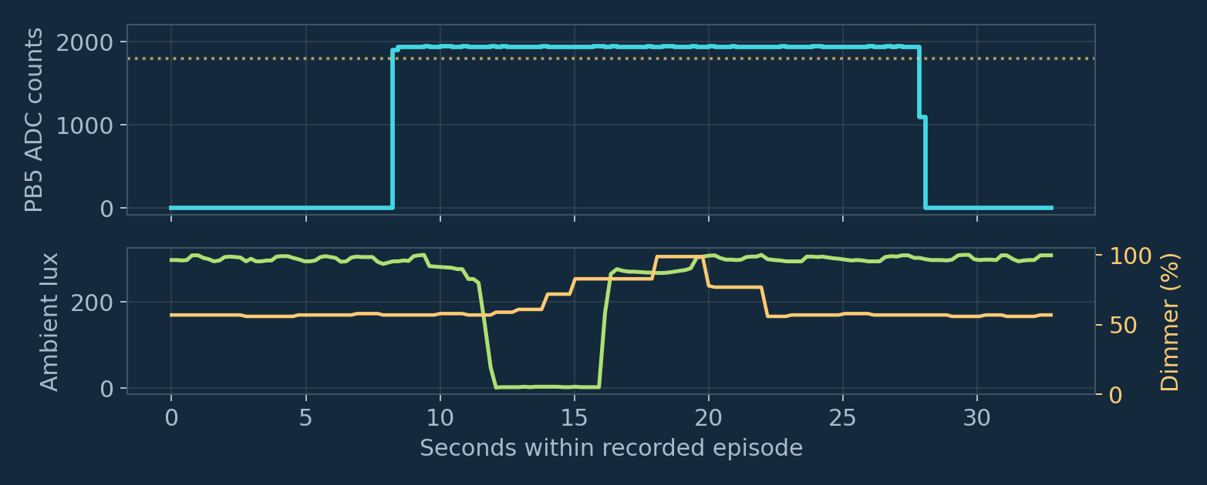
MEASURED PIR ISSUE
A raw PB5 HIGH pulse lasted 19.6 seconds
The long input pulse outlives the fixed 10-second output interval.
OBSERVATION
19.611 s raw HIGH
Sampling and packet
traffic continued.
Cover/uncover trials
correlated with longer
pulses.
Cause remains open.
After the 10-second burst, a held HIGH cannot create another rising edge; the input must clear first.
Source: actual PB5 log pir-live-20261111-202854.jsonl; measured completed HIGH = 19611 ms
NUMAKER / GPIO RING + AMBIENT LIGHT / 11 NOV 2026
15
Notes:
The plotted data is a real captured episode selected around the first completed 19.611-second HIGH interval in the live monitor log. The monitor classifies raw PB5 as HIGH >1800, LOW <100 and MID between those values. Its interval measurement is sampled telemetry and has sampling/communication uncertainty. Other cover/uncover episodes had roughly 19-second highs, while many earlier highs lasted approximately 5–7 seconds. This establishes that the raw measured voltage stays high; it does not establish whether the cover action, PIR retriggering, lamp feedback, supply effects, or another hardware detail is the cause. The firmware's first-trigger-only policy intentionally suppresses repeated held-high input events.
SOURCES
build/pir-live-20261111-202854.jsonl
firmware/header_link.h; header_ring.h; standalone_demo.h; demo_startup.h; demo_effects.h; main.c

Slide 16
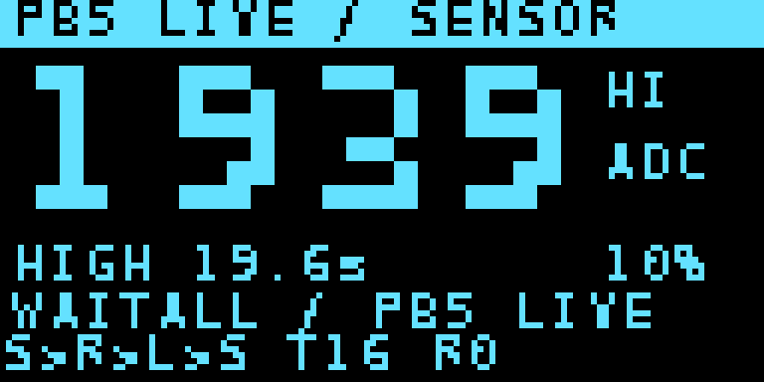


OLED DIAGNOSTICS
Put live state where the wiring is
Normal dashboards visualize timing and packets; the sensor diagnostic enlarges the raw input.
Relay dashboard
Captured framebuffer
Lighting
dashboard
Captured framebuffer
Large-PB5 diagnostic • native-rendered preview
Sensor diagnostic: 28-pixel digits, current level duration, last HIGH duration, warmup/readiness and packet counts.
Bench firmware and verification artifacts
NUMAKER / GPIO RING + AMBIENT LIGHT / 11 NOV 2026
16
Notes:
The large sensor view is a preview generated by the actual native framebuffer drawing code, rather than a photograph. The sensor-specific -pb5 image was flashed and APROM-verified at 20:43:36 UTC on 11 November 2026. The normal relay and lighting images are captured framebuffer snapshots from the earlier verified standalone deployment. Normal dashboards show a big elapsed stopwatch, dimmer percentage, local readings and a transmit/receive strip with a real-transmission comet. The PB5 view replaces the main sensor stopwatch with a four-times-scale raw ADC number, keeps a small startup line, and adds current raw level duration and last completed high duration.
SOURCES
build/pb5-display-diagnostic.json
build/standalone-startup-verification.json
firmware/header_link.h; header_ring.h; standalone_demo.h; demo_startup.h; demo_effects.h; main.c

Slide 17
VALIDATION STATUS
Separate verified behavior from open hardware questions
Bench evidence supports the software paths; unplugged-power behavior and PIR causality need distinct checks.
VERIFIED
OPEN / LIMITED
Three baseline images flashed and verified
All-board ready mask reached 7
Traffic and both samplers advanced with host serial
ports closed for 12 s
Native protocol, timer, rearm and sensor-failure tests
pass
Serial-ports-closed test kept USB cables attached; it
does not prove physical unplugged-power operation.
PIR output type/polarity and long-pulse cause remain
unconfirmed.
Ring has airtime and scheduling latency.
Verification artifacts retain timestamps, port/node IDs, counters, output state and flash results.
Bench firmware and verification artifacts
NUMAKER / GPIO RING + AMBIENT LIGHT / 11 NOV 2026
17
Notes:
Standalone observation passed at 20:00:16 UTC on 11 November 2026. It observed all three nodes ready, then closed every host serial port for 12 seconds and verified continued packet traffic. The source PIR and ambient sampling counters also advanced. USB cables remained connected. Some earlier physical-unplug tests were user-reported inconsistent, so this report does not claim that external-power bring-up has been proven by the ports-closed experiment. Link diagnostics include framing, overflow, CRC and parse counters. A few accumulated errors during staggered board programming are different from demonstrating zero steady-state error rate. Native tests are simulated policy/parser tests, not electrical qualification.
SOURCES
build/standalone-startup-verification.json
build/standalone-demo-manifest.json
tools/test_demo_startup.c
tools/test_demo_sensor_paths.c

Slide 18
PIR ISOLATION EXPERIMENT
Compare ambient control with a fixed light output
Keep sensing and logging active while removing dimmer changes from the experiment.
A BASELINE
B FIXED DUTY
COMPARE
Normal ambient dimming
Record PIR-only pulses, then
repeat the cover/uncover action.
Keep the hand away from PIR
where possible.
Diagnostic relay build: 60%
Lux and PB5 keep updating.
PWM and white target stay fixed.
Repeat the same action after the
white fade settles.
Log HIGH duration, lux, duty,
event ID and sample counters.
A difference points toward an
output-related effect; more
controls distinguish optical from
supply effects.
Status: the fixed-60% relay image is built and native-tested; deployment is pending relay USB connection.
Bench firmware and verification artifacts
NUMAKER / GPIO RING + AMBIENT LIGHT / 11 NOV 2026
18
Notes:
The fixed60 relay image was prepared but is not recorded as flashed. Its local PWM is constant at 60%, while lux acquisition, target computation, forwarding and motion control continue. Lighting receives the fixed duty and its white envelope settles to a constant target. RGB/relay motion behavior is kept the same in both cases. Record at least several repeat trials with consistent placement and timing. If the high extension persists even with fixed outputs and a controlled card movement outside the PIR field, further sensor-circuit investigation is needed. If it disappears, the next comparison can distinguish lamp optical/thermal feedback from supply coupling; the initial A/B test alone does not identify which mechanism applies.
SOURCES
build/fixed-dimmer-diagnostic.json
tools/test_standalone_demo.c

Slide 19
FIRMWARE + DEPLOYMENT
Internal MCU flash stores the application
All three targets are NDA102SD2. The build allocates 64 KB APROM and 12 KB RAM.
REPRODUCIBLE BUILD
GUARDED FLASH + DIAGNOSTICS
python3 tools/build.py
Sensor: --profile sensor --standalone-demo
Relay: --profile dt57 --relay-active-level 0
--standalone-demo
Lighting: --profile lighting --standalone-demo
--swap-green-blue
Identify the exact target before erase.
Snapshot current APROM.
Erase → write → verify → reset.
USB commands are read-only in the autonomous
application. External SPI flash is not used by this
demo.
Lighting-board override: PC5 red, PC3 green, PC4 blue. The observed green/blue wiring differs from schematic labels.
Bench firmware and verification artifacts
NUMAKER / GPIO RING + AMBIENT LIGHT / 11 NOV 2026
19
Notes:
The linker configuration allocates 64K flash and 12K RAM. The firmware currently uses a bare-metal cooperative loop and the 20 kHz SysTick; Zephyr is not required to reproduce the demo. Switching operating systems would not directly correct a long raw PIR signal, power bring-up or protocol airtime. The guarded programmer identifies NDA102SD2 and validates the intended USB/debug interface before erasing. Current APROM is backed up and write verification is performed. LDROM/config are outside the application update operation. Optional builds add --demo-pb5-display for the sensor or --demo-fixed-dimmer 60 for the relay. The supplied green/blue swap is specific to the observed lighting board.
SOURCES
firmware/header_link.h; header_ring.h; standalone_demo.h; demo_startup.h; demo_effects.h; main.c
firmware/link.ld
tools/build.py
tools/flash.ps1

Slide 20
REFERENCES + HANDOFF
Use the implementation and captured evidence together
External references establish device behavior; local artifacts document what this prototype actually did.
Nuvoton baseboard reference
NuMaker-DALI-NDA102SD2 User Manual — DA_JP1 / PC14 / PB15
Ambient sensor primary source
ams OSRAM TSL2572 DS000178 v2-00 — ADCs, registers, I²C and lux
Implementation
firmware/header_link.h, header_ring.h, standalone_demo.h, demo_startup.h, demo_effects.h
Bench evidence
build/standalone-startup-verification.json; ambient-sensor-working.json; pir-live-*.jsonl
Diagnostic status
build/pb5-display-diagnostic.json; fixed-dimmer-diagnostic.json
Official branding assets
Nuvoton and Winbond official website logo images
Bench firmware and verification artifacts
NUMAKER / GPIO RING + AMBIENT LIGHT / 11 NOV 2026
20
Notes:
Read the linked manufacturer documentation for electrical and register definitions. File paths refer to the accompanying NuMaker working tree and its generated bench artifacts. The PPTX contains editable text, tables, shapes and wiring/packet diagrams; waveform and response plots are embedded images generated from source data and formulas. The source generator is tools/build_daisy_chain_pptx.py. Official Nuvoton logo asset: https://www.nuvoton.com/export/system/modules/com.thesys.project.nuvoton/resources/images/Nuvoton_logo.png . Official Winbond logo asset: https://www.winbond.com/export/system/modules/com.thesys.project.winbond/resources/images/logo.png_1914476845.png .
SOURCES
https://cdn.ozdisan.com/ETicaret_Dosya/952782_212238.pdf
https://look.ams-osram.com/m/7501e2380e896801/original/TSL2572-DS000178.pdf
https://ams-osram.com/products/sensor-solutions/ambient-light-color-spectral-proximity-sensors/ams-tsl25721-ambient-light-sensor
https://www.nuvoton.com/ ; https://www.winbond.com/hq/
firmware/header_link.h; header_ring.h; standalone_demo.h; demo_startup.h; demo_effects.h; main.c

