Slide 1
Futarque OpenOTT
Home Automation
Showcasing Zigbee LA / Philips Hue

Slide 2
Purpose
Show analog and digital input
Control Philips Hue lamps based on:
Light sensitive photoresistor
Android App UI
Demonstrate easy app development using Android Studio

Slide 3
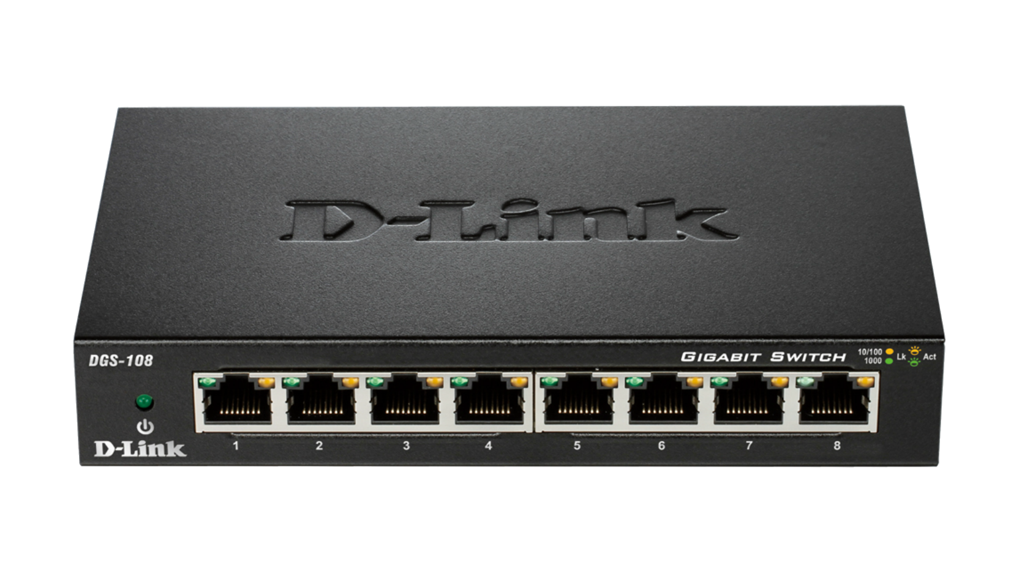
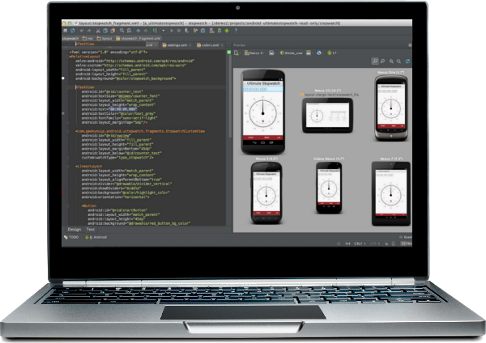

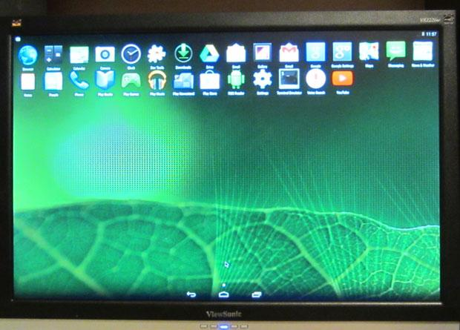
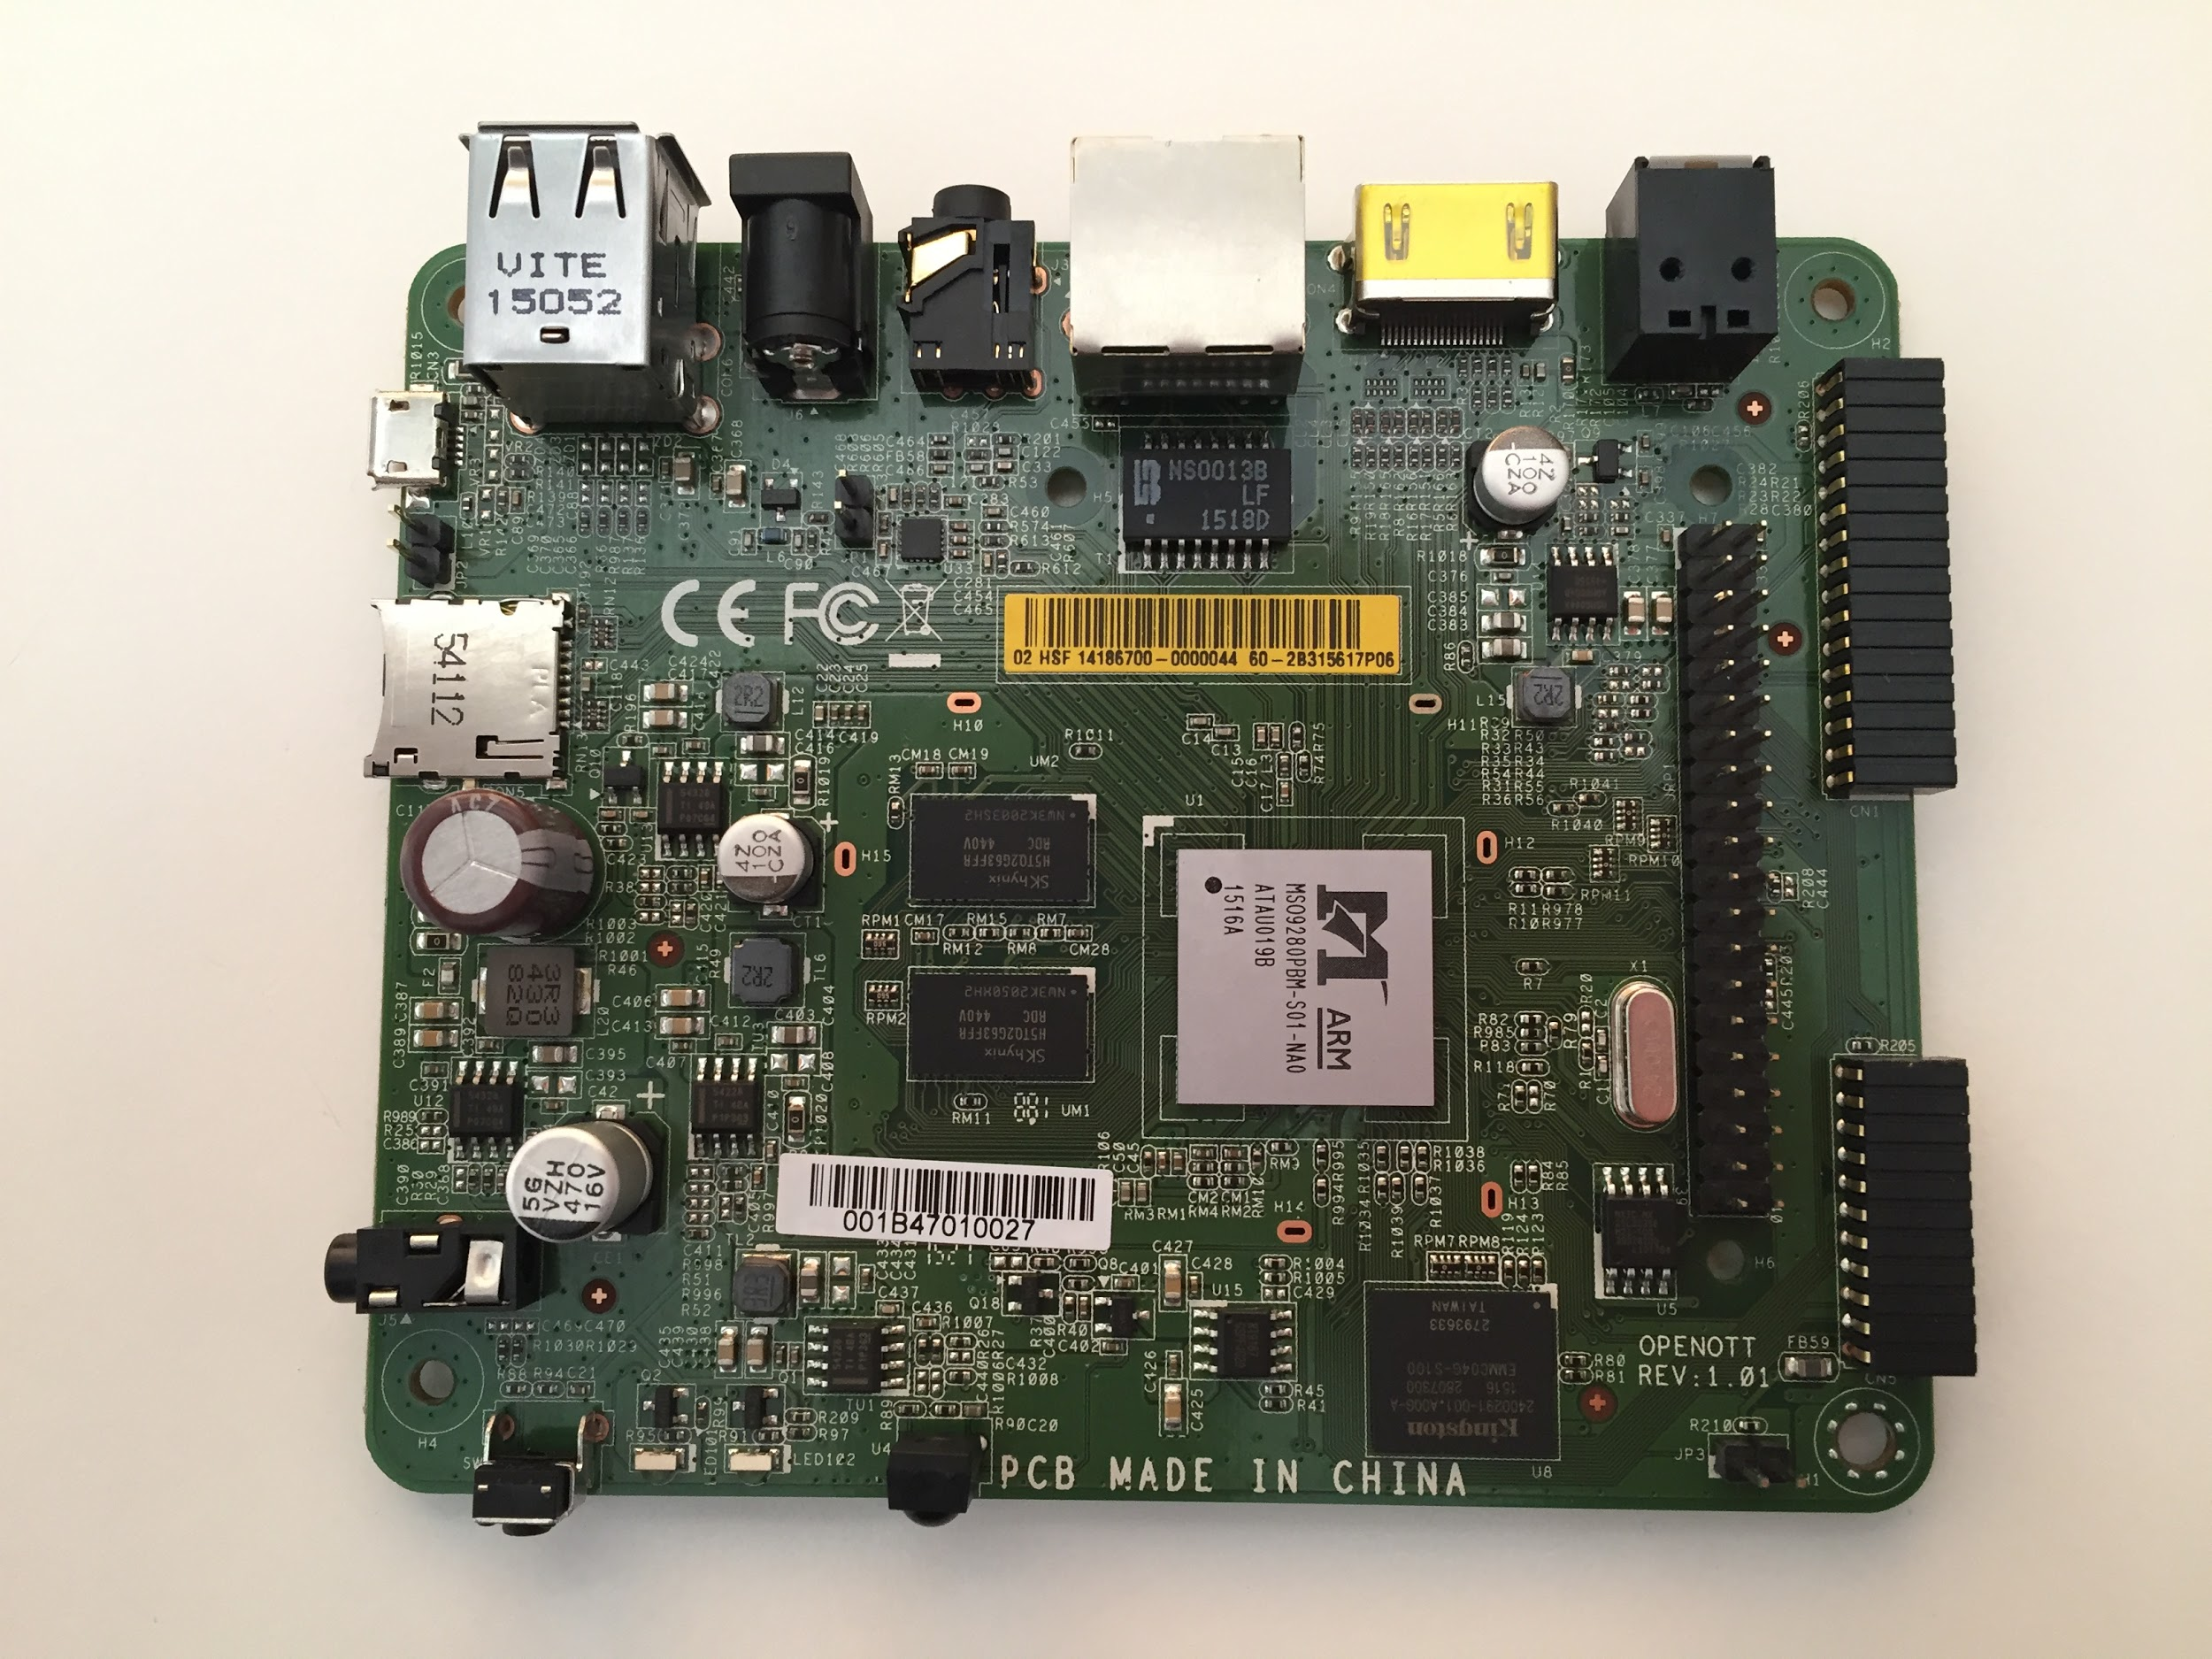

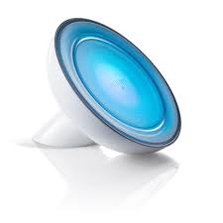
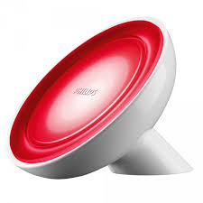

Demo Setup
Switch
Development PC
Ethernet
OpenOTT
To Raspberry Pi
Connector
Wireless Zigbee
Photoresistor Pushbutton

Slide 4
Functional Description
Light input to photoresistor controls one lamp
Pushbutton turns other lamp on/off
Remote Control and/or Android UI app changes lamp colors

Slide 5
Optimization Suggestion
To reduce cost, use USB Zigbee LA dongle rather than Philips Hue bridge.

