Slide 1
Scenario
Transport Infrastructure
ICT Architecture Scenario
Version: 1.01
Status: In Use
Editors: Klaus Vilstrup Pedersen, DIFI
Jens Jakob Andersen, NITA

Slide 2
Statements
Statement of originality
This deliverable contains original unpublished work except where clearly indicated otherwise. Acknowledgement of previously published material and of the work of others has been made through appropriate citation, quotation or both.
Statement of copyright
This deliverable is released under the terms of the Creative Commons Licence accessed through the following link: http://creativecommons.org/licenses/by/3.0/.
In short, it is free to
Share — to copy, distribute and transmit the work
Remix — to adapt the work
Under the following conditions
Attribution — You must attribute the work in the manner specified by the author or licensor
(but not in any way that suggests that they endorse you or your use of the work).

Slide 3
Revision History
Version | Date | Editor | Org | Description
1.00 | 01.02.2011 | Klaus Vilstrup Pedersen | DIFI | First Version
1.01 | 01.08.2012 | Klaus Vilstrup Pedersen | DIFI | Small change to animation (SML vs DNS)

Slide 4
Who, where, why, how?
Why should I trust?
Trust
Sender
How do I transport my document?
Receiver
Registry
Who can I reach?
Where can I send my document?

Slide 5
Scenario
Country A
Send to company C – how??
Invoice
DNS
SMP point:
SMP point de
http://smp.de/
SML Registry
(enter entry to DNS through the SML)
Operator 1
Key: CompanyC
Company B
Key: CompanyC
Doc: Invoice
Profile: Peppol
Company A
Access point,
VAN 1
BusDox
Endpoint:
Access point 2
http://ap2.de/
SMP Registry
Transport properties
Secure
Reliable
Profile properties
Transport + QoS
Country B
Access point 2,
Operator 2
Operator 2
Company C
Public agency D

Slide 6
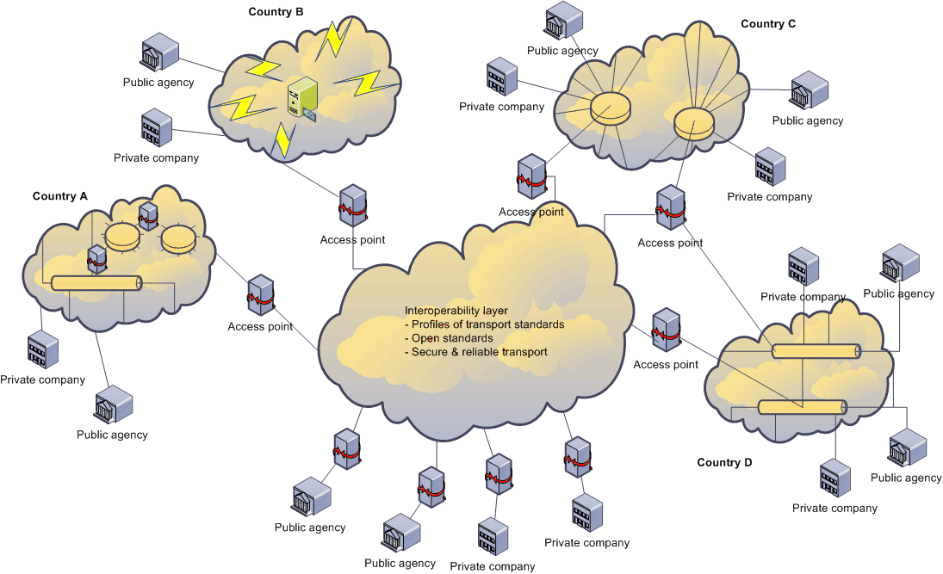
ICT Architecture Framework
PEPPOL 4-corner model

Slide 7

eProcurement
without borders in Europe
www.peppol.eu

