Slide 1
a1
b1
S-port 1
a2
b2
S-port 2
aN
bN
S-port N

Slide 2

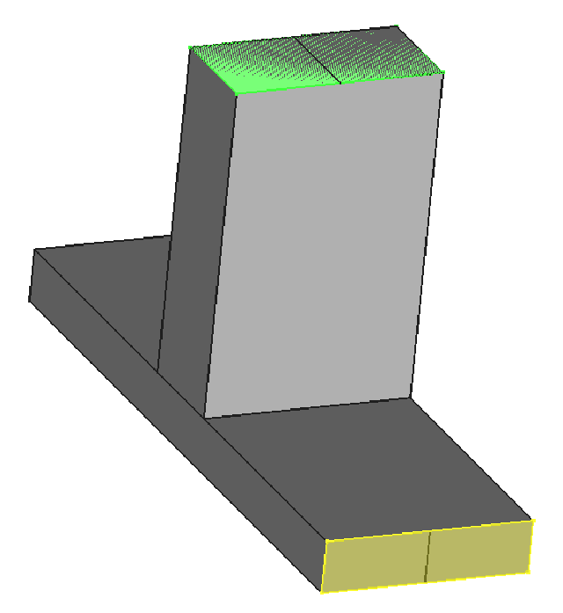
S-port i: 2D simulation for fields, a, b, Z_{o}
Driving field Ey
S-port k: absorbing boundary

