Slide 1
OpenParEM2D
Open Parallel Electromagnetic 2D - A free, open-source electromagnetic simulator for 2D waveguides and transmission lines.
Features
Full-wave solver
  simultaneously solves the electric and magnetic fields
Advanced finite-element method (FEM) with arbitrary high-order elements
Adaptive mesh refinement
Parallel processing through the Message Passing Interface (MPI)
Front-end input file builder for common transmission line and waveguide types.
Licensed under GPLv3 or later.
Capabilities
Calculations
  propagation constant
  characteristic impedance
  dielectric loss
  conductor loss
  surface roughness loss
  field distributions
Dominant and higher-order modes
Arbitrary cross sections
Arbitrary high frequencies
v.1.1

Slide 2
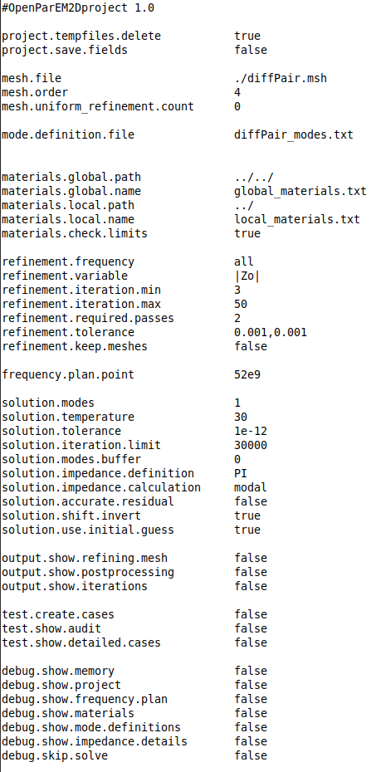

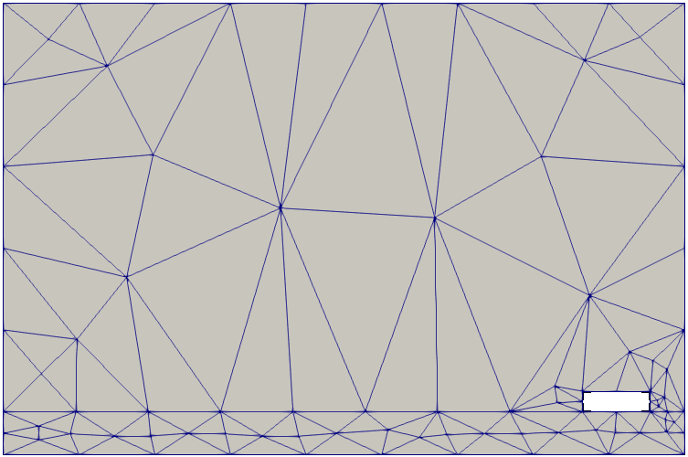
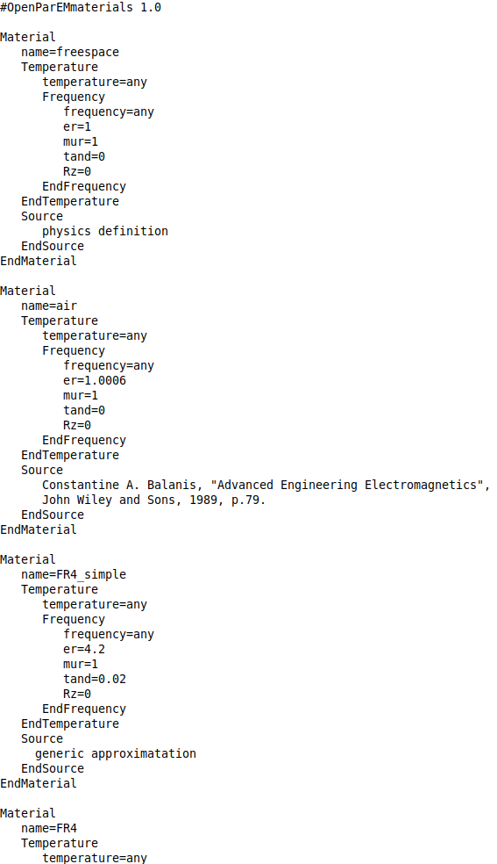
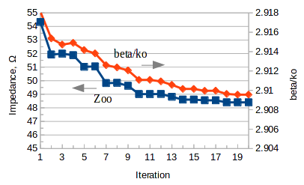

Workflow without “builder”
OpenParEM2D is a command-line tool with text inputs and outputs
Use with open source tools to create a complete workflow
Workflow used for development:
Arbitrary Cross Section
text editor
FreeCAD
export modes and boundary conditions file
project setup file
export drawing file
export mesh file
OpenParEM2D
gmsh
text editor
material database file
library and/or local
ParaView input files
CSV file
OpenOffice
ParaView

Slide 3
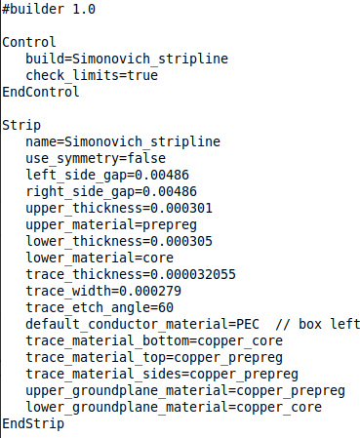
Workflow with “builder”
For transmission line and waveguide types supported by the front-end tool “builder”, the flow is greatly simplified.
builder
project setup file
export drawing file
export modes and boundary conditions file
text editor
export mesh file
OpenParEM2D
gmsh
text editor
material database file
library and/or local
ParaView input files
CSV file
Supported as of This Writing
rectangular waveguide
microstrip
symmetric coupled microstrip
asymmetric coupled microstrip
stripline
symmetric coupled stripline
asymmetric coupled stripline
OpenOffice
ParaView

Slide 4
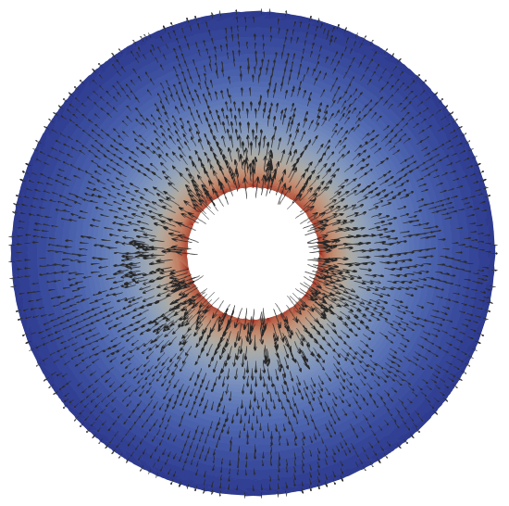
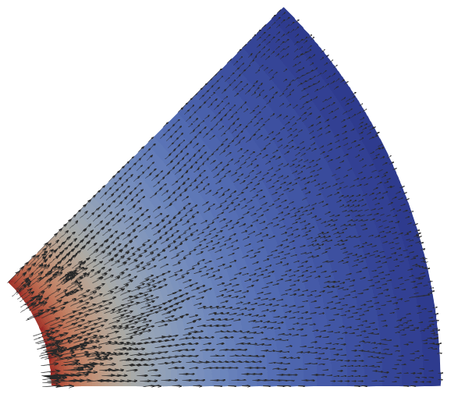
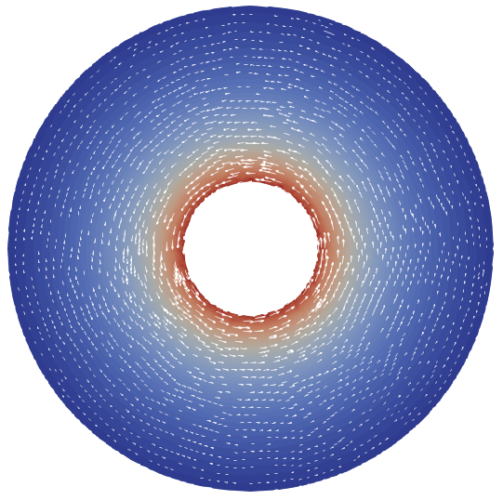
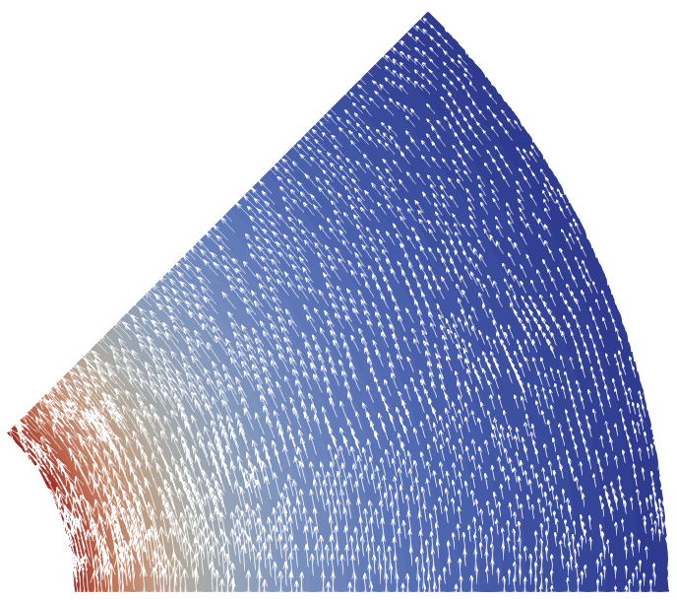
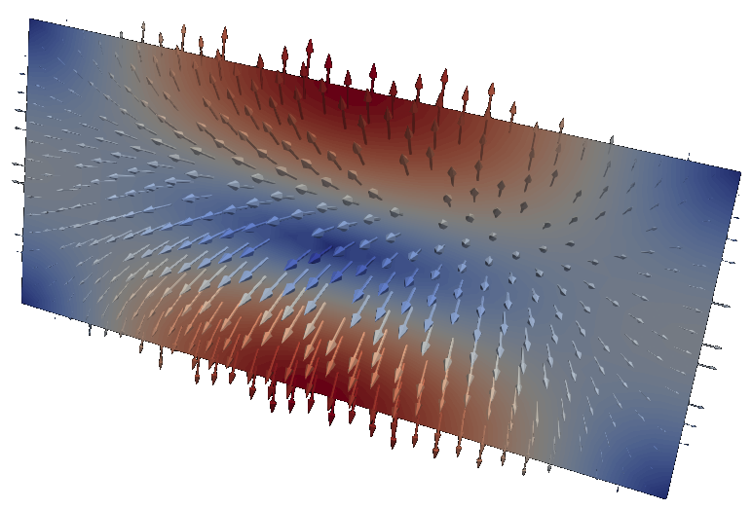
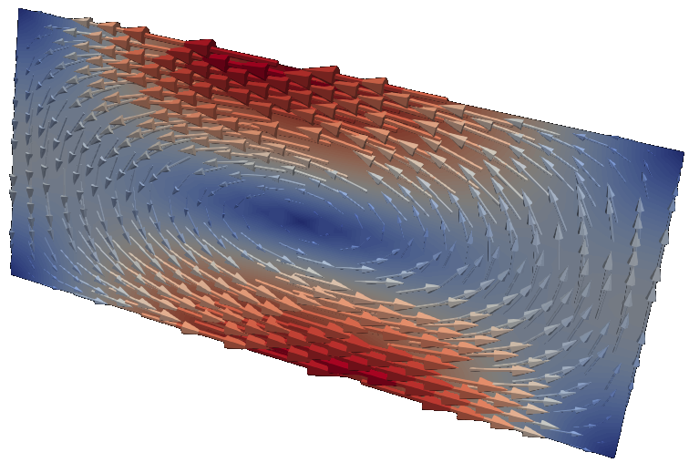
Sample Results
E
H
PMC
2nd-order
elements
2nd-order
elements
PMC
1/8 Coax
using symmetry
Coax
PMC
E real
Cutoff
TE11 Mode
WR90
Rectangular Waveguide
4th-order
elements
H imag

Slide 5
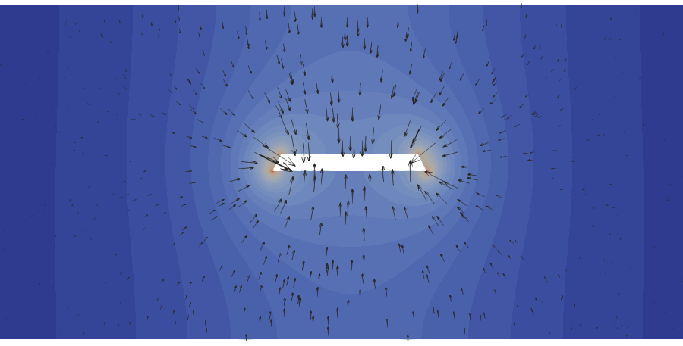


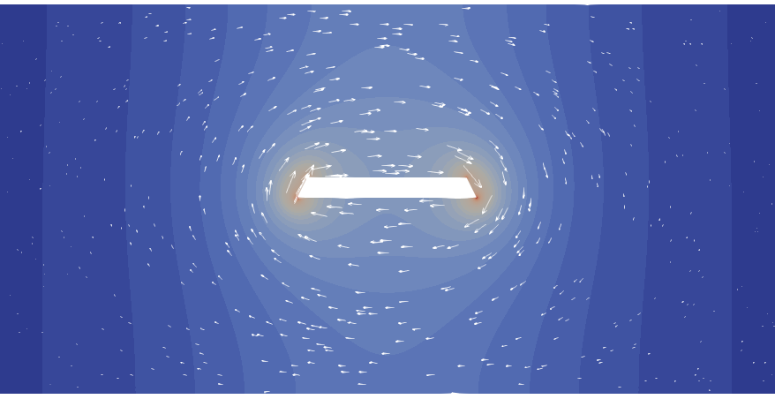


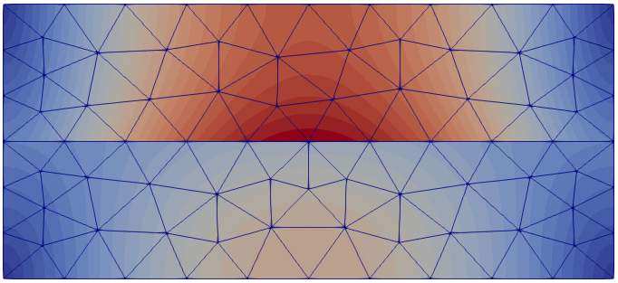
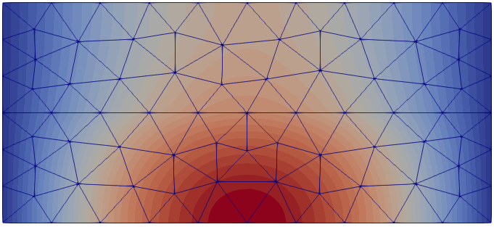
E
E
E
Even Mode
H
H
3rd-order
elements
H
E
E
4th-order
elements
Odd Mode
H
H
Stripline
with etch profile
3rd-order
elements
Coupled Microstrip
E
e_{r}=1
H
6th-order elements
Mesh Shown
No Adaptive Refinement
e_{r}=2.45
Partially-Filled Rectangular Waveguide

Slide 6
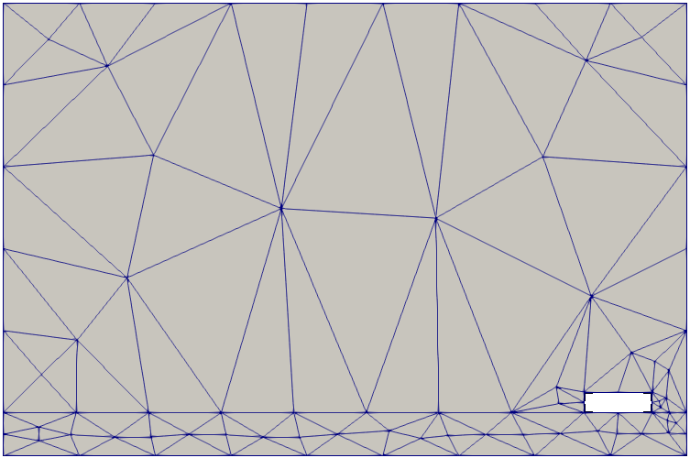

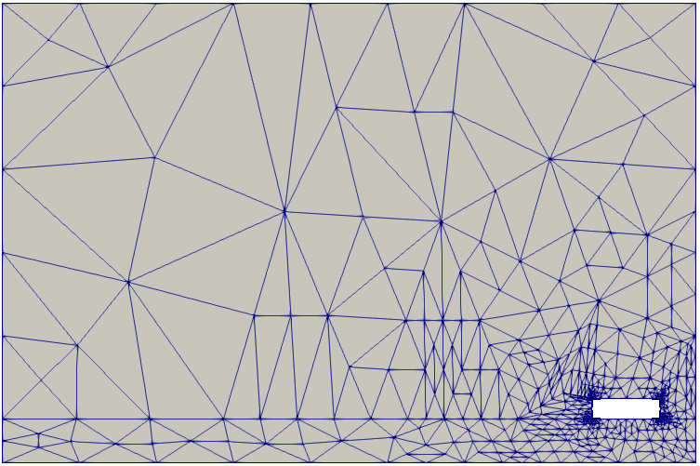

Mesh at iteration 1
4th-order
elements
PEC
E tangential at iteration 20
Mesh at iteration 20
H tangential at iteration 20
PEC
Odd Mode of Coupled Microstrip

