Slide 1
OpenParEM2D
Accuracy
v.1.1

Slide 2
Overview
Solve several practical examples to demonstrate the level of accuracy that is achievable with OpenParEM2D.
For actual engineering use, the tight accuracy settings in this report are overkill and cost excess run time. The user should use settings that are “good enough” to balance accuracy vs. run time.
  See the partially-filled waveguide examples for a demonstration of the run-time vs. accuracy tradeoff.

Slide 3
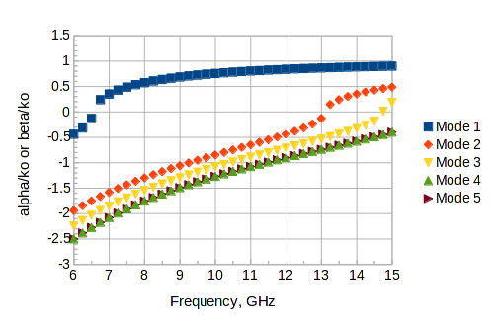
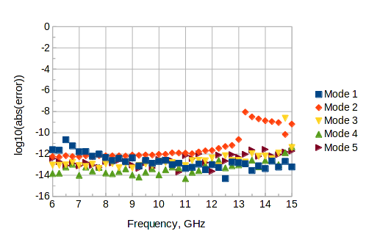
Rectangular Waveguide
WR90 lossless rectangular waveguide
  First 5 modes
regression/WR90_rectangular_waveguide/WR90/WR90_order_6_refinement_no_mesh_reuse/WR90_accuracy_run.proj
accuracy settings
  mesh.order 6
  mesh.uniform_refinement.count 1
  refinement.frequency all
  refinement.variable |gamma|
  refinement.required.passes 2
  refinement.tolerance 1e-9
  solution.tolerance 1e-13
  solution.shift.invert true
  solution.shift.factor 10
The propagation/attenuation plot in the upper right shows the exact analytical results. The computed results are not shown since they overlay the exact results.
The error plot in the lower right shows the error between the analytical and computed results for the propagation/attenuation constants.
The baseline error is about 10⁻¹² with an expected increase in the error as the eigenvalue transitions through zero.
beta
alpha

Slide 4
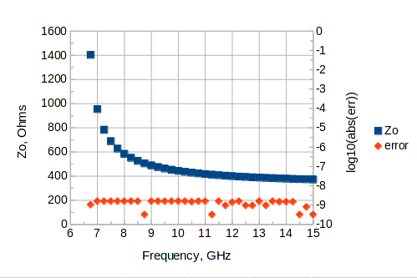
Using the power-voltage (PV) definition of characteristic impedance, the plot at right shows the analytical impedance for the dominant mode, where the computed result is not shown since it would overlay the plot. The plot also shows the error between the analytical and computed results.
  Wave impedance is typically used for waveguides, but for this study, the PV definition is strong test of the simulation since it depends on the electric and magnetic fields across the entire cross section plus the integrated voltage from bottom to top.
The error is typically about 10^{-8.8}.

Slide 5
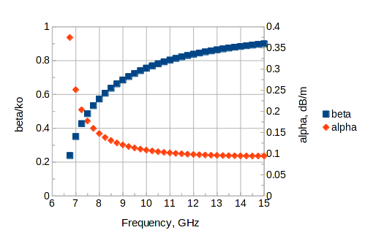
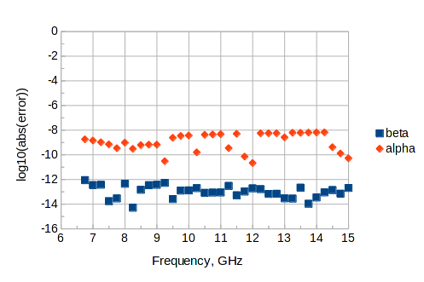
Lossy Rectangular Waveguide
WR90 lossy rectangular waveguide
  TE10 mode with copper wall losses at room temperature
regression/WR90_rectangular_waveguide/WR90/WR90_order_6_refinement_no_mesh_reuse_loss/WR90_accuracy_run.proj
accuracy settings
  mesh.order 6
  mesh.uniform_refinement.count 1
  refinement.frequency all
  refinement.variable alpha
  refinement.required.passes 2
  refinement.tolerance 1e-9
  solution.tolerance 1e-13
  solution.shift.invert true
  solution.shift.factor 10
The theoretical attenuation due to the conductor losses is given by Eq. (27), p. 417 in Simon Ramo, John R. Whinnery, and Theodore Van Duzer, Fields and Waves in Communication Electronics, 2nd Edition, John Wiley and Sons, 1984.
The propagation/attenuation plot in the upper right shows the exact analytical results. The computed results are not shown since they overlay the exact results.
The error plot in the lower right shows the error between the analytical and computed results for the propagation and attenuation constants.
The baseline error for beta is better than 10⁻¹².
The baseline error for alpha is better than 10⁻⁸. Beta is a direct result from the eigenvalue solution, while alpha is calculated from the derived H-fields, so the error for alpha is higher than that for beta.
← Note change from
the lossless setup.

Slide 6
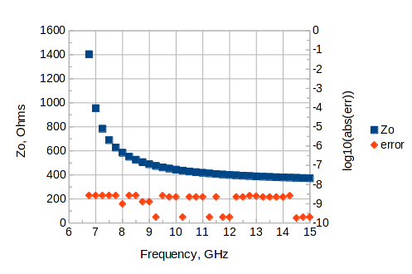
Using the power-voltage (PV) definition of characteristic impedance, the plot at right shows the analytical impedance for the dominant mode, where the computed result is not shown since it would overlay the plot. The plot also shows the error between the analytical and computed results.
The error is typically about 10^{-8.6}.

Slide 7
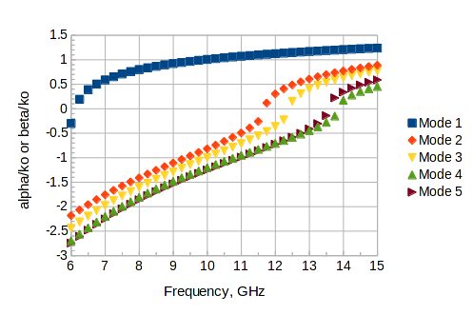
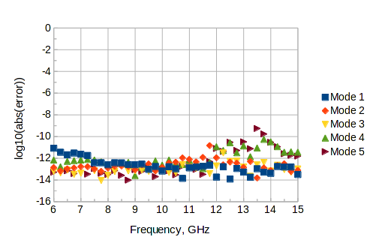
Partially-Filled Waveguide
Partially-filled rectangular waveguide
  First 5 modes
  Roger E. Harrington, Time-Harmonic Electromagnetic Fields, McGraw-Hill, 1961, p. 161, example from Fig. 4-7.
    Dimensioned figure in upper right
    Exact solution is from numerical solution of the transcendental equations in (4-56) and (4-58).
  regression/partially_filled_rect_waveguide/PartFilled_order_6_refinement/PartFilled_accuracy_run.proj
accuracy settings
  mesh.order 6
  mesh.uniform_refinement.count 0
  refinement.frequency all
  refinement.variable |gamma|
  refinement.required.passes 2
  refinement.tolerance 1e-8
  solution.tolerance 1e-13
  solution.shift.invert true
  solution.shift.factor 10
The propagation/attenuation plot in the middle right shows the exact analytical results. The computed results are not shown since they overlay the exact results.
The error plot in the lower right shows the error between the analytical and computed results for the propagation/attenuation constants.
The baseline error is about 10⁻¹² with an expected increase in the error as the eigenvalue transitions through zero.
e_{r}=1
9 mm
e_{r}=2.45
4.5 mm
20 mm
beta
alpha

Slide 8
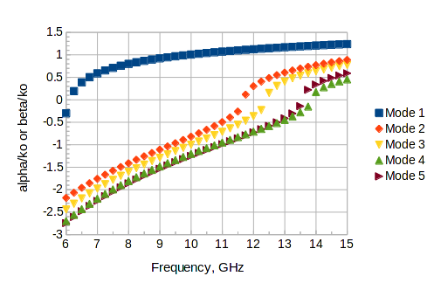
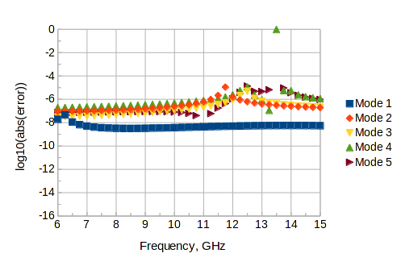
Relaxed Accuracy
This slide is a repeat of the partially-filled waveguide example from the prior slide demonstrating relaxed accuracy settings for a quicker run time.
  regression/partially_filled_rect_waveguide/PartFilled_order_6_refinement/PartFilled_relaxed_run.proj
accuracy settings
  mesh.order 3
  mesh.uniform_refinement.count 0
  refinement.frequency none
  refinement.variable |gamma|
  solution.tolerance 1e-10
  solution.shift.invert true
  solution.shift.factor 10
Compared to the high-accuracy run on the prior slide, the mesh order is dropped from 6 to 3, iterative refinement is skipped, and the eigenvalue solution accuracy is dropped from 10⁻¹³ to 10⁻¹⁰.
As before, the propagation/attenuation plot in the upper right shows the exact analytical results, while the computed results are not shown since they overlay the exact results.
The error plot in the lower right shows the error between the analytical and computed results for the propagation/attenuation constants.
The baseline error is about 10⁻⁶ with an expected increase in the error as the eigenvalue transitions through zero.
The error has substantially increased compared to the high-accuracy run, but the error is still well within useful engineering bounds.
The run time for the high-accuracy run is 1865 s vs. 17.3 s for this relaxed-accuracy example for a 108x speedup with good engineering accuracy remaining.
beta
alpha

Slide 9
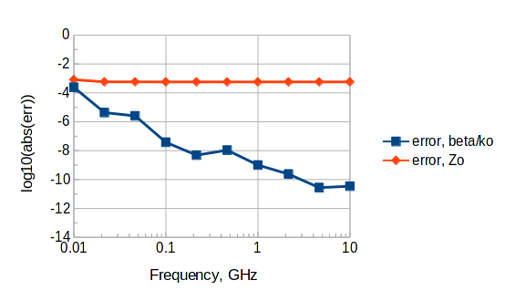
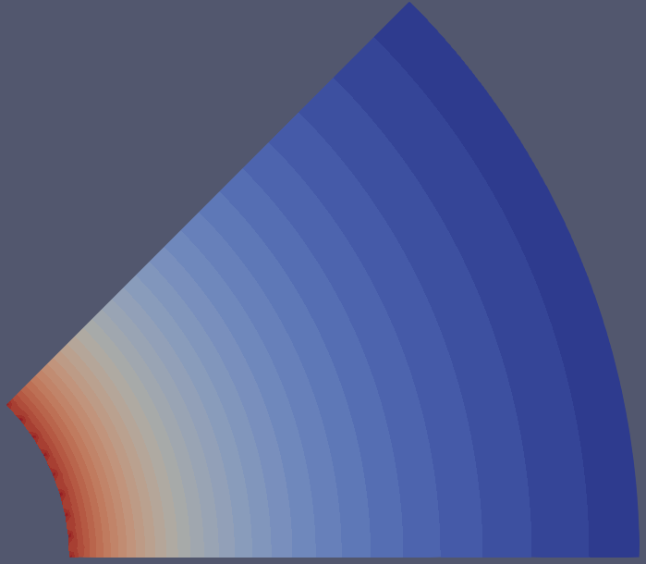
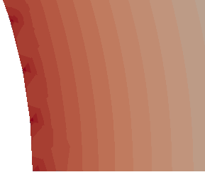
Coaxial Waveguide
coax: a=0.406 mm, b=1.480 mm, and e_{r}=2.26
  exact results at all frequencies:
    (beta/ko)²=2.26
    Zo=51.5874640385028 W
  regression/coaxEighth/coax_accuracy_run.proj
accuracy settings
  mesh.order 3
  mesh.uniform_refinement.count 0
  refinement.frequency all
  refinement.variable |Zo|
  refinement.required.passes 2
  refinement.tolerance 1e-5
  solution.tolerance 1e-13
  solution.impedance.definition PV
Accuracies for beta/ko and Zo are shown in the figure to the upper right.
For beta/ko, the accuracy is good at very low frequencies where Faraday's and Ampere's laws are decoupling enough to affect the full-wave results. At high frequencies, the error is very small.
For Zo, the accuracy is affected by the meshing, where the curved surfaces of the coax are approximated by a piece-wise linear mesh.
  The figure to the lower right shows the computed electric field magnitude with 32 levels of color discretization.
  The shallow corners produce high electric field intensities.
  With the resulting increase in electric field strength near the corners, the error of the Zo calculation is ~10^{-3.2}. This error is really a statement on the physical approximation rather than on the solution accuracy.
  At 10 GHz, the computed Zo=51.617 W, a little higher than the theoretical value of 51.587 W, which is consistent with a higher voltage caused by the corners.
High electric field intensities due to corners in the mesh.

Slide 10
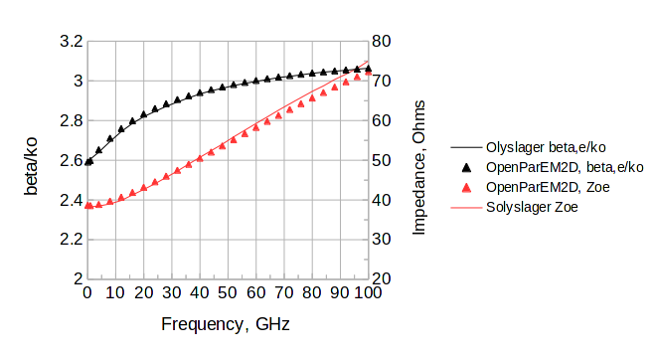
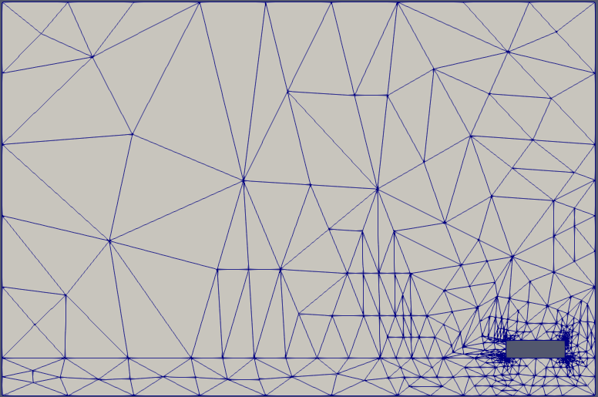
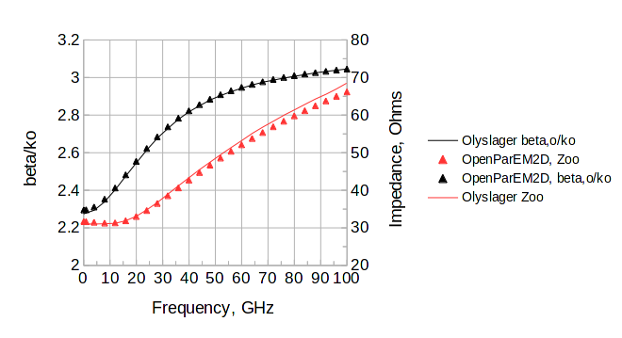
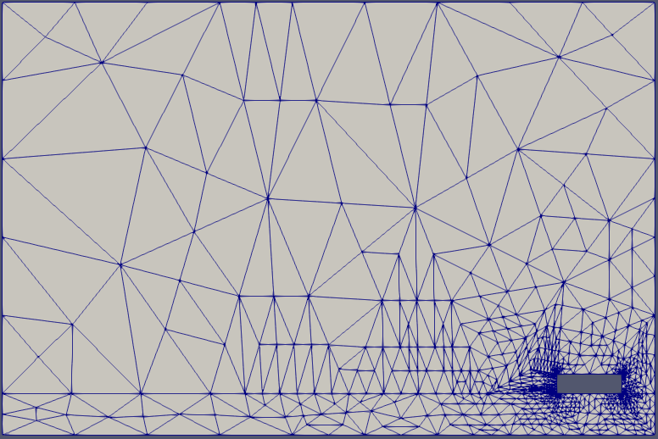
Differential Pair
differential pair
  Frank Olyslager, Daniel De Zutter, and Krist Blomme, “Rigorous Analysis of the Propagation Characteristics of General Lossless and Lossy Multiconductor Transmission Lines in Multilayered Media”, IEEE Trans. Microwave Theory and Techniques, vol. 41, no. 1, Jan. 1993, pp. 79-88.
  comparing Fig. 8 from page 86.
  Results are scaled from the slightly distorted scanned image.
Even and odd modes are computed with OpenParEM2D using separate simulations exploiting symmetry.
  regression/differential_pair/diff_pair_modal_symmetry_odd/diffPair_accuracy_highlow.proj
  regression/differential_pair/diff_pair_modal_symmetry_even/diffPair_accuracy_highlow.proj
accuracy settings
  mesh.order 6
  mesh.uniform_refinement.count 0
  refinement.frequency plan
  refinement.variable |Zo|
  refinement.required.passes 2
  refinement.tolerance 0.0001
  frequency.plan.log 100e6,1e9,1
  frequency.plan.linear 4e9,100e9,4e9
  frequency.plan.point.refine 100e9
  frequency.plan.point.refine 1e9
  solution.tolerance 1e-13
  solution.shift.invert true
For beta/ko, agreement between the published result and OpenParEM2D is very good at all frequencies.
For impedance, agreement is very good up to ~50 GHz, after which, the two sets of simulations diverge by a small amount.
  At 100 GHz the difference between the two is ~3.4%.
Odd Mode
Even Mode

Slide 11
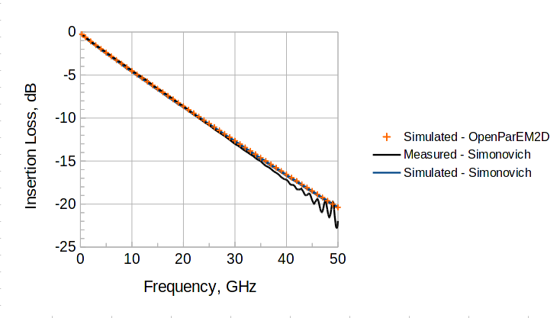
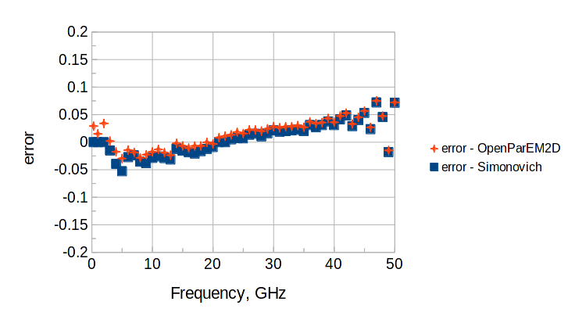

Lossy Stripline
lossy stripline
  Lambert Simonovich, “A Practical Method to Model Effective Permittivity and Phase Delay Due to Conductor Surface Roughness”, 2017 DesignCon.
  comparing Fig. 16, right graph
  results are scaled from the figure
  regression/Simonovich_stripline/Simonovich_stripline_accuracy_run.proj
accuracy settings
  mesh.order 5
  mesh.uniform_refinement.count 0
  refinement.frequency high
  refinement.variable alpha
  refinement.required.passes 3
  refinement.tolerance 4e-4
  solution.tolerance 1e-13
  solution.shift.invert true
  solution.shift.factor 1
As shown in the two figures in the upper right, the simulation with OpenParEM2D is in very close agreement with Simonovich's simulation, and both are in good agreement with the measurement up to ~40 GHz, where ripple from the measurement setup appears.
The figure in the lower right shows the magnitude of the tangential electric field with very smooth equipotential lines and smooth fields down to the sharp points on the trace.

