Slide 1
OpenParEM2D
User Manual
v.1.1

Slide 2
Applications for OpenParEM2D
The typical applications for OpenParEM2D are transmission line and waveguide design.
The outputs from the simulations are propagation constants, attenuations, impedances (either modal or matrix), and field values at given points.
OpenParEM2D is a full-wave 2D electromagnetic (EM) simulator using the finite element method (FEM).
As a 2D solver, it can simulate any transmission line or waveguide for the dominant and higher-order modes.
As a full-wave solver, solving Maxwell's equations including both electric and magnetic fields and their interactions, OpenParEM2D can solve to arbitrarily high frequencies.
However, as a full-wave solver, it cannot solve to arbitrarily low frequencies due to the decoupling of Faraday's and Ampere's laws at low frequency.
  The lower frequency limit primarily depends on the dimensions of the cross-section.
As an FEM method, it can solve arbitrary 2D cross-sections.

Slide 3
Steps to Solve a Problem
Generate the input files for OpenParEM2D
  Project control file
  Finite element mesh file
  Boundary conditions and modes file
  Materials File
Run OpenParEM2D
View results in ParaView
Plot results using a spreadsheet
OpenParEM2D input files can be generated by hand or by various support scripts or programs.

Slide 4
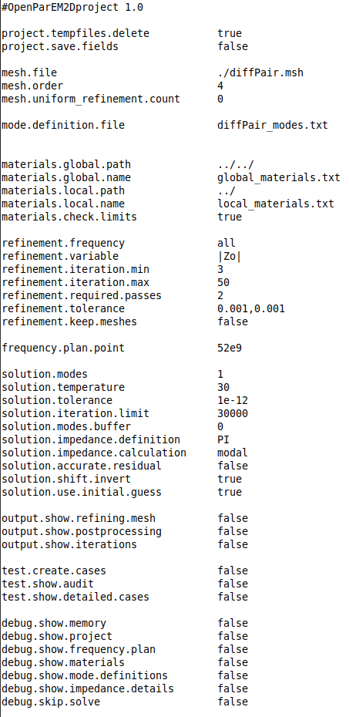
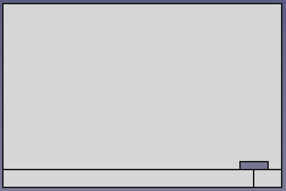
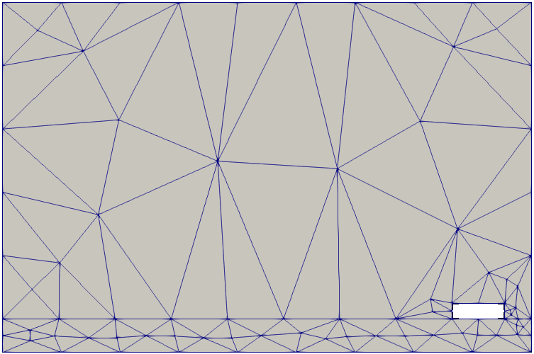
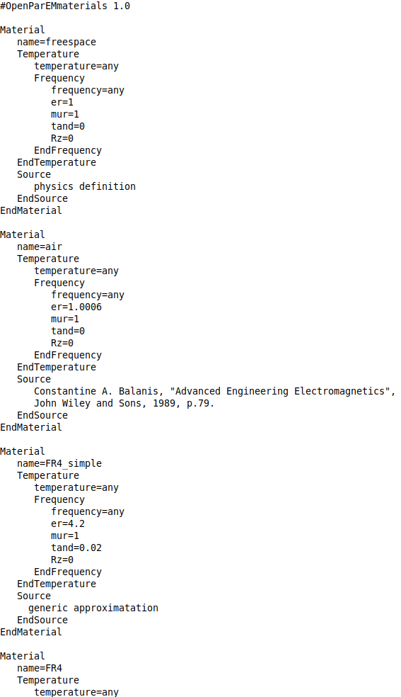
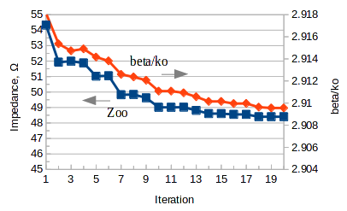

Workflow without “builder”
OpenParEM2D is a command-line tool with text inputs and outputs
Use with open source tools to create a complete workflow
Workflow used for development:
Arbitrary Cross Section
text editor
FreeCAD
export modes and boundary conditions file
project setup file
export drawing file
export mesh file
OpenParEM2D
gmsh
text editor
material database file
library and/or local
ParaView input files
CSV file
OpenOffice
ParaView

Slide 5
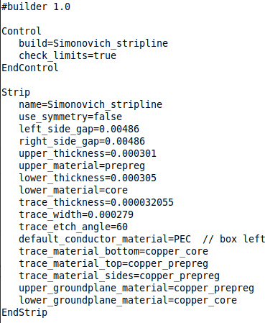
Workflow with “builder”
For transmission line and waveguide types supported by the front-end tool “builder”, the flow is greatly simplified.
builder
project setup file
export drawing file
export modes and boundary conditions file
text editor
export mesh file
OpenParEM2D
gmsh
text editor
material database file
library and/or local
ParaView input files
CSV file
Supported as of This Writing
rectangular waveguide
microstrip
symmetric coupled microstrip
asymmetric coupled microstrip
stripline
symmetric coupled stripline
asymmetric coupled stripline
OpenOffice
ParaView

Slide 6
Workflow
without “builder”
Use to Solve Arbitrary Cross Sections

Slide 7
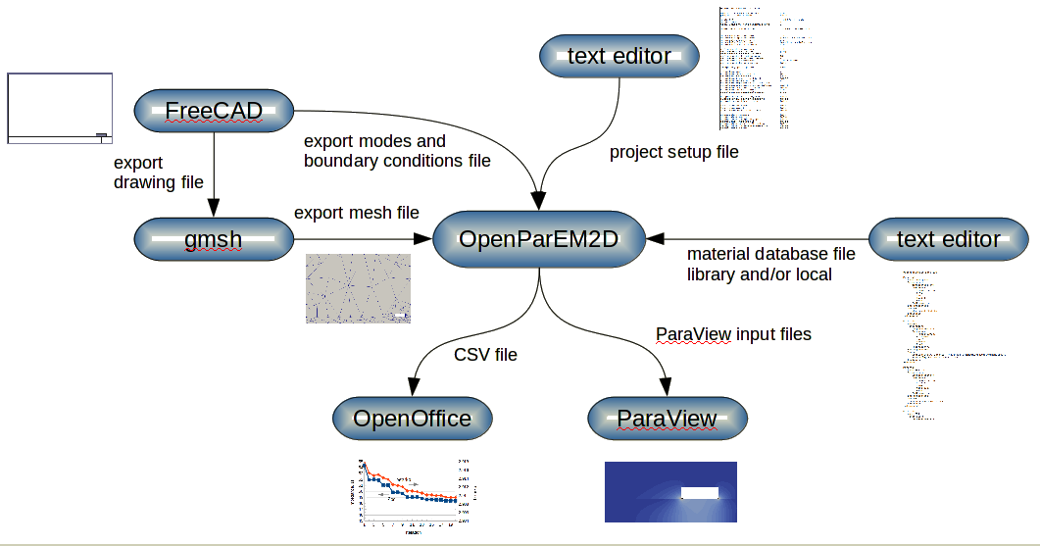
Workflow without “builder”
4
Run FreeCad
  Draw the geometry
  Add borders
  Add ports
  Run the macro “OpenParEM2D_save.py”
    This saves a boundary/modes file.
  save a brep file
Run gmsh
  $ gmsh -format msh22
  Setup and evaluate for the best mesh quality
  Save the mesh.
Locate a global library file to use or write a local materials file
Write a project file
  Pull in the boundary/modes file (from 1), the mesh file (from 2), and a material file or files (from 3)
  Easiest to copy from a similar project and customize
Run OpenParEM2D
  example: $ mpirun -np 5 OpenParEM2D project_file.proj
  example: $ OpenParEM2D project_file.proj
Run ParaView
  Requires project.save.fields true
  Run the macro “field_plot” to generate a standard set of field plots
Run OpenOffice
  Pull in csv output into a spreadsheet to make plots
1
5
3
2
7
6

Slide 8
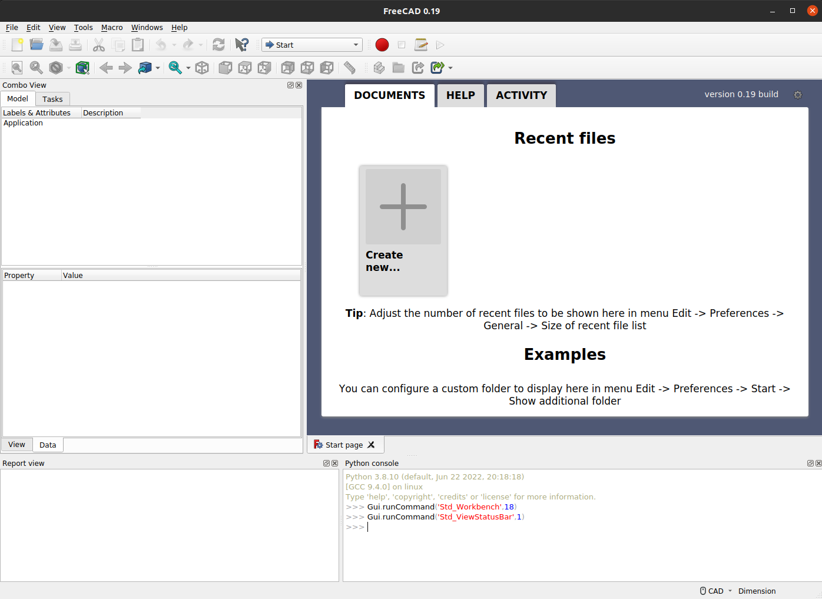
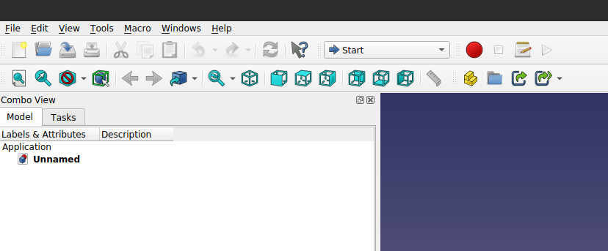

1 FreeCAD
This document is using FreeCad 0.19
start FreeCad: $ freecad &
at the tab “Start page”, tab “DOCUMENTS”, click “Create new ...”
Edit → Preferences → tab “Units” → MKS, “Number of decimals” → 3
Switch mode from “Start” to “Draft”
Draw the structure.
  Set "Make Face" as true as each primitive is drawn.
    This is found in the properties section for each object.
    This can be changed at any time after the element is drawn.
  Name the primitives by editing the "Label" property.
    Use the name of the material that represents the area.
    This can be changed in the mesh file later, if needed.
Switch mode from “Draft” to “Part”
  Use the icon "Make a cut of two shapes" to eliminate overlaps and make cutouts for conductors.
click
Any surface that faces nothing or an unfilled object becomes a perfect electric conductor (PEC) by default in OpenParEM2D. Make a conductor by leaving a “hole” in the drawing. Any surface facing the outside of the drawing is also a PEC. Any surface can be marked to become a perfect magnetic conductor (PMC) or surface impedance boundary.

Slide 9
When the drawing is done, the parts need to be unified into a single object for meshing.
  Select all of the objects, then use the icon “Boolean fragments” to unify them.
  This step enables gmsh to line up the mesh elements along boundaries.
  If you need to go back to primitive objects, you can select the "Boolean Fragments" object, then right click "Delete", and the primitives are restored.
Even though the units are set to MKS, on export, FreeCAD will likely output the object dimensions in mm instead of m. OpenParEM2D requires all physical dimensions in m, not mm. A work-around is to scale the drawing down by 0.001.
  Switch the mode from “Part” back to “Draft”.
  Select the boolean object, then Modification → Clone
  Select the cloned object, then in the properties box, set Scale → x → 0.001 and Scale → y → 0.001.
  Work with the scaled object from now on.
  Tip: You can hide objects by selecting the object then pressing the space bar. Hiding the original unscaled boolean object is a good idea at this point.
Add paths to enable the definitions of S-parameter ports, modes within ports, and boundary conditions.
  S-parameter ports
    Any surface facing the outside of the boolean object, which may be actually inside the object as a hole, is by default PEC.
  Modes within ports
    Voltages - For each voltage integration line, a path is required from one conductor to another.
    Currents - For each current integration path, a closed path is required on the contour of the conductor.
  Boundary conditions
    Any surface facing the outside of the boolean object, which may be actually inside the object as a hole, is by default PEC. For a surface that needs another boundary condition, a path must be defined on that surface.
Process to add a path
  Paths can be added by drawing a line, a polyline, or a rectangle, which ever is most convenient. Any drawn path does need to line up precisely with the boolean object, so be sure to use the snap option.
  For each path, edit the Label in the properties box, and give it a unique name prepended by _P, so _Pname.

Slide 10

Add an S-paremeter port or a boundary. Repeat for additional boundaries.
  Set the mode to “Draft” if the drawing is in another mode.
  Add a Text object to the drawing.
    This is just a trick to get an object for which a unique label can be set.
    Click anywhere outside the boolean object.
    Set the text to anything, but a period is nice and small.
    Click “Create text”.
  Select the newly created text object, then edit its Label in the properties box.
    The format for the label is
      for an S-parameter port: _Sname(impedance_type){[+|-]path,-path,+path,...}
        any name can be used for the port; the S-parameter port numbers are supplied with modes (below)
        impedance_type sets the calculation style for the port impedances and takes a value of VI, PV, or PI
        optimization sets the port optimization parameter and takes a value of alpha, beta, |gamma|, |Zo, Re(Zo), or Im(Zo) [currently, only PV is supported]
      for a boundary: _Bname(SI|PEC|PMC|radiation,material|wave_impedance){[+|-]path,-path,+path,...}
        “name” is a unique name for the boundary
        Select the boundary type by keeping either SI, PEC, PMC, or radiation. Note that PEC is the default, so it does not need to be set. It remains an option here in case it comes in handy some day.
        “material” is required for surface impedance (SI).
        “wave_impedance” is optional for radiation (default=377)
    Choose the physical location for the S-parameter port or boundary by listing previously defined paths by name, not including the _P prefix.
      If more than one path is listed, they are chained together in order to create a more complex path.
      With no sign or with a + sign, the path is included without reversing the direction.
      Use a - sign to reverse the direction of the path.
    The paths for S-parameter ports and boundaries must ultimately form a closed contour without holes.
Add a mode. Repeat for additional modes.
  Add a text object using the procedure described for boundaries.
  Select the newly created text object, then edit its label in the properties box.
    The format for the label is _Mport_name(S-parameter_port_number,voltage|current){[+|-]path,-path,+path,...} or _Lport_number(mode_number,voltage|current){[+|-]path,-path,+path,...}. Use _M if a modal impedance calculation is being done and _L for a lines calculation.
    “S-parameter_port_number” is an integer indicating the S-parameter port. Across all modes for all ports, the S-parameter ports must be numbered sequentially as 1,2, …, N, where N is the total number of S-parameter ports.
    “port_name” is text indicating the port defined with an _S* label.
    Select whether the port is for a voltage or current calculation.
  Two modes can be defined for each mode number, one for voltage and one for current. Since only one of the two modes defined will be used, both should have the same S-parameter port number.

Slide 11
Export the brep file.
  Select the boolean fragment object, then File → Export.
  Open the saved brep file in a text editor and scan the dimensions for correct scale. They should be in m. If they are not, then re-visit the scaling, correct as needed, and export a new brep file.
Export the boundary/modes file.
  Macro → Macros … → select OpenParEM2D_save.py → Execute
Save the project and exit FreeCAD, if desired.
Note: This process is obviously not simple, although it does get easier after a couple of passes through it. Streamlining the process with additional scripting could certainly make it much easier to set up boundaries and ports. For example, being able to click on an edge then right-click to bring up a boundary definition box would be very convenient.

Slide 12
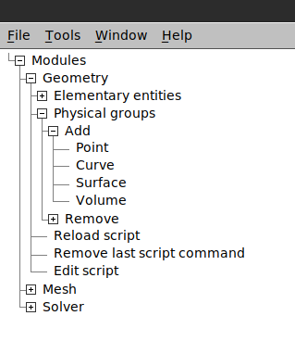
2 gmsh
This document is using gmsh version 4.8.4
Start gmsh: $ gmsh -format msh22 &
Load the brep file exported from FreeCAD
Add physical groups for the dielectric regions.
  Geometry->Physical groups->Add->Surface [see selection A in the figure]
  Name the surface in the pop-up, click the surface, then press the key "e" to end.
    The name of the surface is the material name, and the material name must appear in a materials file called out in the project file.
  For the first region, gmsh needs to create a geo file.
    click “Yes” on the “Create new 'geo' file” button.
  Repeat for each surface, where a name is entered, the region is clicked, and the key “e” is pressed.
  When all regions have been entered, press “q” to quit.
Fix the region numbering.
  Geometry->Edit script [see selection B in the figure]
  For each region, set the number next to the surface name to match the number in the curly brackets.
    Note that the numbers in the curly brackets must start with 1 and go sequentially to higher numbers. If this is not the case, then go back and try again.
  Save and exit the text editor.
  Geometry->Reload script [see selection C in the figure]
    The changes do not take effect until the script is re-loaded.
A
A
C
B

Slide 13
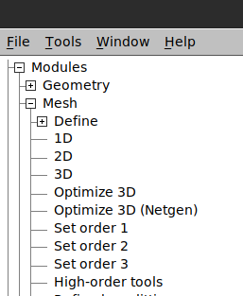
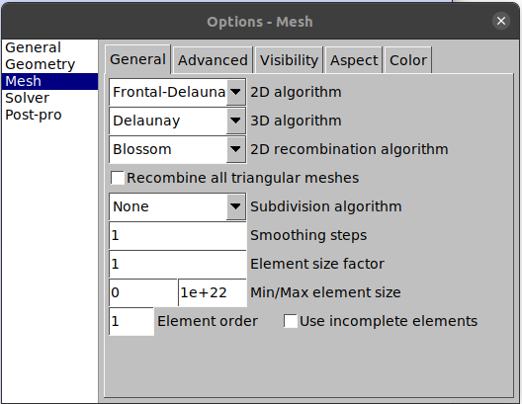
Mesh the layout
  Mesh → 2D [see selection D in the figure]
  Check mesh alignment at boundaries
    Visually check the mesh to make sure that the meshes line up at the boundaries. If they do not line up, then the boolean fragments step was not properly executed in FreeCAD. In this case, delete the brep and geo files, go back to FreeCAD to the boolean fragments step, fix the drawing, then re-export a brep file.
Improve mesh quality, if needed
  Visually evaluate the mesh.
    Ideally, the mesh consists only of equilateral triangles.
    If the mesh has only nice, fat triangles, then proceed to exiting gmsh.
  Long, thin triangles degrade the condition number of the matrices when solving the eigenvalue problem. As the mesh becomes worse, the iterative eigenvalue solution takes more iterations to find a solution. At some point, poor mesh quality can cause the eigenvalue solver to fail to find a solution.
  Bring up general options
    Tools → Options.
  Show meshing options
    Select “Mesh”
    Select the “General” tab
  Try out the circled options to improve the mesh quality.
    After each change, reload the script [C from the prior slide], then click Mesh → 2D.
    The general goal is the smallest mesh with the best mesh quality.
  When the mesh looks good, proceed to saving the mesh.
Save the mesh
  File → Save Mesh
  File → Quit [if desired]
D

Slide 14
3 Material Database
Ideally, a materials file is available as a site-specific materials library.
If a materials file does not exist, one must be written that meets the specifications for materials files in the file “specifications.pdf”.
  A good starting point is the file “global_materials.txt” in the regression directory of the src distribution.

Slide 15
4 Project File
OpenParEM2D is controlled through a text file called the “project file”.
The user must create the project file.
  The specification for the project file can be found in file “specifications.pdf”.
  The easiest way to create a project file is to copy an existing project file then customize it.
The project file pulls in the boundary/mode file exported from FreeCAD, the mesh file exported from gmsh, and the materials file, either referencing a library file or freshly created [or both].

Slide 16
#WR90_order_3_refinement_no_mesh_reuse/WR90.proj
#OpenParEM2Dproject 1.0
project.save.fields true
mesh.file ../WR90_waveguide.msh
mesh.order 3
mode.definition.file ../WR90_waveguide_modes_no_Zs.txt
refinement.frequency all
refinement.variable |gamma|
refinement.iteration.max 20
refinement.tolerance 1e-8
materials.global.path ../../../
materials.global.name global_materials.txt
materials.local.path ./
materials.local.name
frequency.plan.linear 9e+09,1e+10,1e+09
solution.modes 5
solution.temperature 20.
solution.tolerance 1e-12
solution.iteration.limit 10000
solution.modes.buffer 4
solution.impedance.definition PV
An example project file from the regression suite is shown to the left
  defaults are removed with the utility “simplify”
Other inputs are custom for this project
mesh file
boundary/mode file
materials file
to run this example:
$ cd regression/WR90_rectangular_waveguide/WR90/WR90_order_3_refinement_no_mesh_reuse
$ mpirun -np 5 OpenParEM2D WR90.proj
As a description, this project solves a WR90 waveguide for the first 5 modes using 3rd order finite elements at 9 and 10 GHz. The mesh is adaptively refined at both frequencies starting from the initial input mesh. The tolerance is set fairly tight at 1e-12. The power-voltage definition is used to calculate the impedance. Four extra modes are calculated to ensure that the requested 5 non-null modes are found.

Slide 17
5 OpenParEM2D
Execute OpenParEM2D with one of the following commands:
  $ mpirun -np N OpenParEM2D project_file.proj
    Run using N processors
  $ mpirun -np 1 OpenParEM2D project_file.proj
    Run using 1 processor
  $ OpenParEM2D project_file.proj
    Run using 1 processor
OpenParEM2D runs and provides errors, if any, plus status and results to the screen.
  Re-direct the output to save the screen-printed results as a log file.
  The output includes the line “mesh worst element aspect ratio: X <> target: 5”. If X is much greater than 5, perhaps greater than ~10, then revisiting the mesh quality in gmsh could be in order.
A lock file is created at the start of execution, and the lock file is removed on exit. If the job dies without a clean exit, the lock file will prevent another execution. To remove the lock file:
  rm .project_file.lock
As the job runs, intermediate results are saved
  project_file_results.csv - see the commented header for the data included
  project_file_fields.csv [if field.point is included in the project file] - see the commented header
  Paraview files
On clean exit, the intermediate results are final.
Review the information printed to the screen for errors, warnings, and expected behaviors and results.

Slide 18
6 ParaView
Requires project.save.fields true in the project file.
Run paraview
  $ paraview &
Open a file to view a result
  Navigate to the directory “ParaView_project_file”.
  There are results for each mode at each frequency.
  Select result to view and open.
Run the macro “field_plot” to generate a standard set of field plots.
  Note that the macro cannot properly set the scaling for the vector plots. Re-scale as needed.
OpenParEM2D always scales the results such that the tangential electric field is real at its maximum value.
  So generally, view the real electric field and the real magnetic field for propagating modes and the imaginary magnetic field for cutoff modes.
Tip!
  ParaView generally requires that you click the green “Apply” button after clicking on an action. If this is not done, then ParaView can appear to be broken or non-responsive. Be sure to click “Apply”.
  To have ParaView automatically apply new actions, set Settings → Auto Apply → Ok. Then you do not have to click “Apply” after every action.

Slide 19
7 CSV file
OpenParEM2D always produces a csv file with results for propagation and impedance along with some stats about the run.
  See the header for what is included. The header is self-explanatory, except for:
    “converged” is boolean, so 0 means that the simulation did not converge while performing iterative mesh refinement, while 1 means that it did converge.
      If an adaptive simulation is not requested, then converged is entered as 0.
    “modal impedance calculation” is boolean, so 1 means that the ports are set up for a modal impedance calculation, and 0 means that they are set up for a line impedance calculation. See the presentation “impedance_guide.pdf” for details on these two setups.
  These results can be pulled into other tools for further analysis, graphing, etc.
If the project file specifies any field.point keyword/value pairs, then a second csv file is produced with the computed field results.
  See the header for what is included.

Slide 20
Workflow
with “builder”
Use to Solve Transmission Line and Waveguide
Types Supported by builder.
Supported as of This Writing
rectangular waveguide
microstrip
symmetric coupled microstrip
asymmetric coupled microstrip
stripline
symmetric coupled stripline
asymmetric coupled stripline

Slide 21
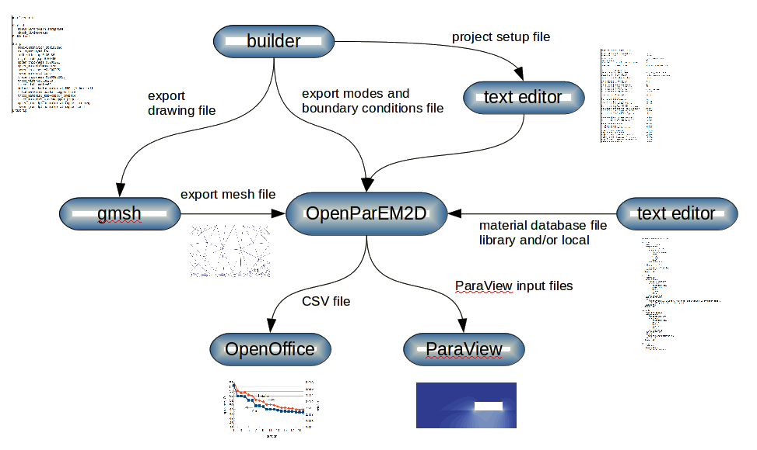
Workflow with “builder”
1
Run builder
  Edit a text file to describe the geometry
  Run builder
  builder generates 3 of the needed 4 text files
    geometry file (*.geo)
    boundary/modes file (*_modes.txt)
    template project file (*.proj).
Run gmsh
  $ gmsh -format msh22
  Import the *.geo file produced by builder
  Generate and save a 2D mesh
Locate a global library file to use or write a local materials file
Customize the project file produced by builder (from 1)
  Point to the boundary/modes file (from 1), the mesh file (from 2), and a material file or files (from 3)
  Customize the finite element order, convergence critieria, frequencies, etc.
Run OpenParEM2D
  example: $ mpirun -np 5 OpenParEM2D project_file.proj
  example: $ OpenParEM2D project_file.proj
Run ParaView
  Requires project.save.fields true [output by default from builder]
  Run the macro “field_plot” to generate a standard set of field plots
Run OpenOffice
  Pull in csv output into a spreadsheet to make plots
4
5
3
2
7
6

Slide 22
1 builder
The frontend tool “builder” is included in the OpenParEM2D source tree and compiles/installs along with OpenParEM2D.
  builder supports a number of transmission line and waveguide types. See the specification for the currently supported types.
Edit a text file to create an input file for builder.
  See the specifications document for the keyword/pair format for describing a geometry.
  Typically, an existing deck is copied as a starting point. See the regression directory tree for examples.
Run builder
  $ builder builder.txt
builder produces 3 output files
  *.proj - A project file that can be quickly customized.
  *_modes.txt - The required boundary/modes file. Editing is not required.
  *.geo - The geometry input file required by gmsh.
Example builder Input File
#builder 1.0
Control
build=Simonovich_stripline
check_limits=true
EndControl
Strip
name=Simonovich_stripline
use_symmetry=false
left_side_gap=0.00486
right_side_gap=0.00486
upper_thickness=0.000301
upper_material=prepreg
lower_thickness=0.000305
lower_material=core
trace_thickness=0.000032055
trace_width=0.000279
trace_etch_angle=60
default_conductor_material=PEC trace_material_bottom=copper_core
trace_material_top=copper_prepreg
trace_material_sides=copper_prepreg
upper_groundplane_material=copper_prepreg
lower_groundplane_material=copper_core
EndStrip

Slide 23
2 gmsh
This document is using gmsh version 4.8.4
Start gmsh: $ gmsh -format msh22 &
Load the *.geo file exported from builder
Mesh the layout
  Mesh → 2D [see selection D in the figure]
  Check the mesh for visual quality.
  Apply gmsh features to improve the quality, if needed. See the “2 gmsh” slide in the section “Workflow without 'builder'”.
Save the mesh
  File → Save Mesh
  File → Quit [if desired]
D

Slide 24
3 Material Database
Unchanged from the “3 Material Database” slide in the section “Workflow without 'builder'”

Slide 25
4 Project File
OpenParEM2D is controlled through a text file called the “project file”.
Edit the template project file produced by builder.
Customize as needed.
  Adjust file names and paths for the mesh, boundary/modes, and materials files.
  Finite element order
  Convergence criteria
  Frequencies
  etc.

Slide 26
5 OpenParEM2D
Unchanged from the “5 OpenParEM2D” slide in the section “Workflow without 'builder'”

Slide 27
6 ParaView
Unchanged from the “6 ParaView” slide in the section “Workflow without 'builder'”

Slide 28
7 CSV file
Unchanged from the “7 CSV file” slide in the section “Workflow without 'builder'”

