Slide 1

OpenParEM3D
Electromagnetic Simulator
Brian Young
January 9, 2024

Slide 2
Agenda
Motivation
Features
S-parameters
3D FEM setup
Adaptive mesh refinement
Examples and discussion
Regression suites
Conclusion

Slide 3
Motivation
Lack of a free or very low-cost frequency-domain S-parameter electromagnetic simulator inhibits exploration of new ideas and development of new products
Target audience
  Engineers wanting to explore ideas at home
  Continuing education
  Students
  Small startups
Feasibility
  Leverage existing open-source projects
  CAD (FreeCAD), meshing (gmsh), FEM (MFEM), visualization (ParaView)
  “Just” need to glue it all together

Slide 4
Features
Full-wave time-harmonic 3D electromagnetic simulator
Computing
  Electric and magnetic fields
  S-parameters between 2D ports on the surface of the 3D space
Arbitrary high-order elements
  courtesy of MFEM, ParaView [up to 6th order]
Parallel processing via MPI
  courtesy of MFEM, PETSc, and SLEPc plus custom code
Adaptive mesh refinement
  courtesy of MFEM plus custom code
TBD: impedance boundary condition for conductor losses and antennas

Slide 5
S-parameters
“S-parameters” is short for “scattering parameters”
  Links incident and reflected waves at the ports of a 3D volume
Dominant in engineering to include electromagnetic results in circuit simulations and for performance analyses
A “must have” output for a practical simulator

Slide 6
S-parameter Matrix Extraction
S-parameter matrix
Propagating waves are modes on transmission lines or waveguides feeding N ports.
a1
b1
Port 1
a2
Define ports - 2D (flat) on surface of 3D space
Solve 1 column at a time
  Drive port i such that ai ¹ 0
  Apply absorbing boundary condition on all other ports, then ak = 0 for k ¹ i
Solve the 3D problem N times for i=1,..,N
Separate ai and bi at the driven port
Output frequency-dependent S-parameters in Touchstone file format
b2
Port 2
aN
bN
Port N
ai is the incident wave to port i
bi is the reflected wave from port i

Slide 7

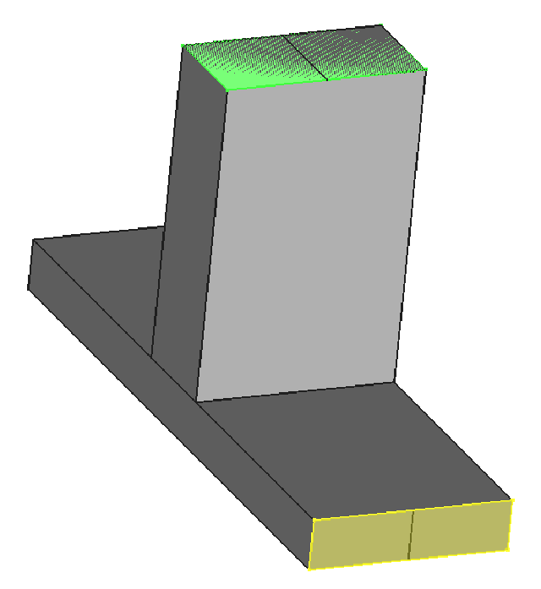
Driving ai
Port i: 2D simulation for fields, a, b, Z_{o}
MFEM’s ParSubMesh functionality is used to extract 2D meshes
A 2D simulation is run for each port with OpenParEM2D*
The 2D field solution for port i is applied to the 3D space, forcing the 3D fields at the port to take the 2D configuration
An absorbing boundary condition is applied at the other ports
3D electromagnetic simulation is run
Repeat for each port
Extract S-paramters (more later)
Port k: absorbing boundary
* OpenParEM2D was presented at the
2022 MFEM Community Workshop.

Slide 8
3D FEM Setup
Weak form of the wave equation in E
Separate the surface integral
MFEM
CurlCurlIntegrator
MFEM
VectorFEMassIntegrator
Surface of the 3D space
N ports
PEC and/or PMC boundary
Apply BC directly to the matrix
[DOF=0 for PEC, keep DOF for PMC]

Slide 9
2D Port Setup on Surface
Setup of the surface integral (from prior slide)
Apply a propagating assumption at the ports
  A first-order absorbing boundary condition
DOF manipulation
Not Supported in MFEM
Identity
Propagation
Assumption
Not supported in MFEM for Nedelec elements
Normal component on the boundary
Assume that this term is negligible
MFEM
VectorFEMassIntegrator

Slide 10
On the Neglected Gradient Term
On the port boundaries, the gradient term of the normal component is neglected
A zero gradient of a non-zero E_{n} is not physically realizable
  This means that it is assumed that E_{n}=0
The implemented boundary condition strictly only applies to transverse electric modes (TE and TEM)
  TE and TEM cases dominate problems of interest. These include microstrip, stripline, coax, triax, slot line, coplanar waveguide, the TE10 mode in rectangular waveguide, and generally, any N-conductor transmission line
  So the TE restriction in practice is not significantly limiting
Non-TE modes suffer field distortion at the port leading to a reflection
Non-TE modes at the boundaries can be supported by using TE modes at the ports with 3D transitions to the required non-TE ports followed by de-embedding (like lab measurements)
For quasi- TE and TEM modes, En is small compared to Et
  The error caused by the reflection is determined by the strength of E_{n}
  For quasi- TE and TEM modes, the reduction in accuracy may be acceptable
Future work is needed to relax this restriction, for example, by including the gradient term or by implementing a perfectly matched layer (PML) boundary condition

Slide 11
Boundaries
PEC/PMC
DOF manipulation
Ports
2D EM simulation
Impedance
VectorFEMassIntegrator
Any surface not defined as PEC, PMC, port, or impedance is assumed to be PEC.
Impedance:
MFEM
VectorFEMassIntegrator

Slide 12
Top-Level Implementation Details
Start Here
ParMixedBilinearForm
→ HypreParMatrix
3D ParMesh
ParSubMesh
methods
2D ParMesh
ports
Re
hypre_ParCSRMatrixToMat()
OpenParEM2D
Custom system construction
Apply known port DOFs
Apply PEC BC
Form linear system
PETSc Mat
Im
complex
Complex Ax=b solve in PETSc*
frequency domain is inherently complex
MFEM does not support complex
Custom fill of Re and Im ParGridFunctions
Solve for H and fill Re and Im ParGridFunctions
[Similar flow as for E]
Solve S-parameters
Export for ParaView
* A real formulation was tried in MFEM, but poor convergence was observed. For background, see David Day and Mike Heroux, “Solving
Complex-valued Linear Systems via Equivalent Real Formulations”, report from Sandia National Laboratories, May 9, 2000. There is a
later SIAM paper based on this work.

Slide 13
Sii: Separating ai and bi
At this point, the 3D fields for E and H are computed.
  The E-field from the 2D port simulation was applied at port i [i.e. the driving port]
  Cannot differentiate E⁺ from E⁻ just from the port i E-field.
  Requires H to separate the two
Just use the tangential components since they dominate in practical applications

Slide 14
At Port i, the Driving Port
Split with weights
Inner products
supported by MFEM
Same mode, same weights
Note the change in sign

Slide 15
Sii
E⁺ is the +z direction in OpenParEM2D
  Away from the 3D space, so related to b
  E⁻ is then related to a
Voltage wave relationships to S:
Proportional to the weights:
(field structure is the same)
Sii:

Slide 16
Sji
Use direct calculation with voltages*
Sji:
Integrate at the output port (no reverse wave):
Integrate at the input port, then take the fraction traveling towards the 3D space:
Use power/voltage definition for Zo
* Can also use currents, which is a future upgrade, to enable the power/current definition of Zo.

Slide 17
Adaptive Mesh Refinement (AMR)
Follows the setup used in the MFEM Tesla miniapp
  CurlCurlIntegrator on E, RT elements for flux, and ND elements for smoothed flux
  Merge errors from both Re(E) and Im(E)
Extract errors from several solutions
  Per driven port
  Combine across all driven ports
  Apply threshold refinement with a cap on the number of elements to refine
Refine using ParMesh::GeneralRefinement
Convergence test is on S. Calculate an error criteria at the Nth iteration
  error=max column norm {SN⁻¹(SN-SN-1)}
Options for sequential number of iterations that must meet the convergence criteria
Options for AMR at multiple frequencies
Issue? Degradation of mesh quality with each iteration, especially at ports

Slide 18
Examples and Discussion

Slide 19
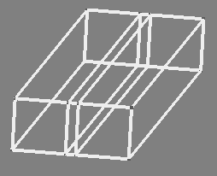
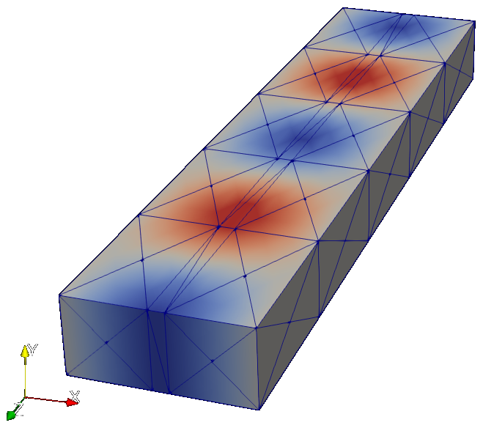
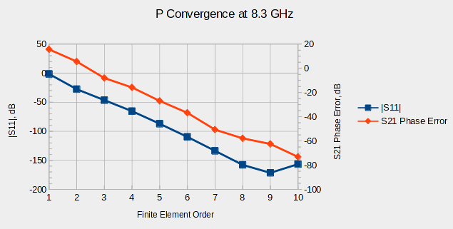
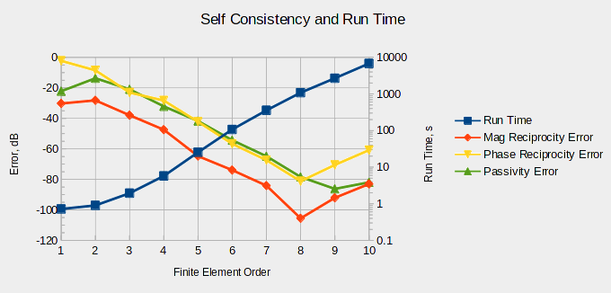
WR90 Loaded Rectangular Waveguide
Exact solution
  |S11| in dB → -∞
  phase shift from high-
  resolution OpenParEM2D simulation
High accuracy with regular improvement to a very low noise floor
Port 2
Port 1
air
Re(Ey)
Teflon
8.3 GHz
max edge length = 0.825 ג

Slide 20
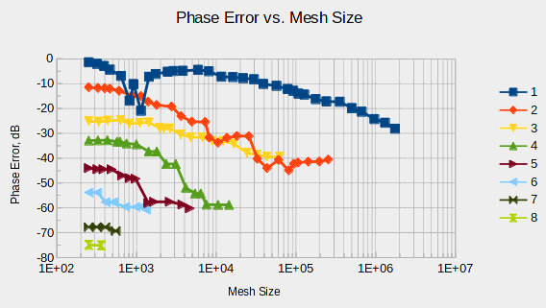
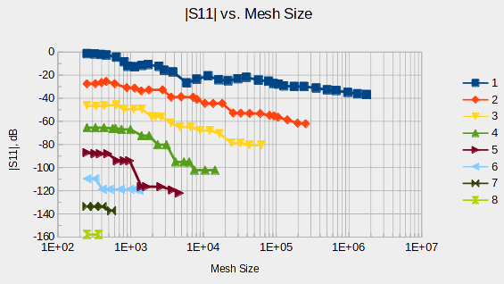
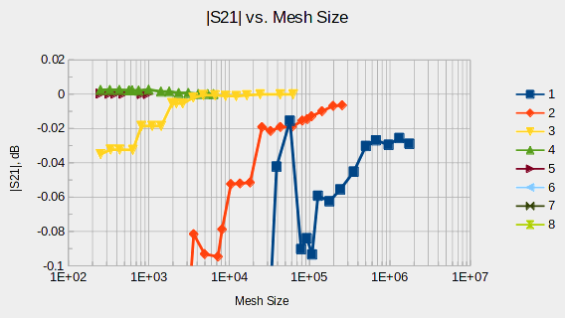
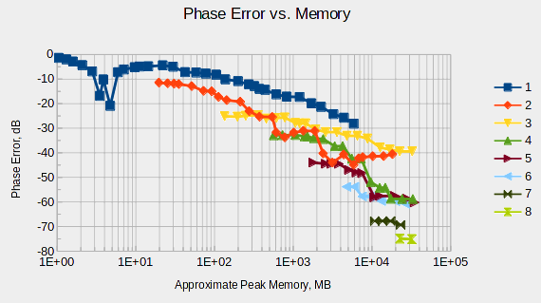
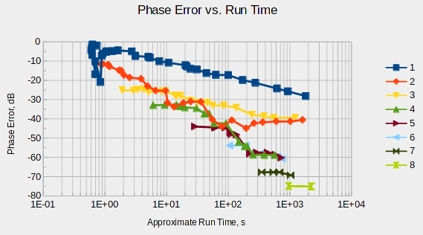
h-Convergence with AMR
WR90 loaded rectangular waveguide at 8.3 GHz
Effective AMR
Accuracy improves with AMR and FEM order
Favor FEM order over iterations

Slide 21
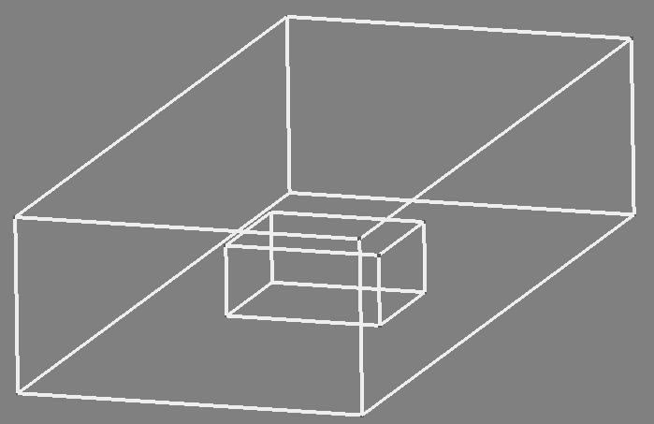
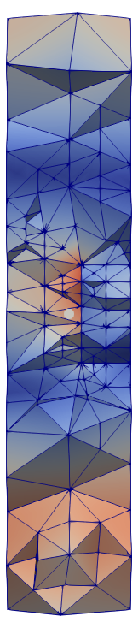
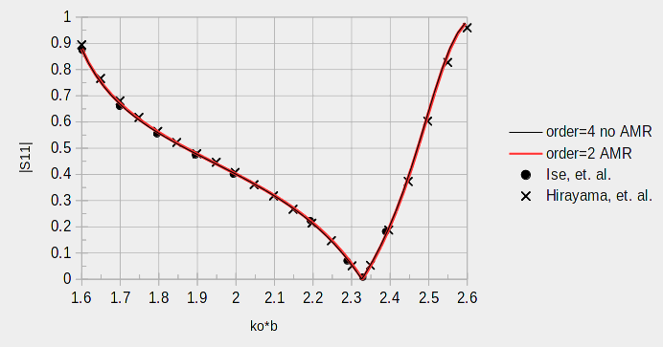
WR75 with Dielectric Puck
Solve with and without AMR
  2nd order, AMR: 575 s
  4th order: 968 s
Excellent agreement between runs with and without AMR
Excellent agreement between this and prior work
Port 2
Port 2
air
Port 1
Refinement focussed on the puck
at 10 GHz
No AMR: max edge length = 0.825 ג
AMR: max edge length = 0.230 ג
refine
refine
Re(|E|)
K. Ise, K. Inoue, and M. Koshiba, “Three-Dimensional Finite-Element Solution of Dielectric Scattering Obstacles in a Rectangular Waveguide,” IEEE Trans. Microwave Theory and Techniques, vol. 38, no. 9, Sept. 1990, pp. 1352-1359.
K. Hirayama, Md. Alam, Y. Hayashi, and M. Koshiba, “Vector Finite Element Method with Mixed-Interpolation-Type Triangular-Prism Element for Waveguide Discontinuities”, IEEE Trans. Microwave Theory and Techniques, vol. 42, no. 12, Dec. 1994, pp. 2311-2316.
Port 1

Slide 22
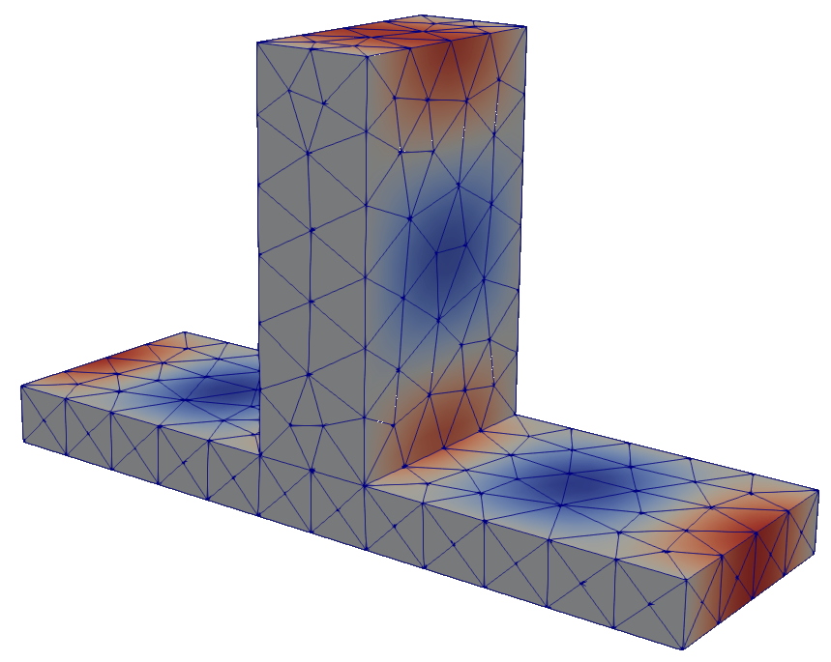
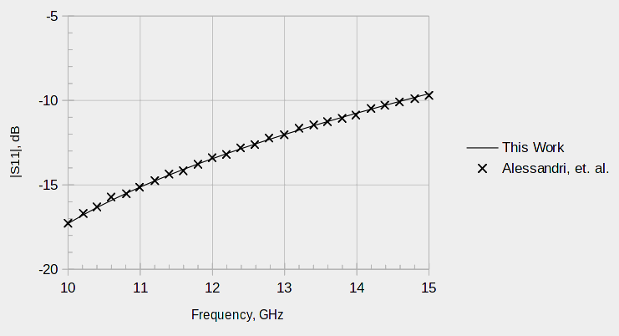
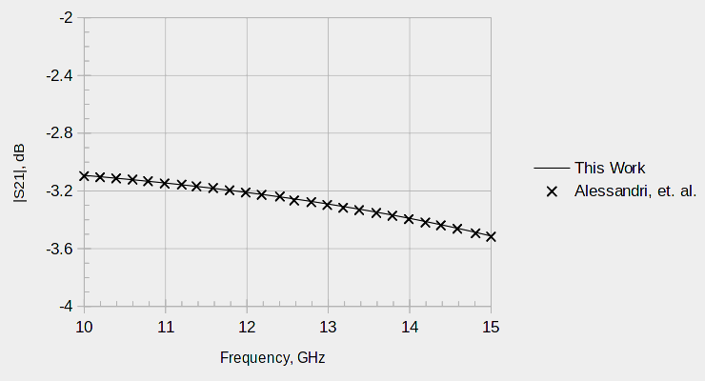
WR75 Waveguide T-Junction
Port 1
WR75 lossless waveguide splitting to two half-height waveguides for an even power split
4th order elements with no adaptive refinement
Excellent agreement between this work and the referenced paper
Re(Hx)
12.5 GHz
max edge
length = 0.245 ג
Port 3
Port 2
F. Alessandri, M. Dionigi, and R. Rorrentino, “Rigorous Analysis of Compensated E-plane Junctions in Rectangular Waveguide,” 1995 IEEE MTT-S Digest, pp. 987-990.

Slide 23
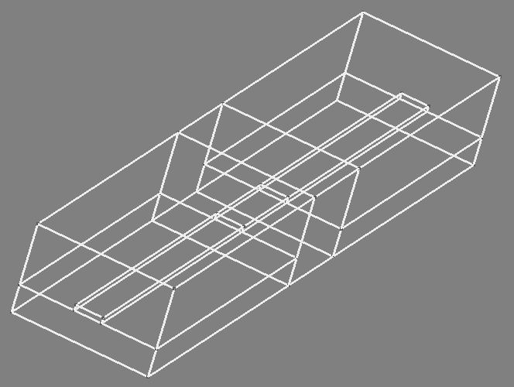
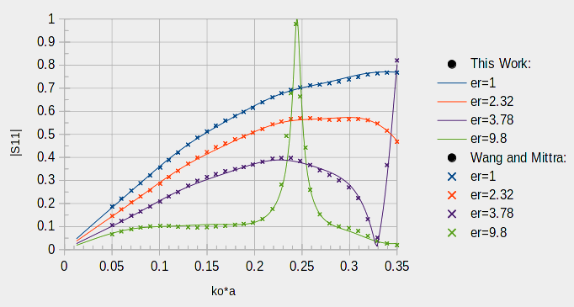
Microstrip Bridge
Microstrip on GaAs bridging across a gap through a block of variable dielectric constant material
5th order elements with no adaptive refinement
  Use the same mesh throughout
Excellent agreement between this work and the referenced paper
filling block with
variable er
air
Port 2
air
GaAs
bridge
Port 1
GaAs
J.-S. Wang, and R. Mittra, “Finite Element Analysis of MMIC Structures and Electronic Packages Using Absorbing Boundary Conditions,” IEEE. Trans. Microwave Theory and Techniques, vol. 42, no. 3, March 1994, pp. 441-449.

Slide 24
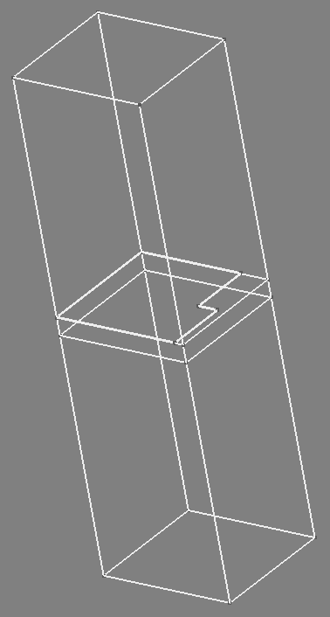
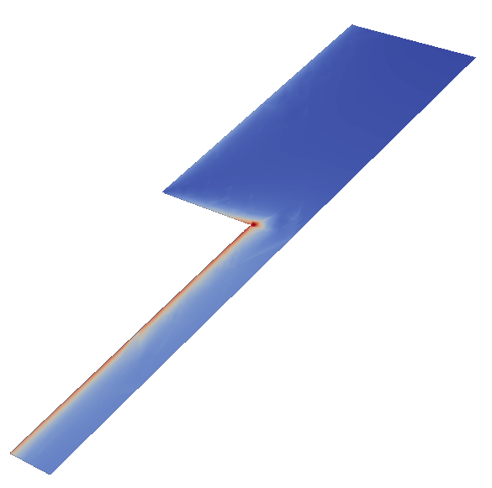
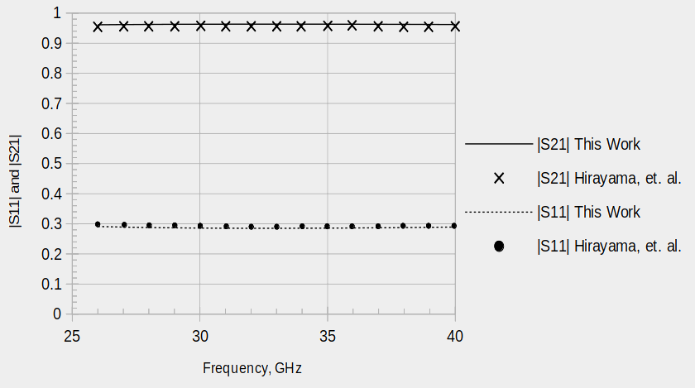
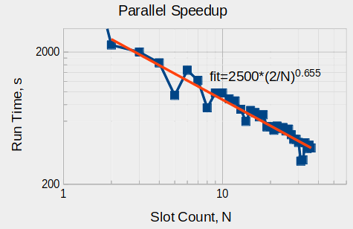
Slotline Step
½ slotline on symmetry
substrate with e_{r}=2.22
3rd order finite elements with 11 passes of AMR at 35 GHz with 0.001 convergence criteria
Excellent agreement between this work and the referenced paper
slotline
air
PEC
Port 2
substrate
Port 1
|Re(E)|
35 GHz
refine
AMR + 1 frequency
K. Hirayama, Md. Alam, Y. Hayashi, and M. Koshiba, “Vector Finite Element Method with Mixed-Interpolation-Type Triangular-Prism Element for Waveguide Discontinuities,” IEEE Trans. Microwave Theory and Techniques, vol. 42, no. 12, Dec. 1994, pp. 2311-2316.

Slide 25
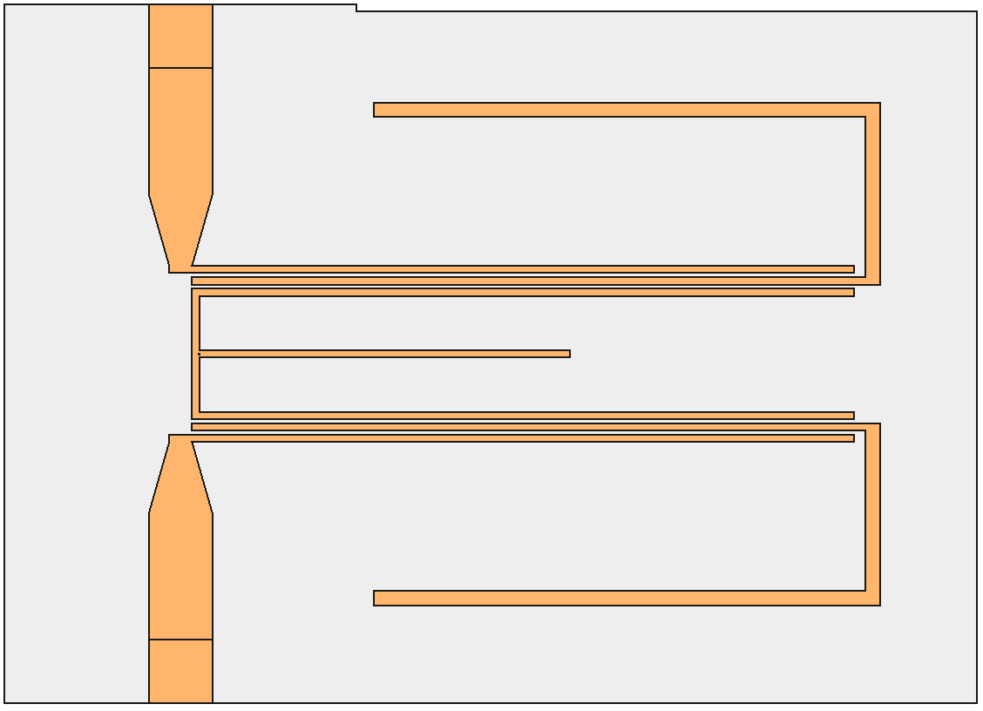
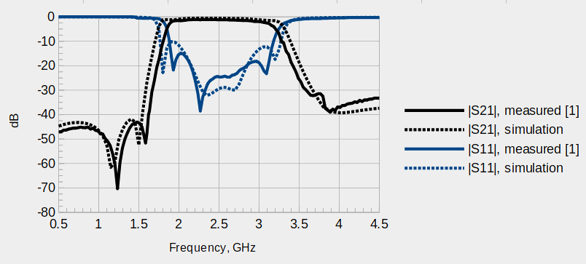
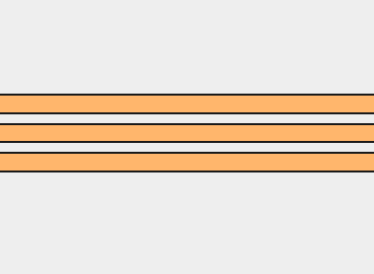
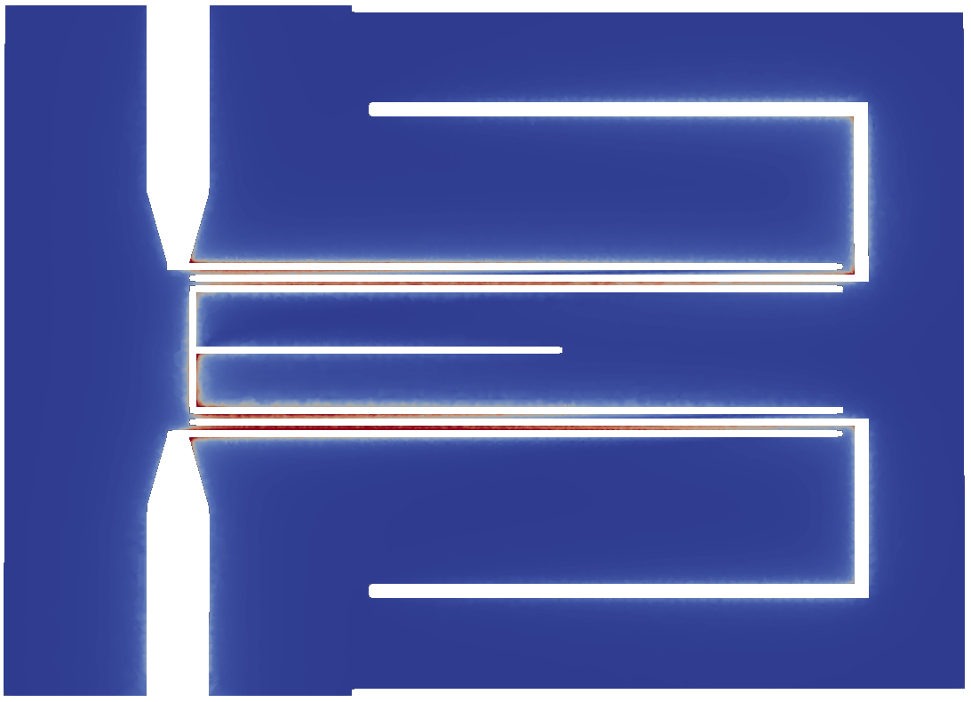
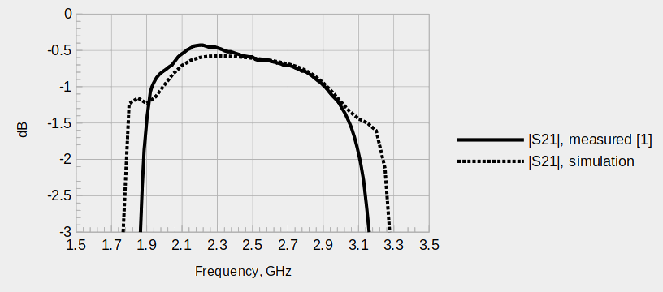
Microstrip Filter
2nd order elements
AMR with 6 iterations at 4 GHz with 0.02 convergence criteria
Good agreement with the simulation showing slightly more bandwidth
Challenging!
refine
|Re(H)| @ 2.5 GHz
W.-C. Weng, “Design and Optimization of Compact Microstrip Wideband Bandpass Filter Using Taguchi’s Method,” IEEE Open Access Journal, vol. 10, 2022, pp. 107242-107249.

Slide 26
Regression Suites
Automated
With and without AMR
OpenParEM2D
  27 test cases
    Microstrip, stripline, coax, rectangular waveguide, loaded rectangular waveguide
  43,738 checks
OpenParEM3D
  17 test cases
    Microstrip, slotline, rectangular waveguide, loaded rectangular waveguide
    Orientation variations (i.e. rotations in space)
  390 checks

Slide 27
Conclusions
An effective 3D full-wave time-harmonic EM simulator for the calculation of S-parameters is outlined and demonstrated to produce high accuracy
Lack of support for the gradient term on boundaries has two consequences
  non-TE modes at ports require de-embedding (should be rare)
  2X run-time increase to separate forward and backward waves at the driving port due to the need to calculate H
To Do
  Add impedance boundary condition for losses and antennas
  Add PML for absorbing boundary condition at ports
  Write documentation
  Release

Slide 28
Thanks to LLNL’s Mark Stowell for many very helpful email exchanges.

