Slide 1

Building a faster
supply network
Board strategy review, October 2026

Slide 2
We will halve the time from
order to delivery by next autumn
Three changes get us there: regional stock, one planning calendar and
carriers we measure every week.

Slide 3
What we will cover
Faster delivery
One calendar
Measured carriers
Regional stock so most
Sales, planning and
Every carrier gets a
orders ship the same
finance work from one
weekly scorecard on
day from a warehouse
weekly plan, reviewed
time, damage and cost,
near the customer, with
every Monday morning
published to the whole
the slow lanes moved to
with the regional leads.
team.
rail.

Slide 4
Why it matters
Customers do not buy software.
They buy fewer bad Mondays.

Slide 5
Four commitments
Ship the same day
Plan every
Monday
Measure carriers
Protect the margin

Slide 6
Where we stand
3.4
92%
$1,240,000
days
Order to delivery
On-time shipments
Freight saved

Slide 7
Three workstreams
Regional stock
Planning
Four new hubs carry the 400
One weekly plan replaces three
fastest-moving items.
monthly ones.
Carriers
A scorecard per carrier, every week.

Slide 8
What customers told us
Orders arrive late
Tracking stops at
Returns take two
in the north.
the border.
weeks to refund.
Support cannot
Invoices arrive
see the carrier.
before the goods.

Slide 9

The team
Ana Ruiz
Sam Lee
Kai Moreau
Mia Chen
Program lead
Logistics
Analytics
Finance
Runs the weekly
Owns the hubs.
Measures
Guards the
plan.
carriers.
margin.

Slide 10
What the pilot region said
“The rollout took six weeks, not six
months, and every store manager was
using it by the second Monday.”
Sofia Brandt
Head of procurement

Slide 11

Part 2
Where the
network grows
Three regions, one plan

Slide 12
Four steps to the new network
1
2
3
4
Pick the
Move the
Switch the
Review
hubs
stock
carriers
every week
Choose four
Move the 400
Contract two
Read the
sites near our
fastest items
carriers per
scorecards and
largest
into the hubs.
region on
adjust the plan.
customers.
scorecards.

Slide 13
The cost of slow paperwork
62 minutes a day
1 in 6 reports
9 days
Average time technicians spend
Sent back for missing details,
Typical delay before a completed
on forms after each visit
which doubles the effort
job can be invoiced
Digital forms remove the rework and let us invoice the day the job closes.

Slide 14
Choose the smallest useful test
Option A: focused pilot
Option B: broad rollout
Two teams, six weeks. Low setup
All teams, three months. Wider
cost and a clear baseline.
reach with greater coordination
needs.
Recommendation: establish the evidence with Option A before
committing to Option B.

Slide 15
Carrier scorecard
Carrier | On time | Damage | Cost
North Freight | 96% | 0.4% | $1.10
Coastline | 91% | 0.9% | $0.95
Rapid Rail | 88% | 0.2% | $0.80
North Freight leads on time.
Rapid Rail is cheapest and
gentlest, and wins the slow lanes.

Slide 16
Three conditions for a useful pilot
Clear scope
Consistent
An explicit
measures agreed
decision
with finance
before the start
Two teams and one
Track completion and
Agree the evidence
workflow keep the pilot
task time against a
needed before
focused.
baseline.
expanding.

Slide 17
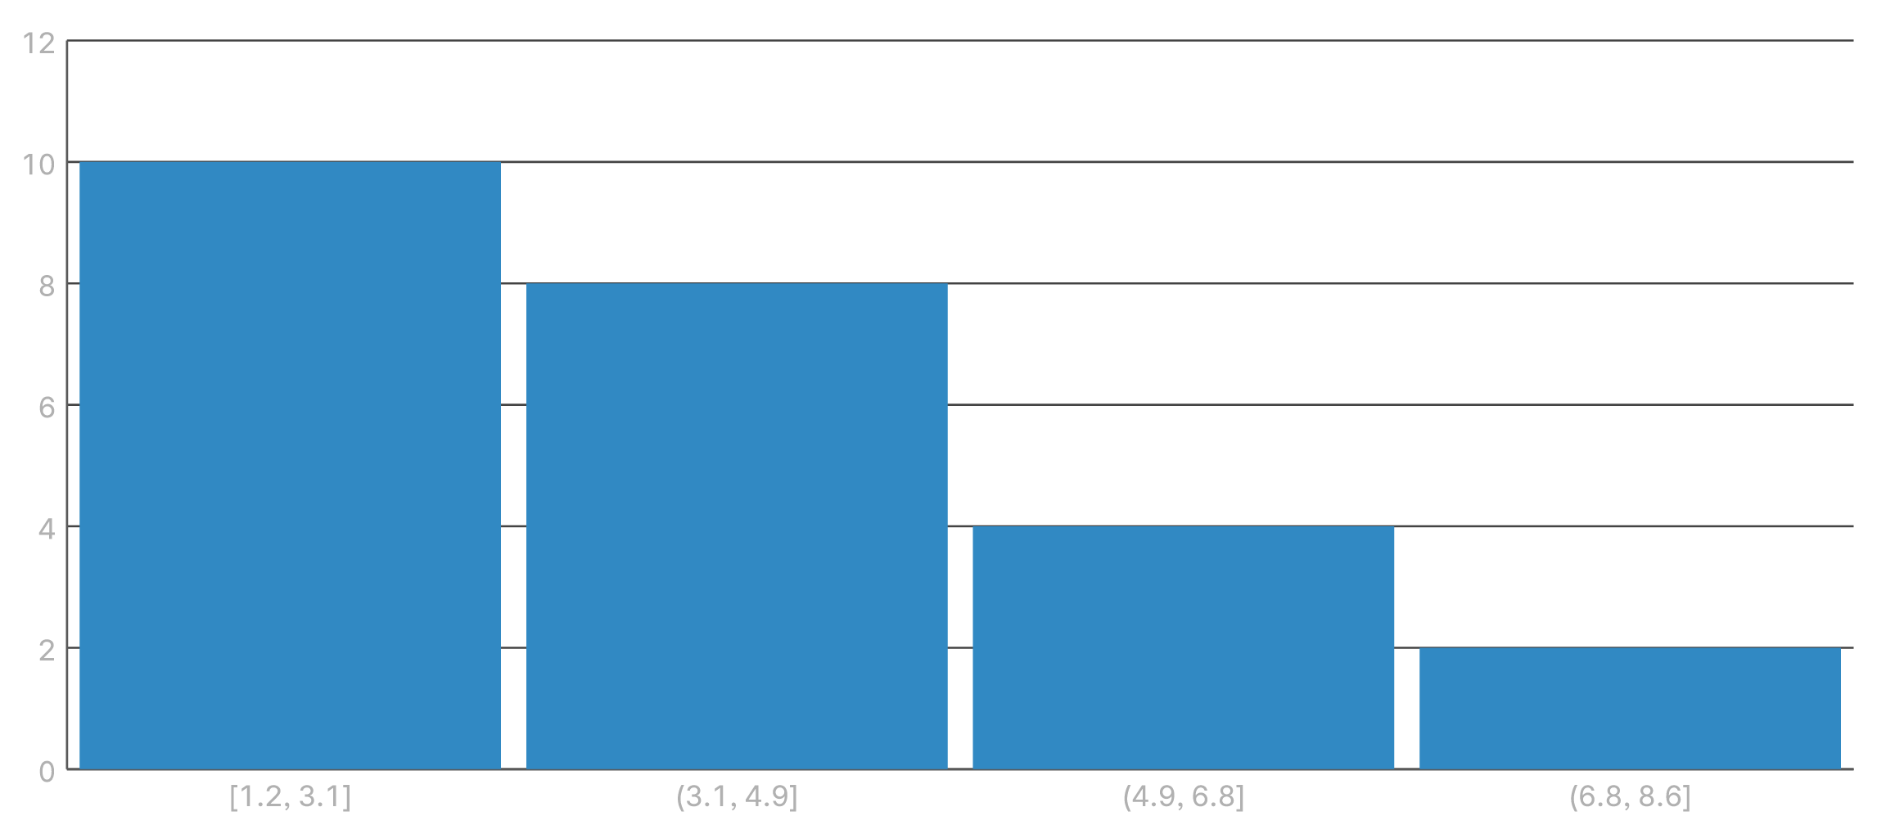
Delivery times in the pilot

Slide 18
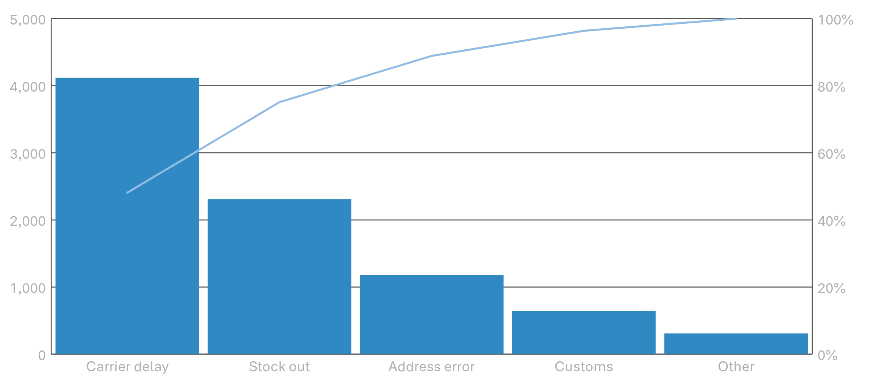
Why orders were late

Slide 19
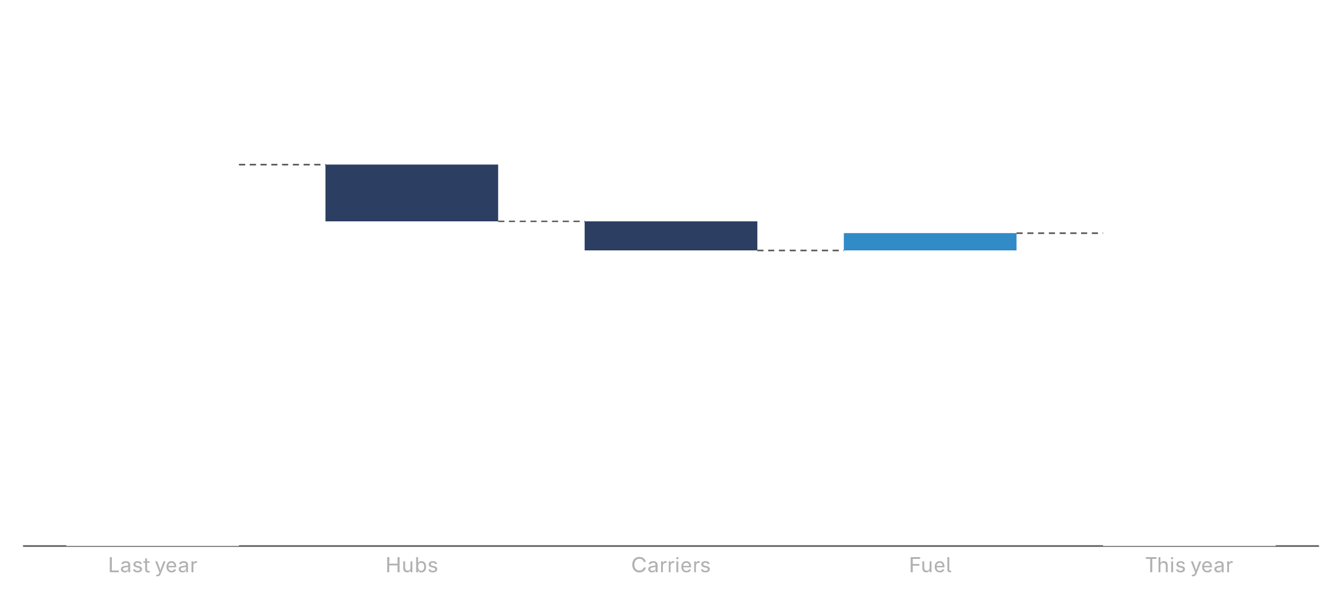
Freight cost, last year to this

Slide 20
Approve the four hubs today
Ana Ruiz, program lead
ana.ruiz@example.com

