Slide 1
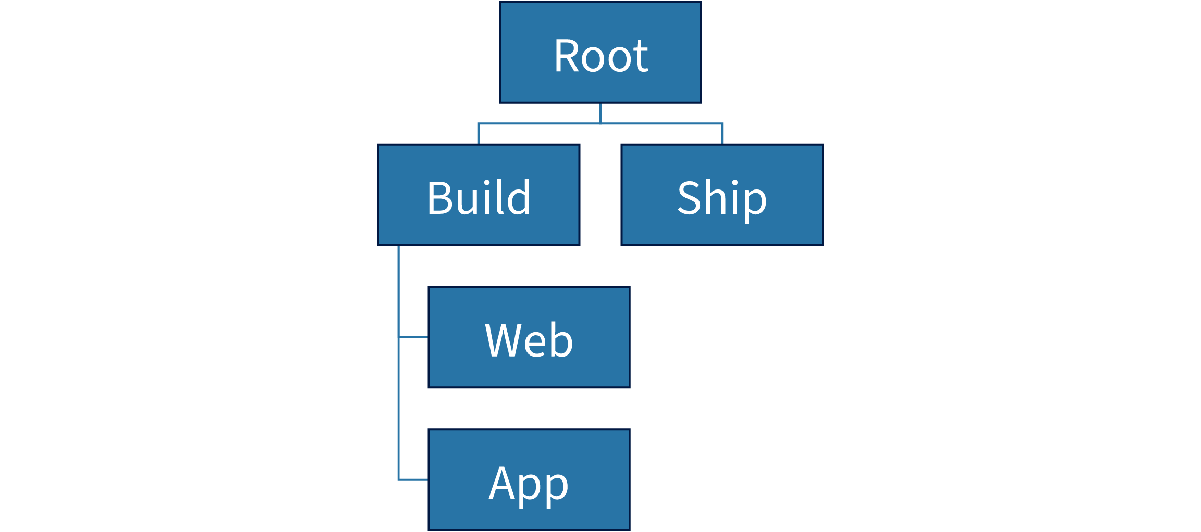
Measured org-chart geometry
Root
Build
Web
App
Ship

